Slide 1
Algorithms

Slide 2
Algorithms Efficiency
Time efficiency: time complexity: how long it takes the algorithm to run
Space complexity: the amount of memory the algorithm uses.
Both are specific for each computer (cpu) but the the trend is the same on all
Good/ usefull algorithms balance between both.
Both efficiencies can be represented by Big O notation: “O”. for instance:
O(n)- The letter “n” here represents the input size. This represents a linear complexity
This big O notation gives us an idea of how complex the algorithm is with respect to the input size.

Slide 3
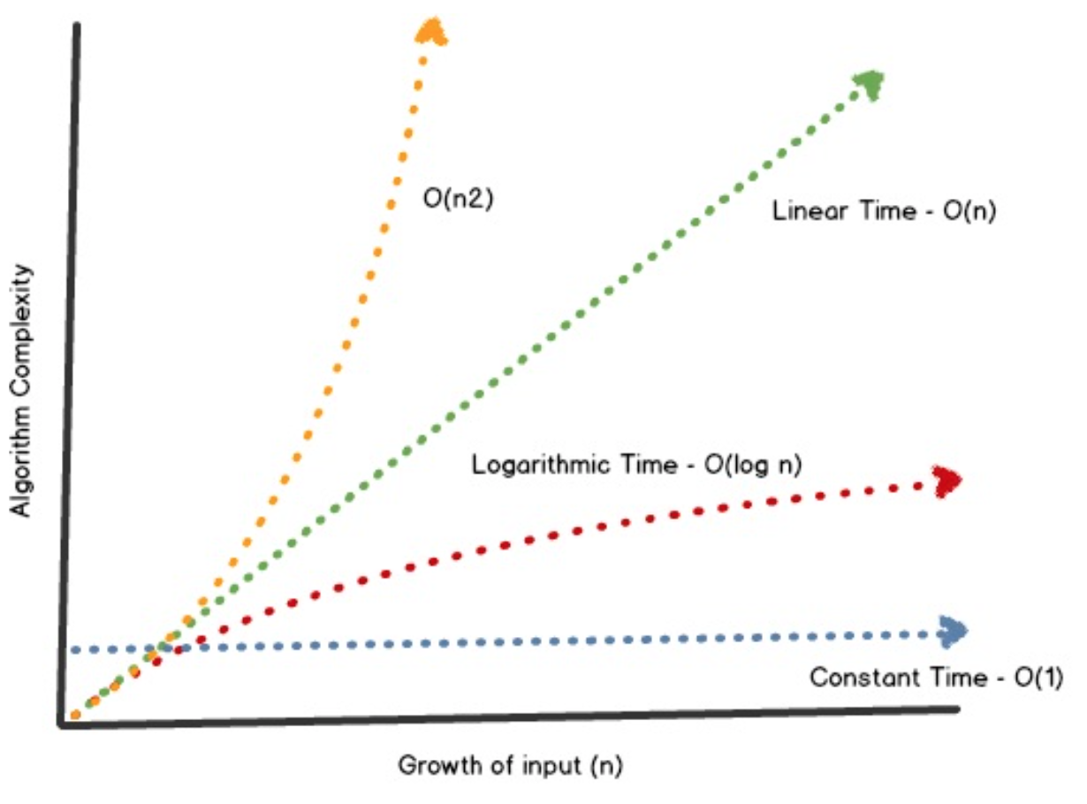
Big O notation Algorithms Diagram

Slide 4
Example: lets implement the the array.sort JS function

Slide 5
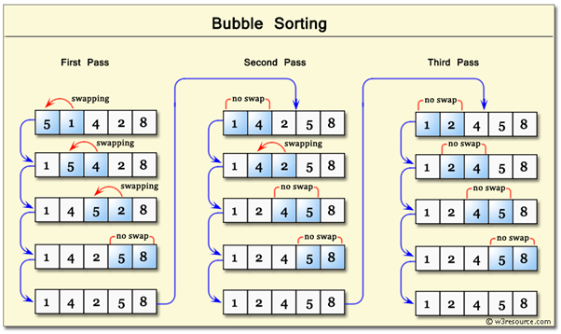
Sorting Algorithms with JS
Bubble sort

Slide 6
Bubble sort time complexity O(n2)? Space complexity?O(2~1)
function bubbleSort(arr) {
for (let i = 0; i < arr.length; i++) {
for (let j = 0; j < arr.length - i - 1; j++) {
if (arr[j + 1] < arr[j]) {
// swapping array elements
[arr[j + 1], arr[j]] = [arr[j], arr[j + 1]];
}
}
}
return arr;
}

Slide 7
Learning Resources
Sorting algorithms:
https://medium.com/@rajat_m/implement-5-sorting-algorithms-using-javascript-63c5a917e811
https://medium.com/siliconwat/algorithms-in-javascript-b0bed68f4038
Github repository for different types of algorithms: https://github.com/TheAlgorithms
Data structures: https://visualgo.net/en/list?slide=1
youtube channel: Algorithms and Data Structures - Full Course for Beginners from Treehouse

Slide 8
Exercise: Implement the next JS build in functions:
Filter
Sort
Map
Reduce
Linked list
Tree
Stack

