Slide 1
Veeve: Candidate Case Study Candidate: Natalya Sniff Date: 08/07/2025

Slide 2
Technical Requirements
• Website
− Build a website for the HCP to find the appropriate MSL
− The form should contain fields for HCPs at minimum
• HCP Name, HCP Email or Phone, NPI Number, Dropdown list of Therapeutic Areas, Zip Code
− Upon Submit, the form should send fields data to search for MSL in Vault CRM
• Receive MSL information from Vault CRM
− Display the MSL information from Vault CRM to the HCP on the Website
• Allow HCP to download Contact Card
• Allow HCP to send request for call back from the MSL
• Vault CRM
− Build a Custom Web API that will search for MSL based on info from website
• Find MSL based on Zip Code and Therapeutic Area
• If MSL is not available, find the Manager of the MSL
− Surface the callback request from HCP to the MSL in Vault CRM
• Show callback channel
− Build a report or custom page to display effectiveness of this channel

Slide 3
Assumptions
Assumed that logged into web application user is the healthcare provider (HCP)
Assumed that in Veeve Vault are multiple companies, that differ by zip code location and therapeutical areas.
Assumed that medical science liaison is determined by department they are in (MSL)
Assumed that medical science liaison would not have title of manager and would have ‘specialist’ word in the title (subject to change)

Slide 4
Current system components
AWS Amplify application for FE of web application
AWS Lambda to process requests to Veeve Vault
Veeve Vault Custom Web API
Veeve Vault triggers to update Picklist values and send Notifications about received request
Veeve Vault Notifications
Veeve Vault Reporting and Dashboard to track effectiveness of the process
Important links:
Users Pool
Veeve Vault

Slide 5
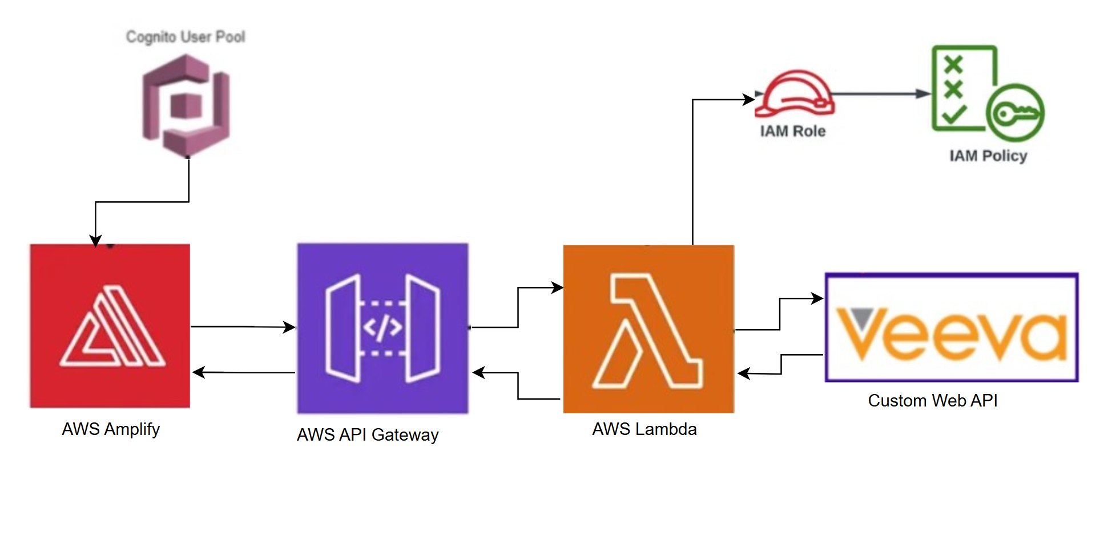
Current System Diagram

Slide 6
Proposed enhancements
To accommodate potential new features (such as process continuity and data retractability), as well as utilization growth, following system upgrades are proposed
Dynamo DB
Amazon Simple Queue Service (Amazon SQS) queue.
Veeve Vault Spark messaging
OAuth2/OIDC Delegated Requests Authorization

Slide 7
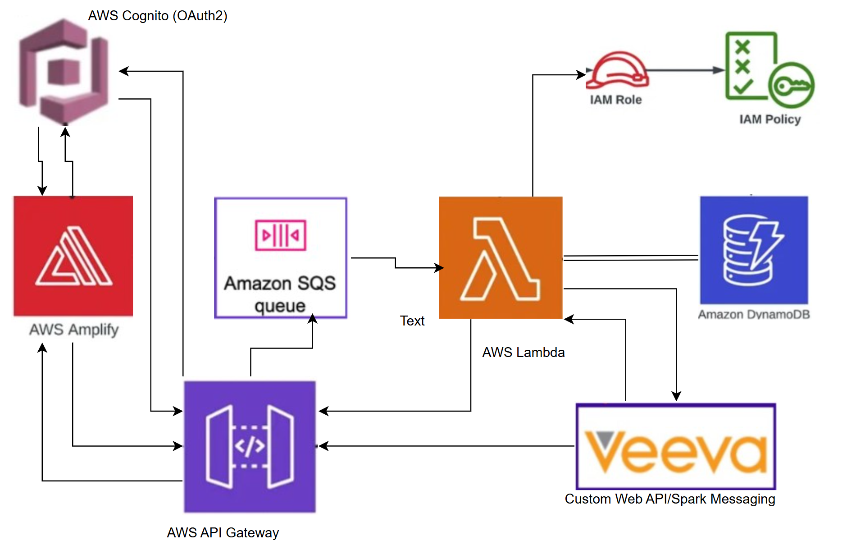
Future Enhancements System Diagram

Slide 8
thank you
Natalya SNIFF
678-986-9046
natalyasniff@gmail.com

