Slide 1
Veeve: Candidate Case Study

Slide 2
Current system components
AWS Amplify application for FE of web application
AWS Lambda to process requests to Veeve Vault
Veeve Vault Custom Web API
Veeve Vault triggers to update Picklist values and send Notifications about received request
Veeve Vault Notifications
Veeve Vault Reporting and Dashboard to track effectiveness of the process

Slide 3
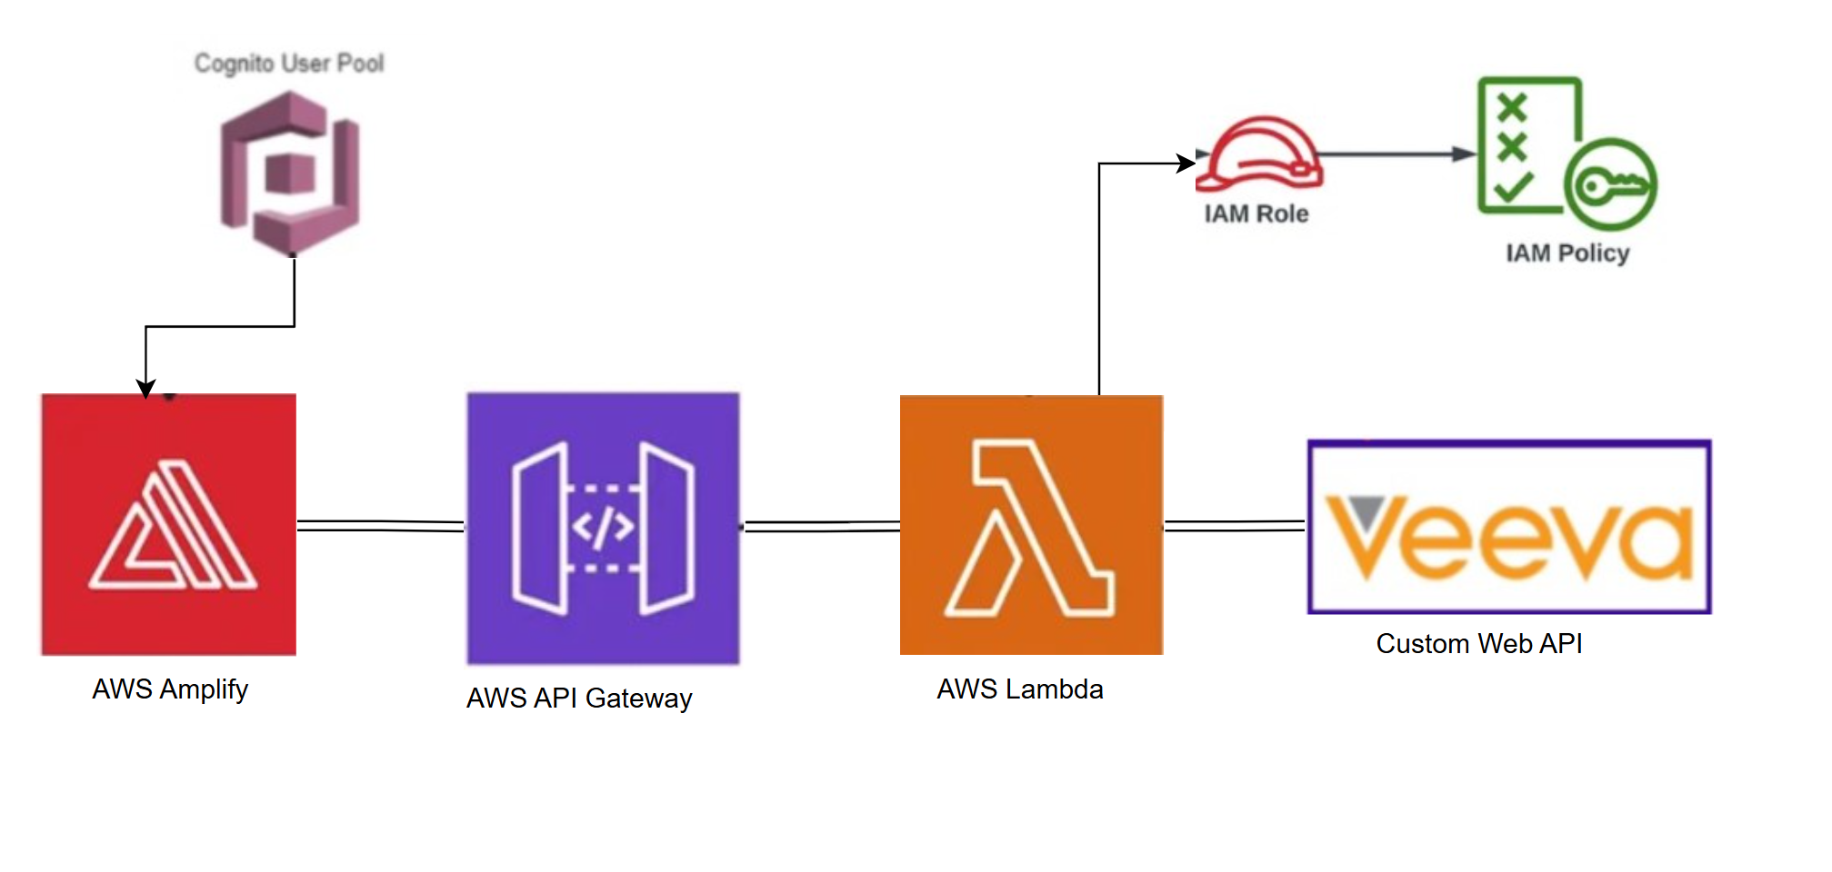
Current System Diagram

Slide 4
Proposed enhancements
To accommodate potential new features (such as process continuity and data retractability), as well as utilization growth, following system upgrades are proposed
Dynamo DB
Amazon Simple Queue Service (Amazon SQS) queue.
Veeve Vault Spark messaging
OAuth2/OIDC Delegated Requests Authorization

Slide 5
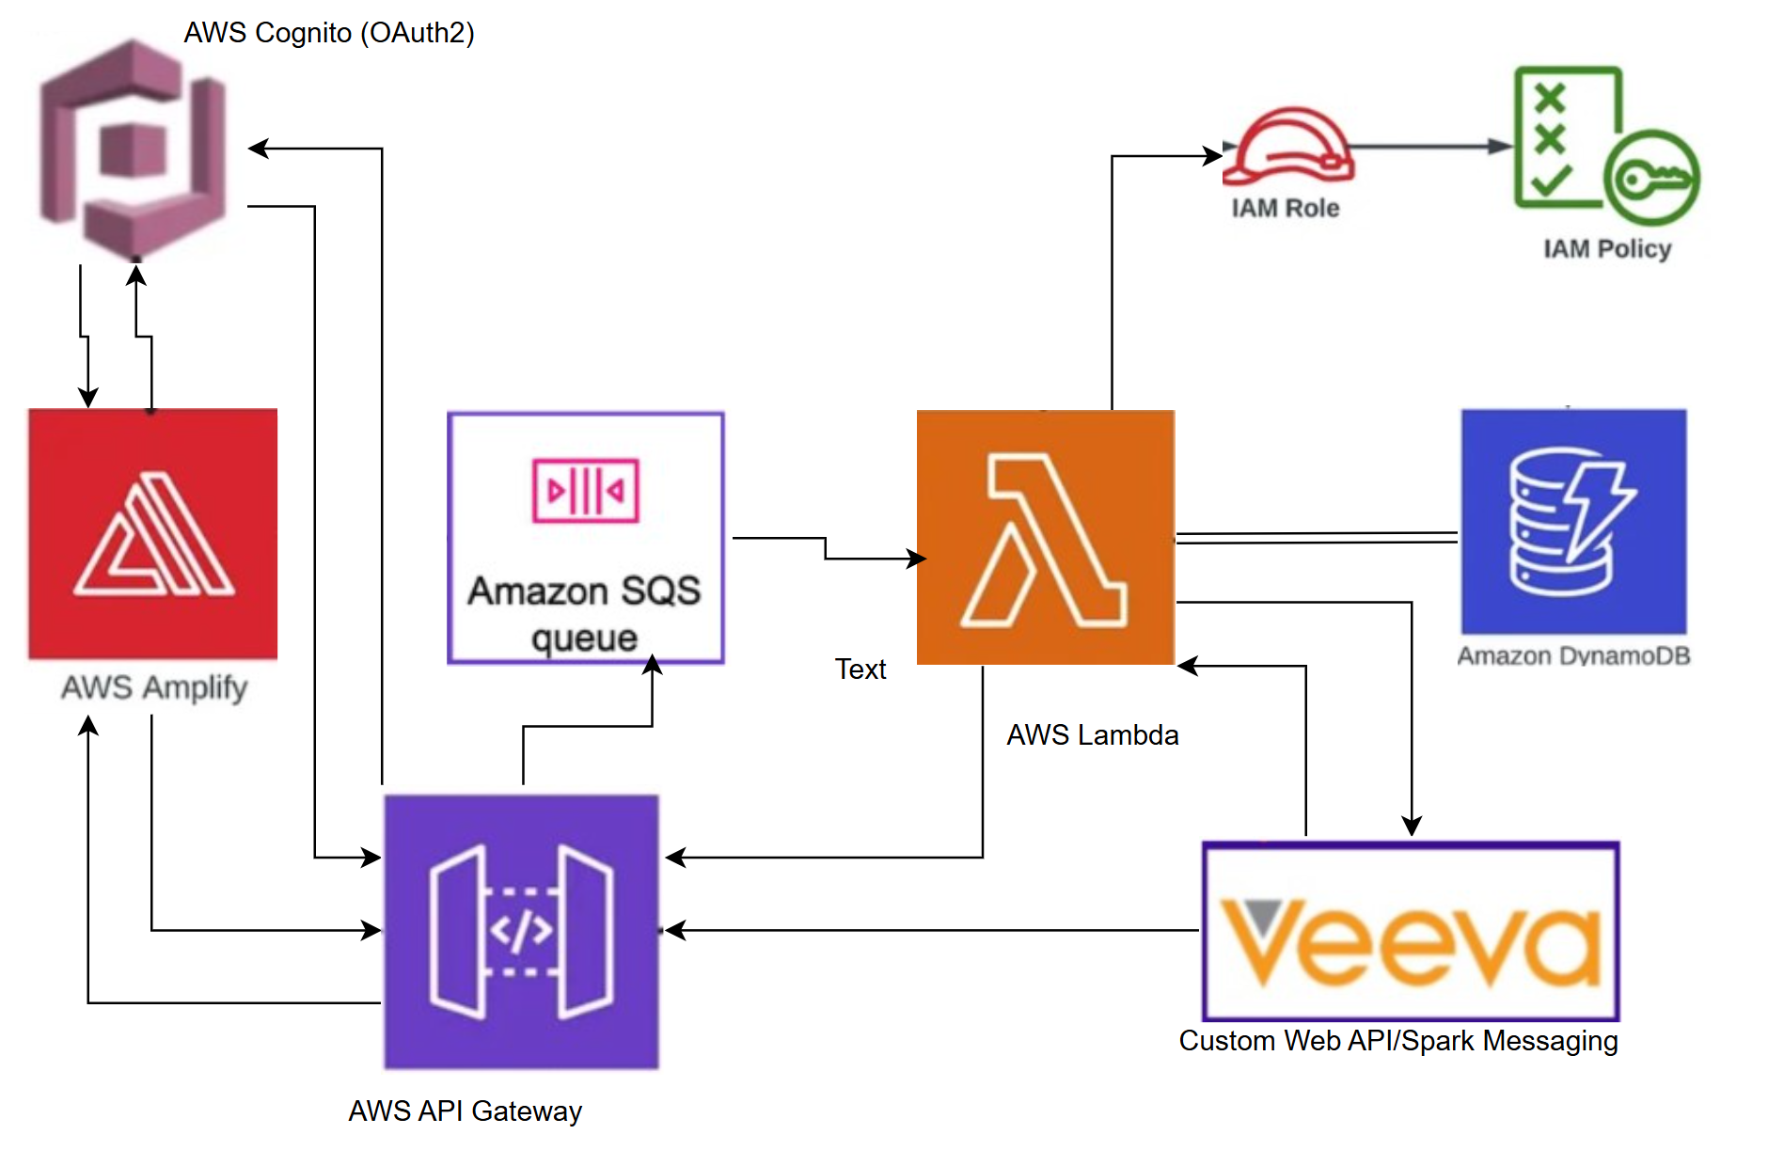
Future Enhancements System Diagram

Slide 6
thank you
Natalya SNIFF
678-986-9046
natalyasniff@gmail.com

