Slide 1
Automated Risk-Scoring System (Framework) for Financial Institutions
Natalja Krjuckova ST50446
Computer Sciences: Data Analytics and Artificial Intelligence
Supervisor: Dr.Sc.Eng. Nadezda Spiridovska, Dr.Sc.Eng. Jelena Kijonoka.
Notes:
Good afternoon, everyone. My name is Natalja, and I'll be presenting my research on developing an automated risk-scoring system for financial institutions

Slide 2
Problem Statement
Payment flows
WIRE • SEPA • SWIFT
Cash deposit/withdrawal
Currency exchange
Daily high volume
Detection models
Risk scoring / classification
Rules + ML
Thresholds & calibration
Alerts and investigation
Alert queue for analysts
Case review & escalation
Regulatory reporting
Operational reality
Low base rate (≈1% suspicious)
High FP → heavy workload
Need explainable decisions
Evolving typologies
New fraud/AML patterns appear
Scenario overlap increases
Concept drift over time
Data constraints
Limited labelled cases
Privacy restrictions
Reproducible benchmarking is difficult
Problem: Evaluate detection that stays reliable under high volume, class imbalance, and changing scenarios, without using real customer data.
Research Object: Procedures for risk assessment and detection of suspicious transactions in financial institutions.
Research Subject: Scenario-based synthetic transaction data generation and classification for suspicious activity detection and scenario typing.
Notes:
Financial institutions regularly face new or evolving money-laundering and fraud typologies, but limited labelled data and restricted access to real customer data make it difficult to reproducibly evaluate whether detection models are reliable, stable as scenarios change, and able to differentiate between suspicious patterns.

Slide 3
Research Goal:
Develop and experimentally validate a demonstrative prototype of an automated risk-scoring framework.
Hypothesis:
Synthetic transaction data created through scenario and rule‑based methods is suitable for training ML models that automate risk assessment in the financial sector
Research questions:
Can realistic synthetic data replicate both normal and suspicious behaviours, including complex fraud schemes?
What technical and regulatory challenges arise when creating such data, and how can quality be evaluated?
How well do ML models trained on multiple synthetic data packages adapt to evolving fraud strategies?
Notes:
To address these challenges, the goal is to develop and experimentally validate a demonstrative prototype of an automated risk-scoring system for financial institutions. During this study, I answer the research questions:
can synthetic data realistically reproduce both normal and suspicious behaviour, including complex fraud scenarios?
what technical and regulatory constraints arise, and how can data quality be evaluated under these constraints?
how well machine-learning models trained on multiple synthetic data packages adapt to evolving fraud scenarios, using both incremental updates and full retraining.*

Slide 4
Literature Review and Research Gaps
Records identified (Scopus, ScienceDirect, Consensus)
(n = 3122)
Excluded: irrelevant, duplicate, or lacking sufficient quality
(n = 3040)
Shortlisted for synthesis
(n = 82)
Included in the final research
(n = 62)
Excluded after evidence extraction
(n = 22)
Key limitations | Research gaps
High volume High false positives Explainability required Limited real-world data Limited control over explicit AML scenarios/typologies Multi-dataset / drift evaluation not standardised | No standard reproducible benchmark Synthetic realism is rarely calibrated Real-data studies are hard to reproduce Explainability is limited Needs enough real data Weak scenario control Multi-datasets evaluation is not standard Hard to guarantee scenario coverage
(Oztas et al., 2024; Kute et al., 2021; Altman et al., 2023; Alexandre & Balsa, 2023; Chen et al., 2021; Altman et al., 2023; Kute et al., 2021)
Notes:
For the literature review, I used Scopus and ScienceDirect databases and the Consensus tool. After screening and exclusions, 62 sources were included in the final research. From these studies, I identified the following gaps: restricted access to real data, weak reproducibility, and limited evaluation of how models adapt to changing scenarios.

Slide 5
Research Limitations
Real data: <500 rows
Synthetic data: 10,000/100 and 50,000/500 (normal/suspicious ≈1%)
Privacy/compliance restricts real-data reuse
Scenario evolution: the scenario catalogue expands over time
Recall ≥0.98 (primary)
Notes:
This study has key limitations: real data is <500 rows and cannot be reused due to privacy/compliance. Therefore, I work with two fully synthetic datasets, Syn100 and Syn500, with about 1% suspicious transactions. For AML screening, I enforce a strict target: Recall ≥ 0.98.

Slide 6
Framework Design
1. Choosing a data synthesis method
2. Scenario catalogue
3. Data synthesis
5. Class balance
SMOTE / ADASYN / ROSE
Class weights
Focal loss
6. Model selection
AutoML with feature analysis for ranking.
Expert validation and shortlisting.
7. Training mode
Incremental/full retraining
Update rules, thresholds, and monitoring
8. Adaptivity check
9. Conclusion
Model background + scenario "overlays"
Rule-based simulation by specifications
Sources: FI guidelines and EU directives
Grouping by mechanism; scenario parameters
4. Data quality check
Rule-based validation
Statistical feature profiling
Model and/or rule-based approach
Limitation: up to <500 real rows
Requirements: adaptable and updatable scenarios
Data Packages
Evolving Scenarios
Notes:
This slide introduces the design of the proposed system prototype, covering synthetic data generation, model selection, and evaluation. The workflow supports both incremental updates and full retraining, and assesses model adaptivity and robustness across multiple synthetic data packages.

Slide 7
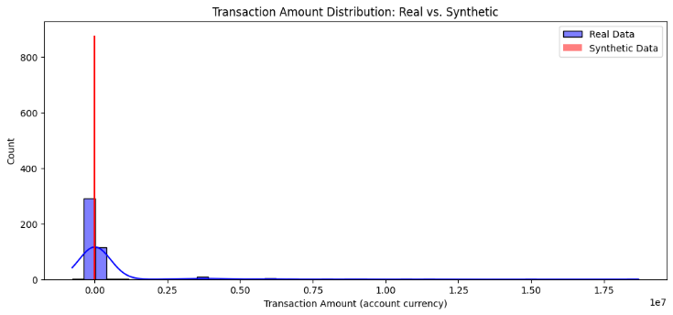
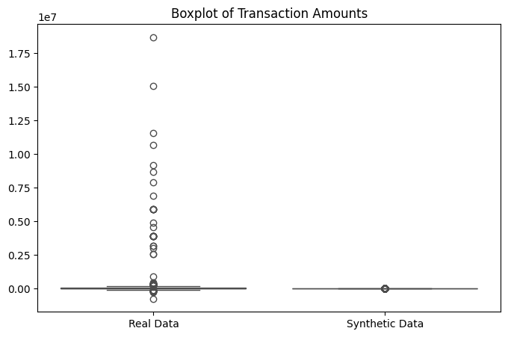
GAN-Based Synthetic Data
Results
Amounts: strong mismatch in the upper tail
(KS = 0.66, p ≪ 0.001)
Categories: no significant difference
(χ² p ≈ 1.0)
GAN preserves categorical proportions but fails to reproduce heavy-tailed transaction amounts
Not suitable for fraud detection benchmarking
Extreme values are not preserved in synthetic data
Notes:
I first tested a GAN approach to generate synthetic transactions. The validation has a significant discrepancy in transaction amounts, particularly for extreme values, despite the similar categorical frequencies. This means GAN data is not reliable enough for AML benchmarking
AML benchmarking - the effectiveness depends on extreme values, which is confirmed by a high KS value and a significant p-value, indicating that the distributions of the generated and actual data do not match.
KS test (Kolmogorov–Smirnov) — checks how similar two samples are in distribution (e.g., transaction amounts: real vs. GAN).
KS-statistic closer to 0 → similar distributions; closer to 1 → very different.
p-value — the probability of observing such differences “by chance” if the distributions are actually identical.
small p-value (e.g., ≪ 0.001) → the difference is statistically significant, not “by chance.”
Upper tail — the “tail” of large amounts. This is critical in AML, as large/rare amounts often trigger controls.
The chi-square test for categories checks for differences in frequencies (for example, by counterparty type).
p≈1 means that the observed frequencies are very consistent (i.e., the GAN fits the category distribution), but this doesn't solve the problem of tailing sums.

Slide 8
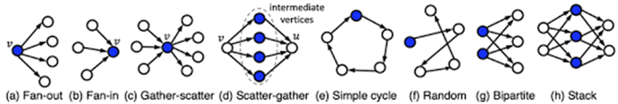
Rule-Based Synthetic Data
1. Transaction flow and velocity monitoring
Daily/Monthly Turnover Thresholds
Circular Money Flow
Rapid Currency Conversion
Transaction Structuring
Sudden Activity After Dormancy
Newly Incorporated Entity High Volume
Unusual Transaction Speed
Identical Transaction Size
2. High-risk jurisdiction detection
High-Risk Country Daily/Monthly Transactions
Very High-Risk Country Transactions
First-Time High-Risk Country Activity
Prohibited Country Transactions
Foreign Country Transaction Ratio
Restricted Country Currency
3. Transaction pattern analysis
Balanced Flow Analysis
One-to-Many Pattern
Many-to-One Pattern
Round Amount Transactions
Historical Transaction Spike
Unusual Increase in Turnover
Foreign Currency First
4. Entity and relationship risk
Shell Company Transactions
Multiple High-Risk Transactions
5. Contractual and documentation issues
Insufficient Transaction Description
Minimal Payment Details
Repetitive/Missing Reference Numbers
Inconsistent Business Activities
Fictitious Loan Transactions
Third-Party Financing
6. Cash and currency operations
Large Cash Withdrawals
Abnormal Cash Activity
Cash Withdrawal Pattern Changes
Multiple Currency Transactions
Transit Payments
1. Uploading data by country and offshore corporations
2. Client environment generation
3. Modelling normal transaction behaviour:
4. Suspicious scenario library
5. Generate normal transactions and suspicious patterns with an alert rate
6. Configuring 34 scenarios and exporting datasets
Syn100: 5 packages (B1–B5) × (10,000 normal + 100 suspicious); Syn500: 5 packages (B1–B5) × (50,000 normal + 500 suspicious).
Notes:
Here, I explain how the rule-based synthetic data is generated. The process has six steps:
Upload a real list of high-risk countries and companies’ names
create a library of suspicious scenarios,
define normal behaviour patterns,
inject suspicious behaviour by scenario overlays,
configure scenario combinations and volumes,
Importantly, the scenarios are not invented randomly: they are derived from financial industry guidance and EU regulatory requirements, and implemented using standard graph-based transaction patterns. In total, the catalogue contains 6 scenario groups with 34 scenarios overall.
As a result, I generate two dataset scales: Syn100 and Syn500, each consisting of five data packages with different scenario combinations to simulate scenario evolution. The generator is configurable: it allows us to add or modify scenarios, and to increase or decrease the number of normal and suspicious transactions depending on the experiment

Slide 9


Model Selection
Manual
Model family | Interpretability | Class imbalance | Batch-wise update | Data scale | Limitations
Gradient‑Boosted (GBM, XGB) | ✓ (post‑hoc SHAP) | ✓ (class‑weights / focal / scale pos weight) | ✓ (batch updates; not online) | 5 k – 1 M | Needs careful probability calibration in tail regions; sensitive to feature leakage.
Random Forest (RF) | ± (feature importance / partial interpretability) | ± (class weights / sampling) | ✓ (batch updates; not online) | ≥ 1 k | Lower quality ceiling than GBM.
Legend: ✓is a strength; ± is an acceptable/tuning dependent; ✗is a weakness; k is a thousand. Note: “Batch-wise update” refers to model maintenance using new data batches and retraining, not true online learning.
H2O AutoML
1 | XGB | Used as an independent benchmark Across 5 data packages, GBM/XGB consistently ranked as leaders Confirms manual model selection
2 | GBM
3 | GBM
4 | GBM
5 | XGB
The gradient-boosted model family (GBM/XGB) was selected as the primary performance-oriented approach, while Random Forest was used as a robust baseline for comparison.
Notes:
Model selection was first done manually based on AML constraints, and then independently validated using H2O AutoML, which consistently selected GBM or XGB across data packages.
Then data was created text stage was model selection was performed using a criteria-based manual shortlist aligned with the system requirements, and was chosen GBM models as the primary family because they give the best performance under a high-recall requirement and remain interpretable and Random Forest as a robust backup baseline, especially under potential drift, while other families were excluded due to practical risks such as scalability and calibration instability.
This table summarises why tree-based ensembles were selected: they balance performance, interpretability, class imbalance handling, and practical batch-wise model updates, which matches AML operational constraints.

Slide 10
Balancing methods
Proportion of suspicious transactions | Proportion of suspicious transactions
 |  | Baseline | SMOTE | ADASYN | ROSE
Syn100 | Suspicious transactions | 65 | 4007 | 4007 | 8015
 | Normal transactions | 8015 | 8015 | 8015 | 8015
 | Proportion | 0.008 | 0.3333 | 0.3333 | 0.5
Syn500 | Suspicious transactions | 1652 | 19374 | 18815 | 38748
 | Normal transactions | 38748 | 38748 | 38748 | 38748
 | Proportion | 0.0409 | 0.3333 | 0.3269 | 0.5
Quality assessment |  | Syn100 |  | Syn500
Variant | Algo | Precision | FP/1000 | Precision | FP/1000
Baseline | GBM | 0.978 | 0.396 | 0.070 | 629.366
Baseline | RF | 0.975 | 0.495 | 0.052 | 857.485
Baseline | XGB | 0.986 | 0.198 | 0.068 | 656.356
SMOTE | GBM | 0.994 | 0.099 | 0.053 | 832.574
SMOTE | RF | 0.975 | 0.495 | 0.051 | 879.386
SMOTE | XGB | 0.994 | 0.099 | 0.057 | 767.604
ADASYN | GBM | 0.981 | 0.297 | 0.052 | 849.822
ADASYN | RF | 0.967 | 0.693 | 0.051 | 882.475
ADASYN | XGB | 0.969 | 0.495 | 0.057 | 777.545
ROSE | GBM | 0.989 | 0.198 | 0.066 | 668.693
ROSE | RF | 0.989 | 0.198 | 0.052 | 864.990
ROSE | XGB | 0.994 | 0.099 | 0.071 | 620.337
Syn100 dataset:
Baseline + SMOTE + ADASYN (exclude ROSE)
Syn500 shortlist:
Baseline + ROSE (exclude SMOTE/ADASYN)
Baseline:
no-balancing reference (zero indicator)
Purpose: shortlist configurations for binary detection (Recall ≥ 0.98 enforced at calibration).
Notes:
Here, I shortlist which dataset–balancing combinations I continue with, always under the Recall ≥ 0.98 requirement. For Syn100, I keep Baseline, SMOTE, and ADASYN, and exclude ROSE. For Syn500, I keep Baseline and ROSE, and exclude SMOTE/ADASYN. Baseline is included as a reference point with no balancing.
ROSE: balances classes by randomly duplicating minority samples until the desired ratio is reached.
SMOTE: balances classes by creating synthetic minority samples via interpolation between each minority point and its nearest minority neighbours.
ADASYN: balances classes by generating more synthetic minority samples in harder regions where minority points have many majority-class neighbours.

Slide 11
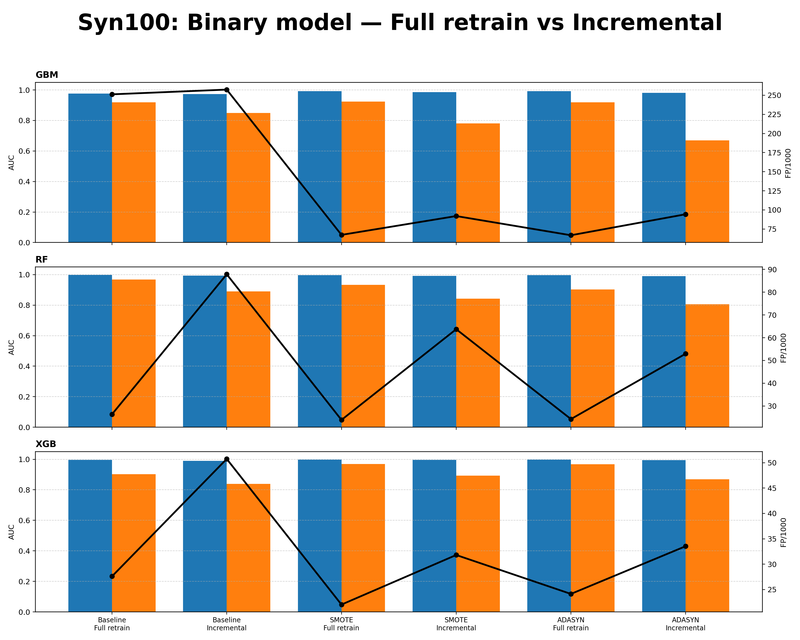
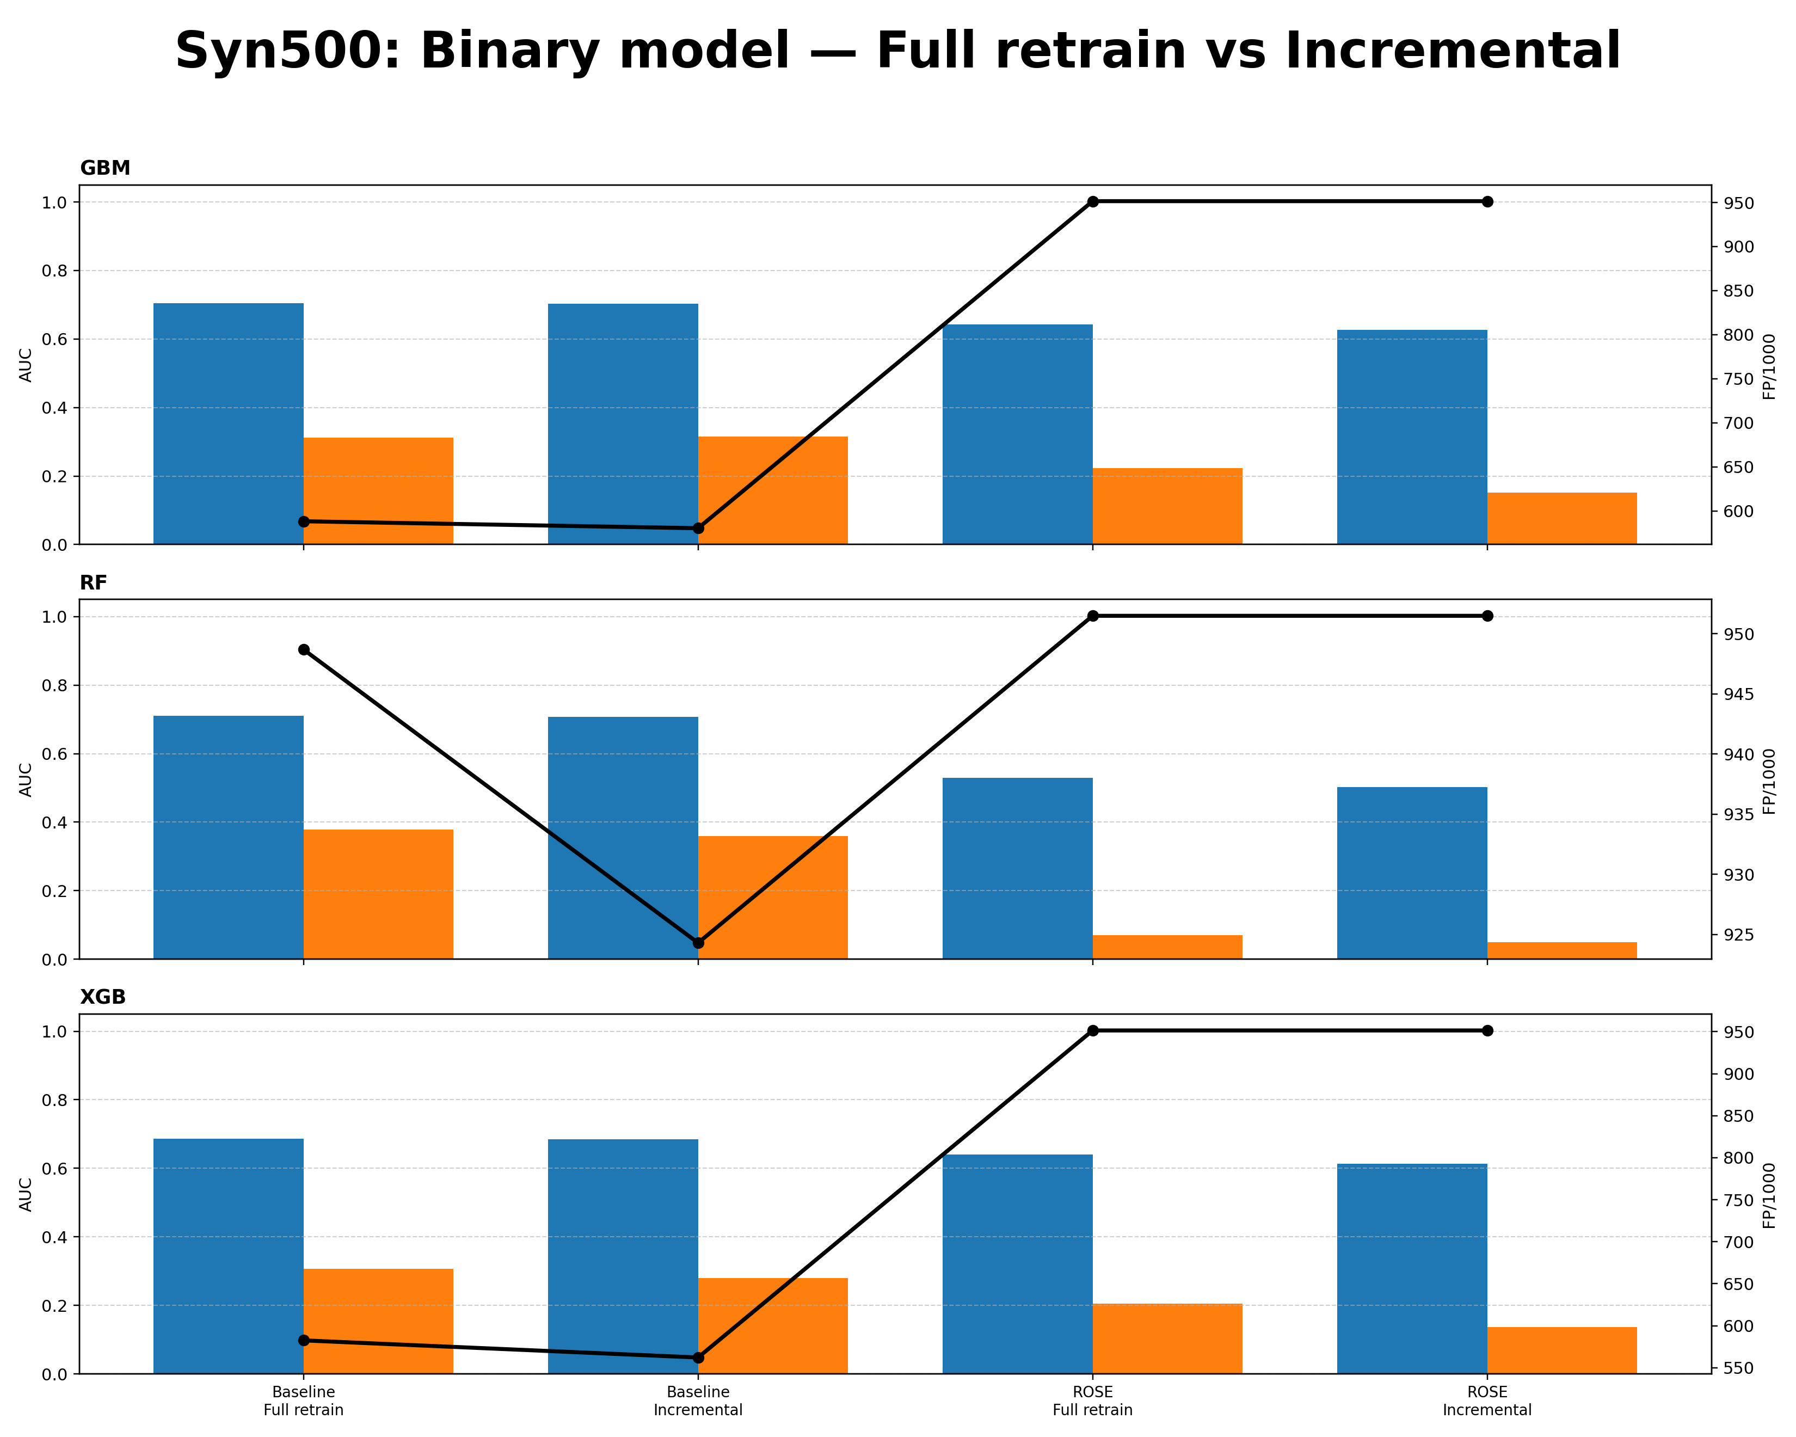

Binary model (Full retrain vs Incremental)
Model | Mode | Best variant | ROC-AUC | PR-AUC | FP/1000
GBM | Full retrain | ADASYN | 0.992 | 0.920 | 66.8
RF | Full retrain | SMOTE | 0.997 | 0.932 | 23.9
XGB | Full retrain | SMOTE | 0.998 | 0.970 | 22.0
XGB | Full retrain | Baseline | 0.996 | 0.903 | 27.6
Model | Mode | Best variant | ROC-AUC | PR-AUC | FP/1000
GBM | Full retrain | Baseline | 0.704 | 0.312 | 588.2
RF | Full retrain | Baseline | 0.710 | 0.378 | 948.7
XGB | Full retrain | Baseline | 0.687 | 0.306 | 582.6
Notes:
Here, we compare binary detection performance under full retraining and incremental updates for small and large synthetic datasets. For Syn100, balancing methods significantly improve precision and reduce false positives, with XGB combined with SMOTE achieving the best trade-off. In contrast, for Syn500, resampling degrades performance, and the unbalanced baseline provides the most stable results. Overall, incremental learning slightly reduces quality but preserves the same ranking of methods.
For the small dataset, balanced training is essential, while for the large dataset, the baseline performs best. Incremental learning shows a minor degradation but remains stable across models.
This slide compares full retraining and incremental learning on small and large datasets. Full retraining is selected as the preferred strategy, as it consistently yields higher PR-AUC and lower false positives. On small data (Syn100), XGB with balancing performs best, while XGB trained on baseline data shows comparable AUC, confirming that balancing is not always critical. On larger data (Syn500), the baseline setup is the most stable, and resampling does not provide additional benefit.

Slide 12
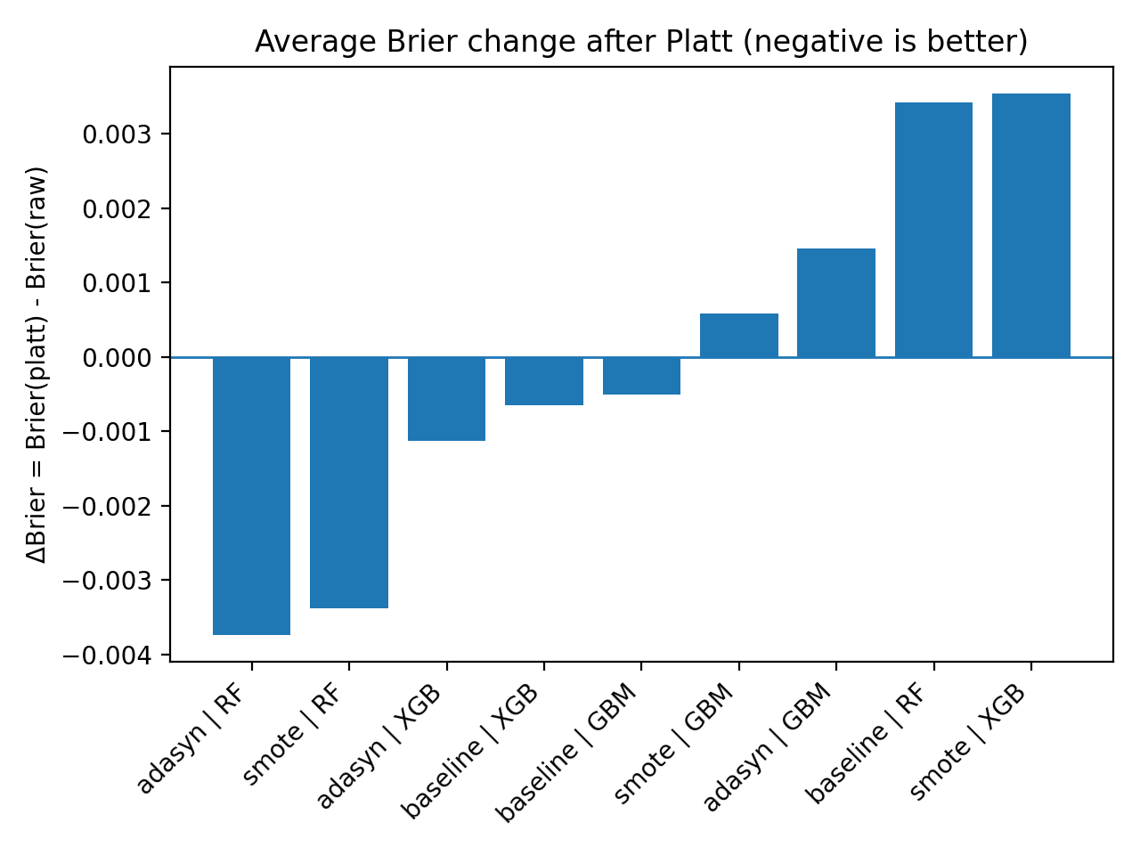
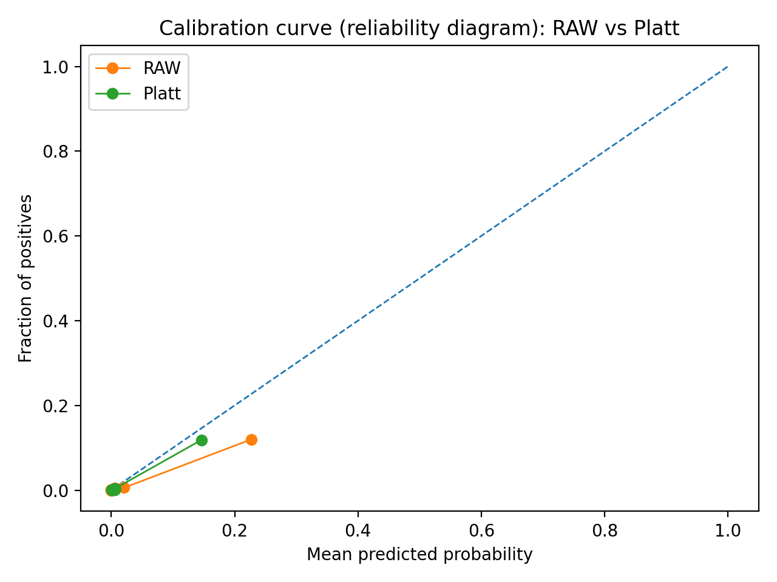
Out of Fold and Platt calibration Syn100
Negative ΔBrier indicates improved calibration.
Platt-scaled probabilities move closer to the ideal calibration line.
OOF predictions provide unbiased probability estimates for calibration
Platt scaling improves probability calibration (lower Brier score)
Ranking performance (ROC/PR) is preserved; only probability reliability changes
Notes:
Probability calibration was evaluated on two dataset scales using out-of-fold predictions and Platt scaling. As expected, ROC-AUC and PR-AUC remain almost unchanged, because calibration does not improve class separation. Instead, it improves the reliability of risk scores: the Brier score decreases for several configurations, and the reliability curve moves closer to the ideal diagonal. From an AML perspective, this means the risk score can be interpreted more consistently and used to set a stable alert threshold under the Recall ≥ 0.98 constraint.
В задачах AML методы OOF и Platt Scaling используются для того, чтобы модель не переобучалась на подозрительных схемах и выдавала честную, математически точную вероятность риска для каждой транзакции.
Эти методы не делают модель «умнее» в разделении легальных и преступных операций, а лишь калибруют её предсказания, чтобы выдаваемые цифры соответствовали реальной вероятности мошенничества.
OOF и Platt Scaling не научили модель лучше отличать «плохих» от «хороших» (поэтому ROC/PR те же), но они заставили модель выдавать честные вероятности, которые теперь можно использовать для оценки реального риска.
Q: Did Platt scaling make the model better? A: It makes the probabilities more reliable, not the classifier more discriminative, which is exactly what is needed for AML risk scoring.

Slide 13
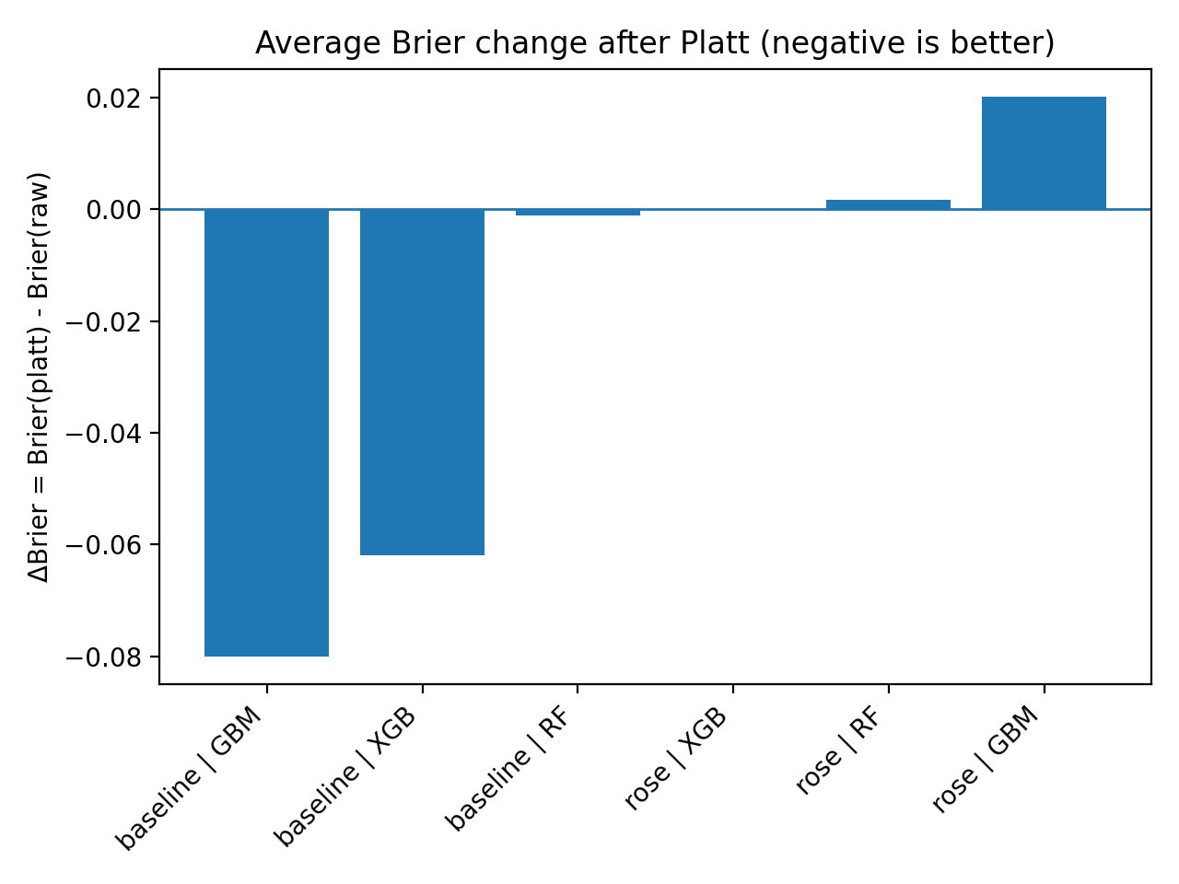
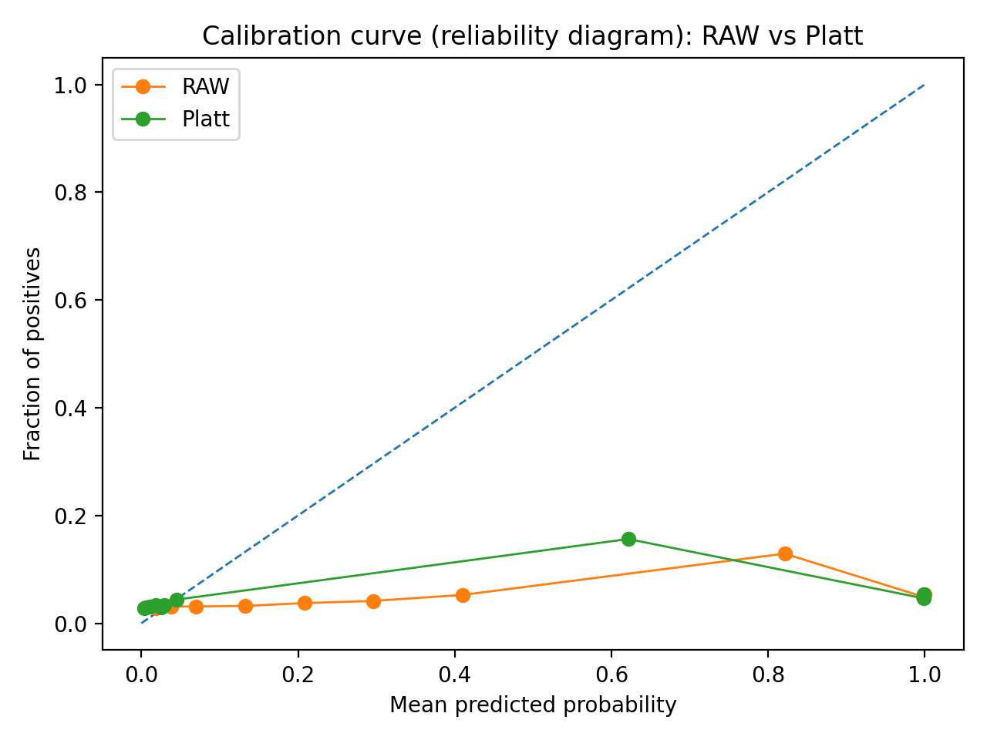
Out of Fold and Platt calibration Syn500
Calibration gains vary across models and resampling strategies.
Platt scaling changes the shape of the calibration curve across probability ranges.
Platt scaling improves calibration mainly for baseline GBM/XGB models
Calibration gains are model and sampling-dependent
Probability reliability improves, while ranking behaviour remains unchanged
Notes:
For Syn500, the effect is more mixed, but baseline models without resampling show the clearest Brier improvement. Metrics again remain nearly unchanged, while the reliability diagram indicates better probability ordering after calibration. In AML terms, this supports more predictable alert volumes and reduces threshold drift across data packages, even when raw model scores are not directly comparable.
aggregated results of model forecasts, grouped to assess the calibration (reliability) of the model.

Slide 14
Multiclass model Syn100 Baseline
Data | Model | Accuracy | F1 | Precision | Recall | TopK1 | TopK2 | TopK3
B1 | GBM | 0.34286 | 0.40741 | 0.50000 | 0.38095 | 0.34286 | 0.48571 | 0.48571
B2 | GBM | 0.60714 | 0.58185 | 0.53497 | 0.75000 | 0.60714 | 0.67857 | 0.67857
B3 | GBM | 1.00000 | 1.00000 | 1.00000 | 1.00000 | 1.00000 | 1.00000 | 1.00000
B4 | GBM | 0.89655 | 0.88474 | 0.91296 | 0.88889 | 0.89655 | 0.89655 | 0.93103
B5 | GBM | 0.96667 | 0.90351 | 0.87500 | 0.97500 | 0.96667 | 0.96667 | 0.96667
B1 | RF | 0.42857 | 0.34354 | 0.34286 | 0.38776 | 0.42857 | 0.45714 | 0.51429
B2 | RF | 0.89286 | 0.87719 | 0.87500 | 0.93182 | 0.89286 | 0.96429 | 1.00000
B3 | RF | 0.95000 | 0.93333 | 0.94444 | 0.94444 | 0.95000 | 1.00000 | 1.00000
B4 | RF | 0.86207 | 0.87525 | 0.92460 | 0.88889 | 0.86207 | 0.93103 | 0.96552
B5 | RF | 0.76667 | 0.52778 | 0.53125 | 0.70000 | 0.76667 | 1.00000 | 1.00000
B1 | XGB | 0.28571 | 0.26154 | 0.23636 | 0.40000 | 0.28571 | 0.37143 | 0.51429
B2 | XGB | 0.57143 | 0.49684 | 0.42013 | 0.66667 | 0.57143 | 0.78571 | 0.96429
B3 | XGB | 1.00000 | 1.00000 | 1.00000 | 1.00000 | 1.00000 | 1.00000 | 1.00000
B4 | XGB | 0.89655 | 0.90194 | 0.90370 | 0.91667 | 0.89655 | 0.93103 | 0.96552
B5 | XGB | 0.76667 | 0.52778 | 0.53125 | 0.70000 | 0.76667 | 1.00000 | 1.00000
Notes:
This slide reports scenario typing performance after the binary detector stage. At this point, the input stream is already filtered as suspicious, so the task is no longer “suspicious vs normal”, but identifying the most likely scenario. Because the number of labelled transactions per scenario is limited, multiclass resampling is not reliable; therefore, the typing model is trained on the baseline data only. We report Top-K accuracy to reflect AML triage: even when the top prediction is wrong, the correct scenario can still appear among the first two or three candidate labels.
Now I move from binary detection to scenario typing. Importantly, this multiclass model is trained on transactions already flagged as suspicious by the binary stage—so the problem is not “suspicious or not”, but “which scenario is most likely”. Because each scenario has very few examples, reliable multiclass balancing is not feasible, so I train only on baseline data. I report Top-K accuracy because in AML practice, it is useful if the correct scenario appears among the first two or three suggestions for analyst triage.
Since the multiclass stage is applied only after the binary detector, all cases are already suspicious; therefore, the key goal is correct scenario assignment for triage. In this stage, overall accuracy is relevant, but it should be complemented with macro-F1 or balanced accuracy and per-class recall to avoid bias towards frequent scenarios
F1-мера — это гармоническое среднее между двумя другими важными метриками: точностью (Precision) и полнотой (Recall).

Slide 15
Multiclass model Syn500 Baseline
Data | Model | Accuracy | F1 | Precision | Recall | TopK1 | TopK2 | TopK3
B1 | GBM | 0.95806 | 0.70919 | 0.70535 | 0.71960 | 0.95806 | 0.97572 | 0.98455
B2 | GBM | 0.83726 | 0.43750 | 0.71259 | 0.38291 | 0.83726 | 0.89293 | 0.89936
B3 | GBM | 0.90223 | 0.51649 | 0.57894 | 0.54366 | 0.90223 | 0.92624 | 0.96741
B4 | GBM | 0.93605 | 0.40353 | 0.45845 | 0.38338 | 0.93605 | 0.95155 | 0.95543
B5 | GBM | 0.83863 | 0.41852 | 0.48986 | 0.41378 | 0.83863 | 0.89976 | 0.92421
B1 | RF | 0.81457 | 0.52321 | 0.67952 | 0.52566 | 0.81457 | 0.99338 | 1.00000
B2 | RF | 0.86081 | 0.55444 | 0.73247 | 0.50592 | 0.86081 | 1.00000 | 1.00000
B3 | RF | 0.80961 | 0.09501 | 0.18380 | 0.08332 | 0.80961 | 0.99314 | 0.99828
B4 | RF | 0.88178 | 0.11876 | 0.16014 | 0.10648 | 0.88178 | 0.94767 | 0.96512
B5 | RF | 0.75795 | 0.06310 | 0.08787 | 0.06250 | 0.75795 | 0.87042 | 0.90220
B1 | XGB | 0.77263 | 0.35048 | 0.52040 | 0.35807 | 0.77263 | 0.97792 | 1.00000
B2 | XGB | 0.82655 | 0.36808 | 0.45538 | 0.32741 | 0.82655 | 0.99358 | 1.00000
B3 | XGB | 0.93139 | 0.65993 | 0.71978 | 0.64094 | 0.93139 | 0.97770 | 0.98971
B4 | XGB | 0.92442 | 0.32736 | 0.36743 | 0.32017 | 0.92442 | 0.95349 | 0.97674
B5 | XGB | 0.87042 | 0.36579 | 0.37505 | 0.41808 | 0.87042 | 0.91198 | 0.93888
Notes:
For Syn500, the same post-detection typing setup is used. Balancing is again avoided, as oversampling can distort class structure and earlier results showed that resampling does not consistently improve performance at scale. The metrics indicate that scenario assignment is less stable than binary detection, which is expected due to overlap between scenario patterns and class imbalance. In AML terms, the model is more suitable for prioritisation and analyst guidance using Top-K suggestions rather than fully automated scenario labelling
For Syn500, the same logic applies: typing after detection, baseline training only. Earlier results also showed balancing is not always beneficial at scale. Here we see that scenario typing is harder and less stable than binary detection, so the model is better used to support analysts with Top-K suggestions rather than to assign final scenario labels automatically.

Slide 16
Conclusion
The hypothesis is partly confirmed: rule-based synthetic data can be used to train ML detectors for risk screening, but it is insufficient for fully automated risk decision-making.
Q1 (behaviour realism): normal and suspicious behaviours are reproduced with realistic overlap; as a result, when a strict recall target is applied, precision decreases due to the lack of a clear separation between classes.
Q2 technical and regulatory constraints (privacy restrictions and limited labelled real data) require fully synthetic generation, while quality is evaluated via privacy–utility–fidelity: privacy is preserved, utility is high for controlled training/benchmarking, and fidelity is limited by predefined rules and simplified business logic.
Q3 (adaptation and scenario typing): binary detection remains stable across data packages and keeps high recall under both incremental updates and full retraining, with only a small quality difference between these regimes. This suggests the model can be updated in batches without major degradation. When a new scenario appears, the binary model can still flag transactions as suspicious, but it cannot assign a reliable scenario label, so scenario typing is mainly useful for triage rather than final labelling.
Notes:
The dataset supports privacy requirements and still provides enough signal to train high-recall binary detectors. Because the synthetic data is close to realistic behaviour, suspicious and normal transactions overlap, so forcing recall to 0.98 naturally leads to low precision and high FP/1000. For adaptation, binary models remain stable across waves under both incremental learning and full retraining, which indicates that the pipeline can be updated over time without major degradation. However, multiclass scenario prediction is significantly more difficult: stacking can separate frequent and well-defined scenarios, but overall macro performance remains moderate and rare classes are unstable due to few samples and intentional overlap. Therefore, scenario prediction should be treated as a supporting tool for alert triage, not as the only source of scenario labels. Binary detection remains stable across different data packages, and it preserves high recall on subsequent packages under both training regimes (incremental learning vs full retraining). The performance gap between incremental updates and full retraining is small, which indicates that the system can be updated in smaller batches without catastrophic degradation. When a new fraud scenario appears, the binary component can still flag a transaction as suspicious, but it cannot reliably assign the correct suspicious category, so scenario typing is better suited for triage than for final labelling.
The hypothesis is partly confirmed. Rule-based synthetic data can train ML detectors for risk screening, but it is not sufficient for fully automated risk decisions. Binary detection remains stable across data packages and update regimes, while scenario typing is mainly useful for triage. Quality is best described as privacy-preserving and useful for controlled benchmarking, but fidelity is limited by simplified rules and business logic.

Slide 17
Scope and Contributions
Scope | Contribution
Synthetic data with 34 AML scenarios, incl. graph-style patterns | Focus on realism impact, not “maximum accuracy”
Two datasets: Syn100 (10k/100) + Syn500 (50k/500), each with 5 data packages | “Too clean” synthetic data → near-perfect metrics can be misleading
Binary detection: GBM / XGBM / RF + H2O AutoML benchmark | More realistic AML-like data → class overlap → higher FP/FN (closer to operations)
Multiclass typing: on top of binary outputs using Top-K | Multiclass stacking supports triage, but labels are moderately reliable
Imbalance handling (binary): Syn100 → Baseline/ADASYN/SMOTE; Syn500 → Baseline/ROSE | At Recall = 0.98, precision can drop to ~4–6% → needs ranking / filters
Training & evaluation: Incremental vs Full retrain; final binary with OOF + plateau | Oversampling + retraining tested; incremental ≈ full retrain (similar stability)
Total tests = 75 (binary) + 30 (multiclass) = 105 | GAN on ~500 real rows: good on “typical” values, weak on heavy tail
Notes:
My contribution is a complete experimental prototype: data generation, quality checks, model selection, training under drift-like updates, calibration, and evaluation for both detection and typing. The system is designed to be reproducible and extendable as new scenarios are added.
The main value is not “perfect accuracy”, but a controlled boundary between too-easy synthetic data and realistic AML complexity.
Shows that with correct distributions and clean structure, synthetic data can be made close enough to reality so that standard models start to struggle (class overlap, higher FP/FN).
Demonstrates a practical limitation: with ~1000 real rows, GAN/VAE can match the “middle” of distributions but often miss the heavy tail (large, rare amounts).
Proposes an interpretable rule-based scenario library + waves (B1–B5) for reproducible testing of drift and new patterns.
Makes the operational trade-off explicit: at Recall = 0.98, precision can fall to ~4–6%, so an extra ranking / filtering layer is needed.
Finds that oversampling (SMOTE/ADASYN/ROSE) is not always a win under a strict recall target, and incremental vs full retrain gives similar quality.
Adds multiclass stacking as a support tool: useful for triage, but not reliable enough for final scenario labels.
Notes
This thesis contributes a methodology for building synthetic AML data that is not artificially simple. When the generator is tuned to be closer to real conditions, suspicious and normal transactions overlap, and the models stop relying on trivial signals, which is closer to industry reality (alerts grow, mistakes appear). This helps to test which extra information is truly needed (context, history, graph relations), instead of training on convenient markers only. A second contribution is the negative result on GAN/VAE under limited real data: even if training loss looks stable, the generator can still fail to reproduce rare extreme values (the heavy tail), which is exactly where the risk signal often sits. Third, the rules-based generator is modular and explainable, with scenario mapping and wave packages (B1–B5), allowing controlled experiments for concept drift and gradual scenario introduction. Finally, the evaluation is operational: models are compared under a fixed high-recall constraint and with FP/1000 checks, plus balancing and retraining strategies. The multiclass stacking layer shows promise for alert triage, but due to small per-class samples and intentional scenario overlap, it cannot be used as the only source of scenario labelling (a two-level design is more realistic).

Slide 18
Thank you to Dr Sc. Eng. Nadezda Spiridovska and Dr Sc. Eng. Jelena Kijonoka for their valuable supervision and advice at every stage of the research
Acknowledgments
Notes:
I would like to thank my supervisors for their valuable supervision and advice at every stage of the research

Slide 19
Thank you for your attention
Notes:
I would like to thank my supervisors for their valuable supervision and advice at every stage of the research

Slide 20
Framework Workflow
1. Divide the data into training and testing sets (B1–B5; Syn100/Syn500)
2. Baseline, SMOTE, ADASYN, and ROSE techniques (train-only; after TF-IDF).
3. GBM, XGBM, and RF, with fixed settings.
4. Calibration, ensure recall is greater than or equal to R₀ while maximising precision.
5. Choosing the optimal data and model combination, taking into account the Recall >=0.98 and based on the PR-AUC metric (+FP/1000 check).
6. Stages B1 to B5 using both A) Incremental and B) Full Retrain (binary: B2–B5).
7. Binary outcome by ensuring threshold stability, FN/FP profile (+OOF aggregates).
8. For typing, implement multiclass strategies, considering both Macro and Weighted Recall (baseline only).
9. Select the final mode (+final model config).
Notes:
This workflow summarises the pipeline: generate five synthetic packages for each dataset scale, apply balancing only where justified, train models under full retraining and incremental updates, calibrate probabilities, and then evaluate binary detection and multiclass scenario typing.

Slide 21
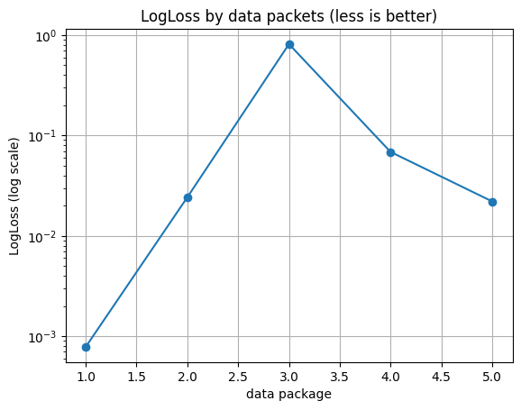
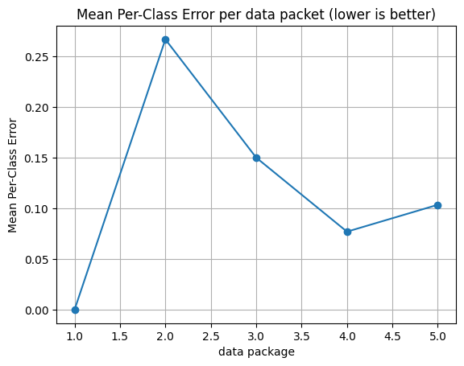
Model Selection with H2O AutoML
Data Package | Leader algorithm | MSE | RMSE | LogLoss | Mean per-class error | HitRatio
1 | XGB | 0.000089 | 0.009451 | 0.000785 | 0.000000 | 1.000000
2 | GBM | 0.001659 | 0.040734 | 0.024234 | 0.266667 | 0.998006
3 | GBM | 0.300184 | 0.547890 | 0.811208 | 0.150000 | 0.998004
4 | GBM | 0.005220 | 0.072252 | 0.068447 | 0.076923 | 0.998504
5 | XGB | 0.001907 | 0.043664 | 0.022020 | 0.103448 | 0.998504
Notes:
In parallel, H2O AutoML was used as an automated check. It confirmed that tree-based models are consistently strong candidates. So manual reasoning and automated search lead to the same conclusion.
LogLoss (the average logarithmic loss across all classes); Mean per-class error (the average error across all classes), which reflects balanced performance across frequent and rare classes by averaging the error per class; and RMSE (the root mean square error), which measures the average "error" in the model's predicted probabilities (the closer the results are to zero, the better all three metrics).
and an AutoML cross-check using H2O to reduce selection bias. Both approaches consistently favoured gradient-boosted models as the best-performing family, with Random Forest retained as a drift-aware baseline.
LogLoss by data packets (less is better) показывает, насколько хорошо модель оценивает вероятности риска на каждом пакете данных.;
Mean Per-Class Error per data packet (lower is better) отражает стабильность классификации по всем классам, а не только по доминирующему.
Leader algorithm — какая модель оказалась лучшей на каждом пакете (GBM или XGB).MSE / RMSE — ошибки вероятностей (связаны с калибровкой).LogLoss — то же, что на графике (численно).Mean per-class error — как на правом графике.HitRatio — доля правильно классифицированных наблюдений (всегда высокая из-за дисбаланса).
High HitRatio alone is misleading in imbalanced AML data, therefore LogLoss and per-class error are more informative.
These plots show how probability calibration and class-wise performance change across data batches: even with high overall accuracy, LogLoss and per-class error reveal instability when new scenarios appear, which reflects realistic AML behaviour and motivates batch-wise updates and calibration.

Slide 22
Binary model Syn100
Mode | Variant | Model | ROC-AUC | PR-AUC | FP/1000
Full retrain | ADASYN | GBM | 0.9920 | 0.9196 | 66.8317
Full retrain | Baseline | GBM | 0.9764 | 0.9192 | 251.2376
Full retrain | SMOTE | GBM | 0.9914 | 0.9242 | 67.3267
Incremental | ADASYN | GBM | 0.9803 | 0.6701 | 94.3069
Incremental | Baseline | GBM | 0.9728 | 0.8487 | 257.4257
Incremental | SMOTE | GBM | 0.9854 | 0.7815 | 91.9554
Full retrain | ADASYN | RF | 0.9960 | 0.9023 | 24.2574
Full retrain | Baseline | RF | 0.9975 | 0.9685 | 26.3614
Full retrain | SMOTE | RF | 0.9966 | 0.9322 | 23.8861
Incremental | ADASYN | RF | 0.9907 | 0.8058 | 52.9703
Incremental | Baseline | RF | 0.9928 | 0.8899 | 87.8713
Incremental | SMOTE | RF | 0.9916 | 0.8422 | 63.7376
Full retrain | ADASYN | XGB | 0.9977 | 0.9673 | 24.1337
Full retrain | Baseline | XGB | 0.9956 | 0.9030 | 27.5990
Full retrain | SMOTE | XGB | 0.9977 | 0.9696 | 22.0297
Incremental | ADASYN | XGB | 0.9949 | 0.8686 | 33.5396
Incremental | Baseline | XGB | 0.9899 | 0.8387 | 50.7426
Incremental | SMOTE | XGB | 0.9958 | 0.8924 | 31.8069

Slide 23
Binary model Syn500
Mode | Variant | Model | ROC-AUC | PR-AUC | Recall | Precision@R | FP/1000
Full retrain | Baseline | GBM | 0.704 | 0.312 | 0.792 | 0.062 | 588.2
Incremental | Baseline | GBM | 0.703 | 0.315 | 0.795 | 0.063 | 580.3
Full retrain | Baseline | RF | 0.710 | 0.378 | 0.998 | 0.049 | 948.7
Incremental | Baseline | RF | 0.708 | 0.359 | 0.990 | 0.049 | 924.3
Full retrain | Baseline | XGB | 0.687 | 0.306 | 0.779 | 0.061 | 582.6
Incremental | Baseline | XGB | 0.684 | 0.279 | 0.762 | 0.062 | 562.2
Full retrain | ROSE | GBM | 0.643 | 0.223 | 1.000 | 0.049 | 951.5
Incremental | ROSE | GBM | 0.626 | 0.151 | 1.000 | 0.049 | 951.5
Full retrain | ROSE | RF | 0.530 | 0.071 | 1.000 | 0.049 | 951.5
Incremental | ROSE | RF | 0.502 | 0.049 | 1.000 | 0.049 | 951.5
Full retrain | ROSE | XGB | 0.640 | 0.205 | 1.000 | 0.049 | 951.5
Incremental | ROSE | XGB | 0.613 | 0.136 | 1.000 | 0.049 | 951.5

Slide 24
Out of Fold and Platt calibration Syn100
Variant | Model | ROC-AUC | PR-AUC | Precision@R | Recall | FP/1000 | Brier raw | Brier Platt | Platt-raw
ADASYN | GBM | 0.99992 | 0.99373 | 0.96861 | 1.00000 | 0.49505 | 0.0123 | 0.0138 | +0.0015
ADASYN | RF | 0.99996 | 0.99752 | 0.97949 | 1.00000 | 0.39604 | 0.0077 | 0.0040 | -0.0037
ADASYN | XGB | 0.99995 | 0.99717 | 0.94544 | 1.00000 | 0.99010 | 0.0074 | 0.0063 | -0.0011
Baseline | GBM | 0.99998 | 0.99908 | 0.97754 | 1.00000 | 0.39604 | 0.0047 | 0.0042 | -0.0005
Baseline | RF | 0.99998 | 0.99878 | 0.97500 | 1.00000 | 0.49505 | 0.0053 | 0.0087 | +0.0034
Baseline | XGB | 0.99999 | 0.99931 | 0.97999 | 1.00000 | 0.29703 | 0.0045 | 0.0038 | -0.0007
SMOTE | GBM | 1.00000 | 0.99984 | 0.99444 | 1.00000 | 0.09901 | 0.0192 | 0.0198 | +0.0006
SMOTE | RF | 0.99997 | 0.99795 | 0.97949 | 1.00000 | 0.39604 | 0.0072 | 0.0038 | -0.0034
SMOTE | XGB | 0.99999 | 0.99912 | 0.98799 | 1.00000 | 0.19802 | 0.0099 | 0.0135 | +0.0035

Slide 25
Out of Fold and Platt calibration Syn500
Variant | Model | ROC-AUC | PR-AUC | Precision@R | Recall | FP/1000 | Brier raw | Brier Platt | Platt-raw
Baseline | GBM | 0.83488 | 0.45761 | 0.06941 | 0.98050 | 638.65347 | 0.1193 | 0.0393 | -0.0800
Baseline | RF | 0.79676 | 0.44866 | 0.05537 | 0.98133 | 803.16832 | 0.0377 | 0.0366 | -0.0011
Baseline | XGB | 0.83489 | 0.46955 | 0.06881 | 0.98050 | 643.82178 | 0.1017 | 0.0397 | -0.0619
ROSE | GBM | 0.83084 | 0.47165 | 0.06782 | 0.98050 | 650.97030 | 0.9291 | 0.9492 | +0.0201
ROSE | RF | 0.79611 | 0.45045 | 0.05414 | 0.98299 | 820.81188 | 0.9474 | 0.9491 | +0.0017
ROSE | XGB | 0.83988 | 0.48527 | 0.06963 | 0.98050 | 631.62376 | 0.9501 | 0.9502 | +0.0001

