Slide 1
Design web site portfolio of pet photographer

Slide 2
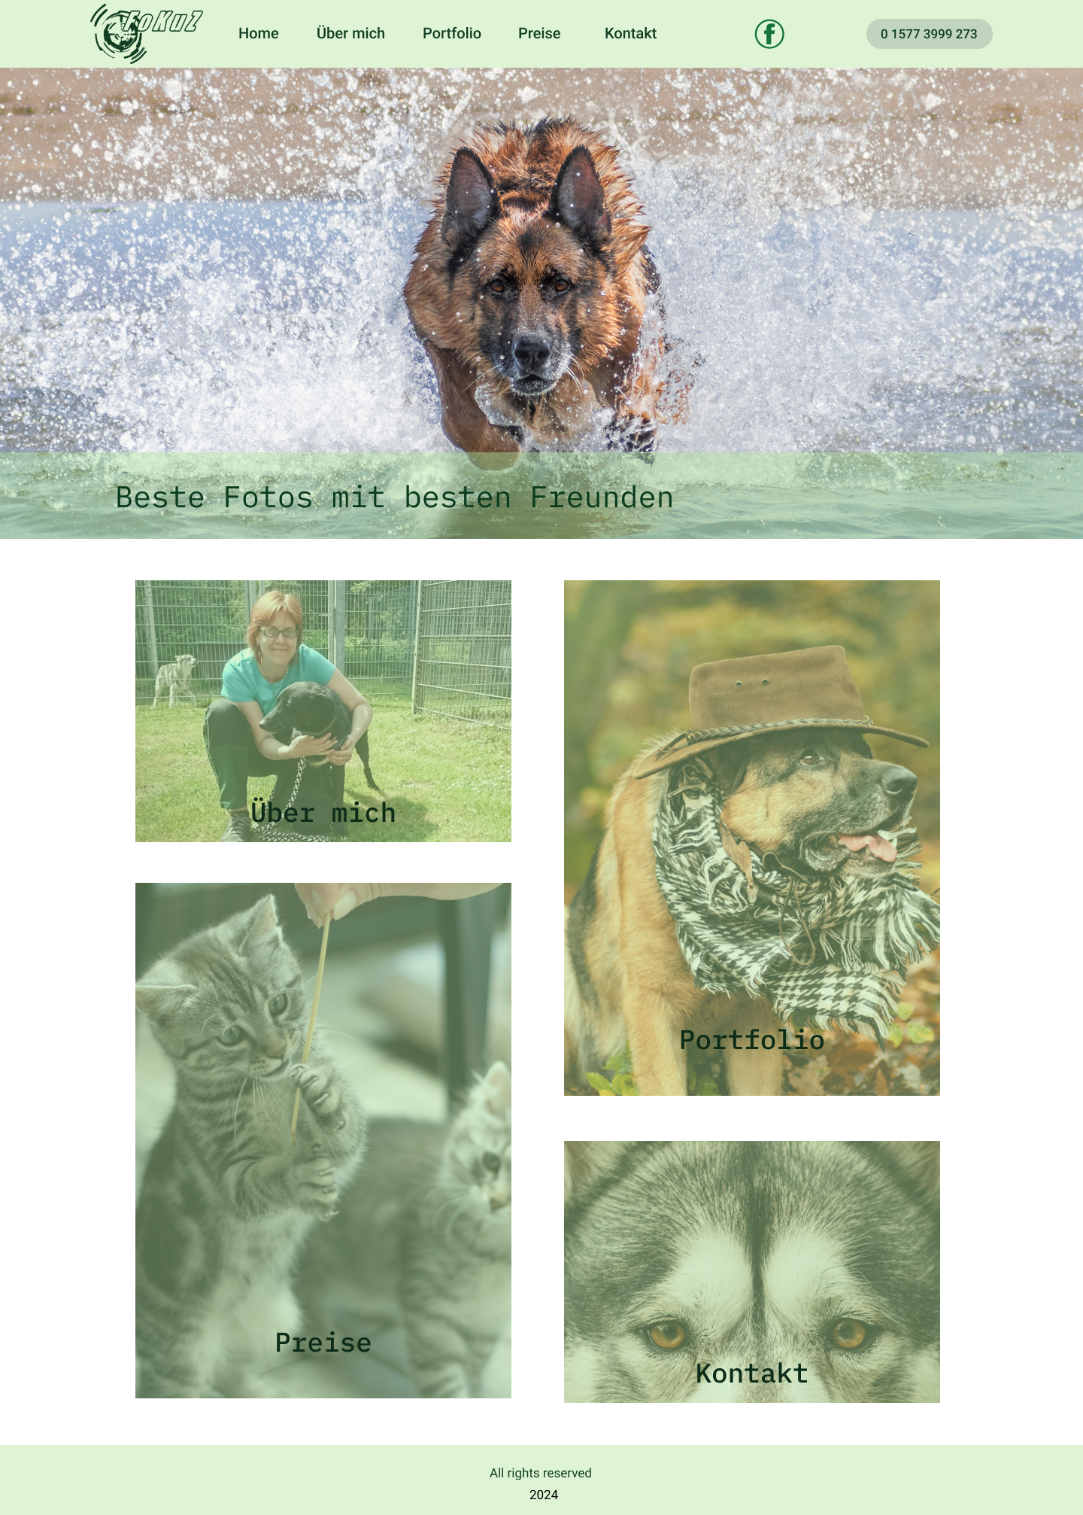
Project overview
The product:
Web site portfolio of a pet photographer who makes photoshooting in pet's shelter.
Preview of selected polished designs.
Project duration:
January - Febbruary 2024

Slide 3
Project overview
The problem:
The goal of this project was to design a responsive and visually striking portfolio website for a photographer who photoshooting domestic pets and pets from shelter in effectively showcases their work while providing a seamless user experience. The website should be easy to navigate and should allow potential clients and collaborators to easily view the photographer’s portfolio and contact them. Additionally, the design should be optimized for all devices and should be visually pleasing and memorable. Overall, the goal was to create a website that effectively represents the photographer’s unique style and helps her stand out in their field.
The goal:
* Balancing visual appeal with functionality: The website needed to be visually striking in order to showcase the photographer’s work, but it also needed to be functional and easy to navigate.
* Creating a cohesive design across different devices: The website needed to look and function well across desktop, tablet, and mobile devices. This required careful consideration of layout, typography, and image sizes.

Slide 4
Project overview
My role:
UX designer leading the app design from conception to delivery.
Responsibilities:
Conducting interviews, paper and digital wireframing, low and high fidelity prototyping, conducting usability studies, accounting for accessibility, iterating on designs, determining information architechture and responsive design.

Slide 5
User research
Personas
Problem statements
Competitive audit
Ideation
Understanding
the user

Slide 6
User research: summary
I conducted interviews and created empathy maps to understand the users I’m designing for and their needs. A primary user group identified through research was people of age over 18 years old who have new born babies, especially first-time parents, this user group is overwhelmed with different duties that have to commit with little children and have little time to browse in internet. The secondary user group are people who have adult children first time parents.
The user group confirmed initial assumption about first time parents and also revealed that some part of users is not familiar with technology, have problems with choosing available goods.

Slide 7
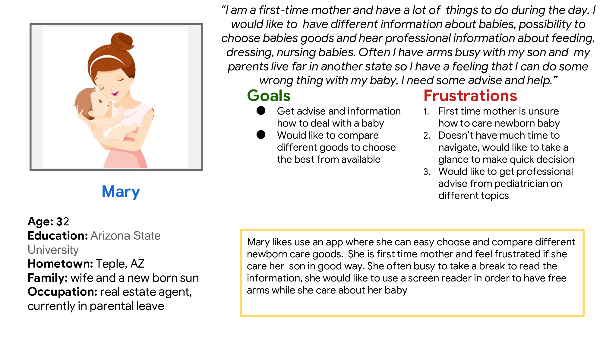
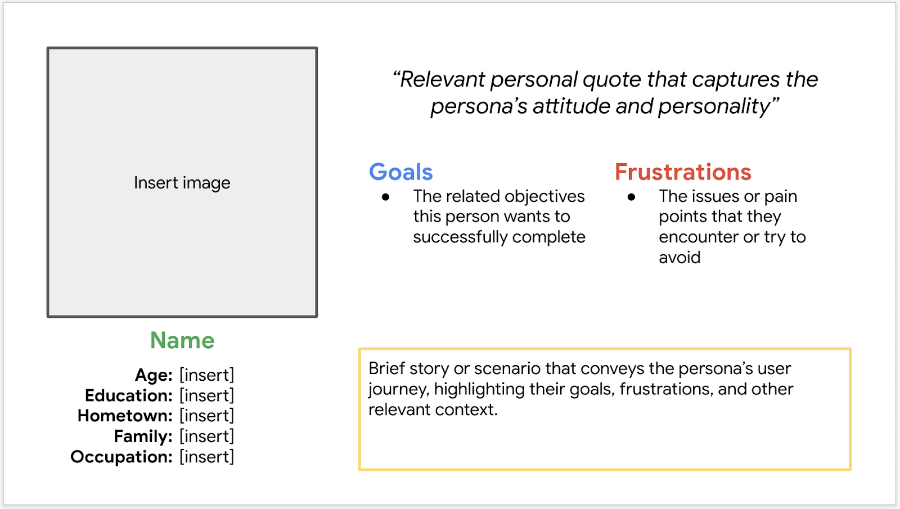
Persona 1: Mary
Problem statement:
Mary is a first time mother that need verified information about different aspect of baby care and choose available newborn care goods.

Slide 8
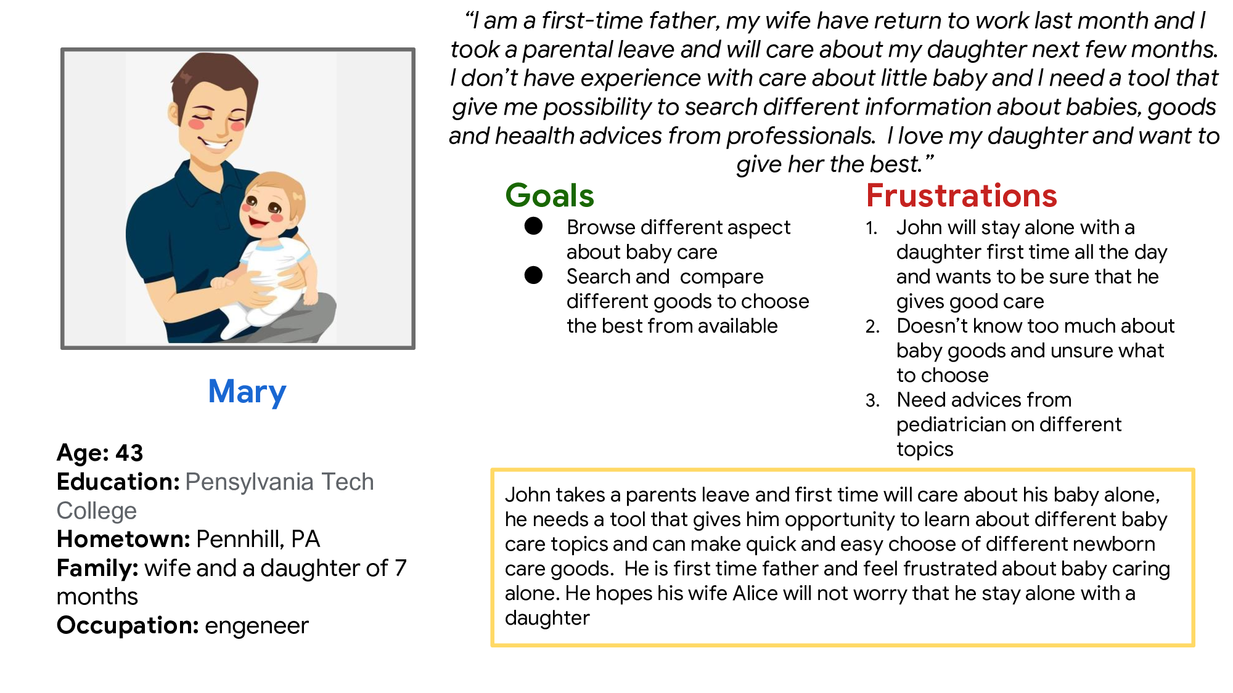
Persona 2: John
Problem statement:
John is a first time father who will care alone his daughter and need a tool that permit him to take information about baby care and newborn care goods.

Slide 9
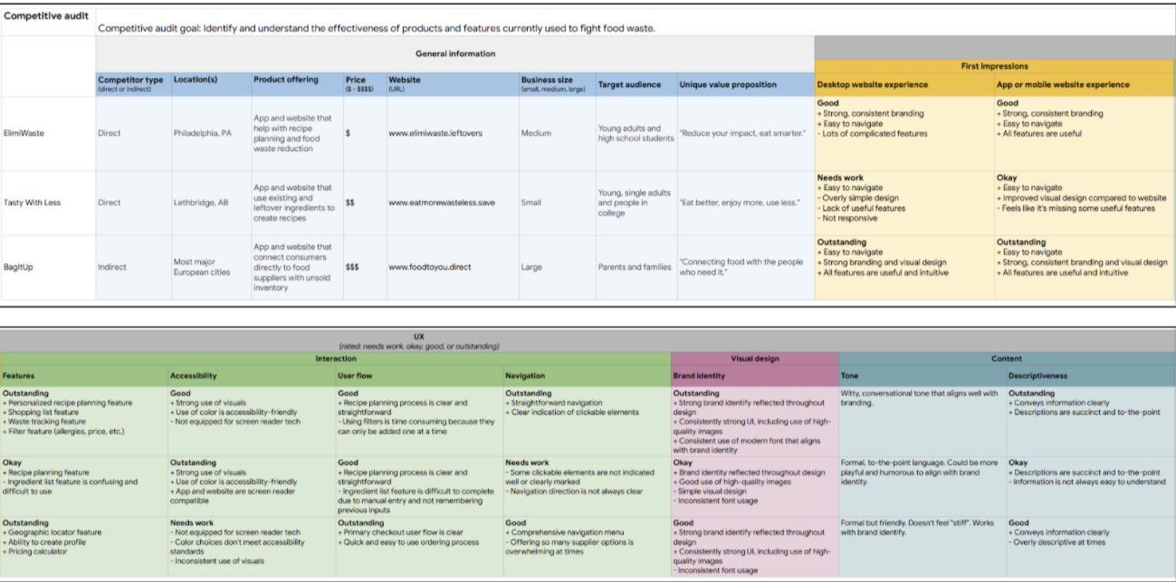
Competitive audit
I provided a competitive audit of competitors products to find gaps and opportunities to adress app for first time parents.
Image of spreadsheet

Slide 10
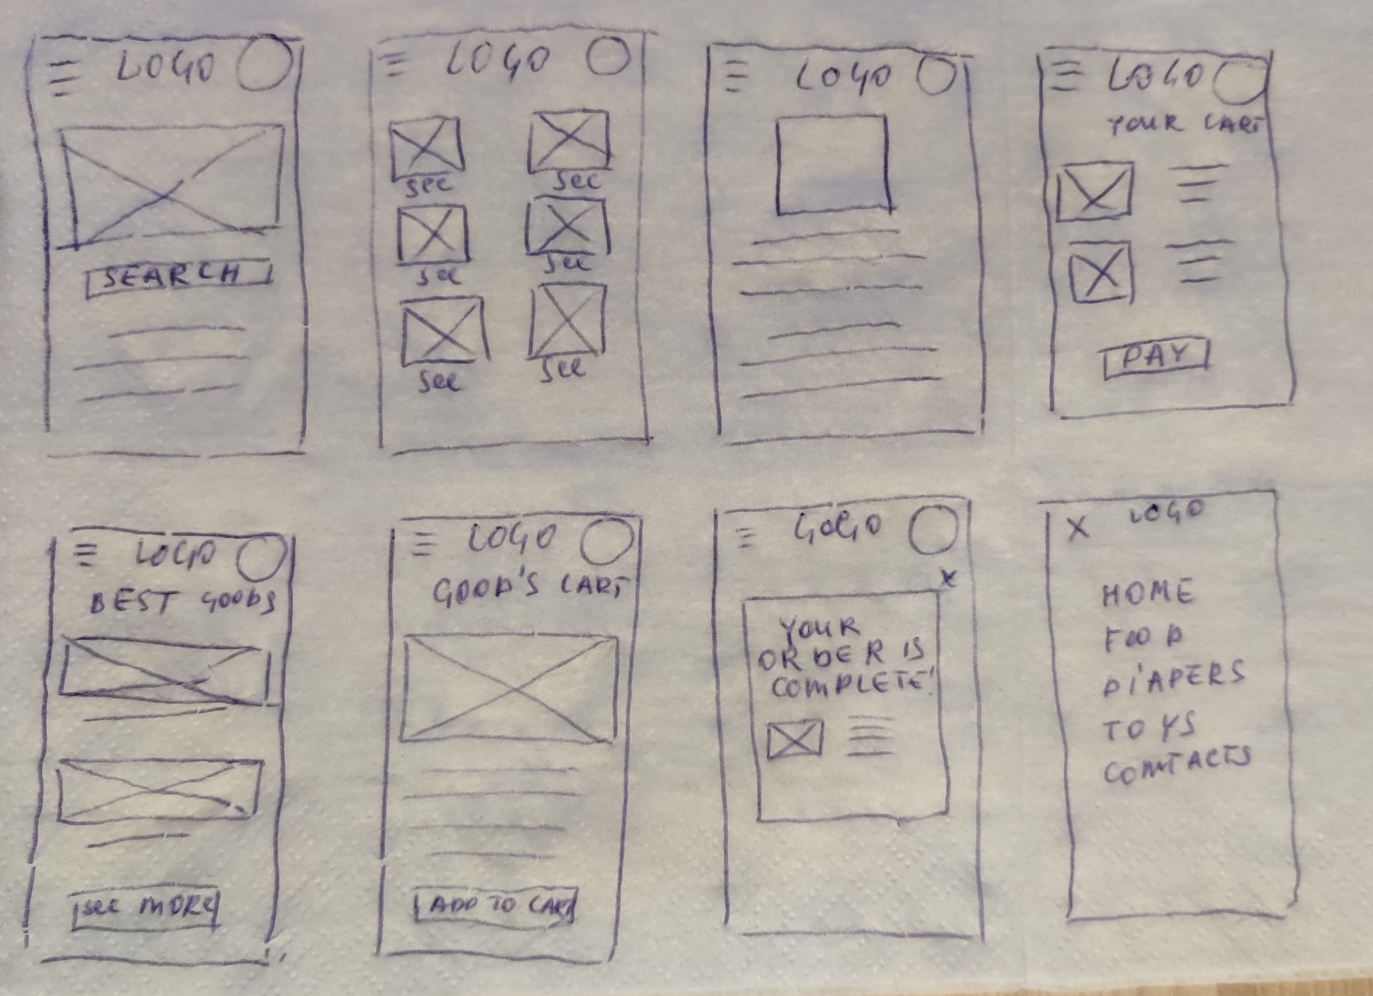
Ideation
I did quick first ideation process to come up with ideas for how to adress gaps identified in the competitive audit.
Image of ideation exercise

Slide 11
Digital wireframes
Low-fidelity prototype
Usability studies
Starting
the design

Slide 12
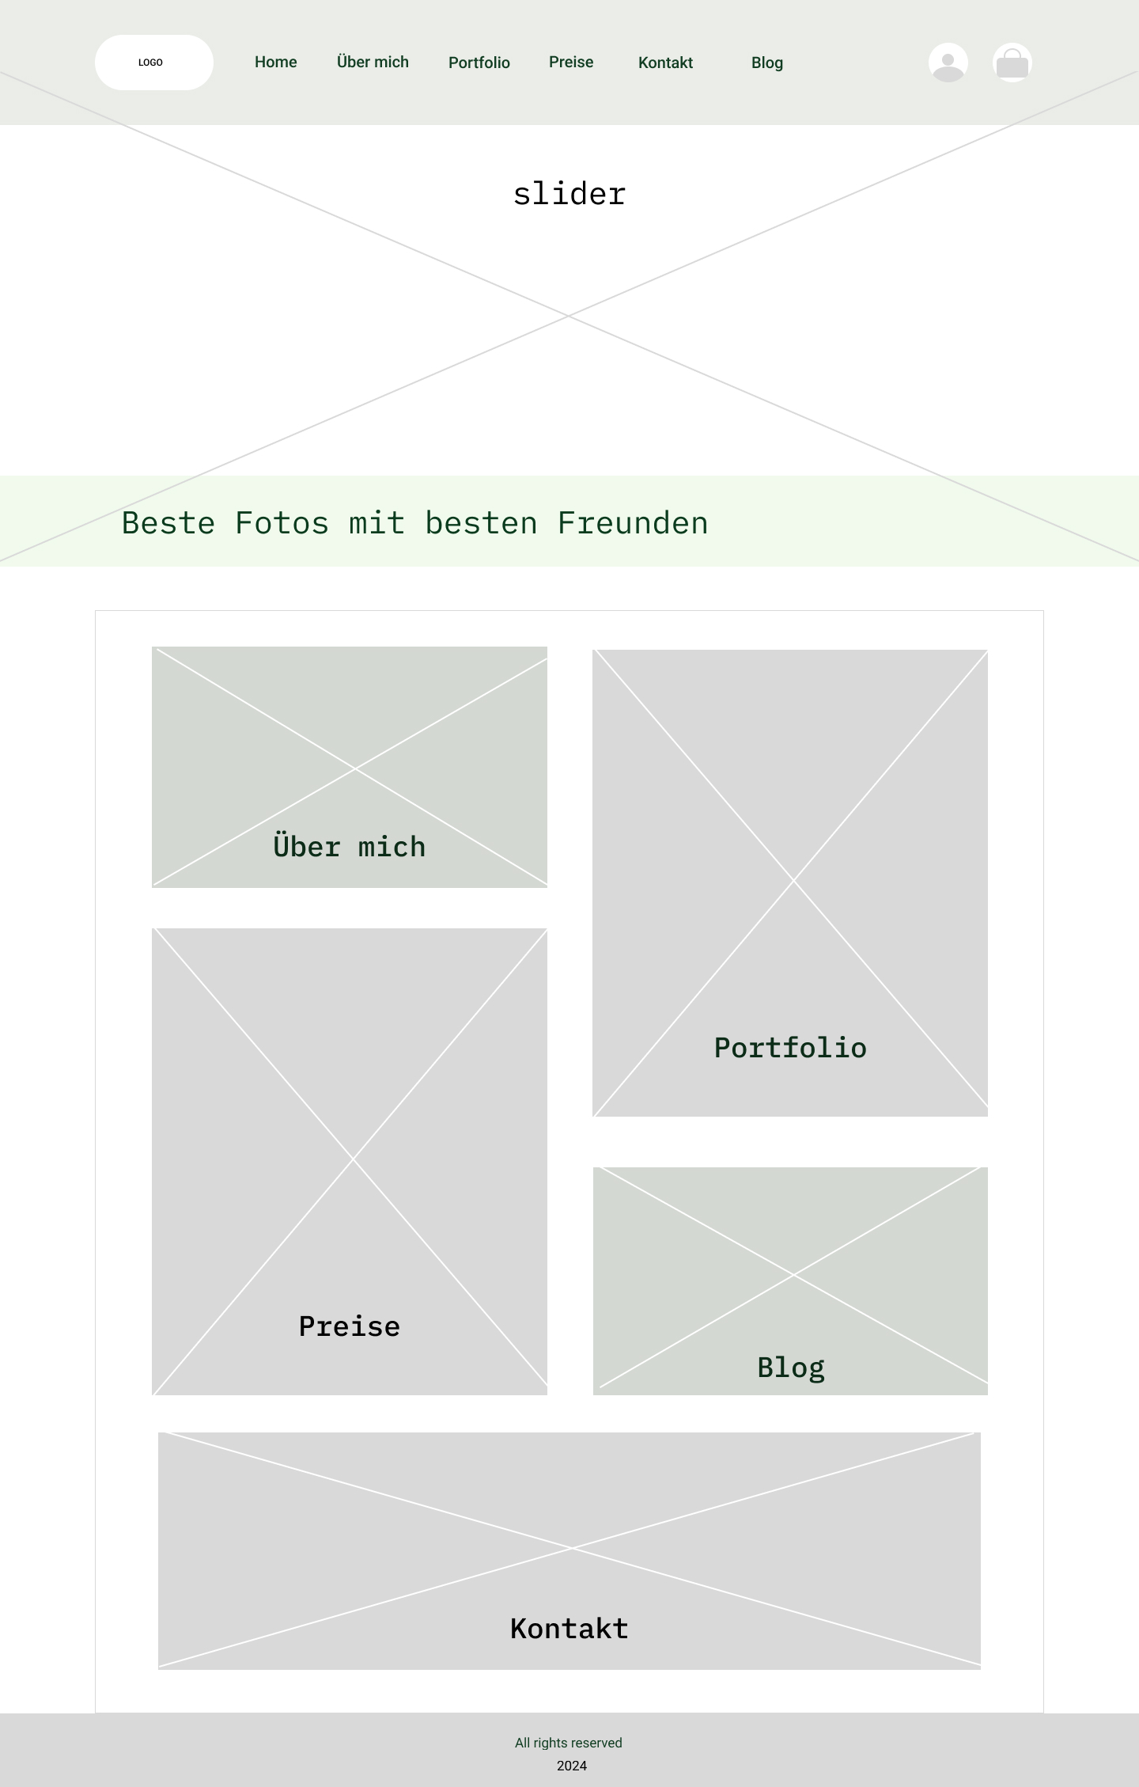
Good vbisible menu that permit access to other pages
Digital wireframes
Digital wireframes
After ideating and paper wireframe process I created the initial designs for the app for first time parents. The design focused on easy access to different parts of the app
Slider in first screen and second screen with large pictures gives impression about photographer's art

Slide 13
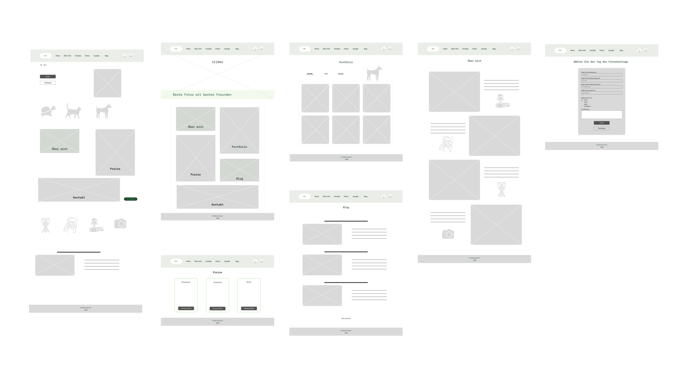
Digital Wireframe
Link:
https://www.figma.com/file/fEUYAa6rZT5lVO1loXiOWL/Fokuz-Wireframe?type=design&node-id=0%3A1&mode=design&t=O1d4LJKClkATXEAX-1

Slide 14
Usability study: parameters
Study type:
Unmoderated usability study
Location:
USA, remote
Participants:
7 participants
Length:
30-60 minutes

Slide 15
Usability study: findings
The main findings uncovered by usability study:
1
2
3
Searching articles and goods
Find product
Proceed with order
People want easy searching themes of interest.
People had difficulty choosing and adding to cart desirable good.
People need indication how to complete o modificate order.

Slide 16
Refining
the design
Mockups
High-fidelity prototype
Accessibility

Slide 17
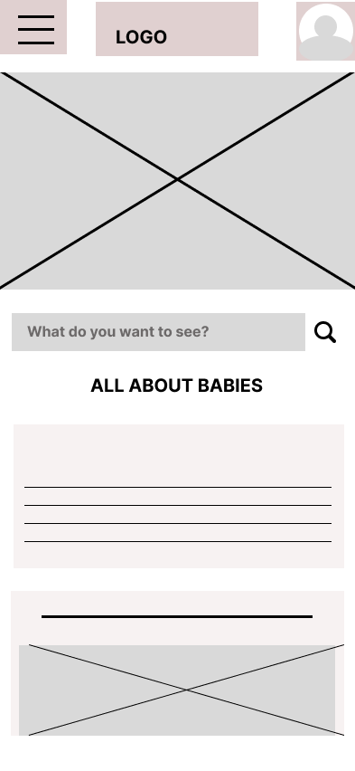
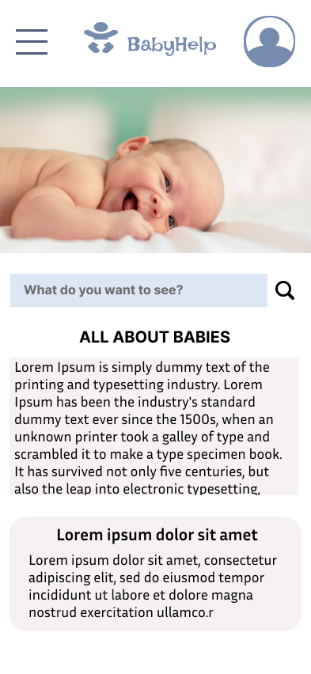
Mockups
Before usability study
After usability study
Based on the insights from the usability study, I applied design changes like providing a clear section of searching desirable themes in searching input
Mockup 1 before
Mockup 1 after

Slide 18
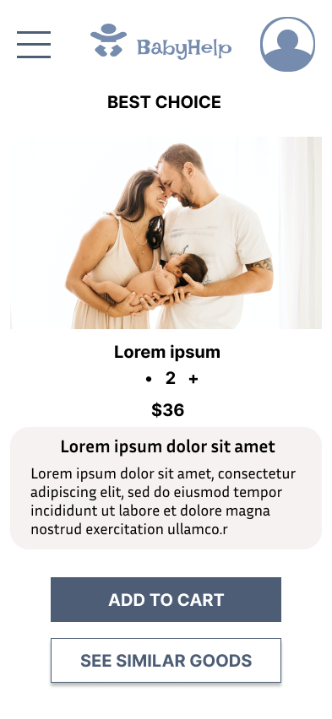
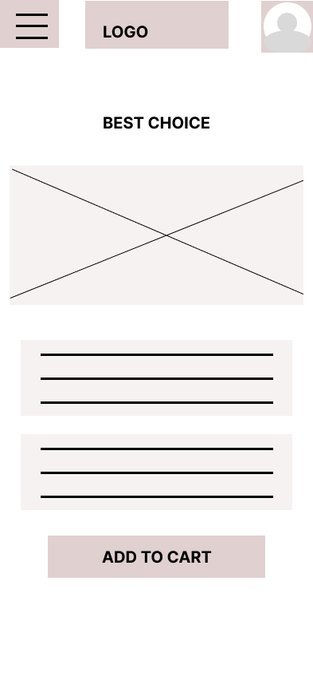
Mockups
Before usability study
After usability study
Additional design changes included adding an option of choosing similar items and their rate
Mockup 2 before
Mockup 2 after

Slide 19
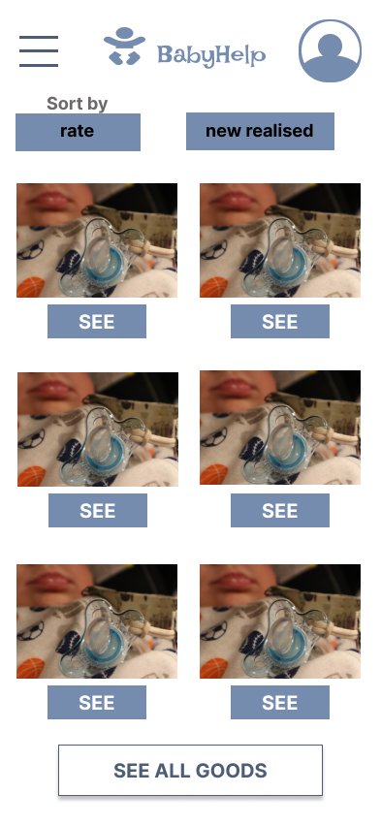
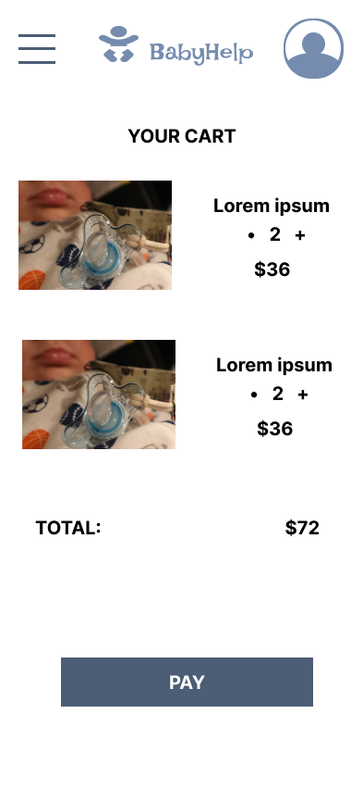
Mockups
Main mockup screen for display
Main mockup screen for display
Main mockup screen for display
Main mockup screen for display

Slide 20
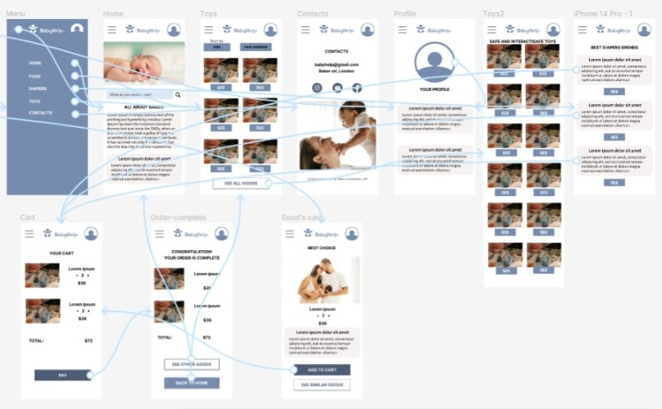
High-fidelity
prototype
The high-fidelity ptototype followed the same user flow as the low –fidelity prototype, including design changes made after usability study
Screenshot of prototype with connections or prototype GIF

Slide 21
Accessibility considerations
1
2
3
Add clear labels for interactive elements that can be read by screen readers.
Initial focus of the home screen on search input for easy searching themes of interest.
Good visible design of button to complete actions.

Slide 22
Responsive Design
Information architecture
Responsive design

Slide 23
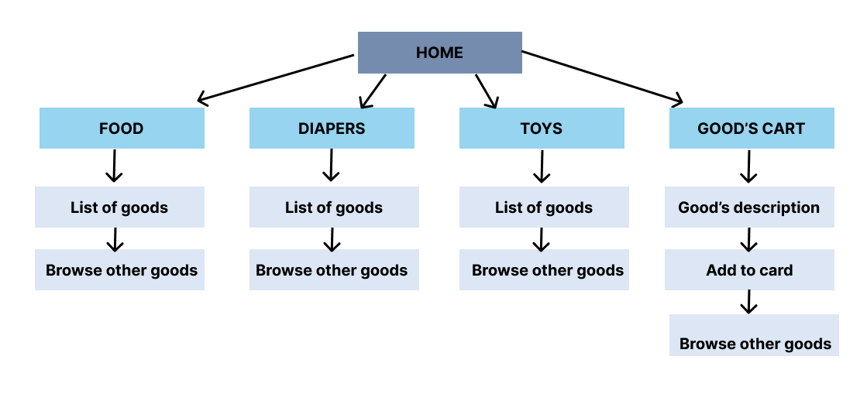
Sitemap
With the app designs completed, I started work on designing the responsive web site. I used the app site map to giude the organizational structure of each screen’s design to ensure a cohesive and consistent experience across devices
Image of sitemap/IA

Slide 24
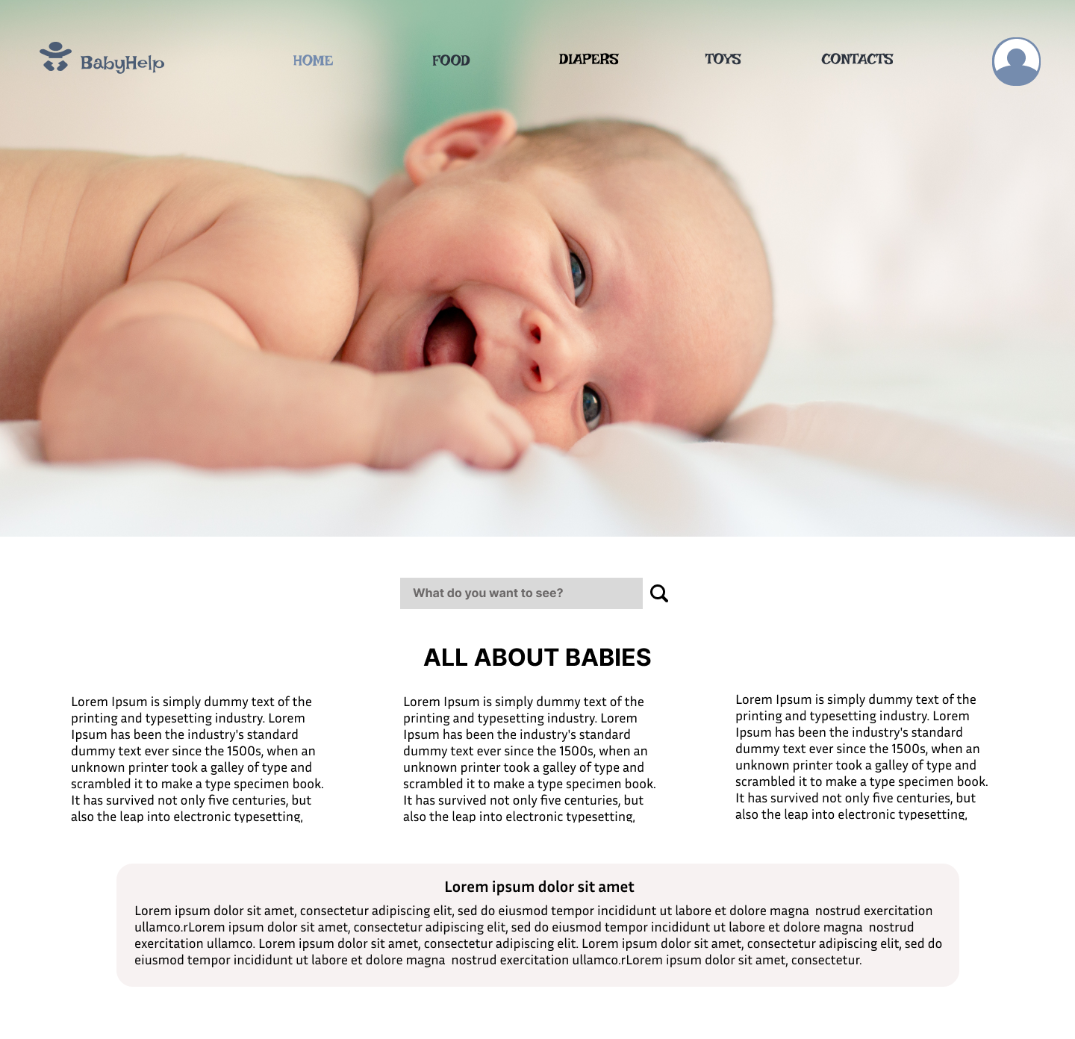
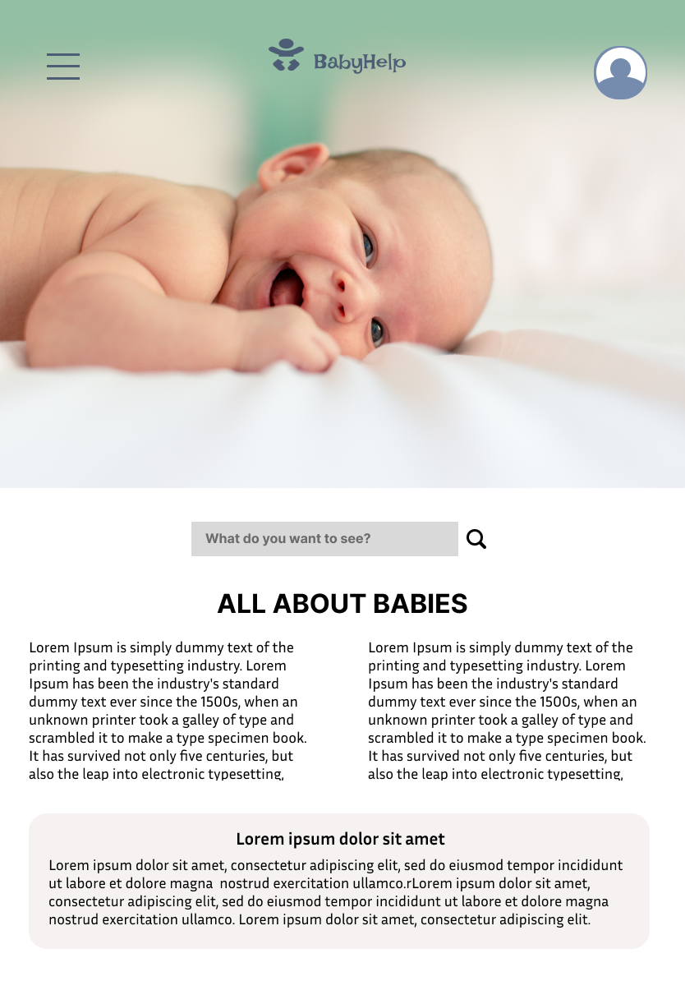
Responsive designs
Design of screen size variation includes mobile, tablet and desktop. I optimized the designs to fit specific user’s need of each device and each screen size
Images of each screen size variation

Slide 25
Going forward
Takeaways
Next steps

Slide 26
Takeaways
Impact:
Users appreciated the app that is a useful tool to search, compare and order newborn baby good that also includes advises from prfessionla pediatrician and experience of other parents.
What I learned:
I learned that even through the problem I was trying to solve was a big one, but diligentl follow each step of the design process and aligning with specific user needs helped me come up with solutions that were both feasible and useful.

Slide 27
Next steps
1
2
3
Conduct research on how succesful the app is in reaching the goal to be useful tool for first time parents.
Add more resourses and engage more professionals to gather more advices and opinions on app’s topics.
Provide a discount system for user who used the app regulary.

Slide 28
Insert a few sentences summarizing the next steps you would take with this project and why. Feel free to organize next steps in a bullet point list.
Let’s connect!
Thank you for careful reviewing of my design work on the app for first time parents. If you would like to get in touch, my contact information is provided below:
alessiaveter@gmail.com
https://nataliitaly.github.io/rsschool-cv/

