Slide 1

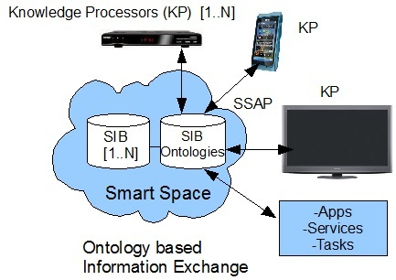
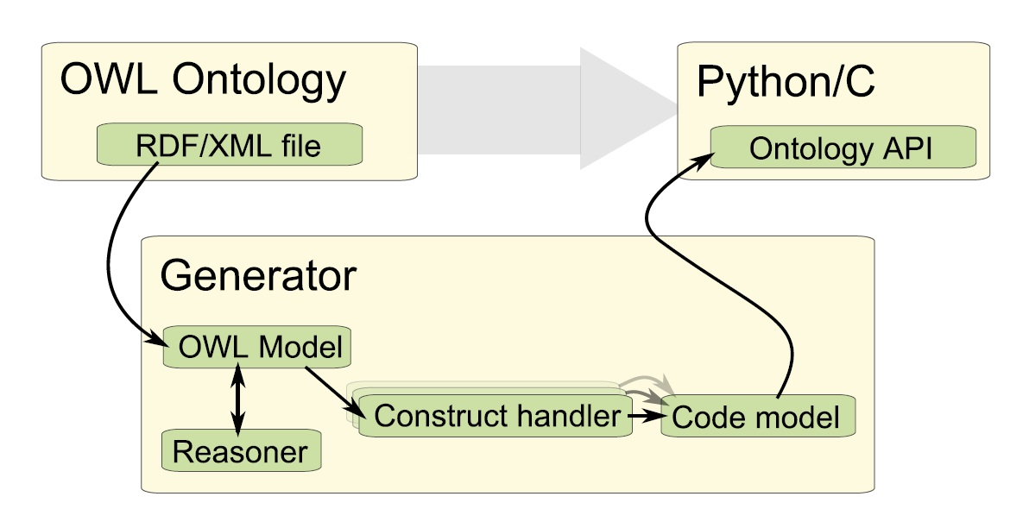
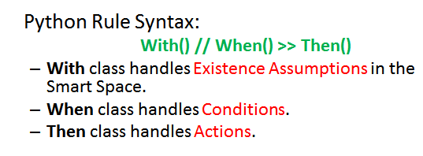
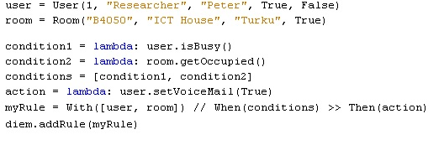
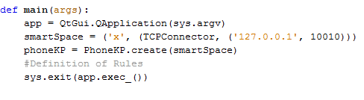
Devices and Interoperability Ecosystem (DIEM) Project
Interoperability Work Package (IOP)
Iván Porres, Johan Lilius
Department of IT, Åbo Akademi University, Turku, Finland.
{name.surname}@abo.fi
Main Contributions -Development Tools-:
1) An Ontology Library Generator (in Python and C): creates a static API from an OWL-DL Ontology containing classes, its properties and Get & Set methods.
2) A Middleware framework: Abstracts the communication with the persistence layer. Provides to the generated ontology API: RDF Triple handling, synchronous and asynchronous querying.
3) PythonRules module for modelling behaviour in the Smart Space.
4) OWL as a Scripting Language.
DELIVERABLES:
D5.6.7 New Release of Ontology Library Generator for Python.
D5.8.5 Report: On Using Smart-M3 in the Personal Information Ecosystem.
D5.9.2 Python runtime bindings for the Smart-M3 behavior.
MASTER THESIS:
Semantic Interoperability in Smart Environments. Lakshman Veer.Ponguwala.
Calendar synchronization in a RDF-based smartspace environment. Emil Karlsson.
Ontology driven application prototyping in a smartspace environment. Jon von Weymarn.
PUBLICATIONS:
Ontology driven Smart Space Application Development. M. Mohsin Saleemi, Natalia Díaz Rodríguez, Espen Suenson, Johan Lilius and Ivan Porres. Book Chapter in Semantic Interoperability: Issues, Solutions, Challenges. River Publishers. 2011.
A Framework for Context-aware Applications for Smart Spaces. M. Mohsin Saleemi, Natalia Díaz Rodríguez, Johan Lilius and Iván Porres. The 4th conference on Smart Spaces ruSMART 2011, August.
OWL Web Ontology Language as a Scripting Language for Smart Space Applications. Espen Suenson, Johan Lilius, Ivan Porres. International Symposium on Rules, RuleML 2011, July.
End-user’s Service Composition in Ubiquitous Computing using Smartspace Approach. ICIW 2011 : The Sixth International Conference on Internet and Web Applications and Services, March 20-25, 2011 - St. Maarten, The Netherlands Antilles.
Framework for Smart Space Application development. A. Kaustell, M. Mohsin Saleemi, T. Rosqvist, J. Jokiniemi, J. Lilius, and I. Porres. IWSI 2011: International Workshop on Semantic Interoperability. 28-30 January, Rome Italy.
Programming Biomedical Smart Space applications with BioImageXD and PythonRules.. N. Díaz, P. Kankaanpää, M.M. Saleemi, J. Lilius, I. Porres. 4th International SWAT4LS Workshop. Semantic web applications and tools for life sciences. (Submitted).
Tools
Rule Expression embedding into Python language
Since the end-user should not deal with the RDF store directly, a PythonRules module is presented to translate Python logic expressions to the SIB API (Query, Subscribe, Insert, Remove, Update).
AIM: Design a Rule syntax for allowing users -with knowledge of basic programming- easy definition of Rules to model Smart Space applications.
Knowledge Processor Programming
RULES are stored and passed to a rule Inference Engine which, based on given/sensed (sensors, RFID, devices, etc) atomic context information, will infer higher level Context Information.
APPLICATION DOMAIN for the Smart Space Development framework:
Office and Personal domain. Home Automation.
BioMedical and Healthcare domain.
Elderly Monitoring Systems, Special needs self-care etc.
ACKNOWLEDGMENT: TEKES ICT-SHOCK DIEM (Devices and Interoperability Ecosystem) project (www.diem.fi) and TUCS (Turku Centre for Computer Science) Graduate School (www.tucs.fi)

