Slide 1
Representation of Russia in British press
before and after Annexation of Crimea
Natalia Kuzminykh

Slide 2
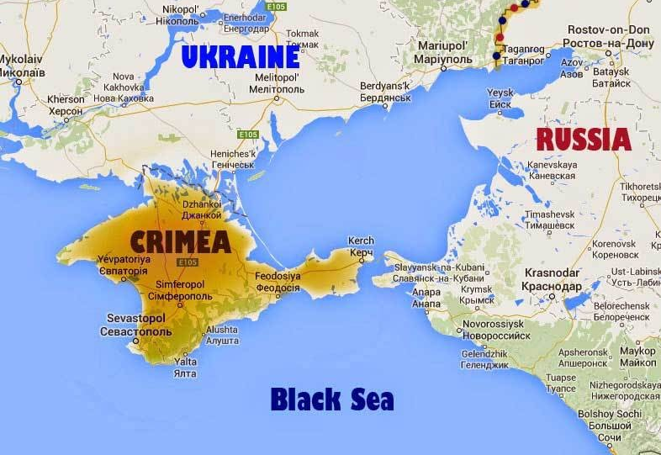
History
The Crimean Peninsula, was annexed by the Russian Federation between February and March 2014;
Ukraine and many other countries condemned the annexation and consider it to be a violation of international law;
This event led to implementation of strict measures against the country (e.g. sanctions, suspension from G8 etc.)
Notes:
Crimea had been part of Russia for 200 years until 1954, when it was gifted to the Soviet Republic of the Ukraine;
The occupation of the peninsula by Russian special forces in February 2014 was followed by a regional referendum under Russian control on 16 March 2014, an official request by the Crimean authorities to become a part of the Russian Federation,

Slide 3
Related works
Nevinskaitė, L., 2017. Framing Russia as Threat in the Lithuanian Media: Corpus Analysis. Lituanus, 63(4).
Differences:
Topic: Russian foreign politics
Source: Lithuanian media
Period: from March 2014 (annexation of Crimea) to February 2015
Results: Russia as aggressor and potential threat to Lithuanian national security

Slide 4
Resources and tools:
Press: BBC, The Telegraph
Tools: Python 3.8., The Natural Language Toolkit (NLTK), Sketch Engine;
Parsing packages: JusText, BeautifulSoup

Slide 5
Press
The analysis was based on BBC and The Telegraph media sources;
Excluded: The Times and The Guardian
Time period:
1) From 20 Feb 2013 to 19 Feb 2014
2) From 20 Feb 2014 to 20 Feb 2015
Key words for search: “Russia”, “Moscow”;
Excluded: broadcastings, videos, radio, music, photo reports, sport results etc.

Slide 6
Building a corpus
To automate the process of data collection, there was used a web scraping tool built with Python libraries:
Initial search: Justext
Accuracy: 84.7% for BBC and 97.1% for Telegraph
Second search: BeautifulSoup
Notes:
Scraping the internet

Slide 7
Building a corpus
Process:
Creating a web scraper;
Extracting text from web pages to .txt files;
on this stage the corpus was separated on 4 parts: Before (BBC/Telegraph) & After (BBC/Telegraph);
Combining data from BBC and Telegraph
Before and After corpora
NB: each .txt file has a name according to the theme and a source from where it was obtained: e.g. BBC_WN_5.txt or Tel_Sp_7.txt
One can differentiate the following topics: Sport; Business & Finance; World News; UK news; Blogs; Travels (only for Telegraph), and Other.
Notes:
Scraping the internet

Slide 8
Collected
 |  | BBC |  |  | The Telegraph
Articles: |  | 451 |  |  | 532
 |  | Before | After |  | Before | After
Articles: |  | 183 | 268 |  | 264 | 268
Corpus
 | Before Annexation | Before Annexation |  | After Annexation | After Annexation
Articles: | 447 |  |  | 536
Tokens: | 256,741 |  |  | 345,183
Notes:
Добавить данные и сверить с wordsmith

Slide 9
Analysis
The analysis was conducted with a help of NLTK and Sketch Engine tools;
NLTK: Frequency of use of words within the corpus after stemming and removal of stopwords;
Sketch Engine: Keyword extraction, Distributional Thesaurus, Collocation comparison etc.

Slide 10
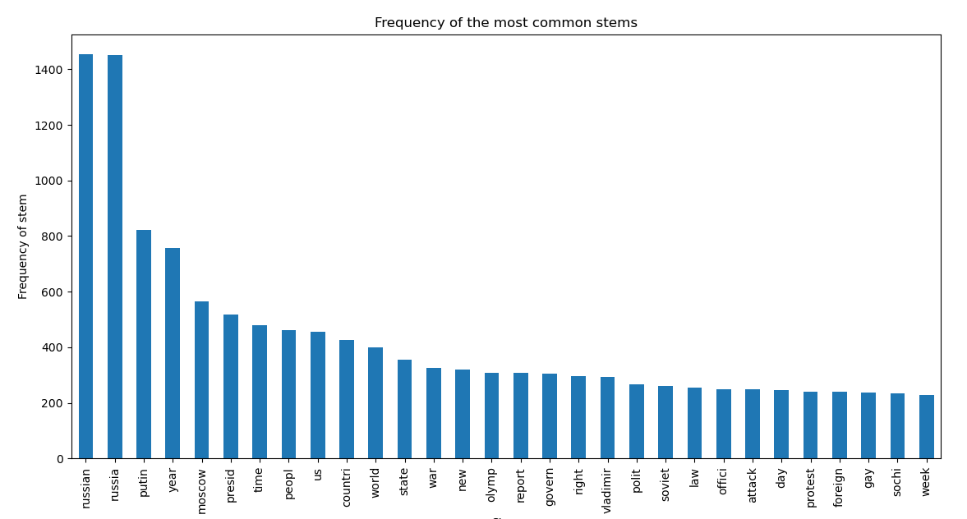
Frequency of the most common stems (Before Annexation)

Slide 11
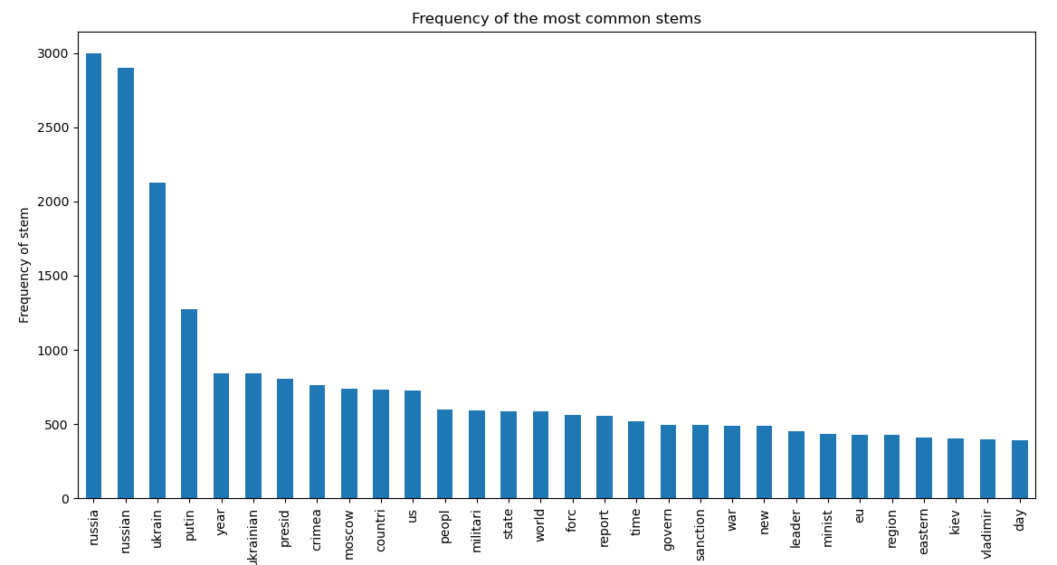
Frequency of the most common stems (After Annexation)

Slide 12
Comparison

Slide 13
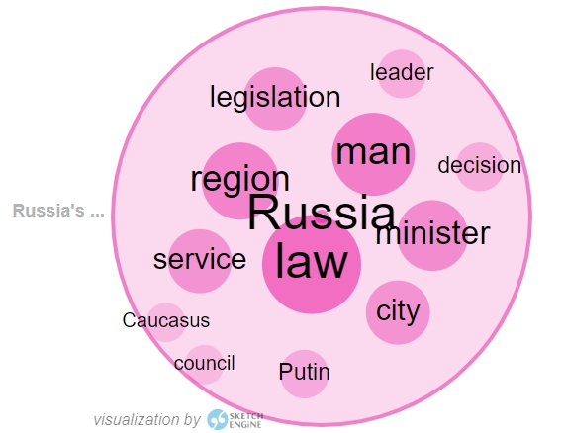
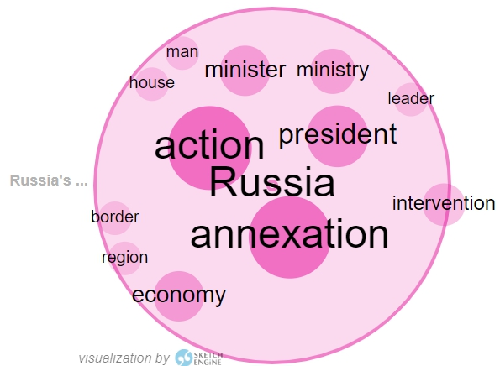
Word collocations (‘Russia’)
Notes:
The thesaurus is an automatically generated list of synonyms or words belonging to the same category (semantic field)

Slide 14
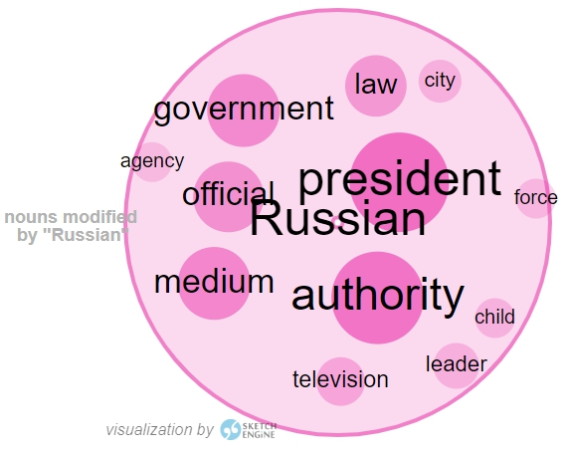
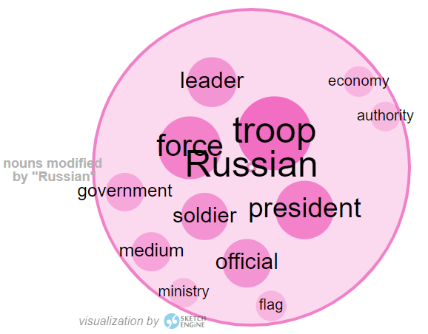
Word collocations (‘Russian’)
Notes:
The thesaurus is an automatically generated list of synonyms or words belonging to the same category (semantic field)

Slide 15
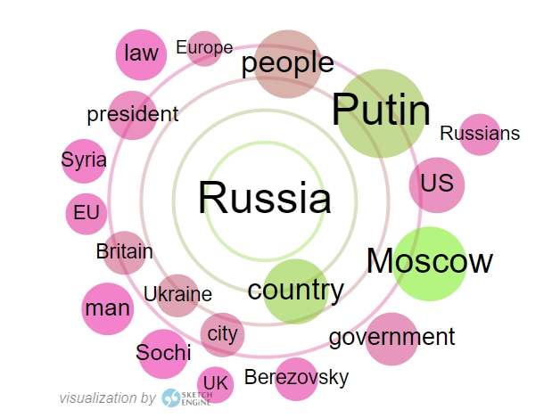
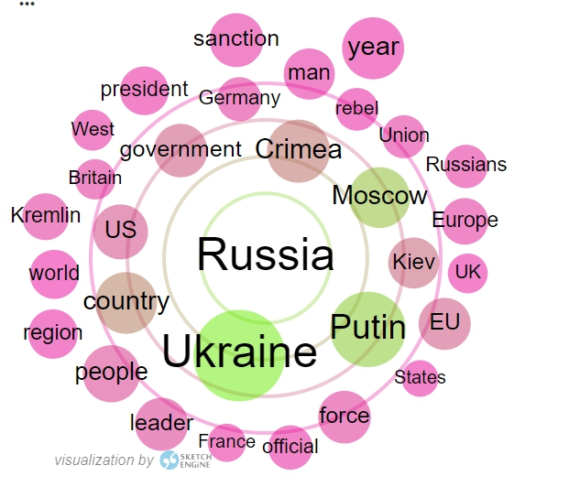
Distributional Thesaurus
an automatically generated list of synonyms or words belonging to the same category
Notes:
The thesaurus is an automatically generated list of synonyms or words belonging to the same category (semantic field)

Slide 16
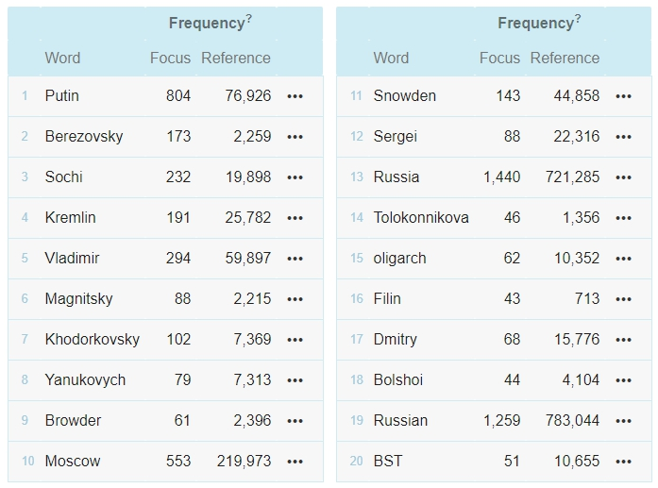
Keyword extraction (Before Annexation)
Reference corpus: English Web
single word units which are typical for a corpus/ext or which define its content or topic

Slide 17
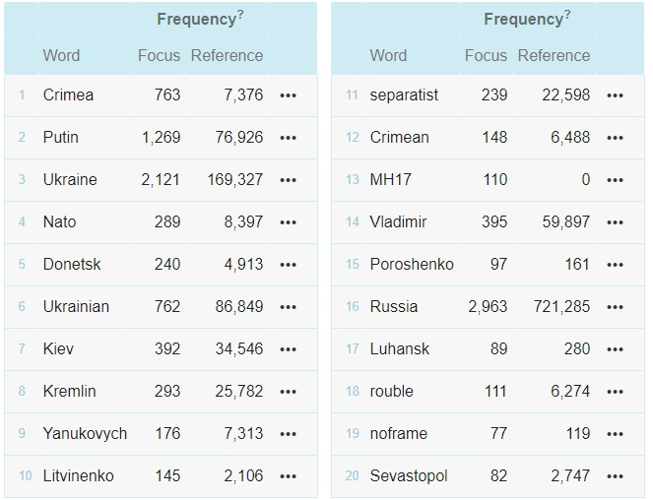
Keyword extraction (After Annexation)
Reference corpus: English Web
single word units which are typical for a corpus/ext or which define its content or topic

Slide 18
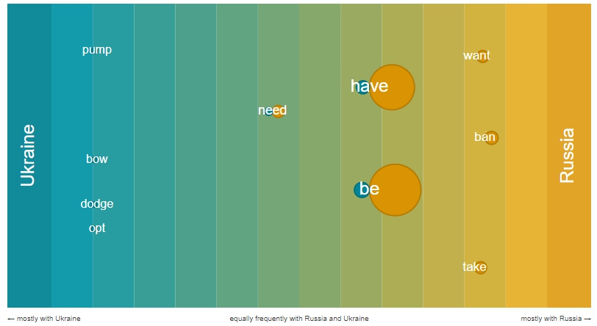
Collocations of two words (Before Annexation)
Verb collocations with ‘Russia/Ukraine’ as subject

Slide 19
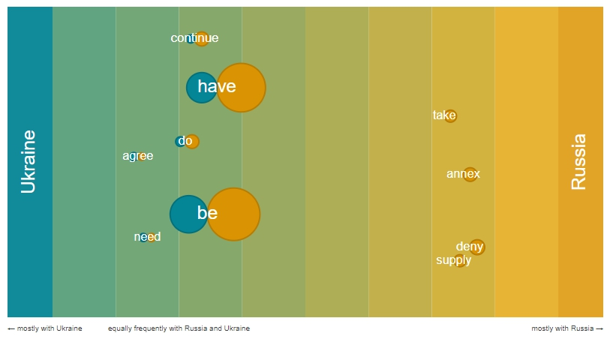
Collocations of two words (After Annexation)
Verb collocations with ‘Russia/Ukraine’ as subject

Slide 20
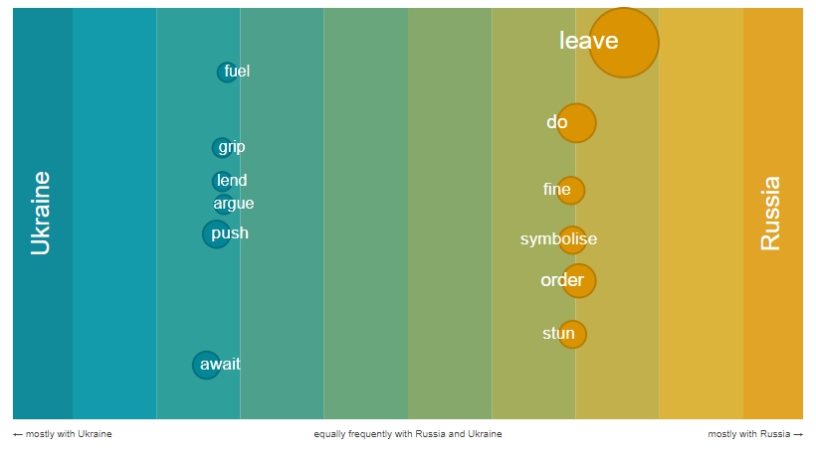
Collocations of two words (Before Annexation)
Verb collocations with ‘Russia/Ukraine’ as object

Slide 21
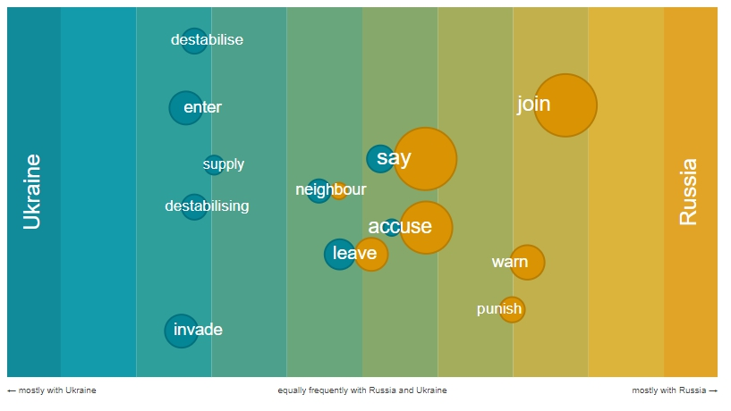
Collocations of two words (After Annexation)
Verb collocations with ‘Russia/Ukraine’ as object

Slide 22
Further research
Sentiment analysis of the corpus;
Extending the chosen period;
Extending corpus by including posts from blogs e.g. twitter

Slide 23
THANK YOU FOR YOUR ATTENTION

