Slide 1
Section 2
Introduction to Functional Programming in Python Part 1
Sep 2022 SDCloud3

Slide 2
Section 2 - References
About Python Functional Programming
https://realpython.com/python-functional-programming/#:~:text=In%20functional%20programming%2C%20a%20program,advantages%20over%20other%20programming%20paradigms.
Why Functional Programming Matters
http://www.md.chalmers.se/~rjmh/Papers/whyfp.pdf
Sep 2022 SDCloud3

Slide 3
What is a Functional Language?
Opinions differ, and it is difficult to give a precise definition, but generally speaking:
Functional programming is style of programming in which the primary method of computation is the application of functions to arguments;
A functional language is one that supports and encourages the functional style.
Sep 2022 SDCloud3

Slide 4
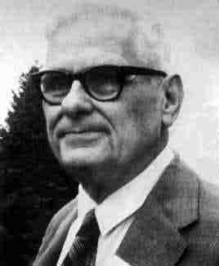
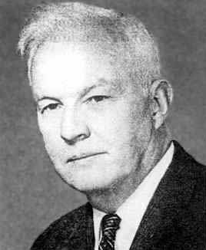
Historical Background
1920s - 1940s:
Alonzo Church and Haskell Curry develop the lambda calculus, a simple but powerful mathematical theory of functions.
Sep 2022 SDCloud3

Slide 5
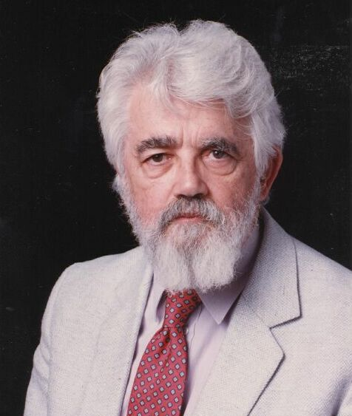
Historical Background
1960s:
John McCarthy develops Lisp, the first functional language. Some influences from the lambda calculus, but still retained variable assignments.
Sep 2022 SDCloud3

Slide 6
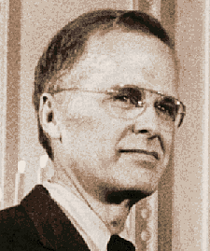
Historical Background
1978:
John Backus publishes award winning article on FP, a functional language that emphasizes higher-order functions and calculating with programs.
Sep 2022 SDCloud3

Slide 7

Historical Background
1999:
The definition of Haskell 98 published, providing a long-awaited stable version of the language.
Sep 2022 SDCloud3

Slide 8
Principles- Functional Programs
No Side effects
No variable assignment
A Function has no effect other than calculating its value
Sep 2022 SDCloud3

Slide 9
Key Features- Functional Programs
Higher Order Functions
Lazy Evaluation
Currying
Lambda Expressions
List Processing
Sep 2022 SDCloud3

Slide 10
Functional Programs
Program consists only of Functions
Main program is a function, receives input as parameters
May in turn be defined as other functions
Sep 2022 SDCloud3

Slide 11
Functional Programs
import sys
def fun1():
# total arguments
n = len(sys.argv)
print("Total arguments passed:", n)
v1= int(sys.argv[1])
v2= int(sys.argv[2])
result = sum(v1,v2)
print("\nSum of {0},{1} = {2}".format(v1,v2,result))
def sum(value1, value2):
return value1 + value2
fun1()
Sep 2022 SDCloud3

Slide 12
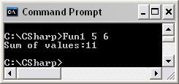
Sep 2022 SDCloud3

Slide 13
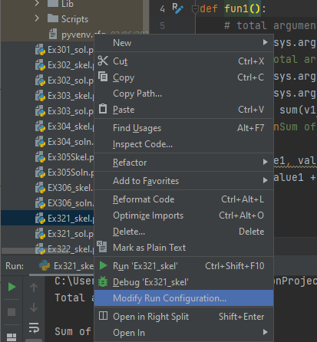
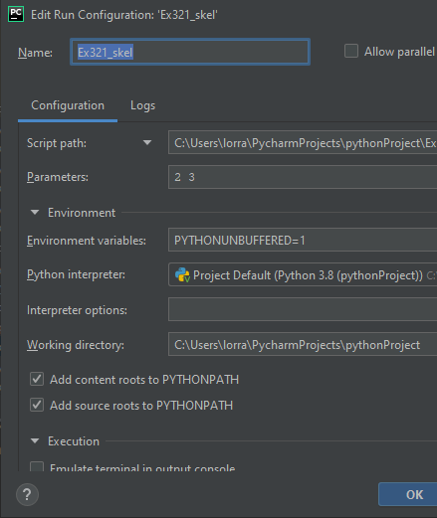
Initialize Command Line
Arguments in PyCharm
Sep 2022 SDCloud3

Slide 14
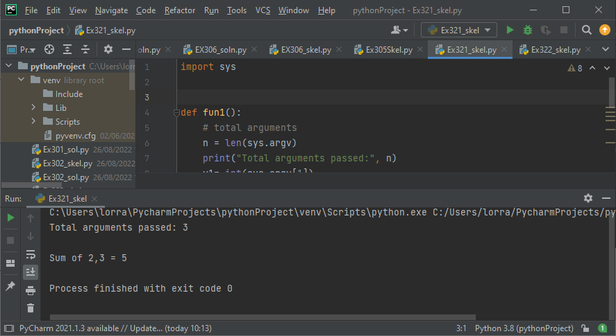
Running the Code
Sep 2022 SDCloud3

Slide 15
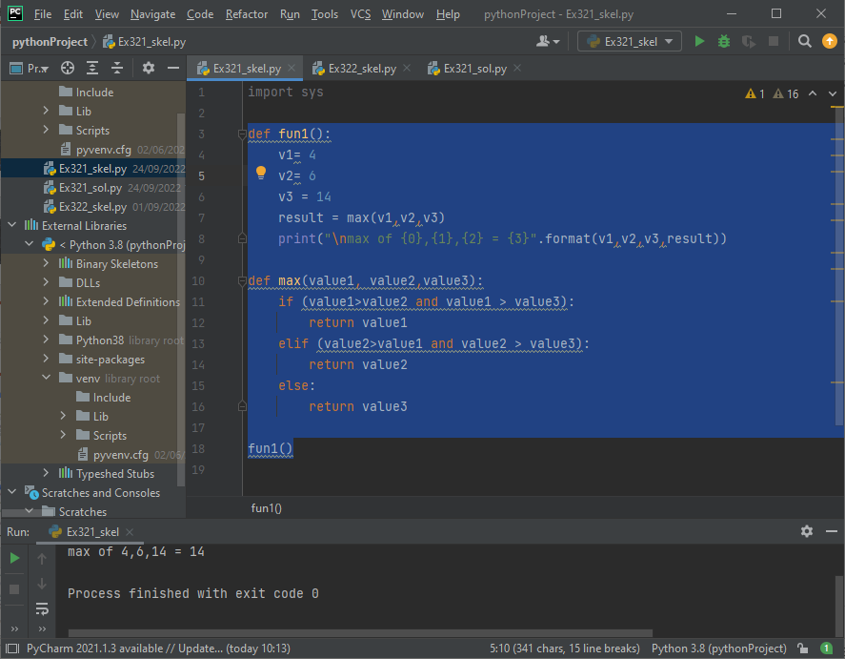
Ex321-
Modify so v1,v2,v3 are entered as
Command-line arguments
def fun1():
v1= 4
v2= 6
v3 = 14
result = max(v1,v2,v3)
print("\nmax of {0},{1},{2} = {3}".format(v1,v2,v3,result))
def max(value1, value2,value3):
if (value1>value2 and value1 > value3):
return value1
elif (value2>value1 and value2 > value3):
return value2
else:
return value3
fun1()
Sep 2022 SDCloud3

Slide 16
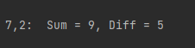
- No side effects
def fun1():
global result2
v1=int(sys.argv[1])
v2=int(sys.argv[2])
result1 = sum(v1,v2)
print("\n{0},{1}: Sum = {2}, Diff = {3}".
format(v1,v2,result1,result2))
def sum(value1, value2):
global result2
result2 = value1 - value2 // side effect
return value1 + value2
fun1()
Sep 2022 SDCloud3

Slide 17
Functional Programming -
Function result only depends on input parameters
Always returns same result for a given parameters
Order of function calls irrelevant:
f(x)=2*x + 1 => f(2)=5 always
Next: A counter example
Sep 2022 SDCloud3

Slide 18
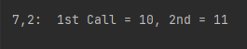
Sample call produces different results
Not Allowed in FP
def fun1():
global v3
v1=int(sys.argv[1])
v2=int(sys.argv[2])
v3=1
result1 = add(v1,v2) # 1st Call
v3=2
result2 = add(v1,v2) # 2nd Call
print("\n{0},{1}: 1st Call = {2}, 2nd = {3}“
.format(v1,v2,result1,result2))
def add(value1, value2):
global v3
return value1 + value2 + v3
fun1()
Sep 2022 SDCloud3

Slide 19
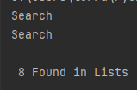
Lazy Exaluation
Postpose do operation until you are
sure you need to do it
def fun1():
target=int(sys.argv[1])
list1 = [2,5,8,11]
list2 = [1,5,9,11]
result1 = search(target, list1) # No Lazy Evaluation
result2 = search(target, list2)
if (result1 == True or result2 == True):
print("\n {0} Found in Lists".format(target))
else:
print("\n {0} Not Found in Lists".format(target))
def search (target, list):
print('Search')
if (target in list):
return True
else:
return False
fun1()
Sep 2022 SDCloud3

Slide 20
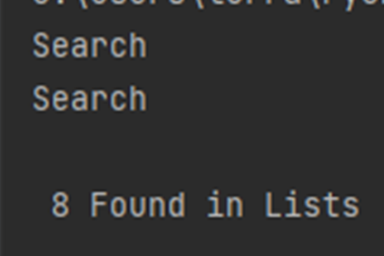
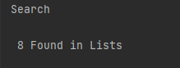
Lazy Exaluation
def fun1():
:
result1 = search(target, list1)
result2 = search(target, list2)
if (result1 == True or result2 == True):
:
====================================================
# No Lazy Evaluation
def fun1(): # Lazy Evaluation
:
if (search(target, list1) == True or search(target, list2) == True):
:
Sep 2022 SDCloud3

Slide 21
No Side-effects - Summary
No global variables
No variable assignment
Function just calculates a value based on input parameters
Next: Another counter example, variable assignment
Sep 2022 SDCloud3

Slide 22
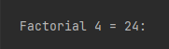
def fun1():
n=int(sys.argv[1])
result1 = factorial(n)
print("\n Factorial {0} = {1}:".format(n,result1))
def factorial(n):
res=1
for el in range(1,n+1):
res = res * el # variable reassignment
return res
fun1()
Sep 2022 SDCloud3

Slide 23
Recursion
Most Functional Programming Languages use recursion
  - avoids variable assignment
  - facilitates Lazy Evaluation
Sep 2022 SDCloud3

Slide 24
def fun1():
n=int(sys.argv[1])
result1 = factorial(n)
print("\n Factorial {0} = {1}:".format(n,result1))
def factorial(n):
if (n==0):
return 1
else:
return n * factorial (n-1)
fun1()
0! = 1
4! = 4 * 3!
n! = n * (n-1)!
Sep 2022 SDCloud3

Slide 25
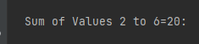
Ex322 Rewrite using Recursion
def fun1():
a = int(sys.argv[1])
b = int(sys.argv[2])
result1 = addInRange(a,b)
print("Sum of Values {0} to {1}={2}:".format(a,b,result1))
def addInRange(first, last):
result=0
for el in range(first, last+1):
result += el
return result # 2+3+4+5+6
addInRange(2,5) = 2 + addIntRange(3,5)
addInRange(3,2) = 0
Sep 2022 SDCloud3

Slide 26
Functional Programming
Two other key features
  - List Processing
  - Polymorphic Types
Sep 2022 SDCloud3

Slide 27
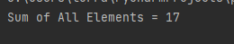
Recursion with Lists
def main():
list1 = [2, 5, 2, 8]
result = addList(list1)
print('Sum of All Elements = {0}'.format(result))
def addList(listp):
if len(listp)==0:
return 0
else:
# remove first
first=listp.pop(0)
return first + addList(listp)
main()
addList[]=0
addList[2,5,2,8]= 2 + addList[5,2,8]
May 19 2011

Slide 28
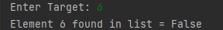
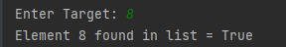
Search
def main():
list1 = [2, 5, 2, 8, 7, 3, 2, 5]
target = int(input('Enter Target: '))
result = searchTarget(list1, target)
print('{0} Found in List = {1} '.format(target, result))
def searchTarget(listp, tar):
if len(listp)==0:
return False
else:
first=listp.pop(0) # remove first
if (first==tar):
return True
else:
return searchTarget(listp,tar)
searchtTarget([],2) = False
searchTarget([2,5,6,1],2) = True
searchTarget([3,5,6,1],2) = searchTarget([5,6,1],2)
May 19 2011

Slide 29
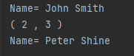
    class Point:
    def __init__(self, a, b):
    self.__x = a
    self.__y = b
    def myPrint(self):
    print('(',self.__x, ',’,
    self.__y, ')’)
    ----------------------------------------
    class Name:
    def __init__(self, f, s):
    self.__first=f
    self.__surname=s
    def myPrint(self):
    print('Name=',self.__first,
    self.__surname)
List and Polymorphic Types
    def fun1():
    list = [Name('John','Smith’),
    Point(2,3),
    Name('Peter','Shine')]
    printList(list)
    def printList(list):
    for el in list:
    el.myPrint()
Sep 2022 SDCloud3

Slide 30
Recursion Using Dictionaries
import sys
class Student:
def __init__(self, n,m):
self.__name = n
self.__mark = m
def myPrint(self):
print('Student=',self.__name, self.__mark)
def readName(self):
return self.__name
def readMark(self):
return self.__mark
Sep 2022 SDCloud3

Slide 31
def fun1():
s1=Student('Jones', 47)
s2=Student('Shine', 66)
s3=Student('White', 55)
s4=Student('Smith',34)
s5 = Student('Peters', 44)
list = {1:s1, c 2:s2, 3:s3, 4:s4, 5:s5}
target = input('Enter Name:')
result = checkMark(list,target) # return 0 if not in list
if (result==0):
print('{0} not in the list'.format(target))
else:
print('{0} Mark = {1}'.format(target, result))
Sep 2022 SDCloud3

Slide 32
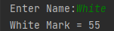
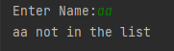
def checkMark(list , target):
if (len(list)==0):
return 0
else:
student = list.popitem()[1]
if (student.readName()==target):
return student.readMark()
else:
return checkMark(list,target)
fun1()
Sep 2022 SDCloud3

Slide 33
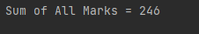
def fun1():
s1=Student('Jones', 47)
s2=Student('Shine', 66)
s3=Student('White', 55)
s4=Student('Smith',34)
s5 = Student('Peters', 44)
list = {1:s1, 2:s2,3:s3, 4:s4, 5:s5}
result = sumAllMarks(list) # return 0 if not in list
print('Sum of All Marks = {0}'.format(result))
Ex323
Complete the Recursive Method ‘sumAllMarks’ to add all
Student marks
Sep 2022 SDCloud3

Slide 34
Functional Programming -other key features
Higher Order Functions
Lazy Evaluation
Currying
Lambda expressions (Nameless functions)
Python Achieves this using lambda (nameless) functions
Sep 2022 SDCloud3

Slide 35
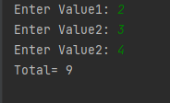
Lambda Functions
def main():
val1 = int(input('Enter Value1: '))
val2 = int(input('Enter Value2: '))
val3 = int(input('Enter Value2: '))
total = x(val1, val2,val3)
print('Total=', total)
x = lambda a, b, c : a + b + c
main()
Nameless Functions
May 19 2011

Slide 36
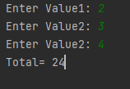
Higher Order Functions
def main():
val1 = int(input('Enter Value1: '))
val2 = int(input('Enter Value2: '))
val3 = int(input('Enter Value2: '))
total = calculate(x,val1, val2,val3)
print('Total=', total)
x = lambda a, b, c : a * b * c
def calculate(f,a,b, c):
return f(a,b,c)
main()
May 19 2011

Slide 37
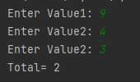
Normal Use of Lambda Functions
def main():
val1 = int(input('Enter Value1: '))
val2 = int(input('Enter Value2: '))
val3 = int(input('Enter Value2: '))
total = calculate( (lambda a, b, c : a - b - c) ,val1, val2,val3)
print('Total=', total)
def calculate(f,a,b, c):
return f(a,b,c)
main()
May 19 2011

Slide 38
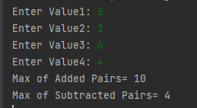
Ex324 Complete the follow application
def main():
val1 = int(input('Enter Value1: '))
val2 = int(input('Enter Value2: '))
val3 = int(input('Enter Value3: '))
val4 = int(input('Enter Value4: '))
result1 = hMax( pAdd ,val1, val2,val3,val4)
print('Max of Added Pairs=', result1)
result2 = hMax( pSub ,val1, val2,val3,val4)
print('Max of Subtracted Pairs=', result2)
pAdd = lambda a, b : a + b
def hMax(f,a,b, c, d):
hMax(pAdd,5,1,6,4)
hMax (6, 10) = 10
hMax(pSub,5,1,6,4)
hMax (4, 2) = 4
May 19 2011

Slide 39
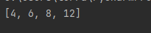
Built in Lambda fns in Python
# Program to filter out only the even items from a list
my_list = [1, 5, 4, 6, 8, 11, 3, 12]
new_list = list( filter(lambda x: (x%2 == 0) , my_list) )
print(new_list)
Sep 2022 SDCloud3

Slide 40
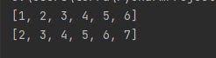
Built in Lambda fns in Python
# Program to add 1 to each element of list
my_list = [1, 2,3,4,5,6]
new_list = list(map(lambda x: (x+1) , my_list))
print(my_list)
print(new_list)
Sep 2022 SDCloud3

Slide 41
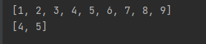
Currying of Functions
# After stepping values by 3, list those < 6
my_list = [1,2,3,4,5,6,7,8,9]
new_list = list( filter(lambda x:(x<6),
list(map(lambda x: (x+3) , my_list))))
print(my_list)
print(new_list)
Sep 2022 SDCloud3

Slide 42
Currying of Functions
# After stepping values by 3, list those < 6
my_list = [1,2,3,4,5,6,7,8,9]
new_list = list( filter(lambda x:(x<6),
list(map(lambda x: (x+3) , my_list))))
print(my_list)
print(new_list)
Output from this map is a list
This becomes an input to filter
Sep 2022 SDCloud3

