Slide 1
Section 3
Introduction to Functional Programming in Python Part 2
Sep 2022 SDCloud3

Slide 2
Functional Programming -other key features
Higher Order Functions
Lazy Evaluation
Currying
Lambda expressions (Nameless functions)
Python Achieves this using lambda (nameless) functions
Sep 2022 SDCloud3

Slide 3
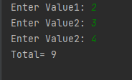
Lambda Functions
def main():
val1 = int(input('Enter Value1: '))
val2 = int(input('Enter Value2: '))
val3 = int(input('Enter Value2: '))
total = x(val1, val2,val3)
print('Total=', total)
x = lambda a, b, c : a + b + c
main()
Nameless Functions
May 19 2011

Slide 4
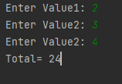
Higher Order Functions
def main():
val1 = int(input('Enter Value1: '))
val2 = int(input('Enter Value2: '))
val3 = int(input('Enter Value2: '))
total = calculate(x,val1, val2,val3)
print('Total=', total)
x = lambda a, b, c : a * b * c
def calculate(f,a,b, c):
return f(a,b,c)
main()
May 19 2011

Slide 5
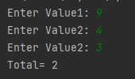
Normal Use of Lambda Functions
def main():
val1 = int(input('Enter Value1: '))
val2 = int(input('Enter Value2: '))
val3 = int(input('Enter Value2: '))
total = calculate( (lambda a, b, c : a - b - c) ,val1, val2,val3)
print('Total=', total)
def calculate(f,a,b, c):
return f(a,b,c)
main()
May 19 2011

Slide 6
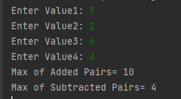
Last Ex Complete the follow application
def main():
val1 = int(input('Enter Value1: '))
val2 = int(input('Enter Value2: '))
val3 = int(input('Enter Value3: '))
val4 = int(input('Enter Value4: '))
result1 = hMax( pAdd ,val1, val2,val3,val4)
print('Max of Added Pairs=', result1)
result2 = hMax( pSub ,val1, val2,val3,val4)
print('Max of Subtracted Pairs=', result2)
pAdd = lambda a, b : a + b
def hMax(f,a,b, c, d):
hMax(pAdd,5,1,6,4)
hMax (6, 10) = 10
hMax(pSub,5,1,6,4)
hMax (4, 2) = 2
May 19 2011

Slide 7
Last Ex Complete the follow application
pSub = lambda a, b : a - b
def hMax(f,a,b, c, d):
val1= f(a,b)
val2= f(c,d)
if (val1>val2):
return val1
else:
return val2
hMax(pAdd,5,1,6,4)
hMax (6, 10) = 10
hMax(pSub,5,1,6,4)
hMax (4, 2) = 2
May 19 2011

Slide 8
HOF & List Processing
# Define 2 lambda Functions x-> x+1 & x –> x * 2
# Define HOF
hCountEven (x->x+1) [ 5,1,6,4,3] => 3
hCountEven (x->x*2) [ 5,11,6,4,3] => 5
Sep 2022 SDCloud3

Slide 9
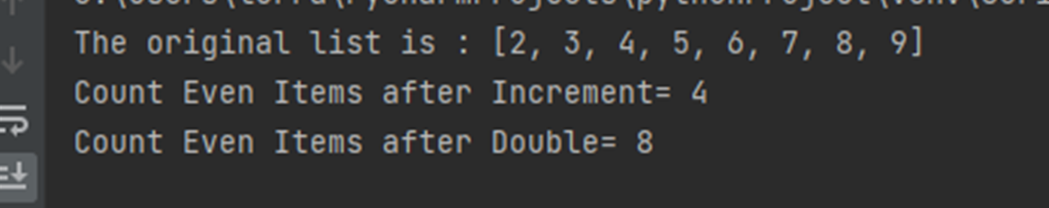
HOF & List Processing
hCountEven incr [2, 5, 4] = hCountEven [3,6,2]= 1
hCountEven incr [7, 5, 4] = hCountEven [8,6,2]= 2
====================================
hCountEven incr [] = 0
hCountEven incr [2, 5, 4] = 0 +hCountEven incr [5,4]
hCountEven incr [7, 5, 4] = 1 +hCountEven incr [5,4]
------------------------------------------------
Sep 2022 SDCloud3

Slide 10
Solution
def main():
list1 = [2,3,4,5,6,7,8,9]
print("The original list is : " + str(list1))
result1 = hCountEven( pIncr ,list1.copy())
print('Count Even Items after Increment=', result1)
result2 = hCountEven( pDouble ,list1)
print('Count Even Items after Double=', result2)
pIncr = lambda a: a + 1
pDouble = lambda a: a * 2
------------------------------------------------
Sep 2022 SDCloud3

Slide 11
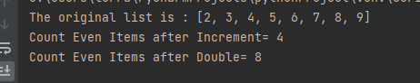
Solution
def hCountEven(f, list):
if len(list)==0:
return 0
else:
first=list.pop(0);
if (f (first) %2 ==0):
return 1 + hCountEven(f, list)
else:
return 0 + hCountEven(f, list)
------------------------------------------------
Sep 2022 SDCloud3

Slide 12
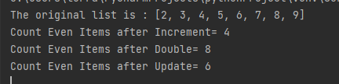
HOF & List Processing
pUpdate = lambda a: (a*2 if a <= 5 else a+1)
#ternary operator
list1 = [2,3,4,5,6,7,8,9]
:
result3 = hCountEven( pUpdate ,list1)
print('Count Even Items after Update=', result3)
hCountEven( [4,6,8,10,7,8,9,10 ] ) = 6
Sep 2022 SDCloud3

Slide 13
Lambda- Multiple Lines
pUpdate = lambda a: (a*2 if a <= 5 else a+1)
pUpdate = lambda a: (
a*2 if a <= 5
else a+1)
Sep 2022 SDCloud3

Slide 14
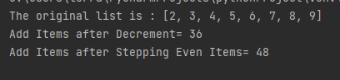
Ex331
hAdd decr [2, 5, 4] = 1+4+3=8
hAdd decr [] = 0
hAdd decr [2, 5, 4] = 1 +hAdd decr [5,4]
------------------------------------------------
Sep 2022 SDCloud3

Slide 15
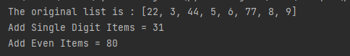
Ex332
hAdd isEven [2, 5, 4] = 2+4=6
hAdd isEven [] = 0
hAdd isEven [2, 5, 4] = 2 +hAdd isEven [5,4]
hAdd isEven [3, 5, 4] = 0 +hAdd isEven [5,4]
------------------------------------------------
Sep 2022 SDCloud3

Slide 16
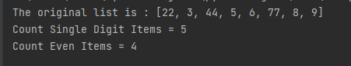
Ex333
hCount isEven [2, 5, 4] = 1
hCount isEven [] = 0
hCount isEven [2, 5, 4] = 1 +hCount isEven [5,4]
hCount isEven [3, 5, 4] = 0 +hCount isEven [5,4]
------------------------------------------------
Sep 2022 SDCloud3

Slide 17
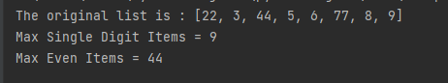
Ex334
hHmax isEven [2, 5, 4,3] = 4
hMax isEven [] = 0
hMax isEven [6, 5, 4,3] = 6
hMax isEven [7, 5, 4,3] = hMax isEven [5,4,3]
hMax isEven [2, 5, 4,3] = hMax isEven [5,4,3]
------------------------------------------------
Sep 2022 SDCloud3

Slide 18
Lambda Functions List Processing
pAdd = lambda list: (0 if len(list)== 0 else
list.pop(0) + pAdd(list) )
pCount = lambda list: (0 if len(list)== 0 else
1 + pCount(list[1:]))
pMax = lambda list: (0 if len(list)== 0 else
list[0] if list[0] > pMax(list.copy()[1:])
else pMax(list[1:]) )
Sep 2022 SDCloud3

Slide 19
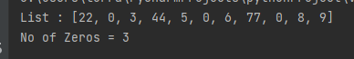
Recursive CountZeros
def main():
list1 = [22,0,3,44,5,0,6,77,0,8,9]
print("The original list is : " + str(list1))
result4=pCountZeros(list1.copy())
print('No of Zeros =', result4)
def pCountZeros(list):
if len(list)==0:
return 0
else:
first = list.pop(0)
if first==0:
return 1 + pCountZeros(list)
else:
return 0 + pCountZeros(list)
cZero[] = 0
cZero[0,2,3] = 1 + cZero[2,3]
cZero[6,2,3] = 0 + cZero[2,3]
Sep 2022 SDCloud3

Slide 20
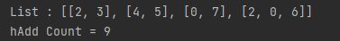
HOF List of Lists
def main(
list1 = [ [2,3], [4,5], [0,7], [2,0,6]]
print("List : " + str(list1))
result4=hAdd(pCount, list1.copy())
print('hAdd Count =', result4)
def hAdd(f, list):
if len(list) == 0:
return 0
else:
first = list.pop(0)
return f(first) + hAdd(f, list)
pAdd = lambda list: (0 if len(list)== 0 else list.pop(0) + pAdd(list))
pCount = lambda list: (0 if len(list)== 0 else 1 + pCount(list[1:]))
hAdd Count [[2,3],[4,5],[0,7],[2,0,6]]
hAdd [ 2 2 2 3 ]
9
Sep 2022 SDCloud3

Slide 21
HOF List of Lists
def hAdd(f, list):
if len(list) == 0:
return 0
else:
first = list.pop(0)
return f(first) + hAdd(f, list)
hAdd count [[2,3],[4,5],[0,7],[2,0,6]]
count([2,3]) + hAdd( count, [[4,5],[0,7],[2,0,6]])
2 + hAdd( count, [[4,5],[0,7],[2,0,6]])
2 + hAdd( count, [[0,7],[2,0,6]])
2 + hAdd( count, [[2,0,6]])
3 + hAdd(count, [])
0
Sep 2022 SDCloud3

Slide 22
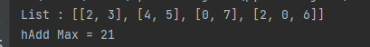
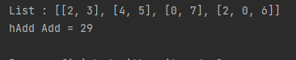
HOF List of Lists
result4=hAdd(pMax, list1.copy())
print('hAdd Max =', result4)
result4=hAdd(pAdd, list1.copy())
print('hAdd Add =', result4)
hAdd pMax [[2,3],[4,5],[0,7],[2,0,6]]
3 + 5 + 7 + 6 = 21
hAdd pAdd [[2,3],[4,5],[0,7],[2,0,6]]
5 + 9 + 7 + 8 = 29
Sep 2022 SDCloud3

Slide 23
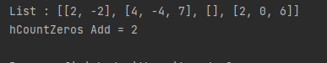
Ex335
def main():
list1 = [ [2,-2], [4,-4,7], [], [2,0,6]]
print("List : " + str(list1))
result4=hCountZeros(pAdd, list1.copy())
print('hCountZeros Add =', result4)
def hCountZeros(f, list):
hCountZeros pAdd [[2,-2],[4,-4,7],[],[2,0,6]]
[ 0 , 7 ,0 , 8 = 2
Sep 2022 SDCloud3

Slide 24
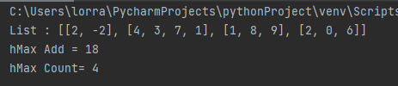
Ex336
def main():
list1 = [ [2,-2], [4,3,7,1], [1,8,9], [2,0,6]]
print("List : " + str(list1))
result4=hMax(pAdd, list1.copy())
print('hMax Add =', result4)
result5=hMax(pCount, list1.copy())
print('hMax Count=', result5)
def hMax(f, list):
Note: always use list.copy() , first.copy()
Sep 2022 SDCloud3

Slide 25
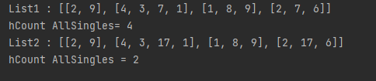
Ex337
def main():
list1 = [ [2,9], [4,3,7,1], [1,8,9], [2,7,6]]
print("List1 : " + str(list1))
result4=hCount(pAllSingleDigits, list1.copy())
print('hCount =', result4)
list2 = [ [2,9], [4,3,17,1], [1,8,9], [2,17,6]]
print("List2 : " + str(list2))
result5=hCount(pAllSingleDigits, list2.copy())
print('hMax Add =', result5)
def hCount(f, list):
pAllSingleDigits[2,23,5] = False
pAllSingleDigits[2,3,6] = True
Sep 2022 SDCloud3

Slide 26
Ex337
def main():
list1 = [ [2,9], [4,3,7,1], [1,8,9], [2,7,6]]
print("List1 : " + str(list1))
result4=hCount(pAllSingleDigits, list1.copy())
print('hCount =', result4)
list2 = [ [2,9], [4,3,17,1], [1,8,9], [2,17,6]]
print("List2 : " + str(list2))
result5=hCount(pAllSingleDigits, list2.copy())
print('hMax Add =', result5)
def hCount(f, list):
pAllSingleDigits[2,23,5] = False
pAllSingleDigits[2,3,6] = True
Sep 2022 SDCloud3

Slide 27
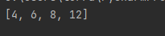
Built in Lambda fns in Python
# Program to filter out only the even items from a list
my_list = [1, 5, 4, 6, 8, 11, 3, 12]
new_list = list( filter(lambda x: (x%2 == 0) , my_list) )
print(new_list)
Sep 2022 SDCloud3

Slide 28
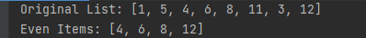
Write MyFilter
def main():
my_list = [1, 5, 4, 6, 8, 11, 3, 12]
print('Original List:', my_list)
new_list1 = list(hMyFilter2(lambda x: (x % 2 == 0), my_list))
print('Even Items:',new_list1)
def hMyFilter2(f, list):
for el in list:
if f(el)==True:
yield(el) # Generator
Sep 2022 SDCloud3

Slide 29
Recursive MyFilter
def hMyFilter(f, list):
if len(list) == 0:
None
else:
first = list.pop(0)
if f(first) ==True:
yield first
yield from hMyFilter(f,list)
else:
yield from hMyFilter(f,list)
Sep 2022 SDCloud3

Slide 30
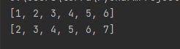
Built in map fns in Python
# Program to add 1 to each element of list
my_list = [1, 2,3,4,5,6]
new_list = list(map(lambda x: (x+1) , my_list))
print(my_list)
print(new_list)
Sep 2022 SDCloud3

Slide 31
Ex338 Write own myHmap function
# Program to add 1 to each element of list
my_list = [1, 2,3,4,5,6]
new_list = list(myHmap(lambda x: (x+1) , my_list))
print(my_list)
print(new_list)
Sep 2022 SDCloud3

Slide 32
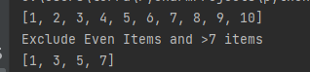
Ex339 Write myExclude
def main():
my_list = [1, 2, 3, 4, 5, 6,7,8,9,10]
new_list = list(hmyExclude (lambda x: x%2==0,
lambda x:x>7, my_list.copy()))
print(my_list)
print('Exclude Even Items and >7 items')
print(new_list)
def hmyExclude (f1,f2, list): # if not (cond1 or cond2)
Sep 2022 SDCloud3

Slide 33
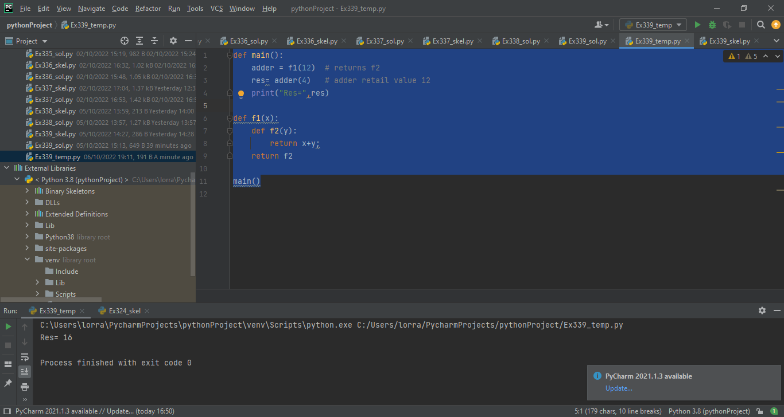
Closure: related to HOF
def main():
adder = f1(12) # returns f2
res= adder(4) # adder retails value 12
print("Res=",res)
def f1(x):
def f2(y):
return x+y;
return f2
main()
Sep 2022 SDCloud3

Slide 34
Closure: related to HOF
def f1(x):
def f2(y): #1
return x+y; #2
return f2 #3
Closure Properties (must Have)
Nested Functions
Nested function refers to value in enclosed scope
Outer Function returns inner function
Sep 2022 SDCloud3

Slide 35
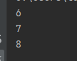
Closure
def main():
plus_1 = f1(1)
plus_2 = f1(2)
plus_3 = f1(3)
print(plus_1(5))
print(plus_2(5))
print(plus_3(5))
def f1(x):
def f2(y):
return x+y;
return f2
main()
Sep 2022 SDCloud3

Slide 36
Use of Closures
Replace Classes that have few (usually 1) method
Reduce need for Global (shared) variables
Provide basis for Decorators
Sep 2022 SDCloud3

Slide 37
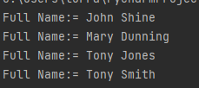
Exercise 310
Complete the Closure my_print
To give the following result
def main():
studentJohn = my_print('John')
studentMary = my_print('Mary')
studentPeter= my_print('Tony')
studentJohn('Shine')
studentMary('Dunning')
studentPeter('Jones')
studentPeter('Smith')
def my_print(first):
main()
Sep 2022 SDCloud3

Slide 38
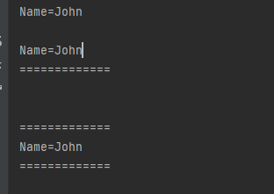
Decorators
def main():
printName("John")
print()
underline_decorator(printName) ("John")
def underline_decorator(func):
def closure(n):
func(n)
print("=============")
return closure
def printName(name):
print("Name="+name)
Sep 2022 SDCloud3

Slide 39
Exercise 311
def main():
printName("John")
print()
underline_decorator(printName)("John")
print('\n')
overline_decorator(underline_decorator(printName))("John")
Add an overline_decorator to
Give the following results
Sep 2022 SDCloud3

