Slide 1
Section 7
Python Decorators
Sep 2022 SDCloud3
1

Slide 2
Review of Closures
Nested Function that return a Function
Sep 2022 SDCloud3

Slide 3
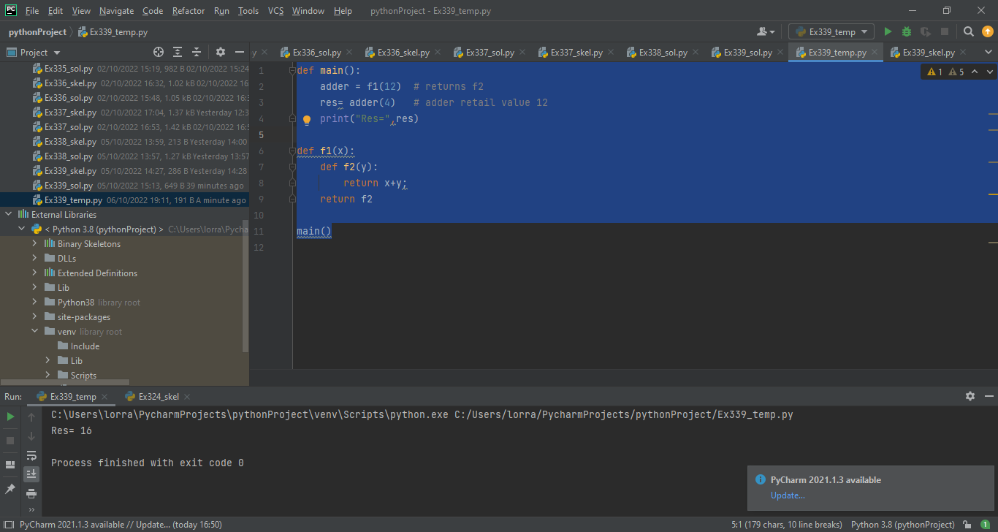
Closure: related to HOF
def main():
adder = f1(12) # returns f2
res= adder(4) # adder retails value 12
print("Res=",res)
def f1(x):
def f2(y):
return x+y;
return f2
main()
Sep 2022 SDCloud3

Slide 4
Closure: related to HOF
def f1(x):
def f2(y): #1
return x+y; #2
return f2 #3
Closure Properties (must Have)
Nested Functions
Nested function refers to value in enclosed scope
Outer Function returns inner function
Sep 2022 SDCloud3

Slide 5
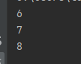
Closure
def main():
plus_1 = f1(1)
plus_2 = f1(2)
plus_3 = f1(3)
print(plus_1(5))
print(plus_2(5))
print(plus_3(5))
def f1(x):
def f2(y):
return x+y;
return f2
main()
Sep 2022 SDCloud3

Slide 6
Use of Closures
Replace Classes that have few (usually 1) method
Reduce need for Global (shared) variables
Provide basis for Decorators
Sep 2022 SDCloud3

Slide 7
Replace Closure with
Class Definition
def main():
plus_1 = F(1)
plus_2 = F(2)
plus_3 = F(3)
print(plus_1.add(5))
print(plus_2.add(5))
print(plus_3.add(5))
class F:
def __init__(self,xPar):
self.x = xPar
def add(self, y):
return self.x+y
main()
main()
Sep 2022 SDCloud3

Slide 8
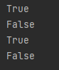
Ex 371
Complete Closure
my_checkEqual to give
the following result
def main():
checkEqualZero = my_checkEqual(0)
checkEqualOne = my_checkEqual(1)
checkEqualTen = my_checkEqual(10)
res=checkEqualZero(0)
print(res)
res=checkEqualZero(5)
print(res)
res=checkEqualOne(1)
print(res)
res=checkEqualTen(5)
print(res)
def my_checkEqual(value1):
main()
Sep 2022 SDCloud3

Slide 9
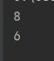
def main():
plus_2_incr = outer(increment,2)
plus_2_decr = outer(decrement,2)
print(plus_2_incr(5))
print(plus_2_decr(5))
def decrement(x):
return x-1
def increment( x):
return x+1
def outer(f, x):
def inner(y):
return f(x+y)
return inner
Can Pass Functions to
Closures also
Sep 2022 SDCloud3

Slide 10
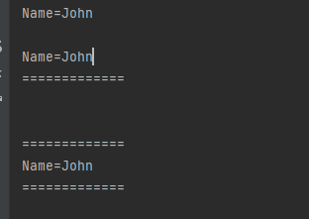
Decorators
def main():
printName("John")
print()
underline_decorator(printName) ("John")
def underline_decorator(func):
def closure(n):
func(n)
print("=============")
return closure
def printName(name):
print("Name="+name)
Sep 2022 SDCloud3

Slide 11
Previous Exercise 311
def main():
printName("John")
print()
underline_decorator(printName)("John")
print('\n')
overline_decorator(underline_decorator(printName))("John")
Add an overline_decorator to
Give the following results
Sep 2022 SDCloud3

Slide 12
Solution 311
def main():
printName("John")
print()
underline_decorator(printName)("John")
print('\n')
overline_decorator(underline_decorator(printName))("John")
def overline_decorator(func):
def closure(n):
print("=============")
func(n)
return closure
Sep 2022 SDCloud3

Slide 13
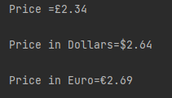
Ex372
def main():
print('Price =£', end='')
printPrice(2.34)
print('\nPrice in Dollars=', end='')
dollar_decorator(printPrice)(round(2.34*1.13,2))
print('\nPrice in Euro=', end='')
euro_decorator(printPrice)(round(2.34*1.15,2))
def dollar_decorator(func):
# Complete
def euro_decorator(func):
# Complete
def printPrice(price):
print(price)
Complete the 2 Closures inner functions
Sep 2022 SDCloud3

Slide 14
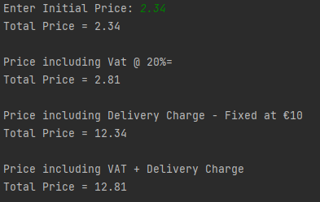
Ex373
def main():
price = float(input('Enter Initial Price: '))
printTotalPrice(price)
print('\nPrice including Vat @ 20%=')
vat_decorator(printTotalPrice)(price)
print('\nPrice including Delivery Charge - Fixed at €10')
delivery_decorator(printTotalPrice)(price)
print('\nPrice including VAT + Delivery Charge')
vat_decorator(delivery_decorator(printTotalPrice))(price)
def vat_decorator(func):
def delivery_decorator(func):
def printTotalPrice(price):
print('Total Price =', round(price,2))
Complete the 2 Closures inner functions
Sep 2022 SDCloud3

Slide 15
Shortcut for using Decorators
Nested Function that return a Function
Sep 2022 SDCloud3

Slide 16
Revisit PreviousDecorators
def main():
printName("John")
print()
underline_decorator(printName) ("John")
def underline_decorator(func):
def closure(n):
func(n)
print("=============")
return closure
def printName(name):
print("Name="+name)
Sep 2022 SDCloud3

Slide 17
Revisit
def main():
printName("John")
print()
underline_decorator(printName)("John")
print('\n')
overline_decorator(underline_decorator(printName))("John")
def overline_decorator(func):
def closure(n):
print("=============")
func(n)
return closure
Sep 2022 SDCloud3

Slide 18
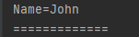
@underline_decorator
def main():
print()
printName("John")
def underline_decorator(func):
def closure(n):
func(n)
print("=============")
return closure
@underline_decorator
def printName(name):
print("Name="+name)
Sep 2022 SDCloud3

Slide 19
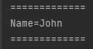
@overline_decorator
def main():
print()
printName("John")
def overline_decorator(func):
def closure(n):
print("=============")
func(n)
return closure
@underline_decorator
@overline_decorator
def printName(name):
print("Name="+name)
Sep 2022 SDCloud3

Slide 20
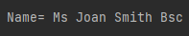
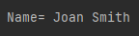
Ex374
def main():
print('\nName= ', end='')
printName("Joan Smith")
print()
def titleMr_decorator(func):
def closure(n):
print('Mr ', end='')
func(n)
return closure
def printName(name):
print(name, end='')
Complete the 2 Closures titleMs_decorator,qualBSc_decorator
+ use shortcut to Decorate printName
To achieve this new output:
Sep 2022 SDCloud3

Slide 21
Decorators That
Take Arguments
def main():
value1=int(input('Enter Value1: '))
print("double_dec increment value1 = ", increment(value1))
print()
value2 = int(input('Enter Value2: '))
print("treble_dec add = ", add(value1,value2))
def double_decorator(func):
def closure(*args): # Variable No arguments
res=func(*args)
return res*2
return closure
Sep 2022 SDCloud3

Slide 22
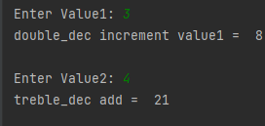
Decorators That
Take Arguments
def treble_decorator(func):
def closure(*args):
res=func(*args)
return res*3
return closure
@double_decorator
def increment(x):
return x + 1
@treble_decorator
def add(x,y):
return x+y
Sep 2022 SDCloud3

Slide 23
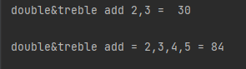
Decorating
Variable Args Method
def main():
print("double&treble add 2,3 = ", add2(2,3))
print()
print("double&treble add = 2,3,4,5 =", add2(2,3,4,5))
def double_decorator(func):
def closure(*args):
res=func(*args)
return res*2
return closure
@double_decorator
@double_decorator
def add2(*args):
res=0
for el in args:
res +=el
return res
Sep 2022 SDCloud3

Slide 24
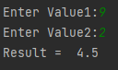
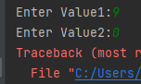
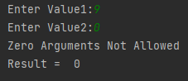
Ex375
def main():
value1= int(input('Enter Value1:'))
value2 = int(input('Enter Value2:'))
res = divide(value1, value2)
print('Result = ',res)
def no_zero_decorator(func):
def closure(v1,v2):
None
return closure
def divide(x,y):
return x/y
N.B. This ex involves a fixed 2 args.
Complete the Closure that receives a 2 arg function & checks that neither Parameter is zero + use shortcut to Decorate divide(x,y):
Required Decorated Output
Sep 2022 SDCloud3

Slide 25
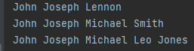
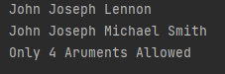
Ex376
Complete & Use
Decorator
def main():
printNames("John", "Joseph", "Lennon")
print()
printNames("John", "Joseph","Michael", "Smith")
print()
printNames("John", "Joseph","Michael","Leo", "Jones")
def max_four_args_decorator(func):
#complete
#@max_four_args_decorator
def printNames(*args):
for el in args:
print(el,end=' ')
Sep 2022 SDCloud3

Slide 26
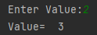
Decorators Used with Arguments
def main():
value=int(input('Enter Value:' ))
value= stepValue(value)
print('Value= ',value)
def stepValue(value):
return value + 1
Sep 2022 SDCloud3

Slide 27
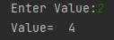
Decorators Used with Arguments
def main():
value=int(input('Enter Value:' ))
value= stepValue(value)
print('Value= ',value)
def repeat_return_decorator(func):
def closure(value):
res= func(value)
return func(res)
return closure
@repeat_return_decorator
def stepValue(value):
return value + 1
Sep 2022 SDCloud3

Slide 28
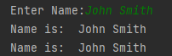
Decorators Used with Arguments
def main():
value=input('Enter Name:' )
printName(value)
def repeat_void_decorator(func):
def closure(value):
func(value)
func(value)
return closure
@repeat_void_decorator
def printName(value):
print("Name is: ", value)
Sep 2022 SDCloud3

Slide 29
Recall
@underline_decorator
def main():
print()
printName("John")
def underline_decorator(func):
def closure(n):
func(n)
print("=============")
return closure
@underline_decorator
def printName(name):
print("Name="+name)
Sep 2022 SDCloud3

Slide 30
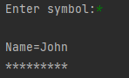
Decorator with parameter
symbolVar=input('Enter symbol:')
def main():
print()
printName("John")
def underline_with_symbol(symbol):
:
return underline_decorator
@underline_with_symbol(symbol=symbolVar)
def printName(name):
print("Name="+name)
Sep 2022 SDCloud3

Slide 31
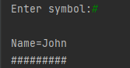
Decorator with parameter
def underline_with_symbol(symbol):
def underline_decorator(func):
def closure(n):
func(n)
for x in range(0,len(n)+5):
print(symbol,end='')
return closure
return underline_decorator
@underline_with_symbol(symbol=symbolVar)
def printName(name):
Sep 2022 SDCloud3

Slide 32
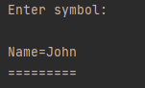
Decorator with default parameter
def underline_with_symbol(symbol= '='):
def underline_decorator(func):
def closure(n):
func(n)
for x in range(0,len(n)+5):
print(symbol,end='')
return closure
return underline_decorator
@underline_with_symbol()
def printName(name):
print("Name="+name)
Sep 2022 SDCloud3

Slide 33
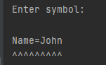
Note:
@underline_with_symbol(symbol=symbolVar)
def printName(name):
# Can also be called
@underline_with_symbol(symbolVar)
def printName(name):
#Or
@underline_with_symbol(‘^’)
def printName(name):
Sep 2022 SDCloud3

Slide 34
Ex377
Decorators Used with Arguments
def main():
value=input('Enter Name:' )
printName(value)
def repeat_void_decorator(func):
def closure(value):
func(value)
func(value)
return closure
@repeat_void_decorator
def printName(value):
print("Name is: ", value)
Sep 2022 SDCloud3

Slide 35
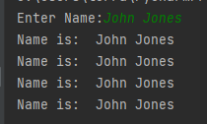
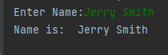
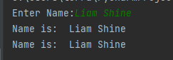
Ex377 Add Repeat Parameter
@repeat_void(num_times=4)
def printName(value):
print("Name is: ", value)
@repeat_void(1)
def printName(value):
print("Name is: ", value)
@repeat_void()
def printName(value):
print("Name is: ", value)
Sep 2022 SDCloud3

Slide 36
Ex378
def main():
printNames("John", "Joseph", "Lennon")
print()
printNames("John", "Joseph","Michael", "Smith")
print()
printNames("John", "Joseph","Michael","Leo", "Jones")
def max_four_args_decorator(func):
def closure(*args):
if (len(args)>4):
print("Only 4 Aruments Allowed")
else:
func(*args)
return closure
@max_four_args_decorator
def printNames(*args):
for el in args:
print(el,end=' ')
Recall EX376
Soln
Sep 2022 SDCloud3

Slide 37
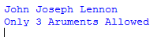
Ex378
def main():
printNames("John", "Joseph", "Lennon")
print()
printNames("John", "Joseph","Michael", "Smith")
print()
printNames("John", "Joseph","Michael","Leo", "Jones")
def max_args_decorator(func):
:
return closure
@max_args_decorator(3)
def printNames(*args):
for el in args:
print(el,end=' ')
Now we want to
Vary Max from 4
With a default of 4
Sep 2022 SDCloud3

Slide 38
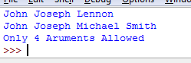
Ex378
def main():
printNames("John", "Joseph", "Lennon")
print()
printNames("John", "Joseph","Michael", "Smith")
print()
printNames("John", "Joseph","Michael","Leo", "Jones")
def max_args_decorator(func):
:
return closure
@max_args_decorator(3)
def printNames(*args):
for el in args:
print(el,end=' ')
@max_args_decorator()
Now we want to
Vary Max from 4
With a default of 4
Sep 2022 SDCloud3

Slide 39
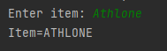
Final Example
def main():
item = input("Enter item: ")
print("Item=", end='')
printItem(item)
def all_uppercase_decorator(func):
def closure(n):
print(n.upper())
return closure
@all_uppercase_decorator
def printItem(item):
print(item)
Sep 2022 SDCloud3

Slide 40
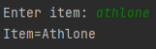
Final Example
def main():
item = input("Enter item: ")
print("Item=", end='')
printItem(item)
def start_upper_decorator(func):
def closure(n):
item=n.lower()
print(item[0].upper()+item[1:len(item)])
return closure
@start_upper_decorator
def printItem(item):
print(item)
Sep 2022 SDCloud3

