Slide 1
Web Development 3 JQuery
Ashley Cahill
ashley.cahill@tus.ie

Slide 2
Learning Outcomes
What is jQuery?
What does jQuery Offer?
jQuery onReady
Selectors
Events
Creating elements & appending to DOM
Changing Styles
AJAX

Slide 3
What is jQuery?
jQuery is a JavaScript Library
jQuery greatly simplifies JavaScript programming
The purpose of jQuery is to make it much easier to use JavaScript on your website
jQuery is designed to handle all cross-browser issues therefore it should run exactly the same in all major browsers

Slide 4
What is jQuery?
jQuery is a lightweight, "write less, do more", JavaScript library
jQuery also simplifies a lot of the complicated things from JavaScript, like Ajax calls and DOM manipulation
The jQuery library contains the following features:
HTML/DOM manipulation
CSS manipulation
HTML event methods
Effects and animations
Ajax
Plugins (Data Validation, Slide Shows, Carousels)

Slide 5
How to get jQuery?
There are several ways to start using jQuery on your web site. You can:
Download the jQuery library from jQuery.com
Include jQuery from a CDN, like Google
Downloading
Production version – intended for live website as it has been minified and compressed
Development version - for testing and development (uncompressed and readable code)
Both can be downloaded from jQuery.com

Slide 6
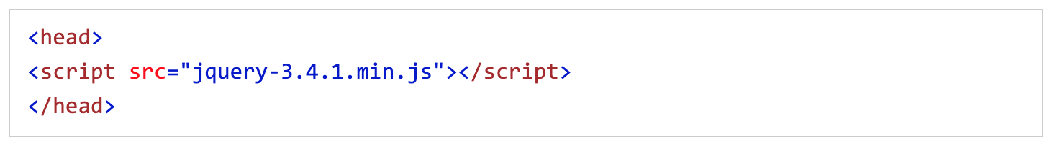
How to get jQuery?
The jQuery library is a single JavaScript file, and you reference it with the HTML <script> tag
Your jQuery code will also be stored in a separate file you will add in
Tip: Place the downloaded file in the same directory as the pages where you wish to use it

Slide 7
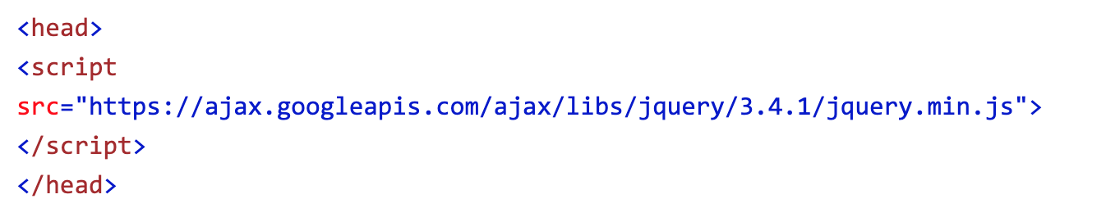
How to get jQuery?
If you don't want to download and host jQuery yourself, you can include it from a CDN (Content Delivery Network)
Both Google and Microsoft host jQuery.
Example from Google CDN

Slide 8
How to get jQuery?
Advantages of using a CDN
Many users already have downloaded jQuery from Google or Microsoft when visiting another site
As a result, it will be loaded from cache when they visit your site
Also, most CDN's will make sure that once a user requests a file from it, it will be served from the server closest to them
All of this means it will lead to faster loading time for your site

Slide 9
jQuery Syntax
The jQuery syntax is tailor-made for selecting HTML elements and performing some action on the element(s)
jQuery uses CSS selectors syntax to select elements
Basic syntax is: $(selector).action()
A $ sign to define/access jQuery
A (selector) to "query (or find)" HTML elements
A jQuery action() to be performed on the element(s)

Slide 10
jQuery Syntax Examples
Examples:
$(this).hide() - hides the current element
$("p").hide() - hides all <p> elements
$(".test").hide() - hides all elements with class="test"
$("#test").hide() - hides the element with id="test"

Slide 11
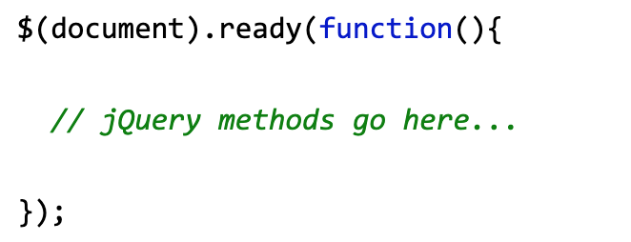
jQuery Document Ready
JavaScript may execute before the DOM finishes loading
We need to make sure the DOM has finished loading before we try to manipulate it
To ensure this jQuery code generally sits inside a document ready event

Slide 12
jQuery Selectors
jQuery selectors allow you to select and manipulate HTML element(s)
jQuery selectors are used to "find" (or select) HTML elements based on their name, id, classes, types, attributes, values of attributes and much more
It's based on the existing CSS Selectors, and in addition, it has some own custom selectors
All selectors in jQuery start with the dollar sign and parentheses: $()

Slide 13

jQuery Selectors
Element selector
The jQuery element selector selects elements based on the element name
You can select all <p> elements on a page like this

Slide 14

jQuery Selectors
The #Id selector
The jQuery #id selector uses the id attribute of an HTML tag to find the specific element
An id should be unique within a page, so you should use the #id selector when you want to find a single, unique element
To find an element with a specific id, write a hash character, followed by the id of the HTML element:

Slide 15

jQuery Selectors
The .class selector
The jQuery .class selector finds elements with a specific class
To find elements with a specific class, write a period character, followed by the name of the class:

Slide 16
jQuery Selectors
The .class selector
The jQuery .class selector finds elements with a specific class
To find elements with a specific class, write a period character, followed by the name of the class:
How to code multiple selectors

Slide 17
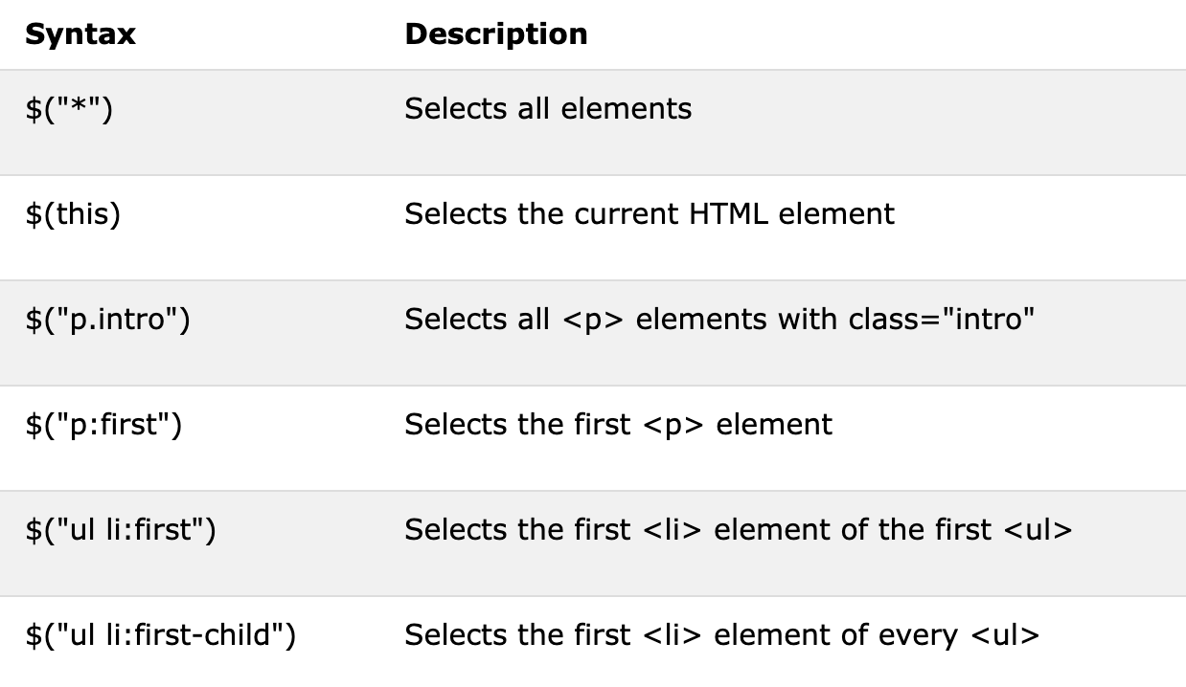
jQuery Selectors

Slide 18
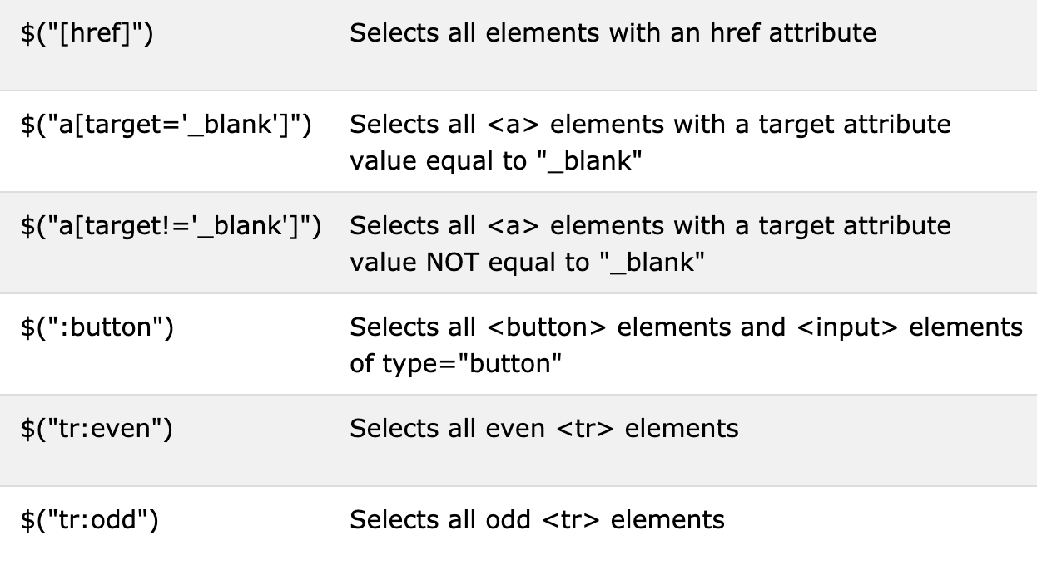
jQuery Selectors
Full selector reference: jQuery Selectors Reference.
Try out the jQuery Selector Tester

Slide 19
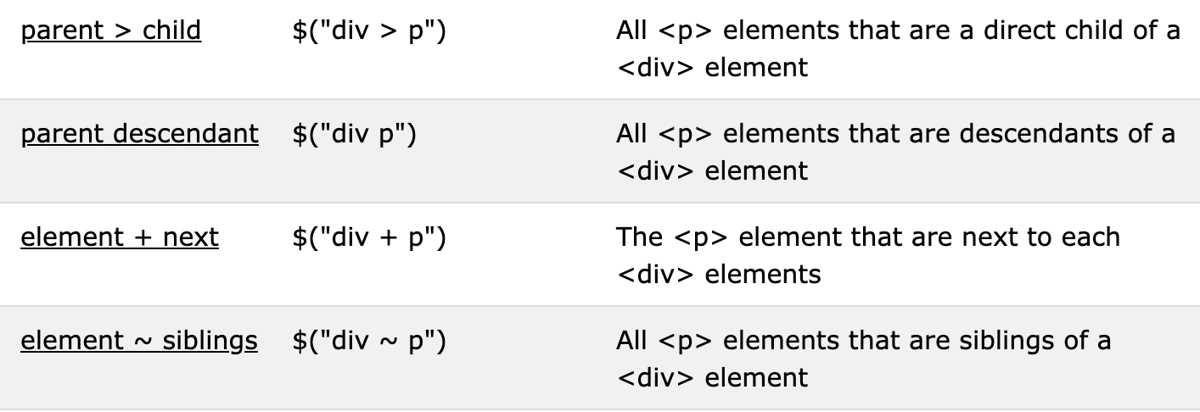
jQuery – Selecting Elements by Relationship

Slide 20
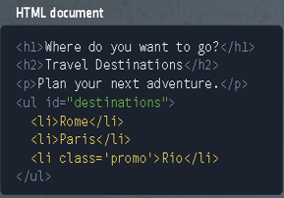
jQuery – Selecting Elements by Relationship
Using the descendant selector
The ("parent descendant") selector selects all elements that are descendants of a specified element.

Slide 21
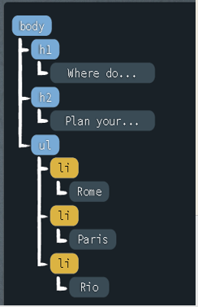
jQuery – Selecting Elements by Relationship
How do we find all <li> elements that are inside of the <ul> tag with the ID “destinations”
$(“#destination li”);

Slide 22
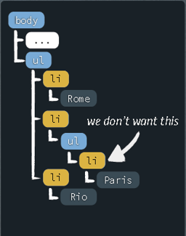
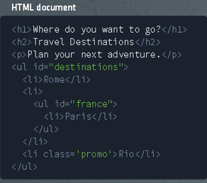
jQuery – Selecting Elements by Relationship
Selecting Direct children
We only want to select the “direct children” <li> elements of id “destinations”.
$(“#destination li”);

Slide 23
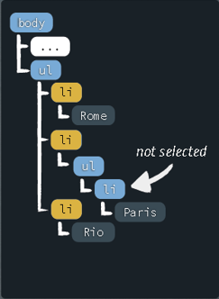
jQuery – Selecting Elements by Relationship
Selecting Direct children
Use > to specify only direct children.
$(“#destination > li”);

Slide 24
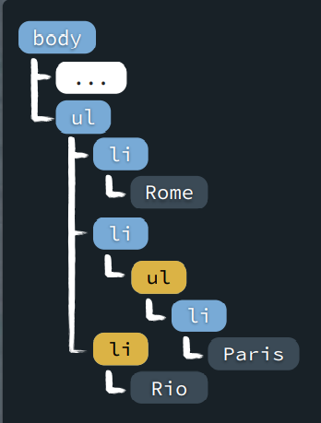
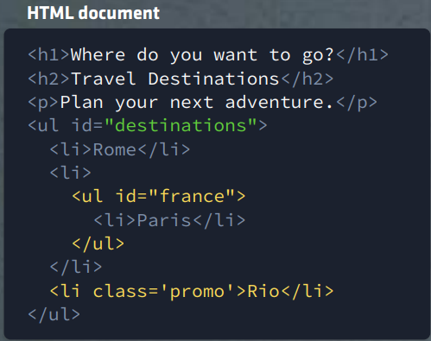
jQuery – Selecting Multiple Elements
Selecting Multiple Elements
We want to find elements with either a class “promo” or ID “france”.
$(“.promo, #france”);

Slide 25
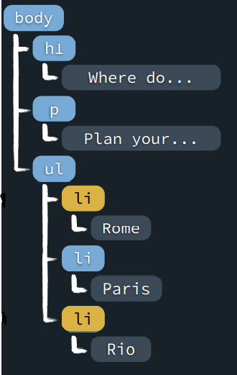
jQuery – CSS-like pseudo Classes
$(“destinations li:first”);
$(“destinations li:last”);

Slide 26
jQuery – CSS-like pseudo Classes
$(“destinations li:first”);
$(“destinations li:last”);

Slide 27
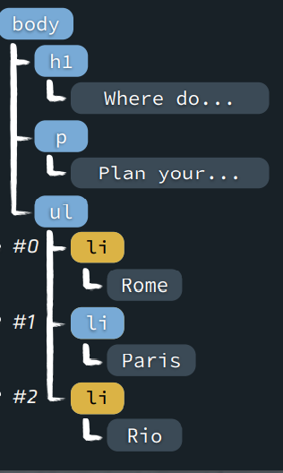
jQuery – CSS-like pseudo Classes
$(“destinations li:odd”);
$(“destinations li:even”);

Slide 28
jQuery – DOM Manipulation
jQuery contains powerful methods for changing and manipulating HTML elements and attributes
Three simple, but useful, jQuery methods for DOM manipulation are:
text() - Sets or returns the text content of selected elements
html() - Sets or returns the content of selected elements (including HTML markup)
val() - Sets or returns the value of form fields

Slide 29
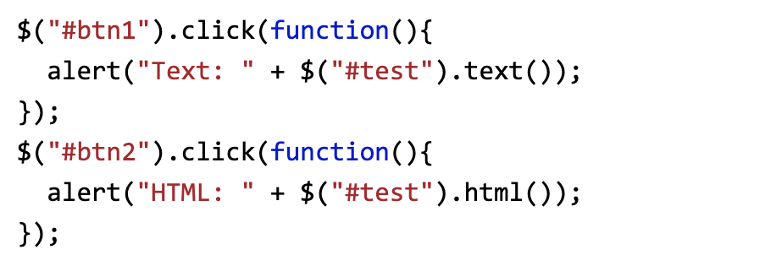
jQuery – DOM Manipulation
The following example demonstrates how to get content with the jQuery text() and html() methods:

Slide 30
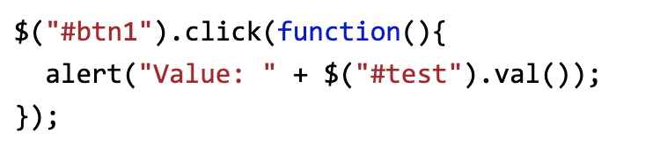
jQuery – DOM Manipulation
The following example demonstrates how to get the value of an input field with the jQuery val() method:

Slide 31
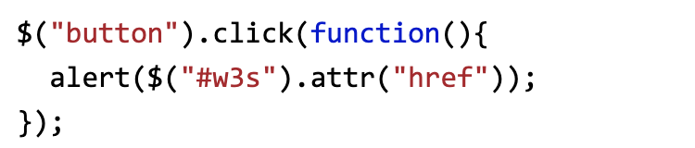
jQuery – DOM Manipulation
The jQuery attr() method is used to get attribute values
The following example demonstrates how to get the value of the href attribute in a link:

Slide 32
jQuery – DOM Manipulation
We will use the same three methods for getting content to also set content:
text() - Sets or returns the text content of selected elements
html() - Sets or returns the content of selected elements (including HTML markup)
val() - Sets or returns the value of form fields

Slide 33
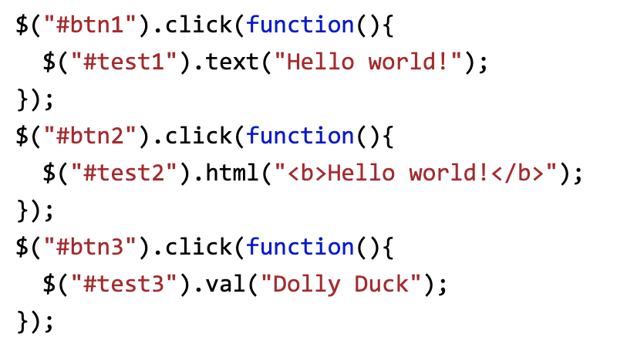
jQuery – DOM Manipulation
The following example demonstrates how to set content with the jQuery text(), html(), and val() methods:

Slide 34
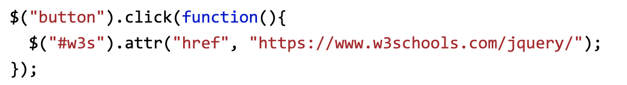
jQuery – DOM Manipulation
The jQuery attr() method is also used to set/change attribute values
The following example demonstrates how to change (set) the value of the href attribute in a link:

Slide 35
jQuery – Adding to DOM
We will look at four jQuery methods that are used to add new content:
append() - Inserts content at the end of the selected elements
prepend() - Inserts content at the beginning of the selected elements
after() - Inserts content after the selected elements
before() - Inserts content before the selected elements

Slide 36


jQuery – Adding to DOM
The jQuery append() method inserts content AT THE END of the selected HTML elements
To append some text to the end of Paragraph tag

Slide 37

jQuery – Adding to DOM
The jQuery prepend() method inserts content AT THE BEGINNING of the selected HTML elements
To append some text to the beginning of Paragraph tag

Slide 38
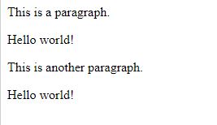
jQuery – Adding to DOM
The jQuery after() method inserts content AFTER the selected HTML element
Add “Hello World” after each <P> element

Slide 39
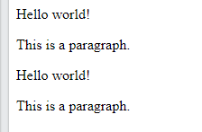
jQuery – Adding to DOM
The jQuery before() method inserts content BEFORE the selected HTML elements
Add “Hello World” before each <P> element

Slide 40
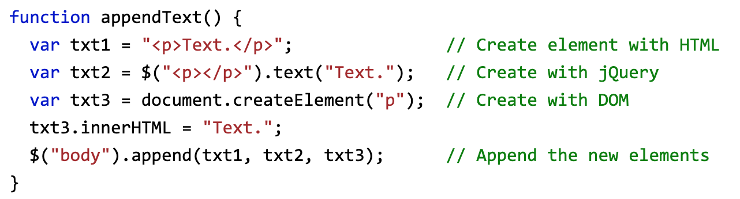
jQuery – Adding to DOM
Both the append() and prepend() methods can take an infinite number of new elements as parameters
The new elements can be generated with text/HTML (like we have done in the examples above), with jQuery, or with JavaScript code and DOM elements

Slide 41
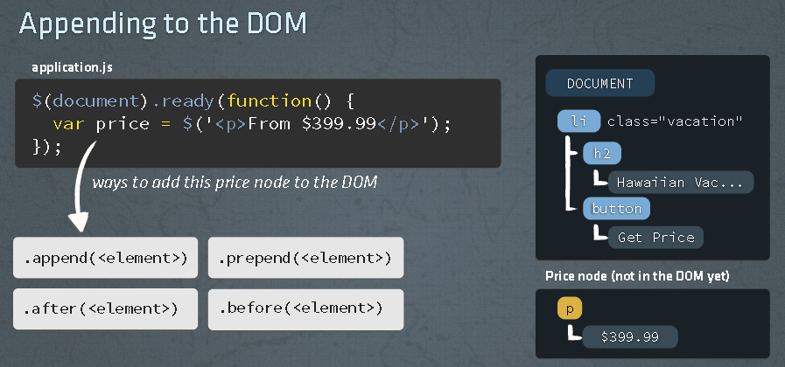
jQuery – Adding to DOM

Slide 42
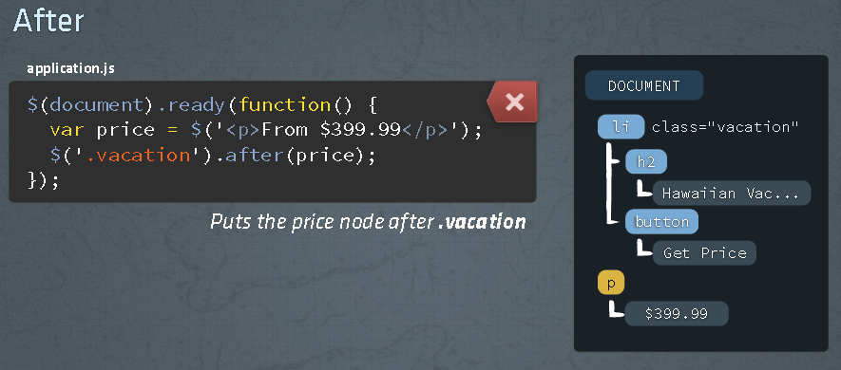
jQuery – Adding to DOM

Slide 43
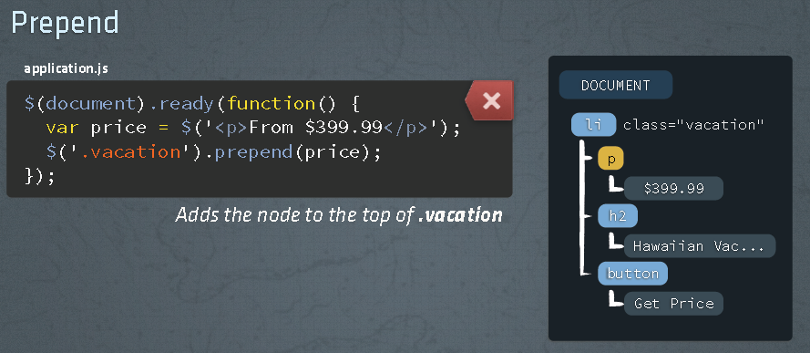
jQuery – Adding to DOM

Slide 44


jQuery – Removing from DOM
To remove elements and content, there are mainly two jQuery methods:
remove() - Removes the selected element (and its child elements)
empty() - Removes the child elements from the selected element

Slide 45


jQuery – Removing from DOM
The jQuery remove() method also accepts one parameter, which allows you to filter the elements to be removed
The parameter is any jQuery selector
The following example removes all <p> elements with class="test":
Remove all <p> elements with class="test” or class="demo":

Slide 46
jQuery – Events
All the different visitors' actions that a web page can respond to are called events
An event represents the precise moment when something happens
Examples:
moving a mouse over an element
selecting a radio button
clicking on an element
The term "fires/fired" is often used with events
Example: "The keypress event is fired = the moment you press a key“
Example: “The click event is fired = the moment you click a button

Slide 47
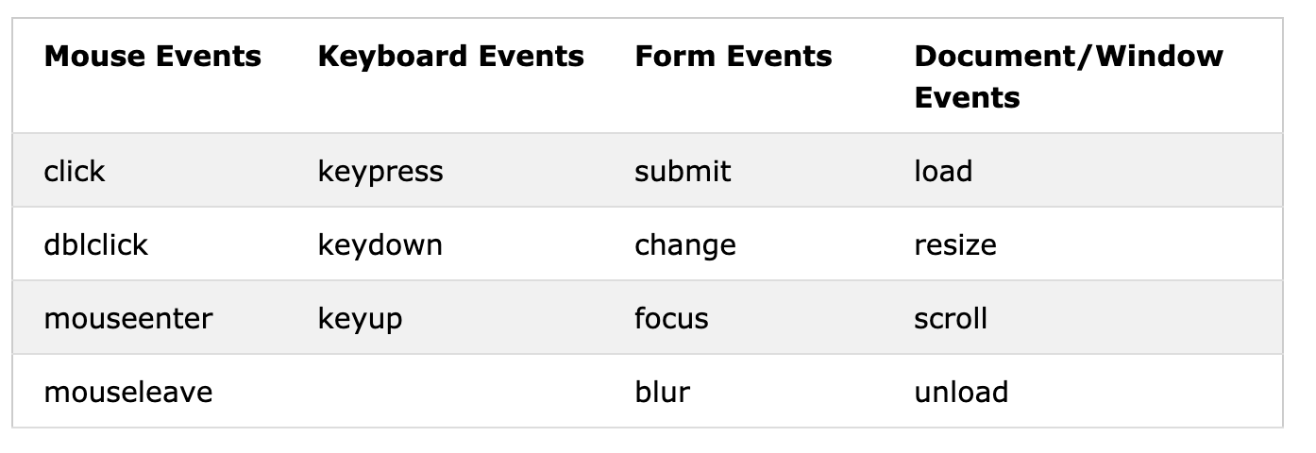
jQuery – Events
Common DOM Events

Slide 48

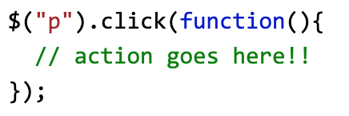
jQuery – Event Method Syntax
In jQuery, most DOM events have an equivalent jQuery method.
To assign a click event to all paragraphs on a page, you can do this:
The next step is to define what should happen when the event fires. You must pass a function to the event:

Slide 49
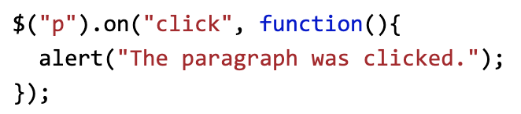
jQuery – on() Event Method Syntax
The alternative syntax is to use the $().on method.
Attach an event handler function for one or more events to the selected elements.:
Attach a click event to the <p> element:

Slide 50
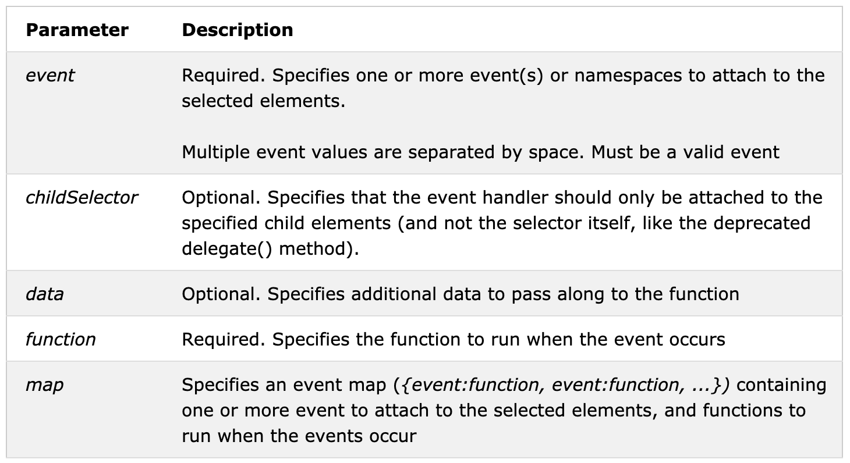
jQuery – on() Event Method Syntax

Slide 51
jQuery – Event Method Syntax
As of jQuery version 1.7, the on() method is the new replacement for the bind(), live() and delegate() methods
Note: Event handlers attached using the on() method will work for both current and FUTURE elements (like a new element created by a script)
Tip: To remove event handlers, use the off() method
Tip: To attach an event that only runs once and then removes itself, use the one() method

Slide 52
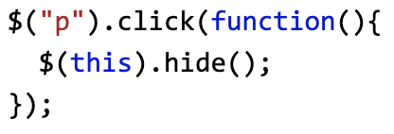
jQuery – Commonly Used Events
The $(document).ready() method allows us to execute a function when the document is fully loaded.
The click() method attaches an event handler function to an HTML element.
The function is executed when the user clicks on the HTML element.
The following example says: When a click event fires on a <p> element; hide the current <p> element:

Slide 53
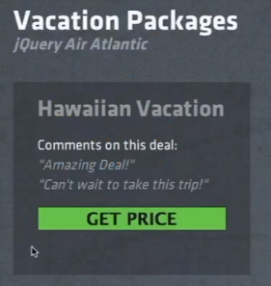
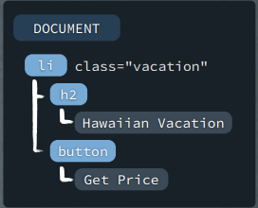
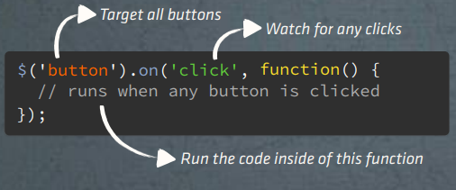
jQuery – Event Examples
Watching for a button click…

Slide 54
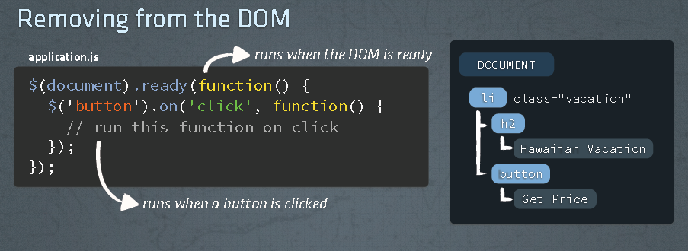
jQuery – Event Examples

Slide 55
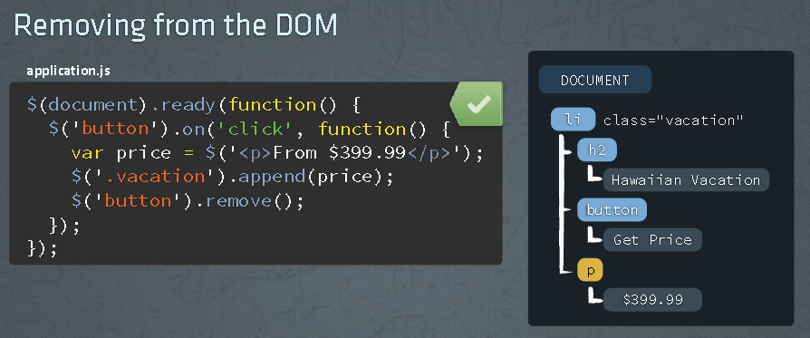
jQuery – Event Examples
ALL BUTTONS WILL BE REMOVED

Slide 56
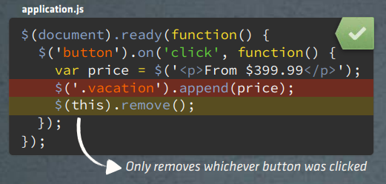
jQuery – Event Examples
Use $(this) to identify the specific element that was clicked
Code will run for every button clicked, but only remove the specific one that was clicked

Slide 57
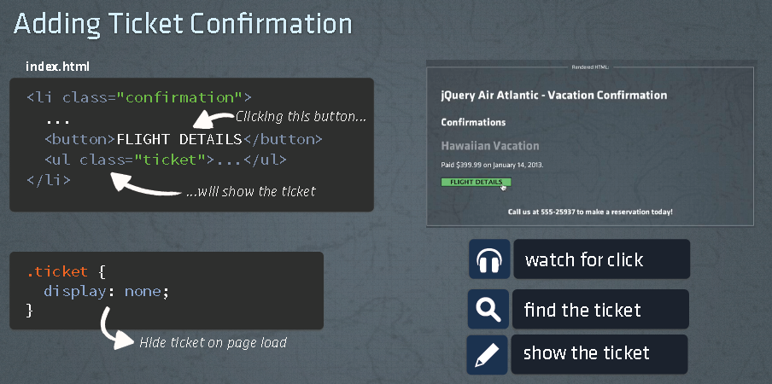
jQuery – Event Examples

Slide 58
jQuery – Ajax

Slide 59

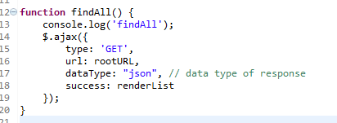
jQuery – Ajax

