Slide 1
Google App Store Data Analysis
Natalia Solar

Slide 2
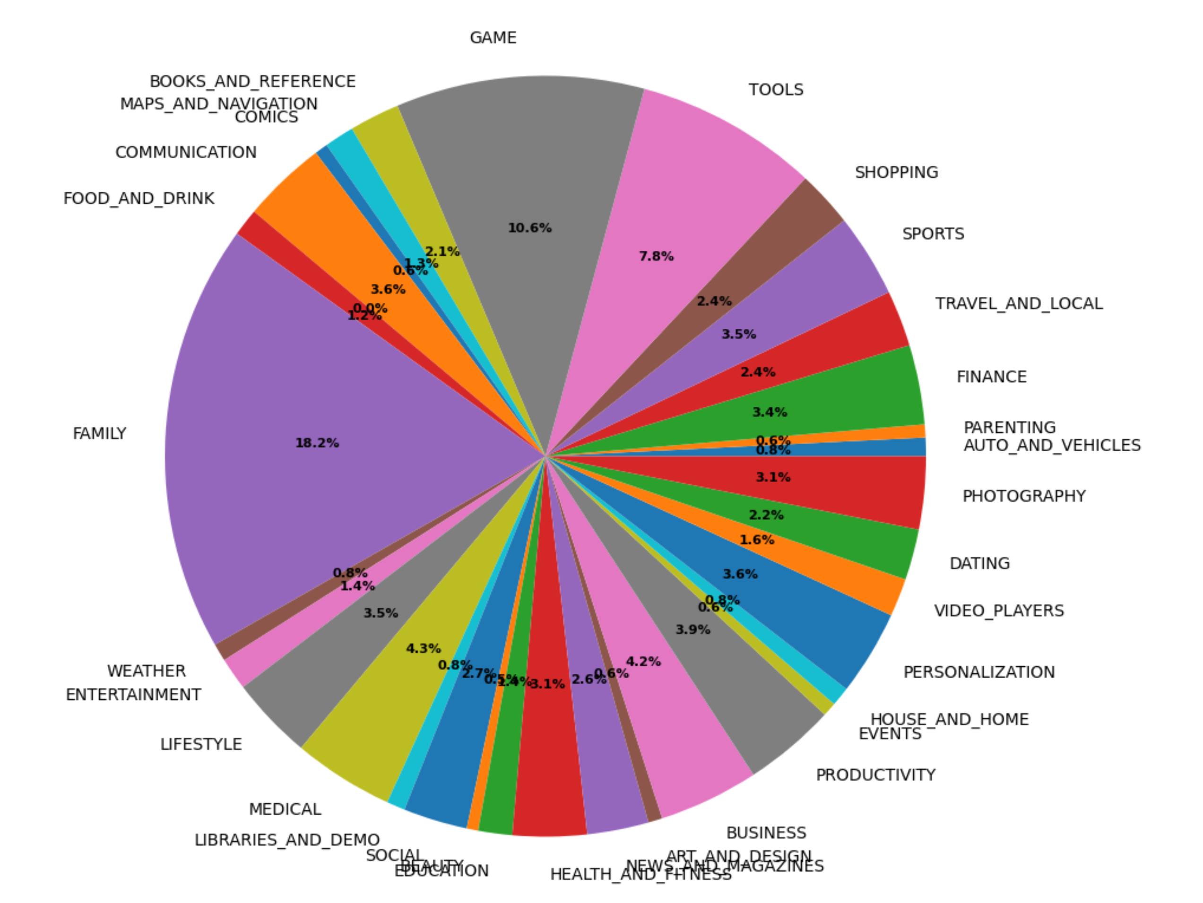
Pie Chart for the Breakdown of Number of Apps in Each Category

Slide 3
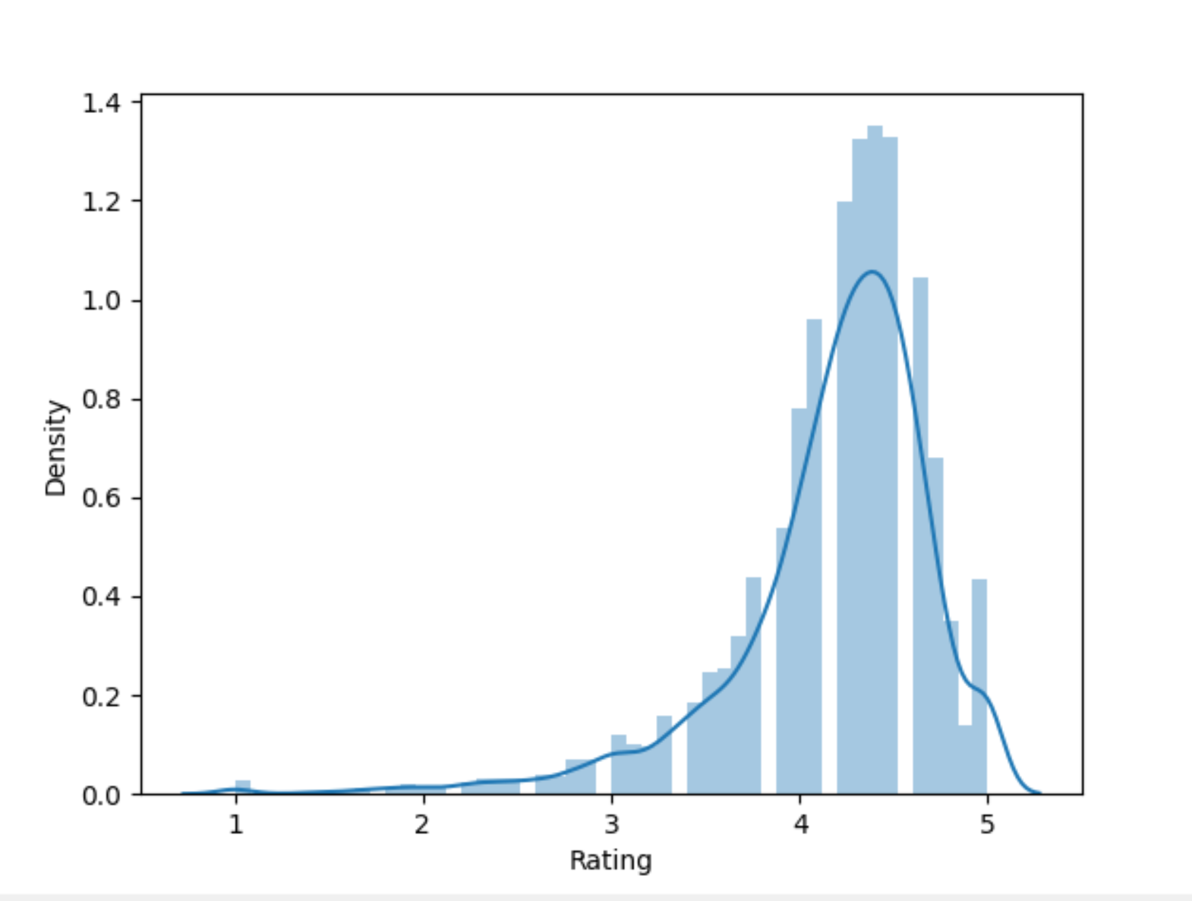
Distribution of the Rating

Slide 4
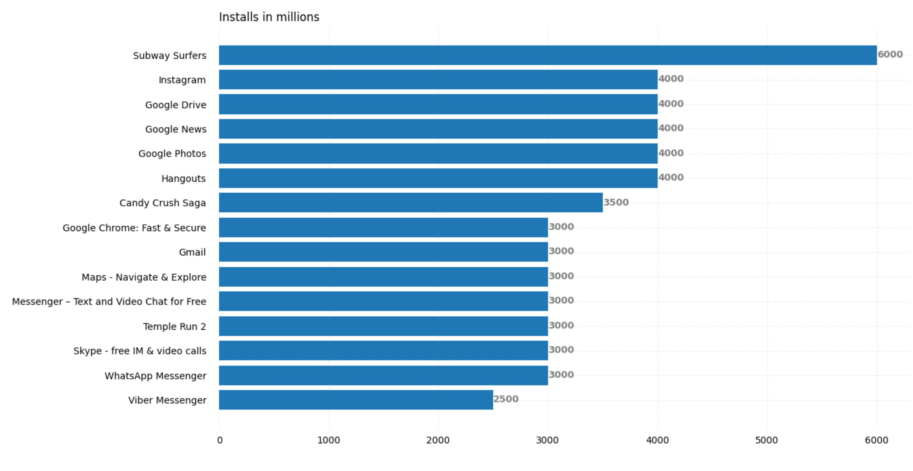
15 Most-Downloaded Google PlayStore Apps

Slide 5
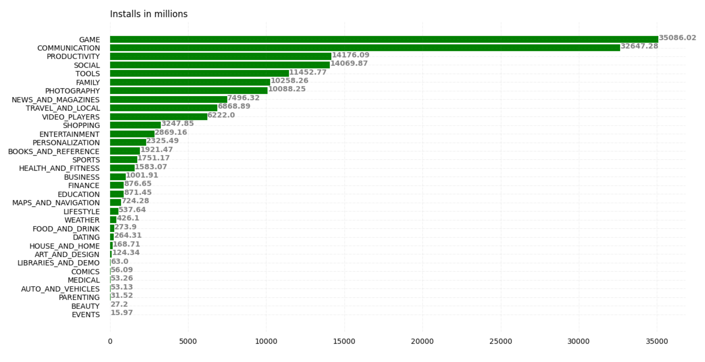
Which category should we build the application on?

Slide 6
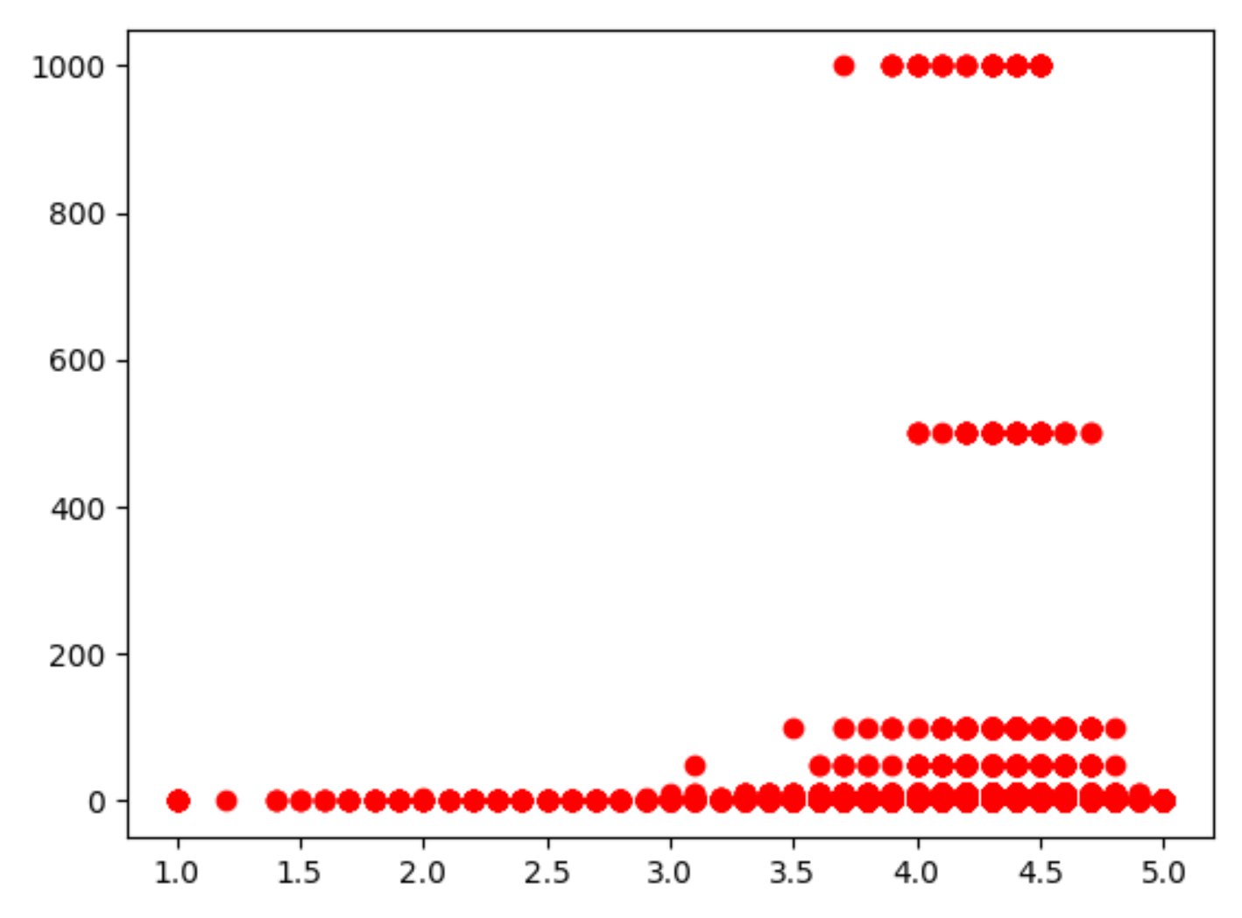
Is there a correlation between downloads and ratings?

Slide 7
Conclusion
Since the 2 most-downloaded app categories are Games and Communication, new application should be built on these categories
To be on the top 10% of downloads the new app should have 10000000+ installs
The correlation between downloads and rating is missing

