Slide 1
Group 3: Radka, Revathi, Natalia
Answer business questions:
Is Magist a good fit for high-end tech products?
Are orders delivered on time?
WBS coding school 21.11.2022

Slide 2
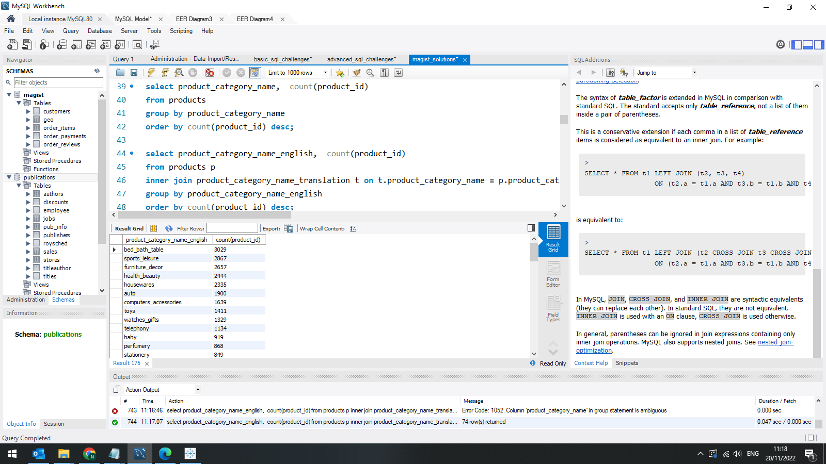
Categories with a most products
~5%
Products: 32951

Slide 3
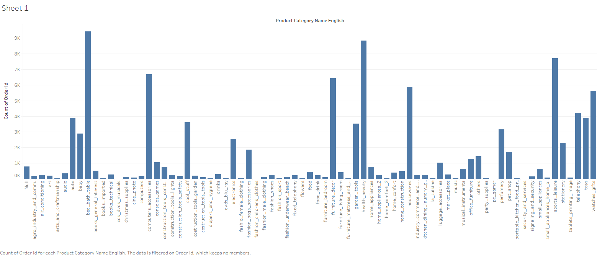
Total orders: 98666
Orders: computer_accessories: 6689 (~ 7 %)

Slide 4
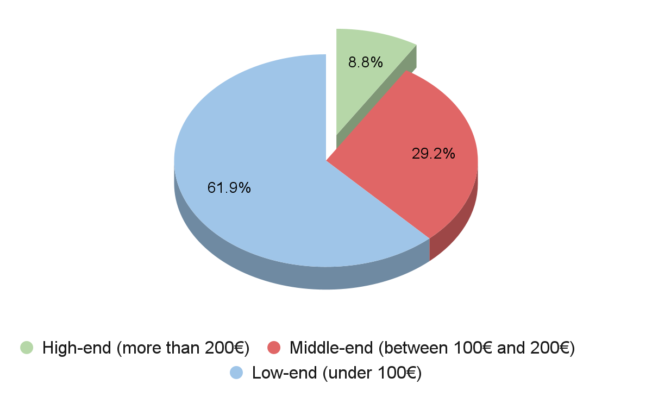

Slide 5
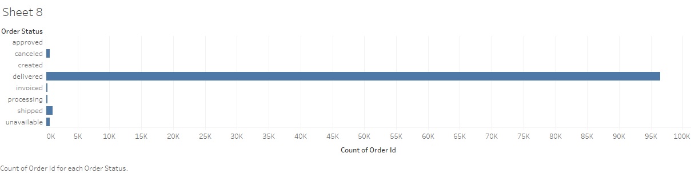
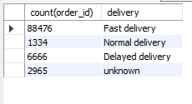
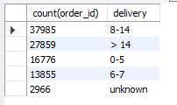
Are orders delivered on time?
Total orders: 99441
Orders delivered: 96478 (97%)
89 %
38 %
1,3 %
28 %
6,7 %
17 %
Fast: order_estimated_delivery_date > order_delivered_customer_date
order_delivered_customer_date - order_purchase_timestamp

Slide 6
