Slide 1
Time to travel
Natalia Sudarchikova
WBS coding school
Berlin, 9 March 2023

Slide 2
Time to travel
Datasets from Kaggle.com:
Tourism Demographics
World Bank Indicators
Happiness index data
Data analysis with:
Python pandas, matplotlib, saeborn

Slide 3
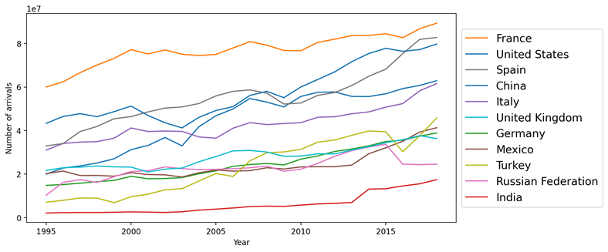
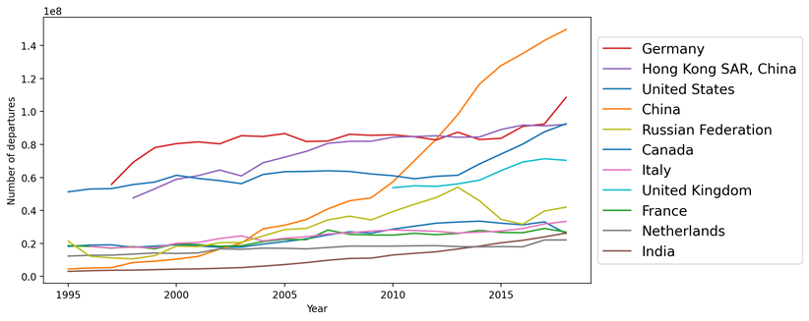
Travel arrivals and departures
arrivals
departures

Slide 4
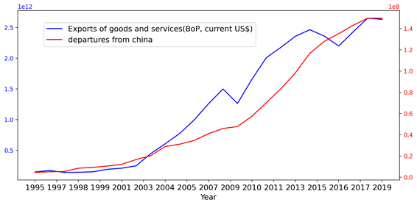
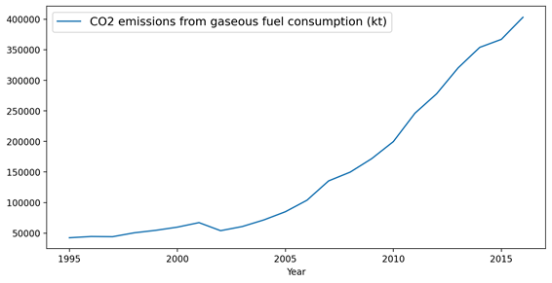
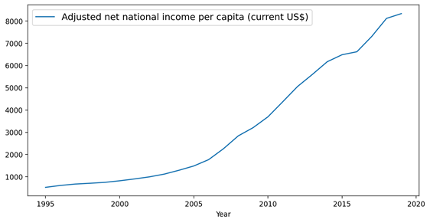
China: high correlation
As well as:
Service imports
School enrolment
Tax revenue
Container port traffic
Patent application
etc.

Slide 5
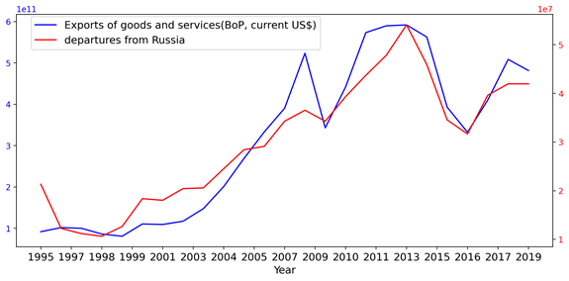
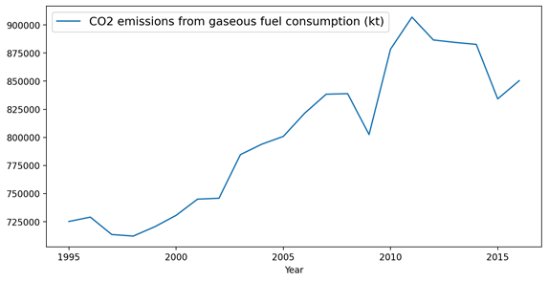
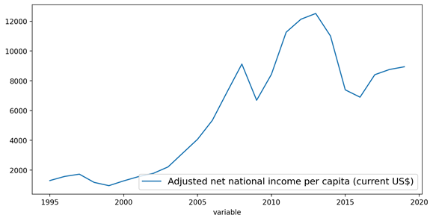
Russia: high correlation
As well as:
energy use
Population in the largest city
Taxes on export
Part time employment
etc.

Slide 6
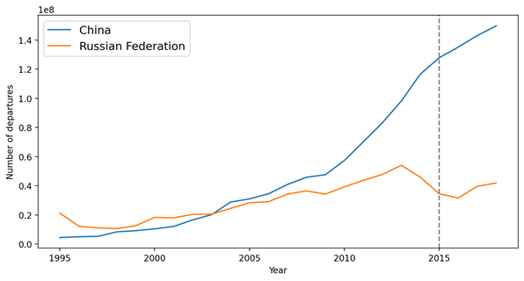
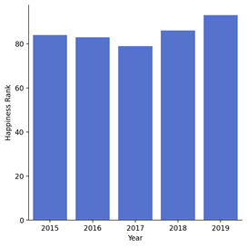
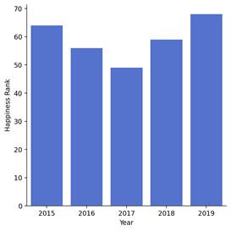
Travels and happiness index
China
Russia

Slide 7
Thank You, Beautiful People!

