Slide 1
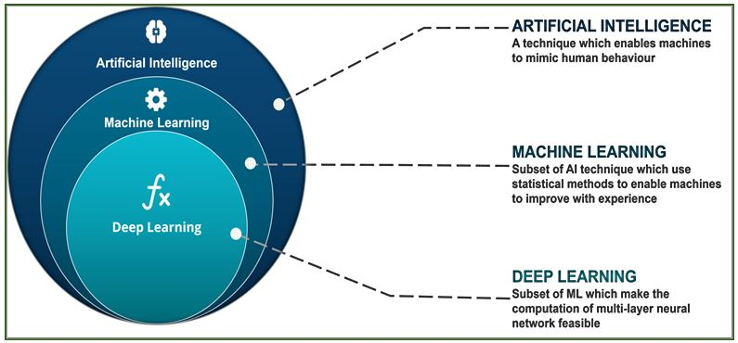
ML/DL
Supervised Learning
What is ML and DL?
Unsupervised Learning
Machine Learning
Semi supervised Learning
Reinforcement Learning

Slide 2
ML/DL
Supervised Learning
Technique to achieve AI through algorithm trained with data
Function that maps and input to an output based on a series of examples
Examples: input-output pairs
Regression
To find/predict an output based on independent predictors
The output is continuous
Methods:
Linear regression; Decision tree; Random forest; NNETs; …
To assign a class to an output (discriminate, separate)
The output is discrete
Methods:
Logistic regression; Linear discriminant; Support Vector Machines; Naïve Bayes; NNETs; DL based models; …
Classification

Slide 3
ML/DL
Unsupervised Learning
Find patterns from input data without references to the outcomes
Clustering
Methods:
K-means; Hierarchical; Mean-shift; Density-based …
Elimination or extraction of variables
Methods:
PCA; …
Dimensionality reduction

Slide 4

K-means clustering
Javier M. Antelis
mauricio.antelis@tec.com
Escuela de Ingeniería y Ciencias
Tecnológico de Monterrey
Guadalajara, México

Slide 5
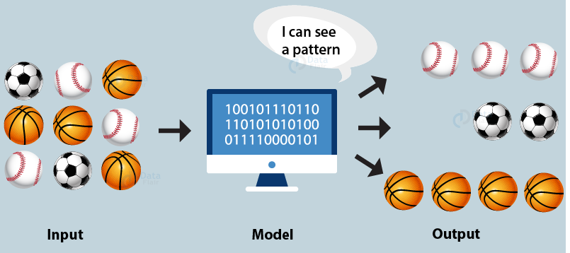
What is Clustering?
Clustering is a set of “computational” techniques used to partition data objects into groups (or clusters)

Slide 6
What is Clustering?
Clusters are defined as groups of data objects that are more similar to other objects in their cluster than they are to data objects in other clusters

Slide 7
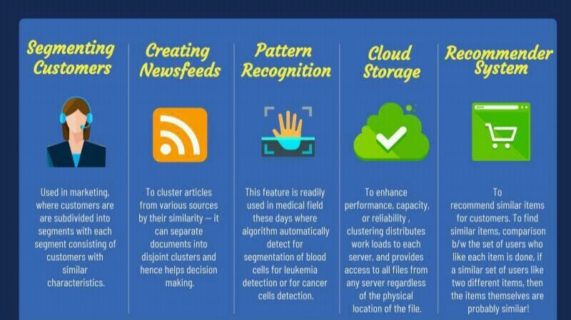
Some applications

Slide 8
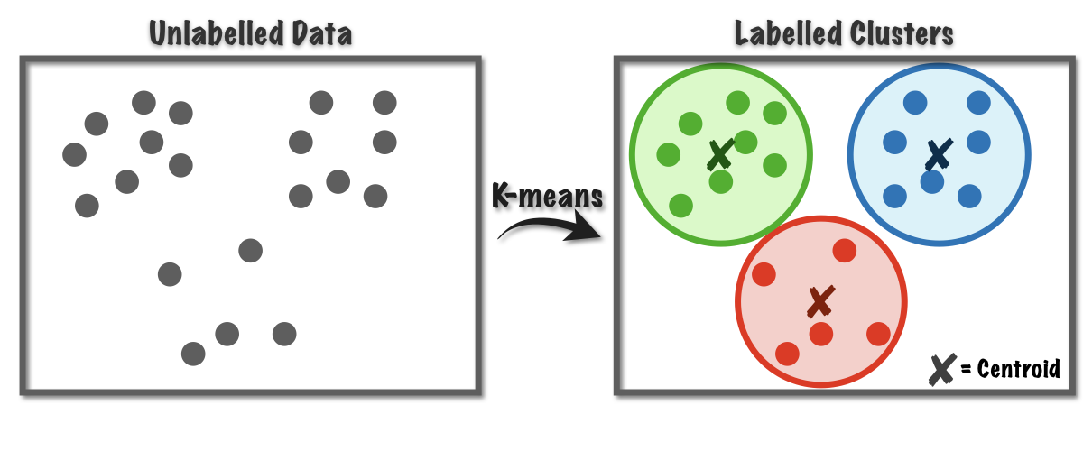
Clustering algorithms

Slide 9
Types of clustering algorithms
K-means Clustering: Using this algorithm, we classify a given data set through a certain number of predetermined clusters or “k” clusters.
Hierarchical Clustering: follows two approaches Divisive and Agglomerative.
Fuzzy C means Clustering: The working of the FCM Algorithm is almost similar to the k-means clustering algorithm, the major difference is that in FCM a data point can be put into more than one cluster.
Density-Based Spatial Clustering: Useful in the application areas where we require non-linear cluster structures, purely based on density

Slide 10
What is K-means?
K-means clustering method is an unsupervised machine learning technique used to identify clusters in data.
K-means is an iterative algorithm that divides a group of data points into K subgroups/clusters based on the similarity and their mean distance from the centroid of that particular subgroup/formed.
K is the pre-defined number of clusters to be formed by the algorithm

Slide 11
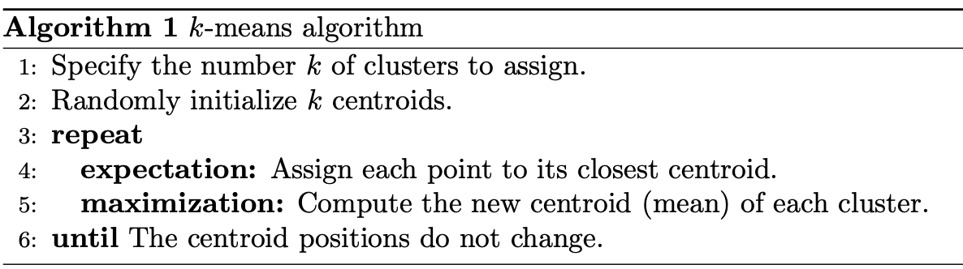
What is K-means?

Slide 12
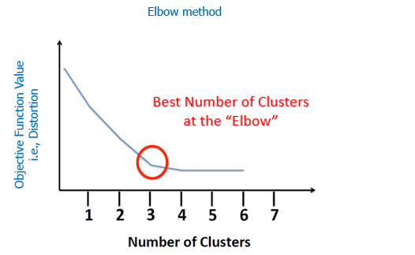
How to choose the number of clusters K
Elbow method gives us an idea on what a good k number of clusters would be based on the sum of squared distance (SSE) between data points and their assigned clusters’ centroids.

Slide 13
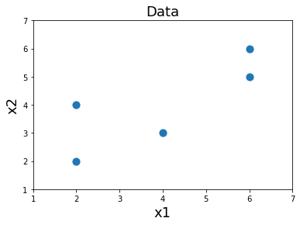
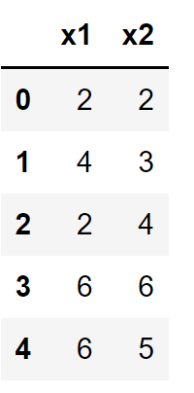
Intuitive explanation on K-means clustering
We have a set of data points that we want to cluster
We do not know the number of clusters in advance, that is, the data is not labelled

Slide 14
Graphical illustration
Data

Slide 15
Graphical illustration
1: Specify the number of clusters

Slide 16
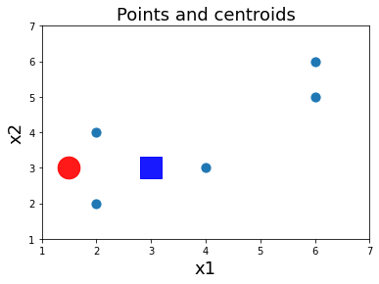
Graphical illustration
2: Initialize the centroids of the clusters

Slide 17
Graphical illustration
3: Repeat the following (with the current centroids)

Slide 18
Graphical illustration
4: Assign each point to its closest centroid

Slide 19
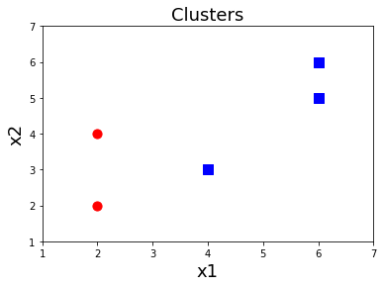
Graphical illustration
4: Assign each point to its closest centroid

Slide 20
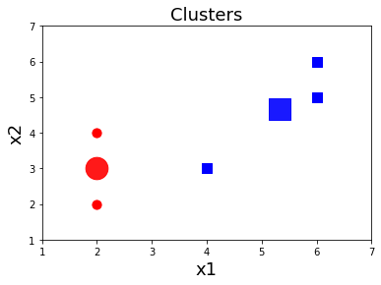
Graphical illustration
5: Compute the new centroid (mean) of each cluster

Slide 21
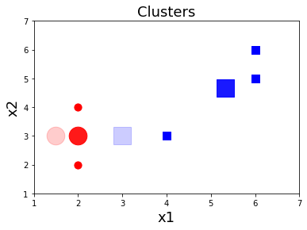
Graphical illustration
6: Until the centroids do not change

Slide 22
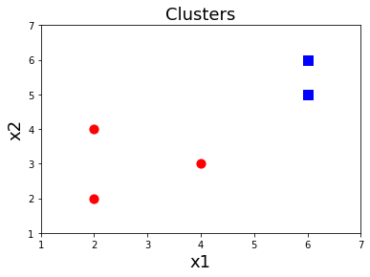
Graphical illustration
Final solution

