Slide 1
Gender and Genre
- in 61.600 popular movies from 1900 through 2017
- listed in The Movie Database (TMDB)

Slide 2
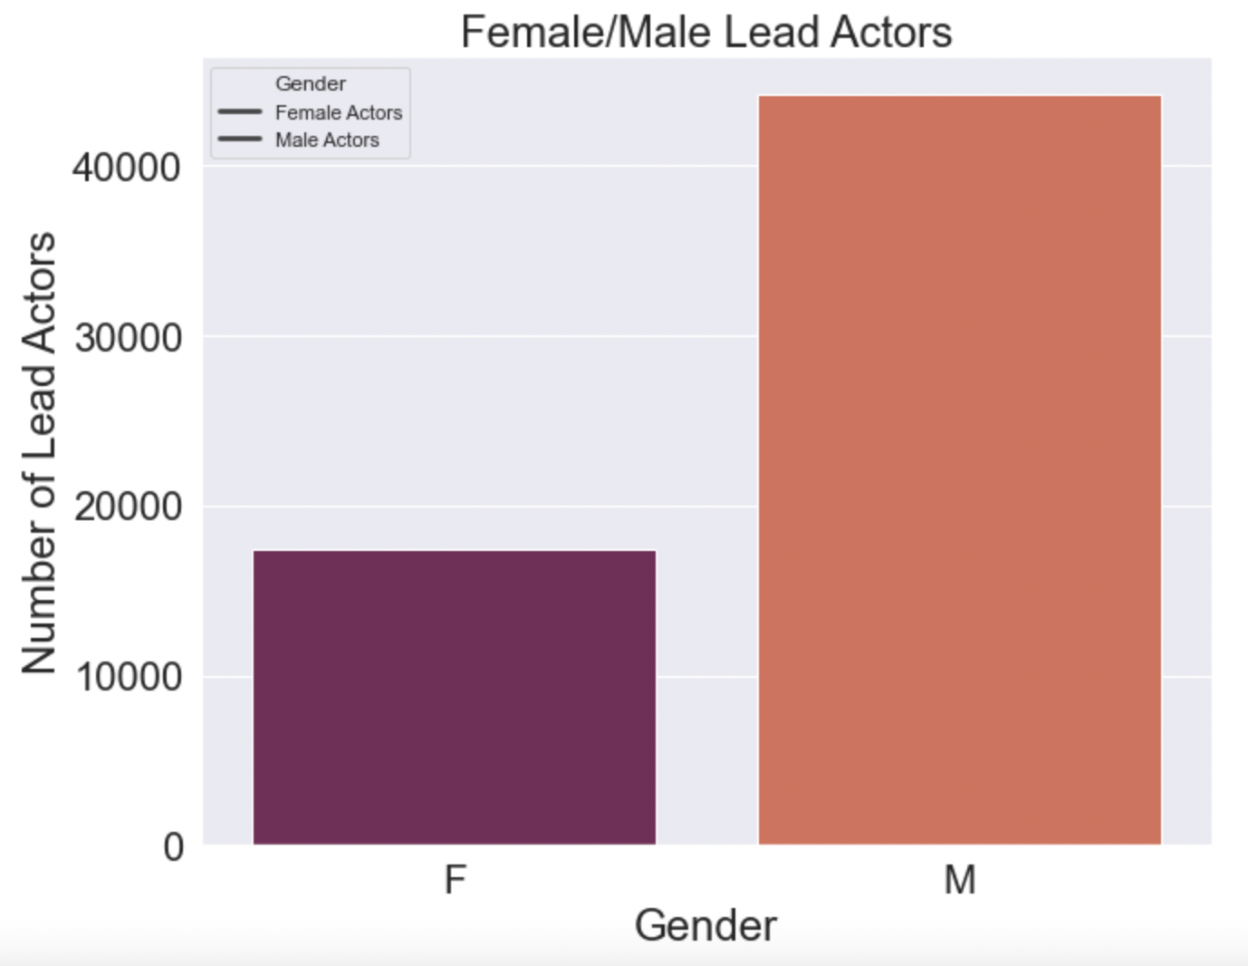
The number of male main film characters is more than twice as high as the number of films starring women.

Slide 3
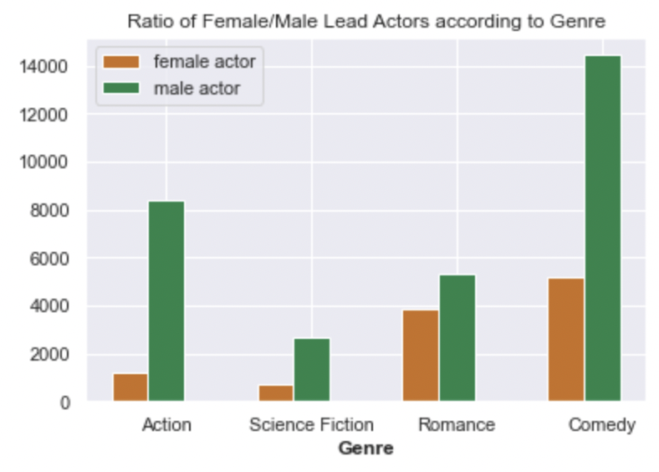
The number of male main film characters is more than twice as high as the number of films starring women.
A similar proportion can be observed regardless of the genre…

Slide 4
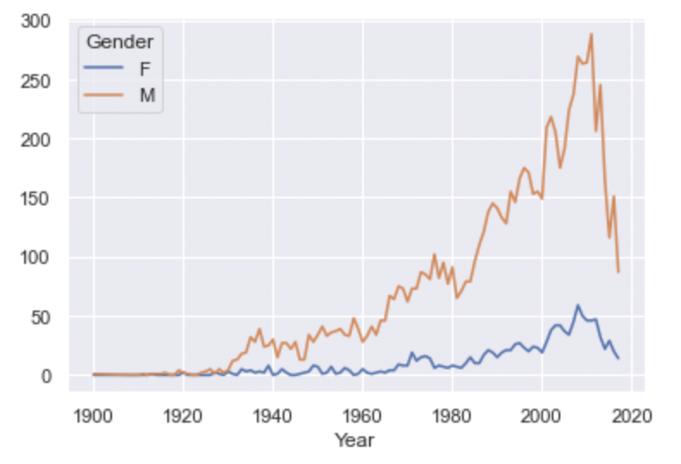
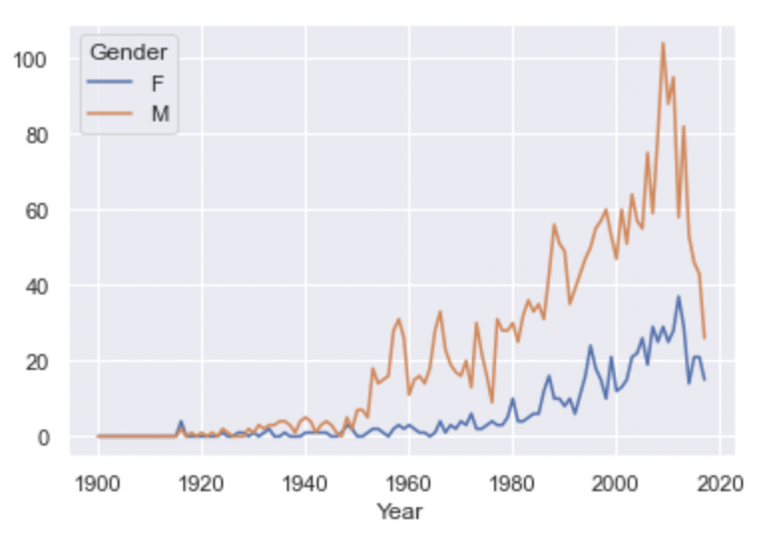
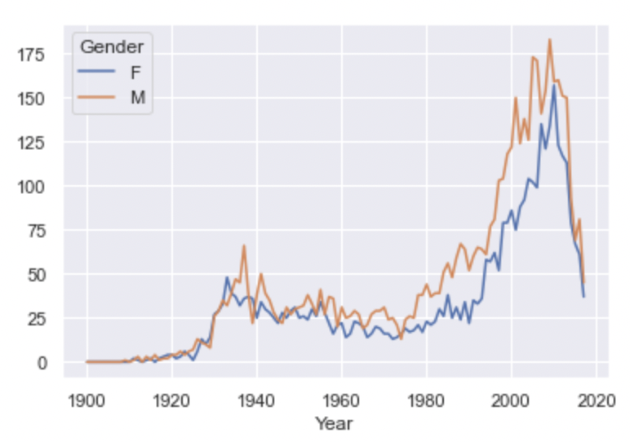
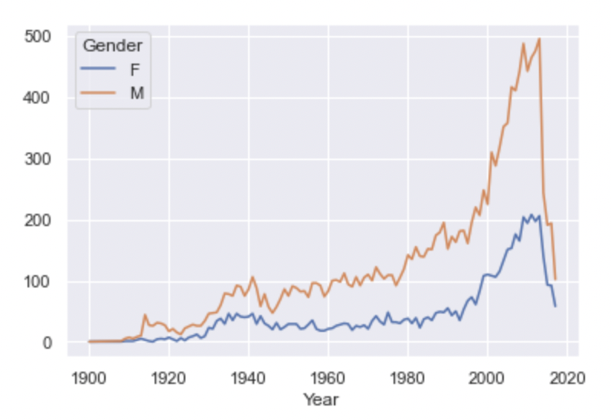
Action
Science Fiction
Action
Romance
Comedy
This imbalance can be observed throughout the years.
NB: There are presumably films missing at the end of the timeline because there were not yet listed at the time of the data’s gathering.

Slide 5
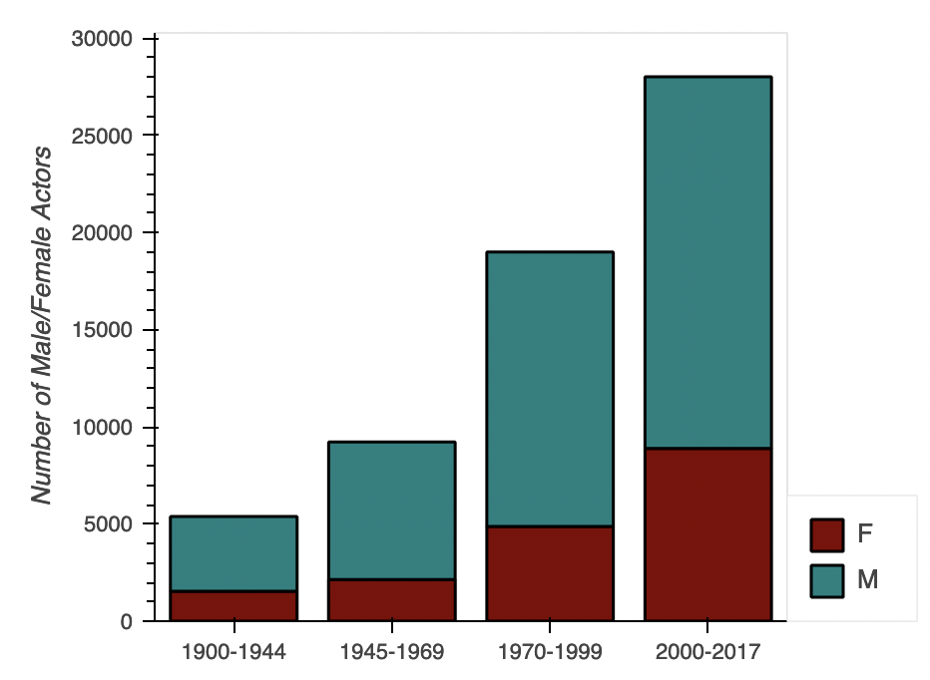

Slide 6
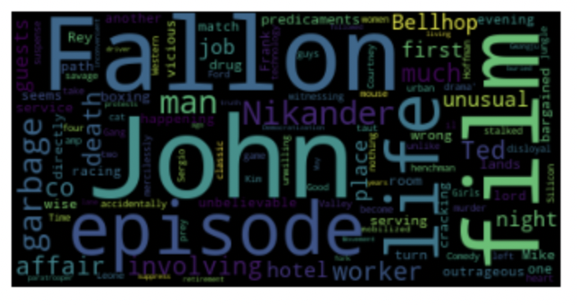
Most frequent words mentioned in the films’ summaries:

Slide 7
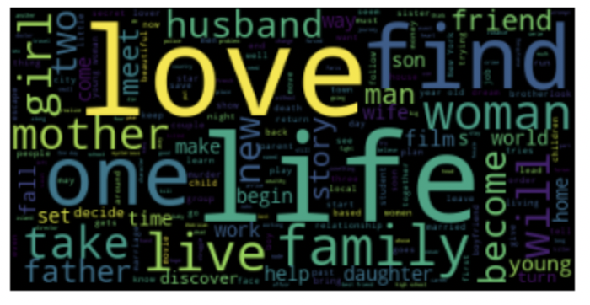
Most frequent words mentioned in the films’ summaries:
Most frequent words in the summaries of films starring women:

Slide 8

Are we reproducing clichés and conventional film patterns by making the same movies over and over again?
Are recommendation systems encourage this tendency by proposing movies based on pure similarity?
How could we train a machine model to break this pattern and create more diverse proposals and in consequense maybe encourage the making of more diverse films?

Slide 9
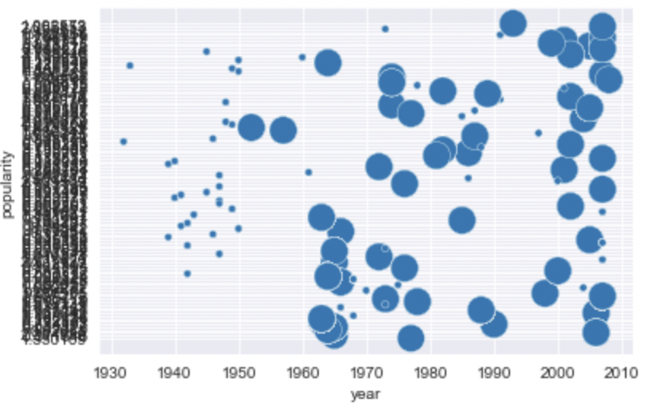
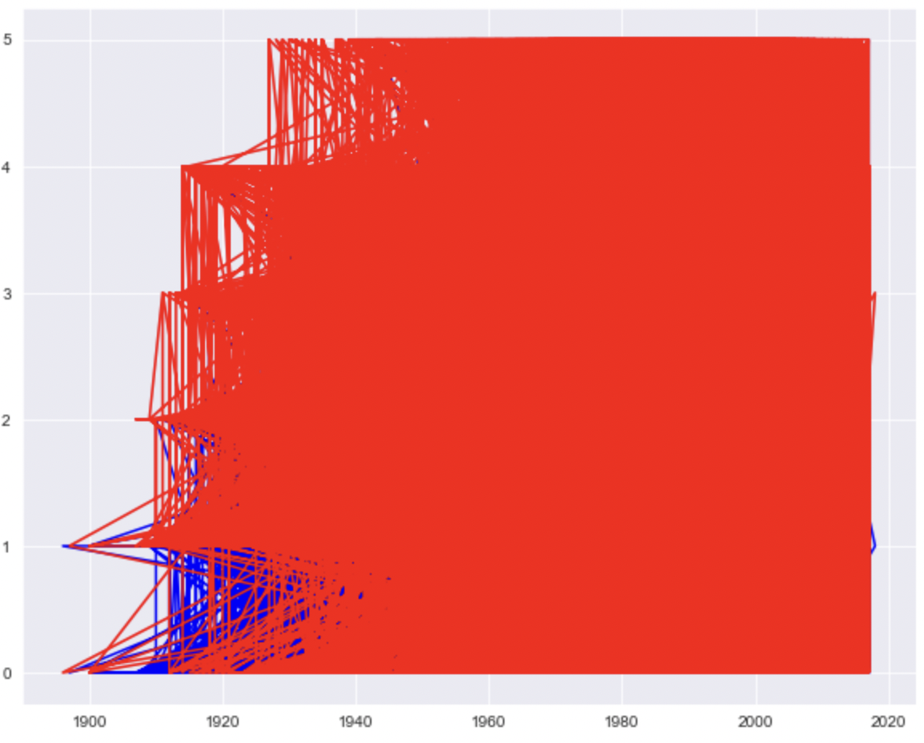
Thank you.

