Slide 1

Scientific publications analysis
Eva Navarrete Espuña
Data Analytics Final Project - allWomen
December 22nd 2021
Notes:
Good evening everyone and thanks for joining the session! My name is Eva, I’m a student at the Data Science course and I have based my Data Analytics final project on the analysis of the scientific publications at the BSC Life Sciences dept, where I work

Slide 2
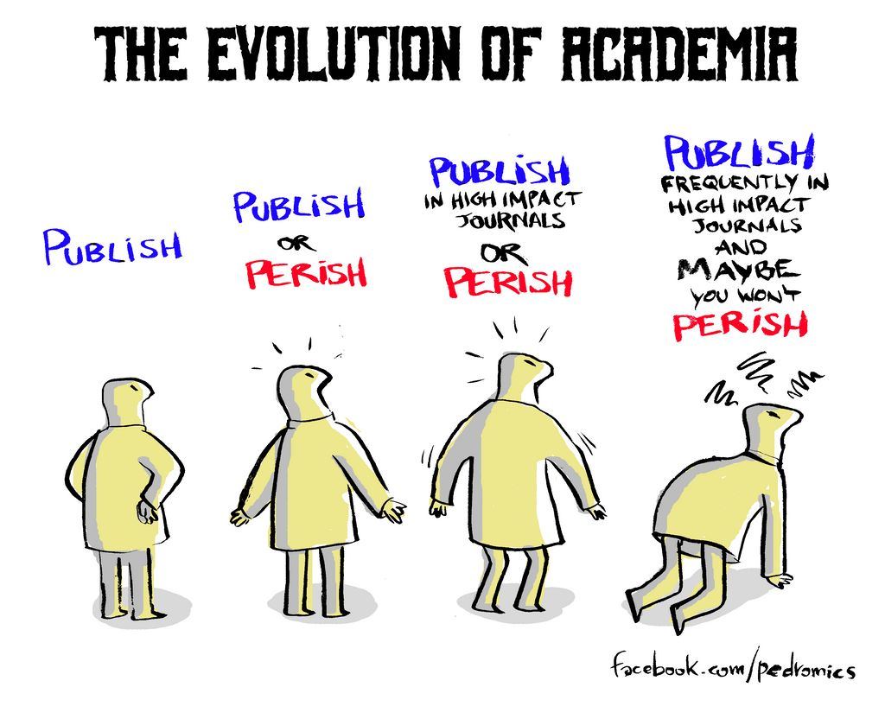
Content
Some context
The dataset
Scientific publication analysis
Conclusions
Notes:
To start the presentation I will give some context on the research ecosystem and why publications matter. Publish or perish you see in the image is a very well-known motto in research because publications are the main outcome and indicator of scientific success in academia, both for individual researchers and research institutes and universities. I will also present the datasets I have used and after the analysis per se I will draw some conclusions

Slide 3

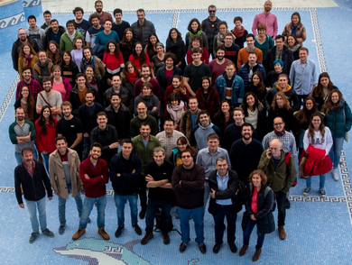
Context
In research, scientific peer reviewed publications are the most important outcome
Analysis of distribution of publications per professional category and gender
The two major indicators to measure research impact are:
Impact factor (journal)
Citations (publication)
The authors (before covid!)
Notes:
Scientific publications are published in peer reviewed journals, that is in journals that request other researchers from the field to review the paper before publication to ensure only quality and rigurous research is published. Even thoug the topic might seem very specific to the research environment (which it definitely is) it is important to note that it has an impact on society, since biomedicine resesarch has a direct impact on the population health and is mainly funded by public administrations – this is public money we are tallking about!
As I was saying publications are the most important outcome of research, and research institutes and researchers are valued depending on the amount and quality (or impact) of their publications. This is why the main indicator is the journal impact factor. I have based part of my analysis on this indicator, and also on citations, professional category and gender and Open Acces, which I will explain later on

Slide 4



Publications per author: Scopus
Journal Impact Factor: Clarivate (2019 & 2020-2021)
Staff
Datasets
Authors
Publication title
Publication journal
Citations
Open access
Impact factor
Professional category
Gender
Final dataset variables:
Notes:
I have used many datasets. From Scopus I. have gathered the publications per PI (group leader at the department). This is why publications are grouped in the analysis.
The Journal Impact Factor is given by Clarivate Analytics. Since my datasets cover the period from 2019 to 2021 I have used two datasets for the impact factor: one for 2019 and one for 2020 and 2021 (the IF for 2021 will be published early next year). The dataset with information on the dept. staff I got it from my institute. The variables that I will be analysing are: authors, publications, journals, citations, open access (whether and how the publication is open to the public), impact factor, professional category and gender of authors. Most variables are categorial, only impact factor and citations are numerical.

Slide 5
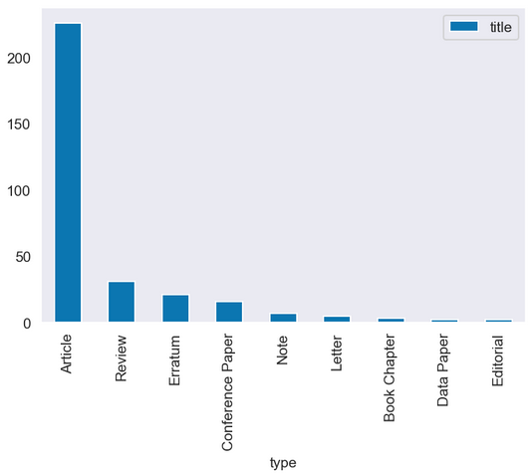
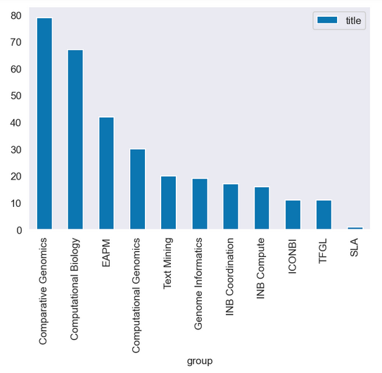
Total publications per type
Total publications per group
Notes:
In the first plot we can see the amount of publications per type, being articles the most frequent and also the type of publication where actual research is published. Reviews are summaries of the state of the art and current research being developed on a topic.
The second plot shows the amount of publications (regardless of type, but as we have seen most are articles) per group. There are six research groups and 5 technical units, meaning their core is not research, but technical support to the research groups mainly), so this is why there are some groups with few publications

Slide 6
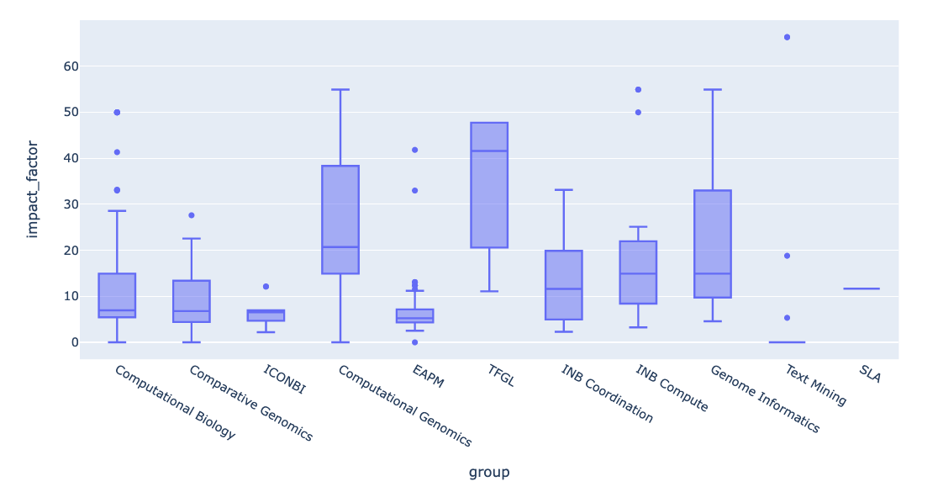

Impact factor
Per group - boxplots
Notes:
The impact factor (IF) reflects the yearly mean number of citations of articles published in the last two years in a given journal. As a journal-level metric, it is frequently used as a proxy for the relative importance of a journal within its field
Here we see a boxplot per group showing the impact factor of each group publications. It’s interesting to consider here that some research groups get higher median IF because they publish in more prestigious journals because of the topic of research. For instance, Computational Genomics and TFGL, which get higher median IF, study cancer. TFGL has very good results but in this case the GL is still publishing with her previous institution (Harvard university), so this are not really publications out of her current work at the institute, and there are a lot of authors involved. We can also see how comparative genomics, which is the group with more publications, has a lower impact factor. They mainly study the genomics of different animals and vegetables, which is very useful for applied research but is not as “famous” and “fashionable” as other fields of study.
The influcence on trends and other varialbes like author position or role in the publications challenge the idea of IF being almost the only indicator considered,

Slide 7
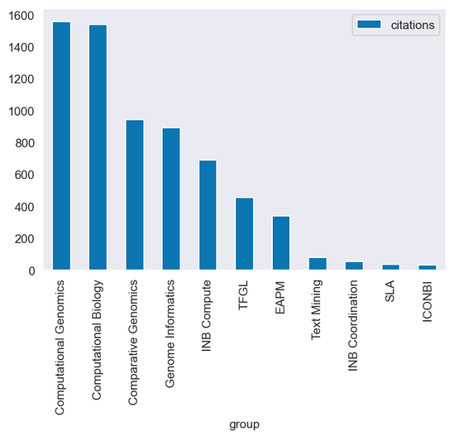
Citations
Per group
Notes:
Citations refer to the number of times that a publication has been cited (i.e. referenced) by other publications
Of course the total sum of citations is related to the amount of publications but not fully related. Comparative genomics is the group with more publications but they are not as cited as the fewer publications from the computational genomics group. This is similar to impact factor - there are topics that are much more studied because of their larger direct impact on society and population. But this is not at all related to scientific relevance or quality

Slide 8
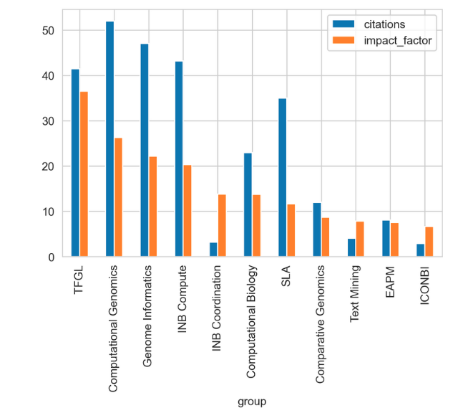
Impact factor & citations
Per group – mean
Notes:
This plot compares the mean impact factor and mean citations per group. As we have seen in the two previous slides both indicators have to be analysed cautiously, since other factors come into play. Here we see the group with a better mean impact factor is the TFGL, but resarch has not been directed from this group at the BSC, but at Harvard, where the GL at the BSC work previously as postdoc
So, we need to know that IF and citations are the two indicators mainly used to evaluate research quality and impact but others have to be considered as well for a thorough analysis which go beyond the scope of this project

Slide 9
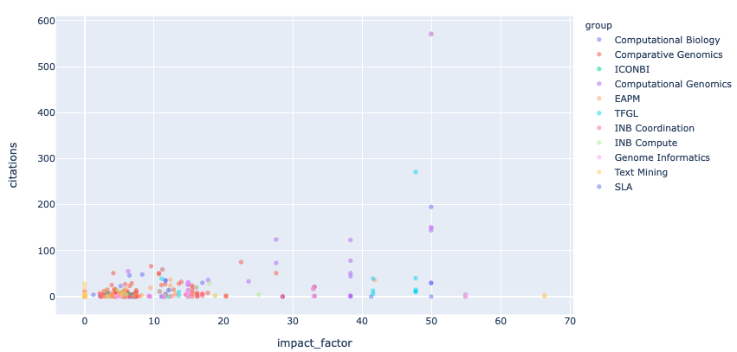
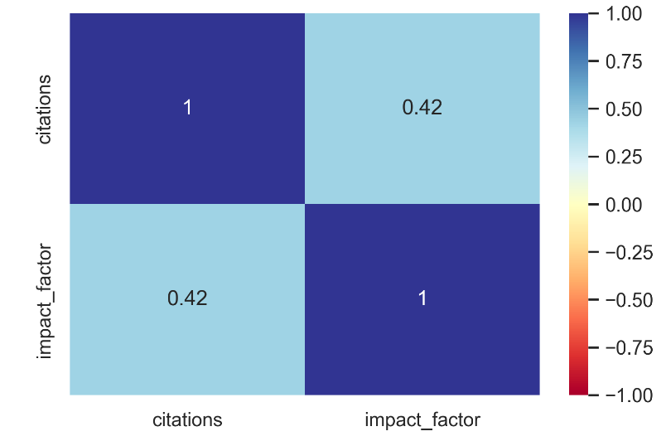
Impact factor & citations
Are they correlated?
Notes:
In this scatterplot we see the relation between impact factor and citations and how they seem to be correlated somehow but not fully. This is why I wanted to check their correlation with a heatmap, which shows that at least in this case they are not fully correlated

Slide 10
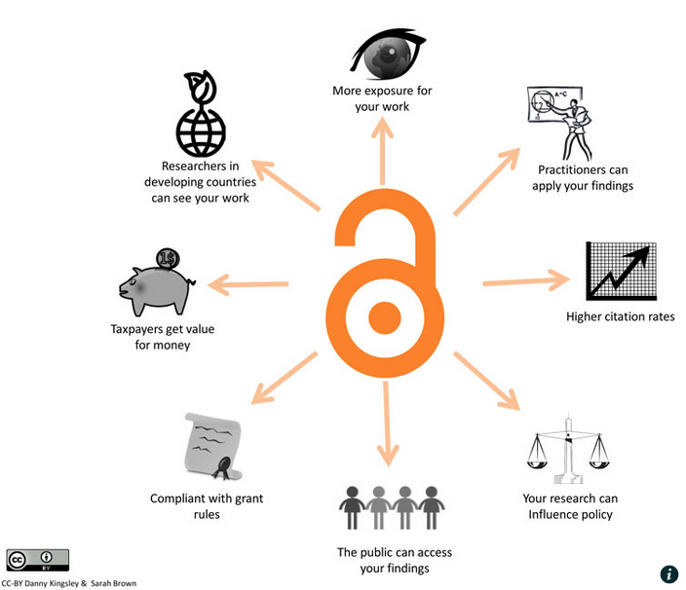
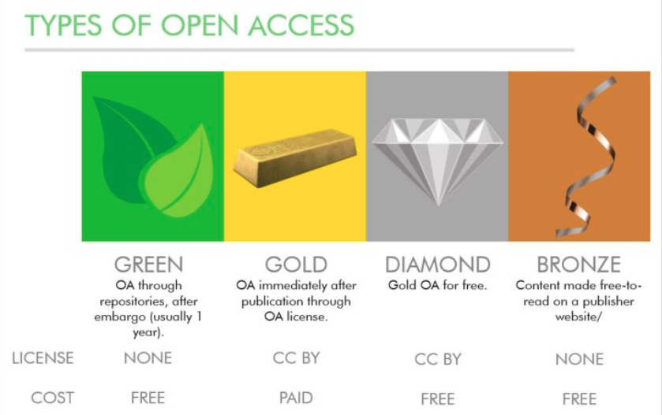
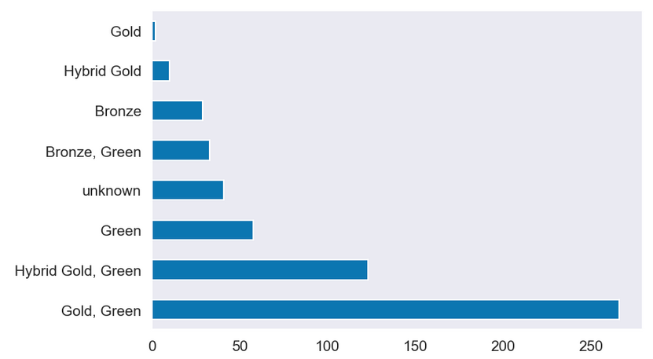
Open Access
Notes:
OA aims at making research available to everyone so anyone can benefit from reading and using research. The European Commission (EC) now requires open access to all peer reviewed research articles resulting from projects funded by the European Commission, this is why almost all publications comply with this requirement:
The most frequent types in this case are
Green – available in institutional repositories 1 year after publication. And has no cost for the authors or institutions
Gold – OA immediately available after publication. Institutions pay to make their publication available in open access

Slide 11
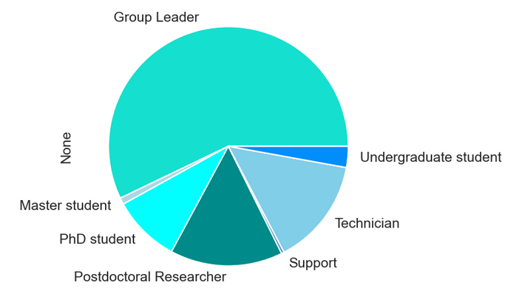
57%
Professional category
3%
1%
14%
9%
<1%
15%
Total department staff: 160
Notes:
Here we see the distribution of publications per professional category. We see group leaders publish way more than the rest of categories, which makes sense, because they sign all the publications produced within the group and usually have collaborations with other institutes that result in more publications signed by them, whereas as younger researchers are not independent and publish usually within the group only, and always with their GL

Slide 12
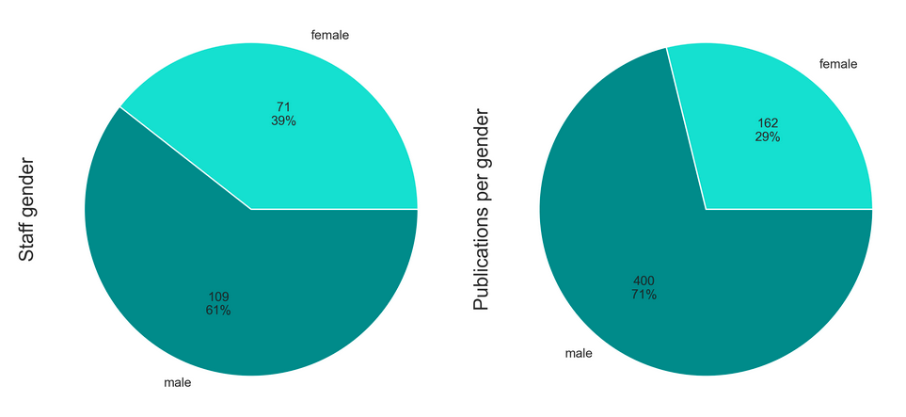
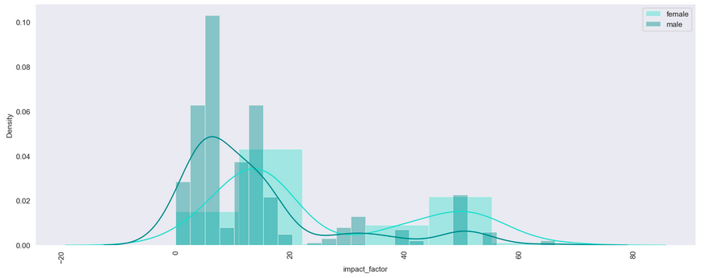
Gender
Notes:
I also wanted to check how are we doing in terms of gender balance. At the staff level, men continue to be majority but we are moving towards a balanced staff. Strong efforts are being put to hire women in leading positions, since most of these 39% of women have lower positions (support, technicians). We see that in terms of publications the unbalance grows, since most women do not participate directly in research and work more on support/technical areas. And of course they usuall suffer from a worse life-work balance, since some of these women take care of domestic and familiy responsabilities, while men don’t or much less than women in general. As seen in the distribution plot, though, women publish less but they get higher impact factor

Slide 13
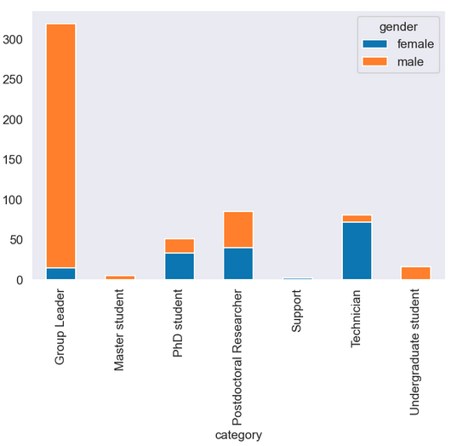
Gender & category
Notes:
In this final slide I wanted to compare gender and professional category to further explore the gender unbalance when it comes to publishing scientific articles. Here we see women are still publishing much less, even the ones that hold GL positions. It is interesting to highligh that all undergrad students are men. Since doing internships is not mandatory at this level, women refrain from contacting research institutes to do internships, but men are typically bolder and have no problem in asking for internships. Women tend to think they are not good enough at this stage, while men see internships as a perfect opportunity to get started in research

Slide 14





Conclusions
Good publications track
Impact factor is challenged
The department is doing great in terms of publications, impact and citations. A comparative among other similar institutes/departments would be necessary as a next step.
If citations and impact factor are not correlated at the publications and authors level, we should question the importance of this metric for journals. More “catchy” topics get published in journals with higher IF.
Open access
Gender unbalance
The department is committed to open access and most publications meet this requirement from public research funders. OA benefits society but also authors and research institutes, since they get more citations.
Staff is quite balanced in terms of gender, but women are still far away from independent positions and, therefore, publish less than men. As a next step it would be interesting to study the effects that the pandemic and the lockdown may have had on this.

Slide 15
Thank you!
Time for questions ☺

