Slide 1
IMMIGRATION IN THE U.S.
DATA ANALYTICS PROJECT 2:ALL WOMEN
DECEMBER 22, 2021
RIAN VAN NORDHEIM

Slide 2
IMMIGRATION MILESTONES THROUGH TIME…
1776: Country Founded
1820–1860: Irish immigration wave
1891, 1917, and 1924: Immigration Acts
1948: Displaced Persons Act
1980: Mariel Boatlift
2001: DREAM Act (Development, Relief, and Education of Alien Minors
2017: Trump Muslim ban
American Revolutionary War
1/3 of all immigrants are of Irish descent, with a good proportion coming from Germany
Limits immigrants to the country based on health status, criminality, literacy, nationality; establishing a quota system by 1924
First refugee and resettlement law for European immigrants after WWII
Chad, Yemen, Iran, Libya, Somalia, Syria as well as North Korea and Venezuela banned
1790: Naturalization Act and first US Census
1880: Chinese Exclusion Act
1942: Bracero Program
1965: Immigration and Nationality Act
1986: Simpson-Mazzoli Act
2012: DACA (Defrerred Action for Childhood Arrivals)
late 2019-NOW: Covid-19

Slide 3
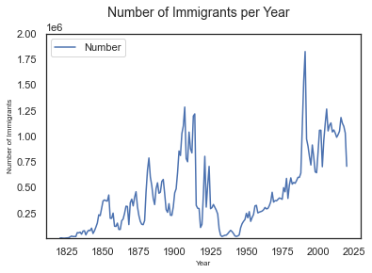
WAVES AND WAVES
Immigration comes in waves.
Immigration acceptance or rejection also comes in waves depending on the benefit and sentiment of the US population.

Slide 4
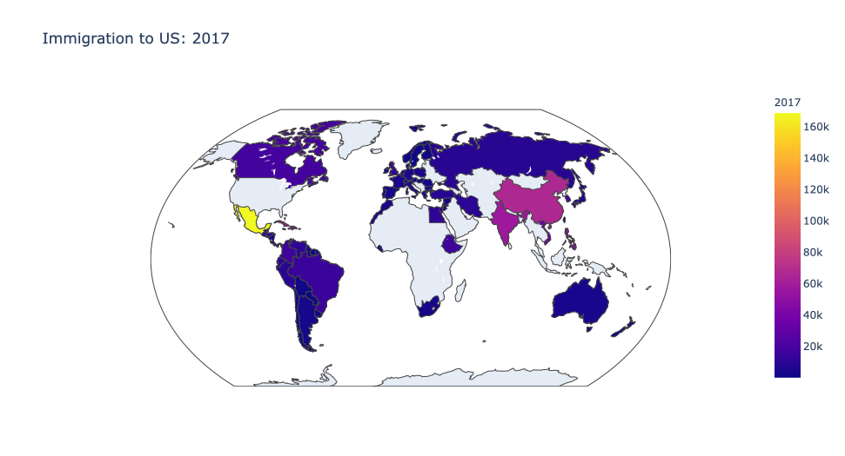
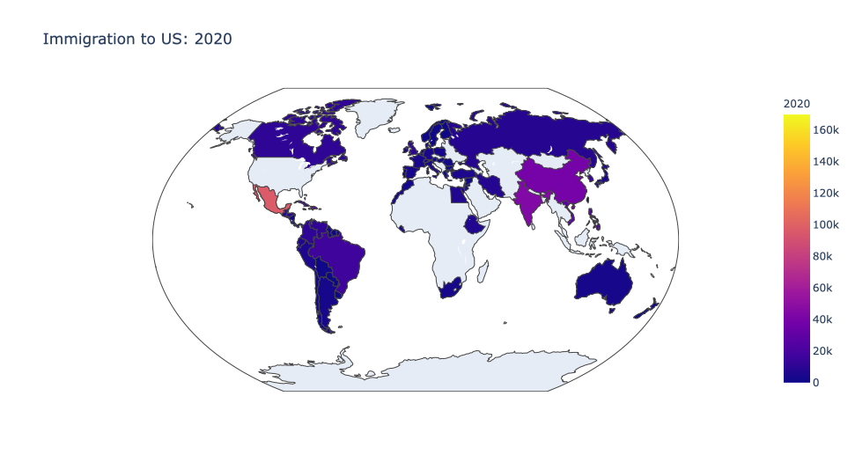
WHAT NATIONS ARE COMING TO THE US?
2017 TOP 5:
MEXICO (~169K)
CHINA (~66.5K)
CUBA (~65K)
DOMINICAN REPUBLIC (~58K)
INDIA (55K)
2020 TOP 5:
MEXICO (96K)
INDIA (44K)
CHINA (39K)
DOMINICAN REPUBLIC (29.7K)
PHILIPPINES (29.3K)

Slide 5
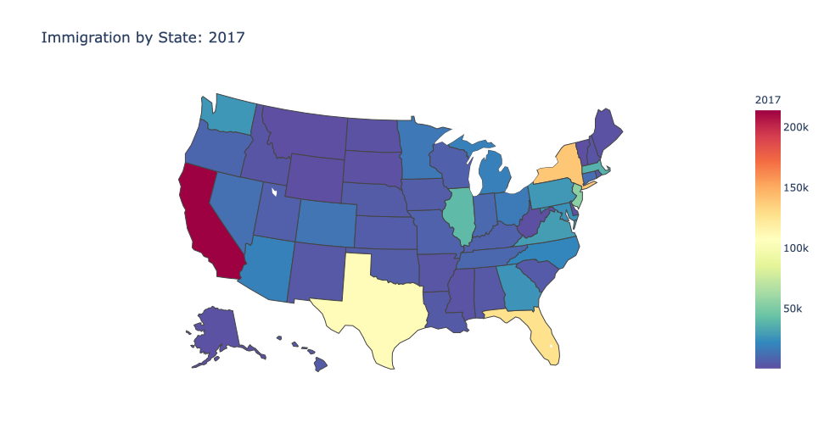
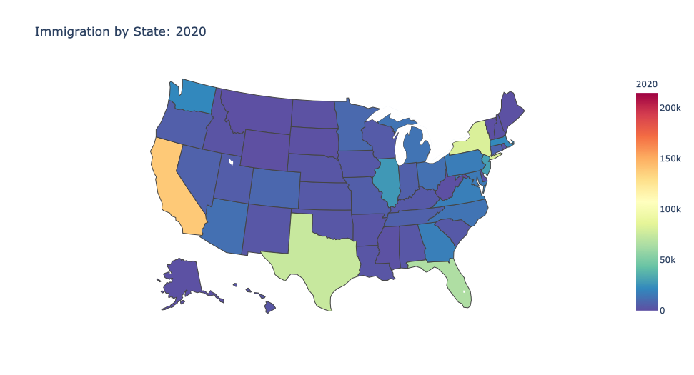
WHAT STATES ARE IMMIGRANTS SETTLING IN?
TOP 5 STATES: 2017
CALIFORNIA
NEW YORK
FLORIDA
TEXAS
NEW JERSEY
TOP 5 STATES: 2020
CALIFORNIA
NEW YORK
TEXAS
FLORIDA
NEW JERSEY

Slide 6
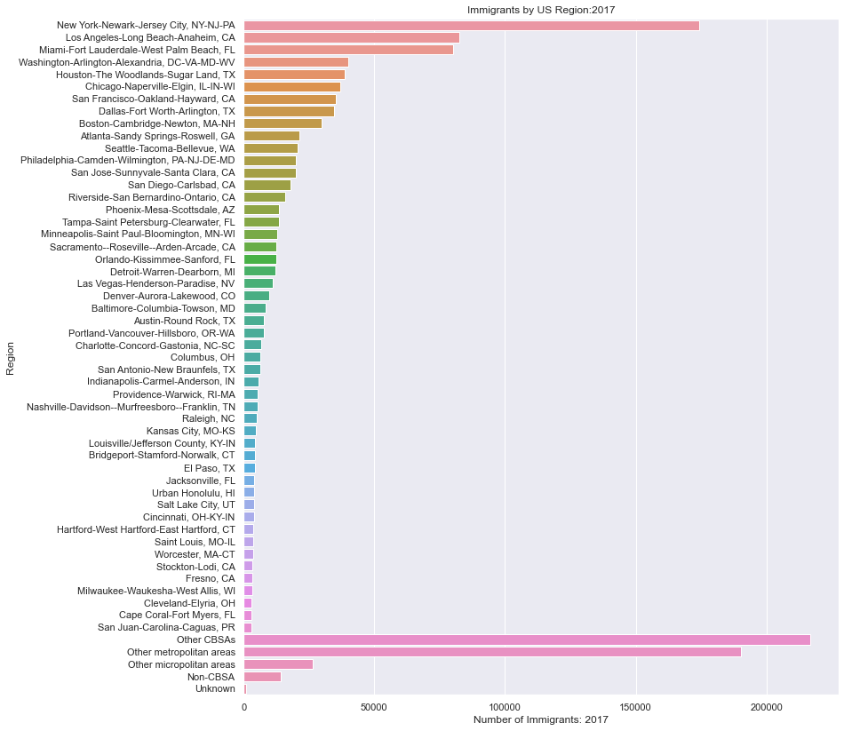
WHAT CITIES ARE IMMIGRANTS MOVING TO?
New York and Los Angeles with the majority
8 cities in California are represented
CBSA: Core Based Statistical Area
Defined as being one or more combined counties with an urban core area of at least 10,000 people
Ex. Los Angeles-Long Beach-Anaheim
Other Metropolitan
At least 50,000+ people
Other Micropolitan
Between 10,000 and 50,000 people

Slide 7

WHO IS COMING TO THE US?

Slide 8
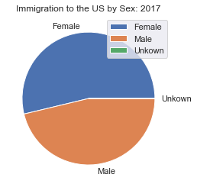
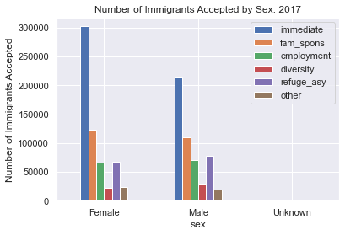
MEN VS. WOMEN: 2017
WOMEN WIN!

Slide 9
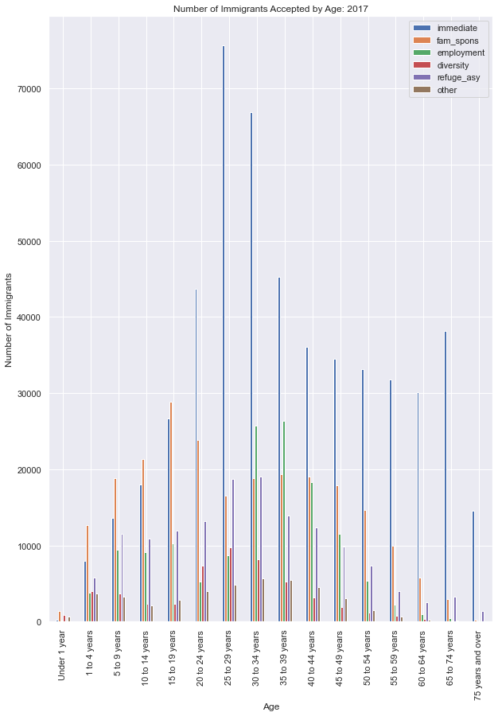
AGE: 2017
PEAK AGE RANGE: 25-29 YEAR OLDS

Slide 10
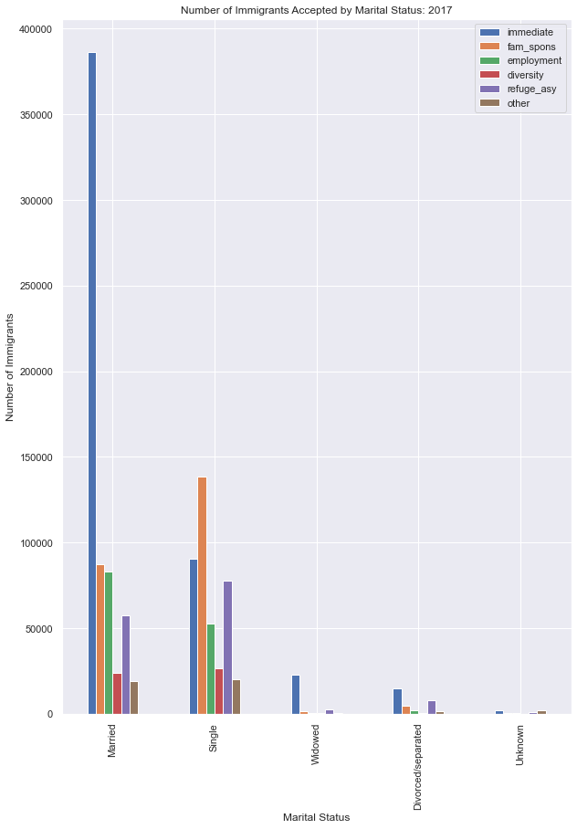
MARITAL STATUS: 2017
MARRIED FOLKS LEADING THE WAY

Slide 11
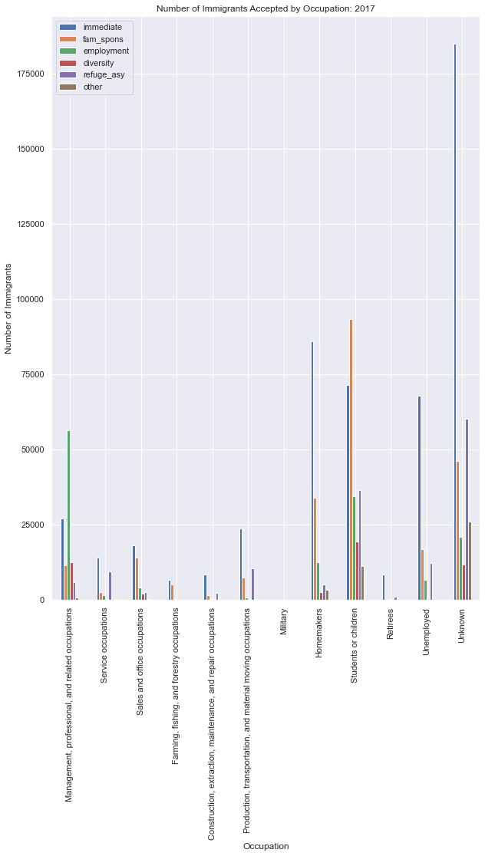
OCCUPATION: 2017
Unknown occupations among immediate family members leading with family sponsored students coming in second

Slide 12
BUT WHAT DOES IT ALL MEAN?
THE TYPICAL IMMIGRANT IS MOST LIKELY:
TO COME FROM MEXICO
SETTLE IN CALIFORNIA
MOST LIKELY IN LOS ANGELES BUT COULD ALSO RESIDE IN:
SAN FRANCISCO
SAN JOSE
SAN DIEGO
RIVERSIDE
SACRAMENTO
STOCKTON
FRESNO
MARRIED
FEMALE
BETWEEN THE AGES OF 25-29YEARS OLD
JOIN IMMEDIATE FAMILY MEMBERS
HAVE AN UNDISCLOSED OCCUPATION

Slide 13
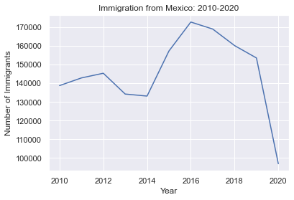
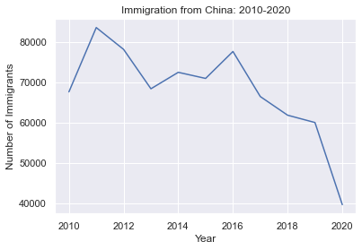
IS THIS ACCURATE…
IMMIGRATION FROM MEXICO HAS BEEN SLOWLY DECLINING, WHILE MAINTAINING ITS NUMBER ONE STATUS
PRIOR TO 2020, IMMIGRATION FROM CHINA HAD BEEN RELATIVELY POSITIVE BUT FOLLOWING THE SAME DECLINING TREND

Slide 14
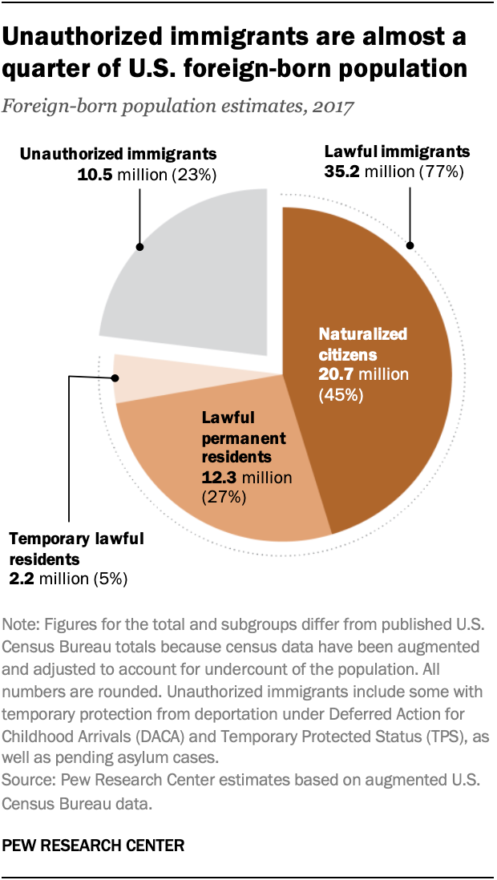
SOMETHING TO CONSIDER…
The data presented only accounts for what is considered ”lawful” immigration: naturalized citizens, permanent residents and temporary residents those who have entered the country legally and undergone the vetting process of becoming a citizen, obtaining and green card or the appropriate visa. It does not account for the undocumented or unauthorized cases.
Undocumented or unauthorized are those that have entered the country illegally or legally but have overstayed their visa allowance.

Slide 15

ROLL THE CREDITS
Data obtained from the Department of Homeland Security
With supplemental data/ insight provided by the Pew Research Center

