Slide 1
Category Learning
Directions

Slide 2
Now we will play a game,
and you can earn bonus money!

Slide 3
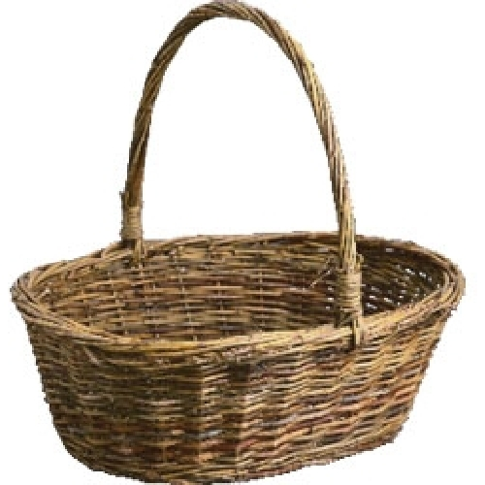
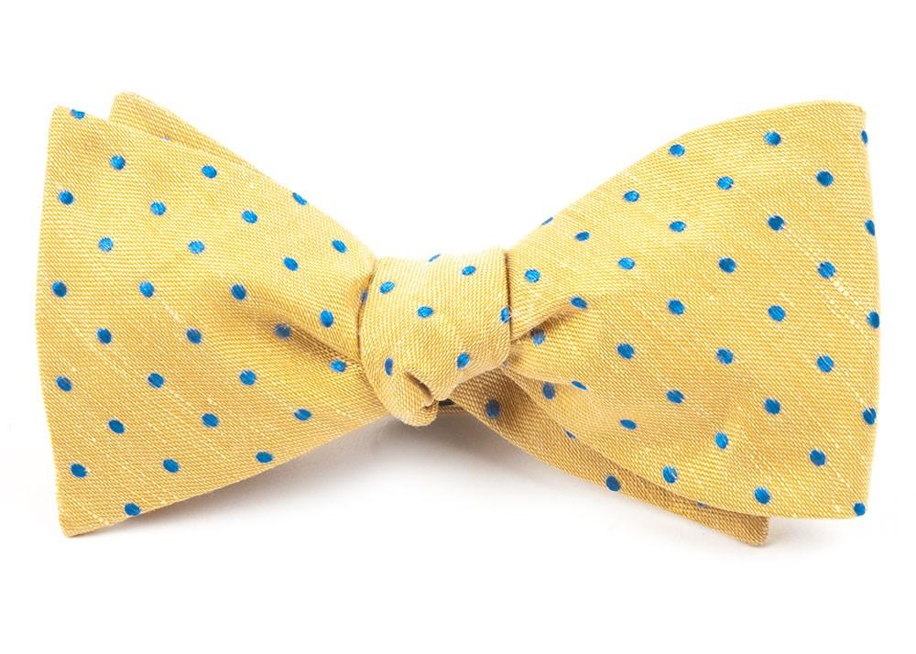
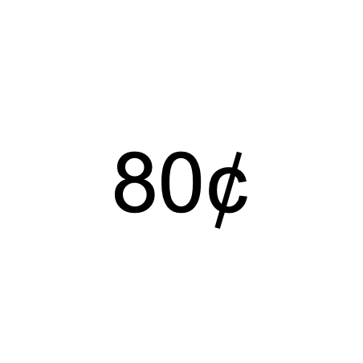
You will see two objects on the screen, and you will choose one.
Each object can win money!
Each object can win 0¢, 20¢, 40¢, 60¢, 80¢, or $1.
After you make your choice, you will see a + on the screen for a few seconds. Then you will see how much you won.
+

Slide 4
Every object is always worth the same amount of money.
If you see the same object again, it will win the same amount.
So if you choose the yellow bowtie and win 80¢,
it will be worth 80¢ the next time you see it.
+
+

Slide 5
Try to win as much as you can!
Choosing objects that are worth more will help you win more bonus money.
You will get a portion of the money that you win as bonus. You can earn up to $2 each round.
After each round, you will see how much money you won on that round. You will see how much total bonus you won at the end of the game.

Slide 6

To choose the left object, press your pointer finger.
To choose the right object, press your middle finger.
You will have up to 1.5 seconds to make your choice.
If you are too slow, you will see
“Please respond more quickly” on the screen,
and the same decision will repeat.
Choose Left
Choose Right

Slide 7
You will play 6 rounds of this game.
Each round will last about 6 minutes.
We will check in with you after each round, and you can take a short break.
Please stay as still as possible when the scanner is making noise!

Slide 8
Now you will take a short quiz to make sure that you understand the directions.
Please ask us any questions now if you don’t understand how the game works.
Press your pointer finger to start.

Slide 9
Category Memory

Slide 10
Now you will be asked about the category of objects you have seen

Slide 11
We will show you names of categories.
For each category, tell us how much it was worth in the Objects game from 0¢ to 100¢.
You may verbally say any number between 0 to 100.
If you can’t remember, please give us your best guess.
You will not be given feedback on your answer.
What is the value of this category?
(0¢ - 100¢)
bowtie
83

Slide 12
When you are ready to start please press your pointer finger.

Slide 13
Size Task

Slide 14
Now you will play the size game!

Slide 15
You will see two objects on the screen.
Choose the bigger object!
Choose the object that is bigger in the real world. The size of the image on the screen does not matter.

Slide 16
To choose the left object, press your pointer finger.
To choose the right object, press your middle finger.
You will have up to 1.5 seconds to make your choice.
If you are too slow, you will not earn bonus money for that decision.
Choose Left
Choose Right

Slide 17
In this example, the bicycle is bigger than the bow tie.
So you should press your middle finger to choose the right object.
After you make your choice, you will see a + on the screen for a few seconds.
You will not receive feedback after your choice.
But you can still win bonus money for responding correctly! You can earn up to $2 each round.
+

Slide 18
You will play 2 rounds of this game.
Each round will last about 4 minutes.
We will check in with you after each round, and you can take a short break.
Please stay as still as possible when the scanner is making noise!

Slide 19
Now you will take a short quiz to make sure that you understand the directions.
Please ask us any questions now if you don’t understand how the game works.
Press your pointer finger to start.

Slide 20
RL Task

Slide 21
Now you will play the ball game!

Slide 22
You will see two balls on the screen, and you will choose one.
Each ball can win money!
Each ball can win 0¢, 20¢, 40¢, 60¢, 80¢, or $1.
After you make your choice, you will see a + on the screen for a few seconds. Then you will see how much you won.
You will get a portion of the money that you win as bonus. You can earn up to $2 each round.
+

Slide 23
In this game, your job is to choose the ball that wins the most money.
Sometimes, you might have to guess. During the game, the amount of money each ball wins might change. Try to choose the ball that wins more money most of the time.
The balls will change sides, but this does not affect how much the balls are worth.
+

Slide 24
To choose the left ball, press your pointer finger.
To choose the right ball, press your middle finger.
You will have up to 1.5 seconds to make your choice.
If you are too slow, you will see
“Please respond more quickly” on the screen.
Choose Left
Choose Right

Slide 25
You will play 1 rounds of this game.
It will last about 4 minutes.
Please stay as still as possible when the scanner is making noise!

Slide 26
Now you will take a short quiz to make sure that you understand the directions.
Please ask us any questions now if you don’t understand how the game works.
Press your pointer finger to start.

Slide 27
MTURK

Slide 28
Category Learning
Directions

Slide 29
Now we will play a game,
and you can earn bonus money!

Slide 30
You will see two objects on the screen, and you will choose one.
Each object can win money!
Each object can win 0¢, 20¢, 40¢, 60¢, 80¢, or $1.
After you make your choice, you will see a + on the screen for a few seconds. Then you will see how much you won.
+

Slide 31
Every object is always worth the same amount of money.
If you see the same object again, it will win the same amount.
So if you choose the yellow bowtie and win 80¢,
it will be worth 80¢ the next time you see it.
+
+

Slide 32
Try to win as much as you can!
Choosing objects that are worth more will help you win more bonus money.
You will get a portion of the money that you win as bonus. You can earn up to 50¢ each round.
After each round, you will see how much money you won on that round. You will see how much total bonus you won at the end of the game.

Slide 33
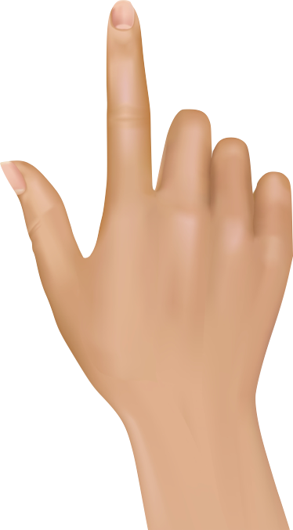
To choose the left object, press the D key.
To choose the right object, press the K key.
You will have up to 1.5 seconds to make your choice.
If you are too slow to respond, you will see
“TOO SLOW” on the screen,
and the same decision will repeat.

Slide 34
You will play 6 rounds of this game.
Each round will last about 6 minutes.
After each round, you can take a short break.

Slide 35
Now you will take a short quiz to make sure that you understand the directions.
Press NEXT to start.

Slide 36
Category Memory

Slide 37
Now you will be asked about the category of objects you have seen

Slide 38
We will show you names of categories.
For each category, tell us how much it was worth in the Objects game, by entering a number from 0¢ to 100¢.
If you can’t remember, please give us your best guess.
You will not be given feedback on your answer.
What is the value of this category?
(0¢ - 100¢)
bowtie
83

Slide 39
When you are ready to start please press NEXT.

Slide 40
Size Task

Slide 41
Now you will play the size game!

Slide 42
You will see two objects on the screen.
Choose the bigger object!
Choose the object that is bigger in the real world. The size of the image on the screen does not matter.

Slide 43
To choose the left object, press the D key.
To choose the right object, press the K key.
You will have up to 1.5 seconds to make your choice.
If you are too slow to respond, you will not earn bonus money for that decision.

Slide 44
In this example, the bicycle is bigger than the bow tie.
So you should press the K key to choose the right object.
After you make your choice, you will see a + on the screen for a few seconds.
You will not receive feedback after your choice.
But you can still win bonus money for responding correctly! You can earn up to 50¢ each round.
+

Slide 45
You will play 2 rounds of this game.
Each round will last about 4 minutes.
After each round, you can take a short break.

Slide 46
Now you will take a short quiz to make sure that you understand the directions.
Press NEXT to start.

Slide 47
RL Task

Slide 48
Now you will play the ball game!

Slide 49
You will see two balls on the screen, and you will choose one.
Each ball can win money!
Each ball can win 0¢, 20¢, 40¢, 60¢, 80¢, or $1.
After you make your choice, you will see a + on the screen for a few seconds. Then you will see how much you won.
You will get a portion of the money that you win as bonus. You can earn up to 50¢ each round.
+

Slide 50
In this game, your job is to choose the ball that wins the most money.
Sometimes, you might have to guess. During the game, the amount of money each ball wins might change. Try to choose the ball that wins more money most of the time.
The balls will change sides, but this does not affect how much the balls are worth.
+

Slide 51
To choose the left ball, press the D key.
To choose the right ball, press the K key.
You will have up to 1.5 seconds to make your choice.
If you are too slow to respond, you will see
“TOO SLOW” on the screen.

Slide 52
You will play 1 rounds of this game.
It will last about 4 minutes.

Slide 53
Now you will take a short quiz to make sure that you understand the directions.
Press NEXT to start.

Slide 54
Old

Slide 55
After you make a choice, you will see a + on the screen for a few seconds. Next, you will get feedback telling you if you are correct or incorrect.
Do you have any questions?
Press space to start the practice.

Slide 56
In this game, your job is to find the correct picture. Sometimes, you might have to guess. During the game, the correct picture might change. Try to choose the picture that is correct most of the time.
There will be two pictures on the screen, one on the left and one on the right. Press the button with your pointer finger to choose the shape on the left, and press the button with your middle finger to choose the shape on the right. The shapes will change sides, but this does not affect whether or not the shape is correct.
Make your choice as fast as you can. Once you choose, a box will show up on the screen. If you choose too late, your choice will not count.
After you make a choice, you will see a + on the screen for a few seconds. Next, you will get feedback telling you if you are correct or incorrect.

Slide 57
There will be two pictures on the screen, one on the left and one on the right. Press the button with your pointer finger to choose the picture on the left, and press the button with your middle finger to choose the picture on the right. The pictures will change sides, but this does not affect whether or not the picture is correct.
Make your choice as fast as you can. Once you choose, a box will show up on the screen. If you choose too late, your choice will not count.
Press the button now to make a choice.

