Slide 1
Welcome to the experiment!
In this experiment, we will show you pairs of images presented one after the other.
The two images will appear one after the other.
When you see a ”+” sign on the screen, you may enter either the “D” or “K” keys to make a decision.

Slide 2
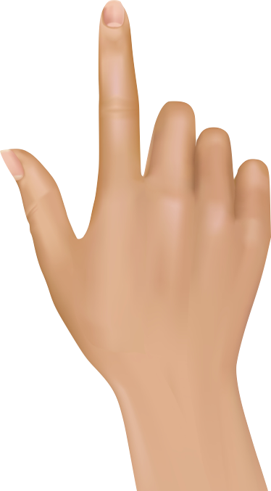
Welcome to the experiment!
In this experiment, we will show you pairs of images presented one after the other.
Two images will appear one after the other, with a “+” in between.
When you see the prompt “MAKE A CHOICE”, you may enter either the “D” or “K” keys to make a decision.
You will learn how to choose “D” vs. “K” correctly on your own
+
MAKE A CHOICE

Slide 3
Welcome to the experiment!
In this experiment, we will show you pairs of images presented one after the other.
When the black square appears on the screen, you will have 2 seconds to press the SPACE bar.
Then, two images will appear one after the other, with a “+” in between.
When you see the prompt “MAKE A CHOICE”, you may enter either the “D” or “K” keys to make a decision.
You will learn how to choose “D” vs. “K” correctly on your own
+
MAKE A CHOICE

Slide 4


If you are correct you will see a green mark, if you are incorrect you will see a red cross (see below).
Correct
Incorrect
You can earn bonus money (up to $10) the more you choose the Correct answer.
You will have up to 3 seconds to make your decision.
If you are too slow to respond, you will see “TOO SLOW” on the screen,
your answer will be considered Incorrect and you will not earn bonus money for that decision.

Slide 5


Slide 6


