Slide 1
Welcome to the experiment!
In this experiment, we will show you pairs of images presented one after the other, and you are asked to choose one of them.
The two images will appear one after the other.
When you see a ”+” sign on the screen, you may enter either the “D” or “K” keys to make a decision.

Slide 2
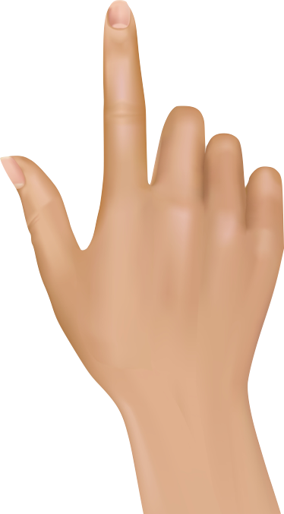
Welcome to the experiment!
In this experiment, we will show you pairs of images presented one after the other, and you are asked to choose one of them.
Two images will appear one after the other, with a “+” in between.
When you see the prompt “MAKE A CHOICE”, you may enter either the “D” or “K” keys to make a decision.
You will learn how to choose “D” vs. “K” correctly on your own
+
MAKE A CHOICE

Slide 3
Welcome to the experiment!
In this experiment, we will show you pairs of images presented one after the other, and you are asked to choose one of them.
Two images will appear one after the other, with a “+” in between.
When you see the prompt “MAKE A CHOICE”, you may enter either the “D” or “K” keys to make a decision.
To choose the first image press the “D” key, and to choose the second image press the “K” key.
+
MAKE A CHOICE

Slide 4
Welcome to the experiment!
In this experiment, we will show you pairs of images presented one after the other, and you are asked to choose one of them.
Two images will appear one after the other, with a “+” in between.
When you see the prompt “MAKE A CHOICE”, you may enter either the “D” or “K” keys to make a decision.
To choose the first image press the “K” key, and to choose the second image press the “D” key.
+
MAKE A CHOICE

Slide 5
Welcome to the experiment!
In this experiment, we will show you pairs of images presented one after the other, and you are asked to choose one of them.
When the black square appears on the screen, you will have 2 seconds to press the SPACE bar.
Then, two images will appear one after the other, with a “+” in between.
When you see the prompt “MAKE A CHOICE”, you may enter either the “D” or “K” keys to make a decision.
You will learn how to choose “D” vs. “K” correctly on your own
+
MAKE A CHOICE

Slide 6
Welcome to the experiment!
In this experiment, we will show you pairs of images presented one after the other, and you are asked to choose one of them.
When the black square appears on the screen, you will have 2 seconds to press the SPACE bar.
Then, two images will appear one after the other, with a “+” in between.
When you see the prompt “MAKE A CHOICE”, you may enter either the “D” or “K” keys to make a decision.
To choose the first image press the “D” key, and to choose the second image press the “K” key.
+
MAKE A CHOICE

Slide 7
Welcome to the experiment!
In this experiment, we will show you pairs of images presented one after the other, and you are asked to choose one of them.
When the black square appears on the screen, you will have 2 seconds to press the SPACE bar.
Then, two images will appear one after the other, with a “+” in between.
When you see the prompt “MAKE A CHOICE”, you may enter either the “D” or “K” keys to make a decision.
To choose the first image press the “K” key, and to choose the second image press the “D” key.
+
MAKE A CHOICE

Slide 8
Welcome to the experiment!
In this experiment, we will show you pairs of images presented one after the other, and you are asked to choose one of them.
Two images will appear for a short time one after the other, with a “+” in between.
You can make your decision once the second image appears on the screen, and while you see the screen “MAKE A CHOICE”.
You may enter either the “D” or “K” keys to make a decision. You will learn how to choose “D” vs. “K” correctly on your own.
+
MAKE A CHOICE

Slide 9
Welcome to the experiment!
In this experiment, we will show you pairs of images presented one after the other, and you are asked to choose one of them.
Two images will appear for a short time one after the other, with a “+” in between.
You can make your decision once the second image appears on the screen, and while you see the screen “MAKE A CHOICE”.
To choose the FIRST image press the “K” key, and to choose the SECOND image press the “D” key.
+
MAKE A CHOICE

Slide 10
Welcome to the experiment!
In this experiment, we will show you pairs of images presented one after the other, and you are asked to choose one of them.
Two images will appear for a short time one after the other, with a “+” in between.
You can make your decision once the second image appears on the screen, and while you see the screen “MAKE A CHOICE”.
To choose the FIRST image press the “D” key, and to choose the SECOND image press the “K” key.
+
MAKE A CHOICE

Slide 11
Welcome to the experiment!
In this experiment, we will show you pairs of images presented one after the other, and you are asked to choose one of them.
When the black square appears on the screen, you will have 2 seconds to press the SPACE bar.
Then, two images will appear for a short time one after the other, with a “+” in between.
You can make your decision once the second image appears on the screen, and while you see the screen “MAKE A CHOICE”.
To choose the FIRST image press the “K” key, and to choose the SECOND image press the “D” key.
+
MAKE A CHOICE

Slide 12
Welcome to the experiment!
In this experiment, we will show you pairs of images presented one after the other, and you are asked to choose one of them.
When the black square appears on the screen, you will have 2 seconds to press the SPACE bar.
Then, two images will appear for a short time one after the other, with a “+” in between.
You can make your decision once the second image appears on the screen, and while you see the screen “MAKE A CHOICE”.
To choose the FIRST image press the “D” key, and to choose the SECOND image press the “K” key.
+
MAKE A CHOICE

Slide 13
Welcome to the experiment!
In this experiment, we will show you pairs of images presented one after the other, and you are asked to choose one of them.
When the black square appears on the screen, you will have 2 seconds to press the SPACE bar.
Then, two images will appear for a short time one after the other, with a “+” in between.
You can make your decision once the second image appears on the screen, and while you see the screen “MAKE A CHOICE”.
You may enter either the “D” or “K” keys to make a decision. You will learn how to choose “D” vs. “K” correctly on your own
+
MAKE A CHOICE

Slide 14


If you are correct you will see a green mark, if you are incorrect you will see a red cross (see below).
Correct
Incorrect
You can earn bonus money (up to $5) the more you choose the Correct answer.
You will have up to 2 seconds to make your decision.
If you are too slow to respond, you will see “TOO SLOW” on the screen,
your answer will be considered Incorrect and you will not earn bonus money for that decision.

Slide 15
You will now take a short quiz to make sure you understood the instructions.

Slide 16


Slide 17


