Slide 1
Coder Detox Spa Ruby Terminal Application
by Natalie Bottema

Slide 2
What is Coder Detox Spa?
The coder detox spa is a two-part application
The first part of the application allows the user to complete a quiz on programming in order to earn points for their spa wallet
The second part of the application allows users to cash in their points to ‘purchase’ spa treatments

Slide 3
DESIGN PROCESS & DECISIONS APPLICATION OBJECTIVES
Create an application that provides the user with an interactive and engaging way to revise programming concepts
The quiz aims to give the user a different approach to studying
Provide a virtual reward system for completing the quiz
The spa aims to be amusing and somewhat satirical

Slide 4
OVERVIEW APP FEATURES
Menu
Quiz
Treatments
Create a Booking
Change a Booking
Display Booking
Check Spa Points
Checkout

Slide 5
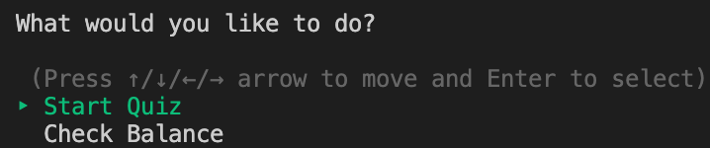
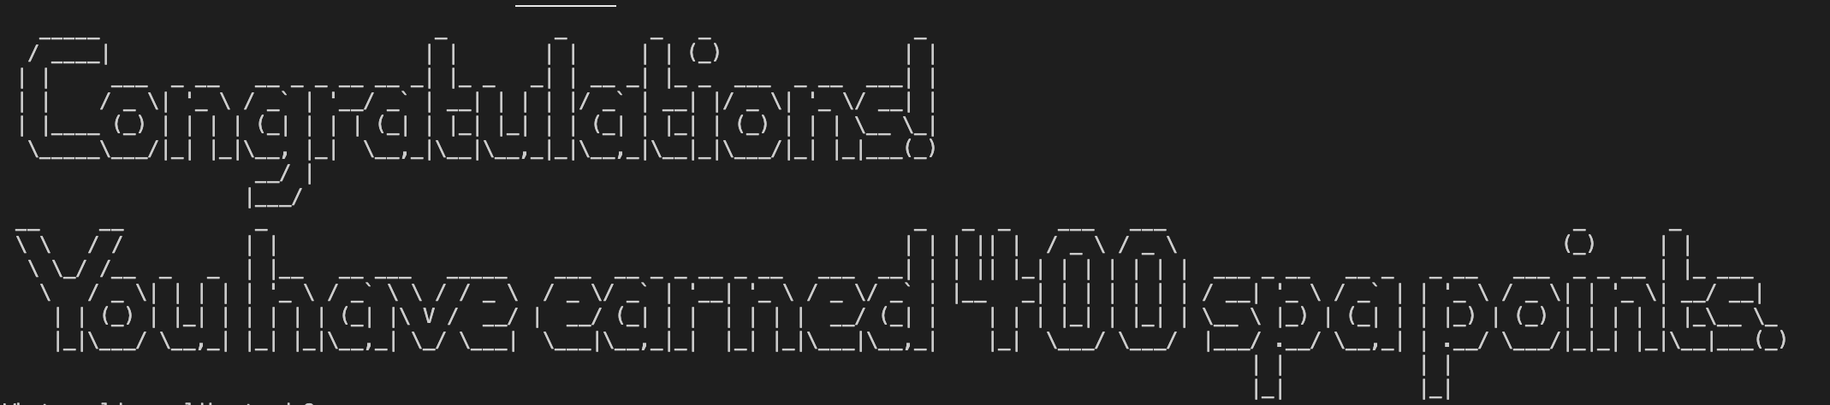
RUBY GEMS UTILISED
tty-prompt
colorize
Artii
tty-font
tty-progressbar
tty-box
pastel

Slide 6
OVERVIEW MENU FEATURE
The Coder Detox Spa has three menus, which include:
A Main Menu
A Treatments Menu
A Checkout Menu

Slide 7
CODE IMPLEMENTATION MENU FEATURE
Each menu utilises TTY-Prompt, which enables the user to select an option without the user entering invalid input
All three menu’s are structured utilizing a while loop, which breaks when the user selects exit

Slide 8
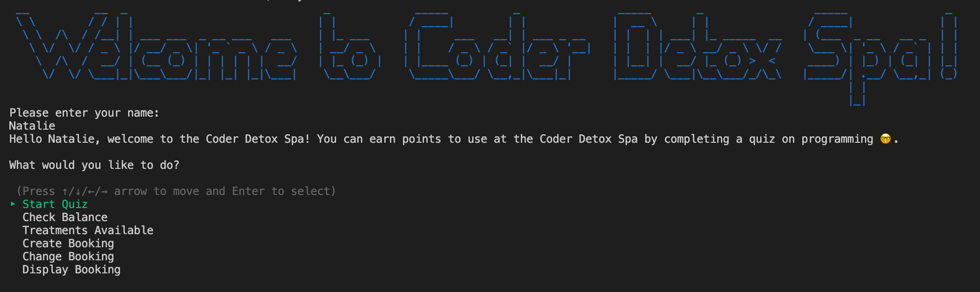
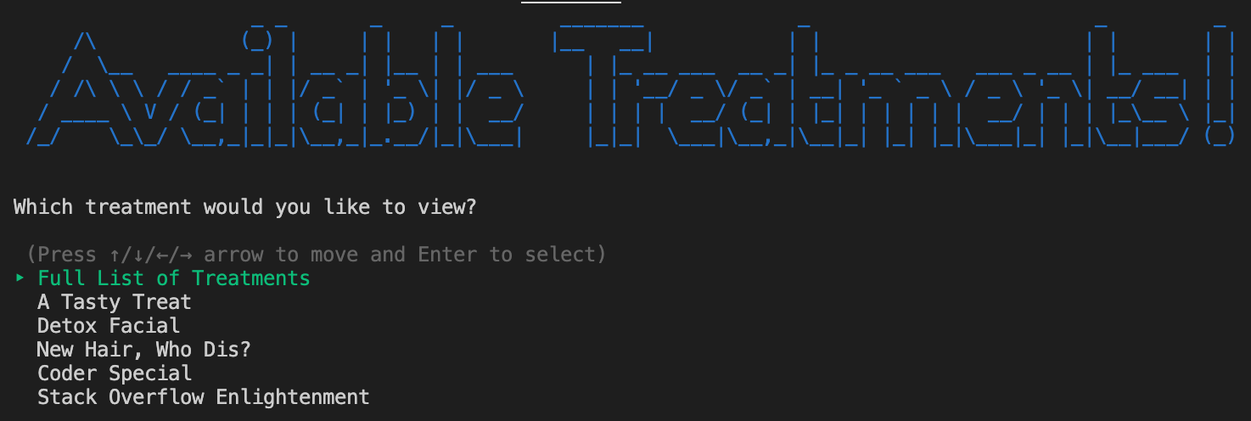
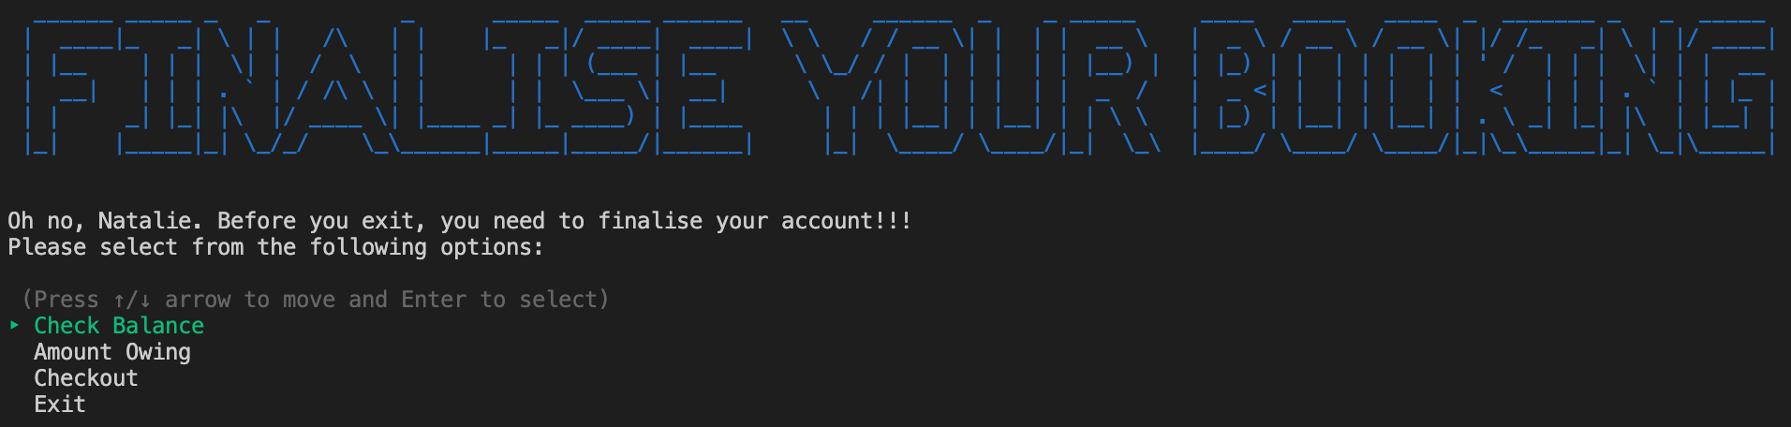
FINAL DESIGN MENU FEATURE

Slide 9
OVERVIEW QUIZ FEATURE
The user has the option to take a test on programming
The user is presented with 5 statements, in which the user is required to answer with either “true” or “false”.
When the user answers a question correctly they receive 50 points
After finishing the quiz the user is presented with a final score

Slide 10
CODE IMPLEMENTATION QUIZ FEATURE
A Quiz Class
Attributes of question, answer and score
An Array of Questions
- holds all new quiz class objects
A For loop
loops through all questions. When the User answers correctly a score is allocated to a score variable
A SpaPoints Class
- stores the users final score from the quiz as a SpaPoints object

Slide 11
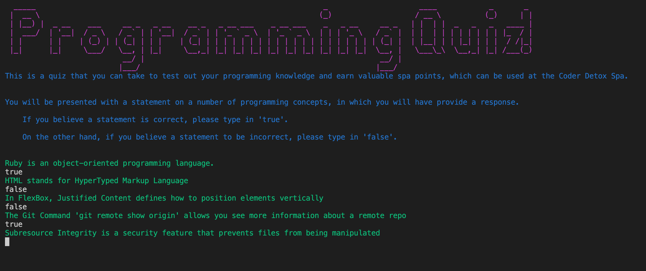
FINAL DESIGN QUIZ FEATURE

Slide 12
OVERVIEW TREATMENT FEATURE
Allows the User to view either a full list of treatments or individual treatments
Each treatment includes a name, a description and a price.
This provides the user with what is involved in the treatment and how many spa points they need to book the treatment.

Slide 13
CODE IMPLEMENTATION TREATMENT FEATURE
The code implemented in the treatment feature includes:
A treatment class with the attributes of name, description and price
THE FULL LIST OF TREATMENTS OPTION iterates over all individual treatments and puts to the screen for the user to view
THE INDIVIDUAL TREATMENT OPTION utilises a case statement to determine what individual treatment to print and accesses that treatment’s corresponding class attributes
The user accesses this information through the treatment menu

Slide 14
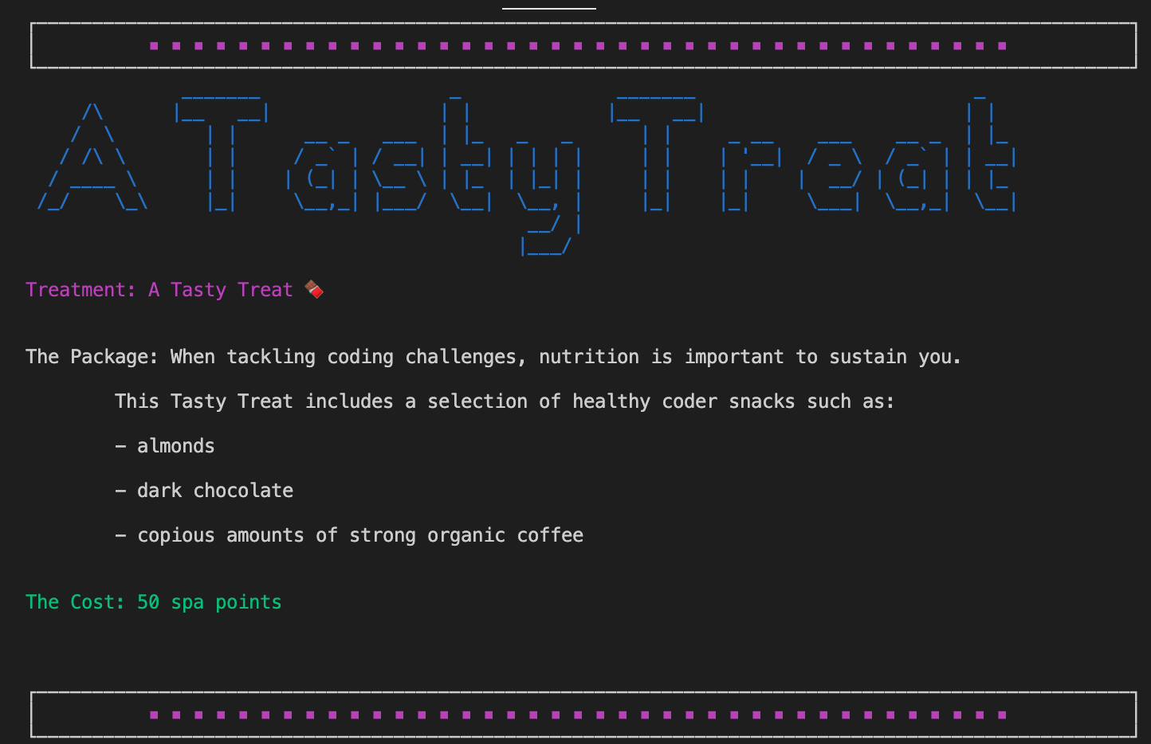
FINAL DESIGN TREATMENT FEATURE

Slide 15
OVERVIEW CREATE A BOOKING FEATURE
The Create a Booking Feature allows users to create a booking for a treatment
Through the menu prompts the user will be able to:
Select a treatment
Select a day
Select a time
After the user has selected all the above information, they will receive a message stating that they have secured a booking for their chosen treatment, day and time

Slide 16
CODE IMPLEMENTATION CREATE A BOOKING FEATURE
The code implemented in the create a booking feature includes:
Storing each piece of user input into a hash called booking. Storing the information in a hash will allow the program to easily display the booking details when the user requests them.
Furthermore, a booking class will also be implemented to store the booking in a secondary location as booking1. When a hash value pair is produced, the values are stored as a new booking class object.

Slide 17
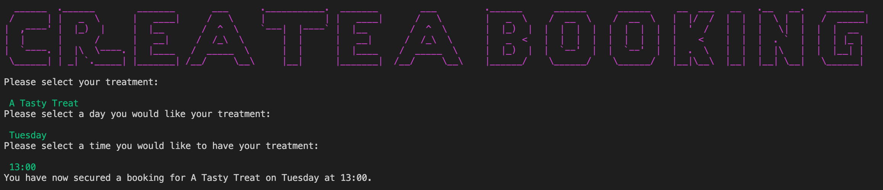
CODE IMPLEMENTATION CREATE A BOOKING FEATURE

Slide 18
OVERVIEW CHANGE A BOOKING FEATURE
The Change a Booking Feature allows the user to change their original treatment booking
Like the Create a Booking feature, the Change a Booking menu prompts the user to:
Select a treatment
Select a day
Select a time
After the user has selected all the above information, they will receive a message stating that they have secured a new booking for their chosen treatment, day and time. The user is also told that their original booking has been deleted.

Slide 19
CODE IMPLEMENTATION CHANGE A BOOKING FEATURE
The code implemented in the Change a Booking Feature includes:
Deleting the previous bookings key values from the bookings hash
Storing each new piece of user input into the booking hash.
A new booking class object will also be created as booking2, which utilises the values in the bookings hash

Slide 20
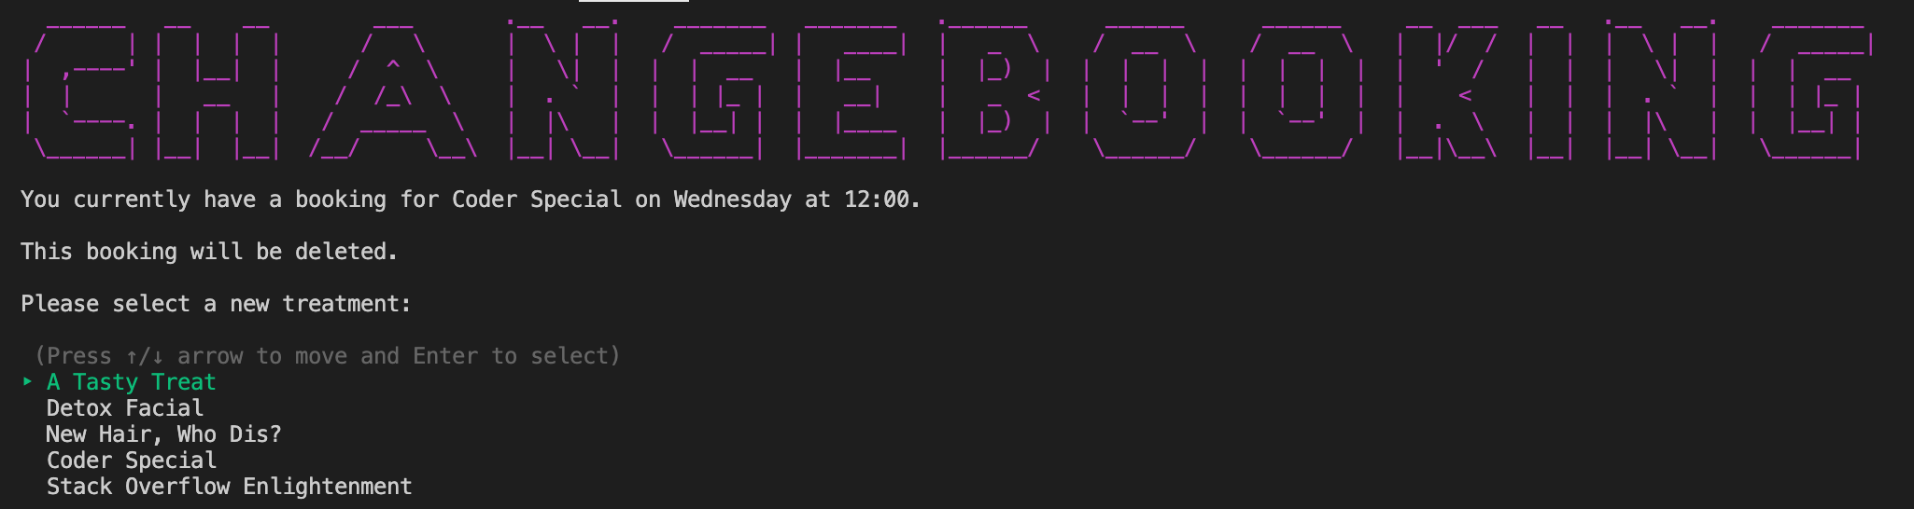
FINAL DESIGN CHANGE A BOOKING FEATURE

Slide 21
OVERVIEW & CODE IMPLEMENTATION DISPLAY BOOKING FEATURE
The Display Booking Feature allows users to view their future treatments
Display Booking feature code implementation accesses the treatment, description and price information by calling on the values stored in the bookings hash
This information is then puts to the screen for the user to view

Slide 22
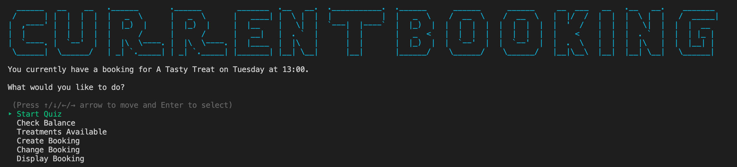
FINAL DESIGN DISPLAY BOOKING

Slide 23
OVERVIEW & CODE IMPLEMENTATION CHECK SPA POINTS FEATURE
The Check Spa Points Feature allows users to view how many spa points they have received
The Check Spa Points Feature accesses the users spa points via the objects stored in the Spa Points Class
This information is then puts to the screen for the user to view

Slide 24
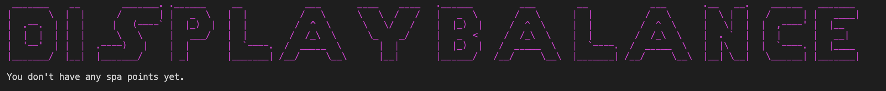
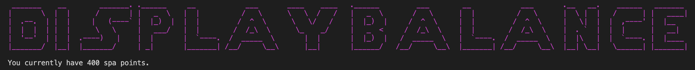
FINAL DESIGN CHECK SPA POINTS FEATURE
Before completing the quiz
After completing the quiz

Slide 25
OVERVIEW & CODE IMPLEMENTATION CHECKOUT FEATURE
The Checkout Feature allows users to finalise payment for their booked treatment
The code implemented in this feature is:
A transaction method that calculates the treatment price subtracted from their spa points
If the treatment price is more then the user’s spa points the application will prompt the user to either retake the quiz or select another treatment

Slide 26
DEVELOPMENT & BUILD PROCESS APPROACHING THE TASK
Planning :
Working off my workflow chart to understand what classes and methods were needed to build my application
Time Management & Prioritisation: -
Utilising a Trello board to construct a software development plan
GitHub: -
Initiating a remote repository and committing regularly

Slide 27
DEVELOPMENT & BUILD PROCESS CHALLENGES
Not having the experience to know how to fix a bug
Working across local files with “require_relative”
Amending a line of code to fix a bug, which ultimately breaks something else in the program
Time management

Slide 28
DEVELOPMENT & BUILD PROCESS FAVOURITE PARTS
Incremental success – when you change something in your code and it finally works – the eureka moment!
The learning process – I have a much better understanding of Ruby after completing this project
The satisfaction of the final product

