Slide 1
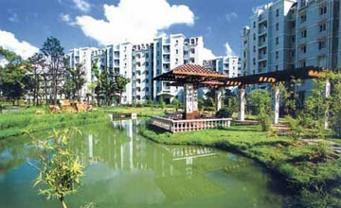
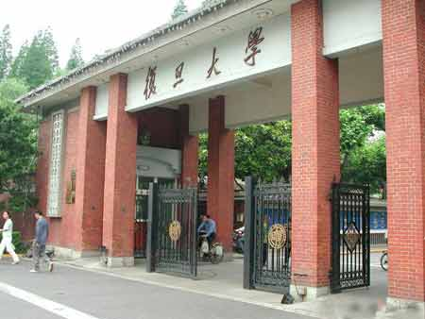
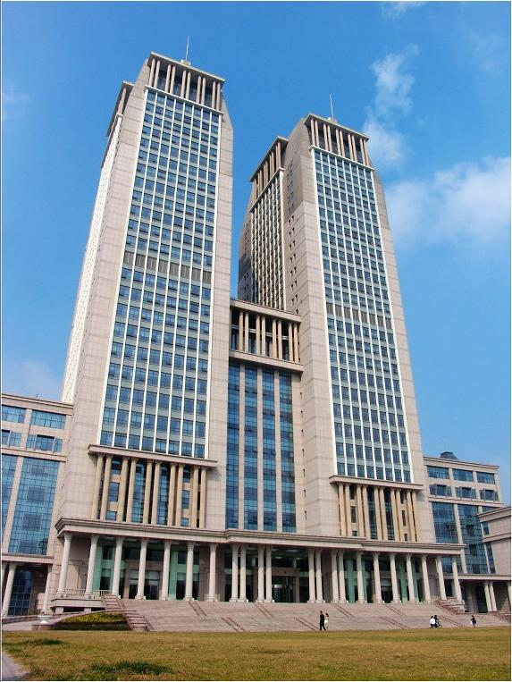
Artificial Intelligence
Xiaoqing Zheng
zhengxq@fudan.edu.cn

Slide 2
Uncertainty
• Uncertainty can be considered as the lack of adequate
information to make a decision.
• Uncertainty is a problem because it may prevent us
from making the best decision and may even cause a
bad decision to be made.
• All living creatures are experts at dealing with
uncertainty or they could not survive in the real world.

Slide 3
Types of error
Error
Ambiguous
Incorrect
Measurement
Reasoning
Incomplete
Random
Systematic
Human
False positive
Precision
Accuracy
Inductive
Deductive
Equipment
False Negative
Wrong
Unreliable
No

Slide 4
Examples of common type of error
Example | Error | Reason
Turn the valve off | Ambiguous | What value?
Turn valve-1 | incomplete | Which way?
Turn valve-1 off | Incorrect | Correct is on
Valve is stuck | False positive (Type I) | Valve is not stuck
Valve is not stuck | False negative (Type II) | Valve is stuck
Turn valve-1 to 5 | Imprecise | Correct is 5.4
Turn valve-1 to 5.4 | Inaccurate | Correct is 9.2
Turn valve-1 to 5.4 or 6 or 0 | Unreliable | Equipment error
Valve-1 setting is 5.4 or 5.5 or 5.1 | Random error | Statistical fluctuation
Valve-1 is not stuck because it’s never been stuck before | Invalid induction | Valve is stuck
Output is normal and so valve-1 is in good condition | Invalid deduction | Valve is stuck in open position

Slide 5
Errors and induction
All men are mortal
Socrates is man
Deduction
Always right
Socrates is mortal
My disk has never crashed
Induction
degree of confidence
My disk will never crash

Slide 6
Inductive argument
Rules 1
The fire alarm goes off
There is a fire
Rules 2
The fire alarm goes off
I smell smoke
Rules 3
There is a fire
The fire alarm goes off
I smell smoke
My clothes are burning
There is a fire

Slide 7
Fallacy
If the value is in good condition,
p → q
then the output is normal
q
The output is normal
p
The valve is in good condition
The valve may be stuck in the open position. If it is necessary to close the valve, the problem will show up.

Slide 8
Nonmonotonic Reasoning
I know not only that x looks red but also that x is illuminated by red lights and red lights can make things look red when they are not
x looks red
support
P
x is red
R
Q
defeat

Slide 9
Problems
• Buridan's ass and performing medical diagnosis.
• Paradox of the lottery and preface (collective defeat).
Notes:
The classical illustration of this is the medieval tale of Buridan’s ass who starved to death standing midway between two equally succulent bales of hay because he could not decide from which to eat.
If the agent is performing medical diagnosis, and the evidence favoring two diseases is tied, we do not want the agent to decide randomly to treat the patient for one disease rather than the other. It could happen that the diseases are not serious if left untreated, but if the patient is treated for the wrong disease, that treatment will gravely exacerbate his condition.
This marks an important difference between practical reasoning and epistemic reasoning.
Even apart from the dispute about skeptical and credulous reasoners, this way of handling collective defeat is not uncontroversial. Another example of collective defeat occurs in the lottery paradox.10 Suppose you hold one ticket in a fair lottery consisting of one million tickets, and suppose it is known that one and only one ticket will win. Observing that the probability is only .000001 of a ticket being drawn given that it is a ticket in the lottery, it seems reasonable to infer defeasibly that your ticket will not win. But by the same reasoning, it will be reasonable to believe, for each ticket, that it will not win. These conclusions conflict jointly with something else we are warranted in believing, namely, that some ticket will win. Assuming that we cannot be warranted in believing each member of an explicitly contradictory set of propositions, it follows that we are not warranted in believing of each ticket that it will not win.
There once was a man who wrote a book. He was very careful in his reasoning, and was confident of each claim that he made. With some display of pride, he showed the book to a friend (who happened to be a probability theorist). He was dismayed when the friend observed that any book that long and that interesting was almost certain to contain at least one falsehood. Thus it was not reasonable to believe that all of the claims made in the book were true. If it were reasonable to believe each claim then it would be reasonable to believe that the book contained no falsehoods, so it could not be reasonable to believe each claim. Furthermore, because there was no way to pick out some of the claims as being more problematic than others, there could be no reasonable way of withholding assent to some but not others. Therefore, concluded his friend, "you are not justified in believing anything you asserted in the book."
The classical illustration of this is the medieval tale of Buridan’s ass who starved to death standing midway between two equally succulent bales of hay because he could not decide from which to eat.
If the agent is performing medical diagnosis, and the evidence favoring two diseases is tied, we do not want the agent to decide randomly to treat the patient for one disease rather than the other. It could happen that the diseases are not serious if left untreated, but if the patient is treated for the wrong disease, that treatment will gravely exacerbate his condition.
This marks an important difference between practical reasoning and epistemic reasoning.
Even apart from the dispute about skeptical and credulous reasoners, this way of handling collective defeat is not uncontroversial. Another example of collective defeat occurs in the lottery paradox.10 Suppose you hold one ticket in a fair lottery consisting of one million tickets, and suppose it is known that one and only one ticket will win. Observing that the probability is only .000001 of a ticket being drawn given that it is a ticket in the lottery, it seems reasonable to infer defeasibly that your ticket will not win. But by the same reasoning, it will be reasonable to believe, for each ticket, that it will not win. These conclusions conflict jointly with something else we are warranted in believing, namely, that some ticket will win. Assuming that we cannot be warranted in believing each member of an explicitly contradictory set of propositions, it follows that we are not warranted in believing of each ticket that it will not win.
There once was a man who wrote a book. He was very careful in his reasoning, and was confident of each claim that he made. With some display of pride, he showed the book to a friend (who happened to be a probability theorist). He was dismayed when the friend observed that any book that long and that interesting was almost certain to contain at least one falsehood. Thus it was not reasonable to believe that all of the claims made in the book were true. If it were reasonable to believe each claim then it would be reasonable to believe that the book contained no falsehoods, so it could not be reasonable to believe each claim. Furthermore, because there was no way to pick out some of the claims as being more problematic than others, there could be no reasonable way of withholding assent to some but not others. Therefore, concluded his friend, "you are not justified in believing anything you asserted in the book."

Slide 10
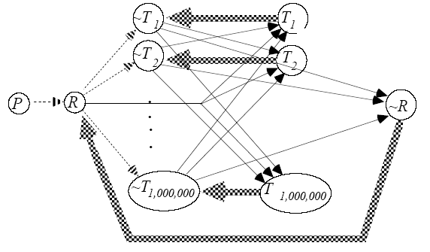
Paradox of the Lottery
Should I buy the lottery?

Slide 11
Paradox of the Preface
• There once was a man who wrote a book. He was very
careful in his reasoning, and was confident of each claim
that he made.
• He showed the book to a friend (who happened to be a
probability theorist). He was dismayed when the friend
observed that any book that long was almost certain to
contain at least one falsehood.
• There was no way to pick out some of the claims as being
more problematic than others, there could be no reasonable
way of withholding assent to some but not others.
• Therefore, concluded his friend, "you are not justified in
believing anything you asserted in the book."

Slide 12
Problems
• Buridan's ass and performing medical diagnosis.
• Paradox of the lottery and preface (collective defeat).
• Defeat cycle.

Slide 13
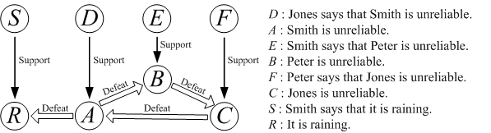
Defeat cycle
We might let D be "Jones says that Smith is unreliable", A be "Smith is unreliable", E be "Smith says that Peter is unreliable", B be "Peter is unreliable", F be "Peter says that Jones is unreliable", C be "Jones is unreliable", and let S be "Smith says that it is raining" and R be "It is raining".

Slide 14
Classical probability
• Experimental and subjective probabilities.
• Compound and conditional probabilities.
• Hypothesis test.

Slide 15
Three Statistical Experiments
• A lady, who adds milk to her tea, claims to be able to
tell whether the tea or the milk was poured into the
cup first. In all of ten trials conducted to test this, she
correctly determines which was poured first.
• A music expert claims to be able to distinguish a page
of Haydn score from a page of Mozart score. In ten trials
conducted to test this, he makes a correct determination
each time.
• A drunken friend says he can predict the outcome of a
flip of a fair coin. In ten trials conducted to test this, he
is correct each time.

Slide 16
Three Statistical Experiments
• In all three situations, the unknown quantity θ is
the probability of the person answering correctly.
• A classical significance test of the various claims
consider the null hypotheses (H₀) that θ = 0.5
• In all three situations this hypothesis would be
rejected with a (one-tailed) significance level 2⁻¹⁰.

Slide 17
Problems of hypothesis test
• A point null hypothesis
The point null hypothesis is almost certainly not
exactly true, and that this will always be confirmed
by a large enough sample.
• Tests of fit
It is virtually certain that the model is not exactly
correct, so a large enough sample will almost always
reject the model.

Slide 18
Conclusion
• A theory should be proposed to solve all above problems.
• A link should be established between epistemic reasoning
(reasoning about what to believe) and practical reasoning
(reasoning about what to do).
• Individual preferences should be considered properly when
dealing with the above issues.

Slide 19
Bayes' theorem
The method of Bayesian decision making is used in the PROSPECTOR experts system to decide favorable sites for mineral exploration.
P(O) = 0.6 P(O') = 0.4
P(+|O) = 0.8 P(–|O) = 0.2
P(+|O') = 0.1 P(–|O') = 0.9

Slide 20
Bayesian decision making
Probabilities
Prior
Subjective Opinion of site
P(H_{i})
No Oil
P(O') = 0.4
Oil
P(O) = 0.6
Conditional
Seismic Test Result
P(E|H_{i})
– Test
P(–|O')
= 0.9
+ Test
P(+|O')
= 0.1
– Test
P(–|O)
= 0.2
+ Test
P(+|O)
= 0.8
P(–∩O')
= 0.36
P(+∩O')
= 0.04
P(–∩O)
= 0.12
P(+∩O)
= 0.48
Joint
P(E∩H_{i}) = P(E|H_{i})P(H_{i})

Slide 21
Bayesian decision making
Probabilities
Unconditional
P(E)
– Test
P(–) = 0.48
+ Test
P(+) = 0.52
Posterior
P(H_{i}|E)
= P(E|H_{i})·P(H_{i})/P(E)
No Oil
P(O'|–)
= 3/4
Oil
P(O|–)
= 1/4
No Oil
P(O'|+)
= 1/13
Oil
P(O|+)
= 12/13
P(–∩O')
= 0.36
P(–∩O)
= 0.12
P(+∩O')
= 0.04
P(+∩O)
= 0.48
Joint
P(E∩H) = P(H_{i}|E)P(E)

Slide 22
Bayesian decision making
Event
Test Result
+ or –
A
$470,000
P(–) = 0.48
P(+) = 0.52
Act
Quit or Drill
D
$62,500
E
$846,153
Quit
Drill
Quit
Drill
Event
Oil or No Oil
B
$62,500
C
$846,153
No Oil
P(O'|–)
= 3/4
Oil
P(O|–)
= 1/4
No Oil
P(O'|+)
= 1/13
Oil
P(O|+)
= 12/13
–$50s
–$250s
$1,000s
–$50s
–$250s
$1,000s
Payoff
Oil lease, if successful
Drilling expense
Seismic survey
$1,250,000
–$200,000
–$50,000
Notes:
先验信息、样本信息、效用函数

Slide 23
Bayesian analysis
A farmer try to decide which crop to grow next year.
a₁: drought-resistant crop
a₂: high-yielding crop
θ : the precipitation of next year

Slide 24
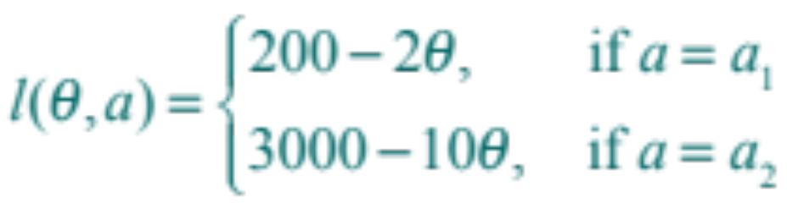
Bayesian analysis
A farmer try to decide which crop to grow next year.
a₁: drought-resistant crop
a₂: high-yielding crop
θ : the precipitation of next year
Loss function

Slide 25
Bayesian analysis
A farmer collects the information about precipitation by listening to weather forecast. If next year's precipitation is less than 400mm, he will grow drought-resistant crop, otherwise, he will choose to grow high-yielding crop.
Is it wise to make the decision like this?

Slide 26
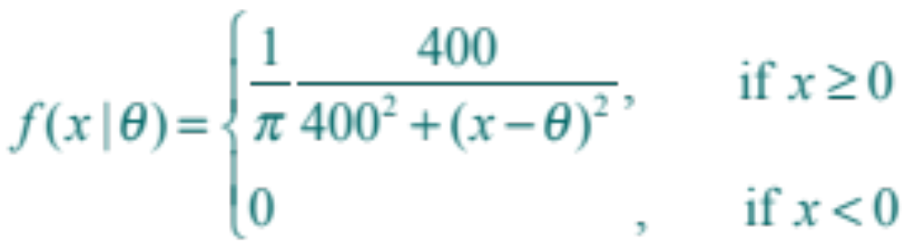
Bayesian analysis
According to history record, the accuracy of weather forecast has a C(400, θ ) density.

Slide 27
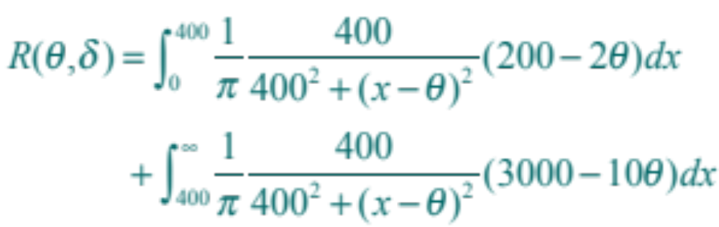
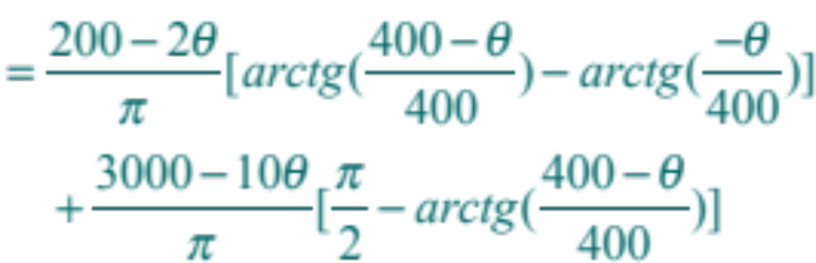
Bayesian analysis
The risk of decision is:

Slide 28
Bayesian analysis
According to the farmer's experience, the next year's precipitation has a prior density as follows.
θ | 0 | 100 | 200 | 300 | 400 | 500 | 600 | 700 | 800
π(θ) | 0 | 0.052 | 0.104 | 0.153 | 0.178 | 0.204 | 0.153 | 0.104 | 0.052

Slide 29
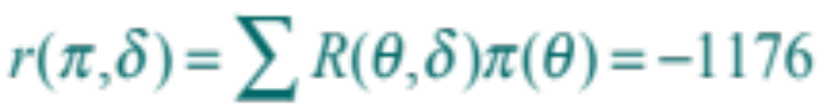
Bayesian analysis
According to the farmer's experience, the next year's precipitation has a prior density as follows.
θ | 0 | 100 | 200 | 300 | 400 | 500 | 600 | 700 | 800
π(θ) | 0 | 0.052 | 0.104 | 0.153 | 0.178 | 0.204 | 0.153 | 0.104 | 0.052
The Bayes risk of decision is:
The farmer is smart!
Notes:
在调查对象进行推断时，除了样本信息之外，还有两类相关的信息特别重要：对决策后果的认识和先验信息
对样本进行分析后采取下一步行为或决策带来可能后果的认识。这种认识常需要量化为每一个可能的行为和决策所造成的损失。而一般的统计抽样调查技术并不提供这样的量化
二是非样本信息，称之为先验信息，先验信息来自于过去的经验
将先验信息正式地纳入统计学中去并探索如何利用这种信息的方法被称为贝叶斯分析，而把损失函数加到统计分析中形成了决策论，两者结合在一起就是贝叶斯决策论
简单说一下贝叶斯序贯决策

Slide 30
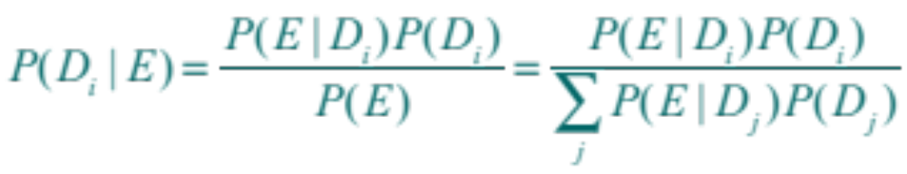
Difficulties with the Bayesian method
Bayes' Theorem is used to determine the probability of a specific disease, given certain symptoms as
D_{i}
E
P(E)
P(E|D_{i})
the ith disease,
the evidence,
the prior probability of the patient having the disease before any evidence is known
the conditional probability that the patient will exhibit E, given that disease D_{i} is present.

Slide 31
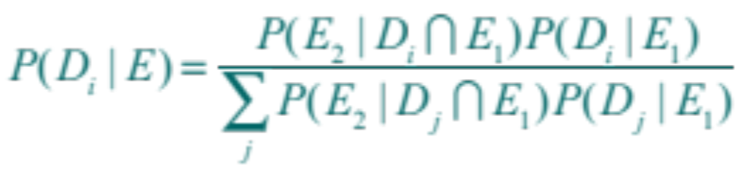
Difficulties with the Bayesian method
A convenient form of Bayes' Theorem that expresses the accumulation of incremental evidence is:
where E₂ is the new evidence added to the existing body of evidence, E₁, to yield the new evidence.
The situation grows worse as more pieces of evidence accumulate and thus more probabilities are required.
Notes:
Since there are only 92 natural elements. Possible disease hypotheses are much greater because there are many more micro-organisms.

Slide 32
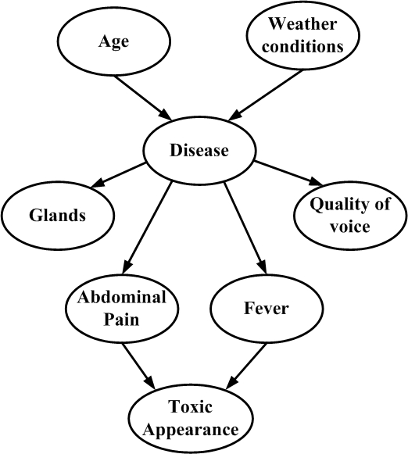
Bayesian networks
Medical diagnosis
Integrate probabilistic approaches with neurocomputing; practical balance can be established between computational needs and the accuracy of conclusions.

Slide 33
MYCIN rule
IF
The stain of the organism is gram positive, and
The morphology of the organism is coccus, and
The growth conformation of the organism is chains
THEN
There is suggestive evidence (0.7) that the identity of the organism is streptococcus.

Slide 34
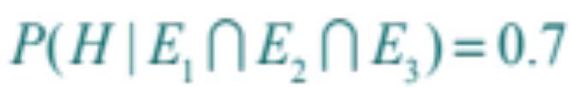
MYCIN rule
IF
The stain of the organism is gram positive, and
The morphology of the organism is coccus, and
The growth conformation of the organism is chains
THEN
There is suggestive evidence (0.7) that the identity of the organism is streptococcus.
This can be written in terms of posterior probability as

Slide 35
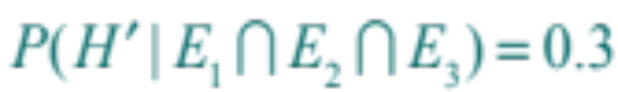
MYCIN rule
IF
The stain of the organism is gram positive, and
The morphology of the organism is coccus, and
The growth conformation of the organism is chains
THEN
There is suggestive evidence (0.7) that the identity of the organism is streptococcus.
This can be written in terms of posterior probability as
The experts would agree to above equation, they became uneasy and refused to agree with the probabilistic result

Slide 36
Belief and disbelief
Assume your grad point average (GPA) has not been too good and you need an A in this course to bring up your GPA.
P( graduating | A in this course ) = 0.70
It somehow seems intuitively wrong by
P( not graduating | A in this course ) = 0.30

Slide 37
Belief and disbelief
There could be problems due to a number of reasons that would still prevent your graduation, such as
• School catalog changes so that not all your courses counted
toward the degree.
• You forgot to take a required course
• Rejection of transfer courses.
• Rejection of some elective courses you took.
• Tuition and library fines that you owe and were hoping
would be forgotten weren't
• Your GPA was lower than you thought and an A still won't
raise it up.
• "They" are out to get you.

Slide 38
Certainty factors
CF
MB
MD
the certainty factor in the hypothesis H due to evidence E
the measure of increased belief in H due to E
the measure of increased disbelief in H due to E
CF(H, E) = MB(H, E) – MD(H, E)

Slide 39
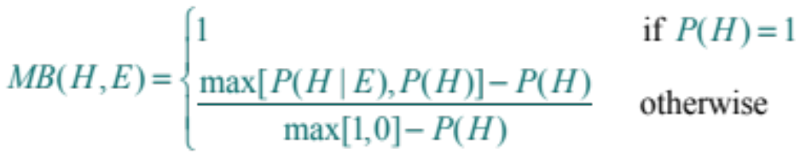
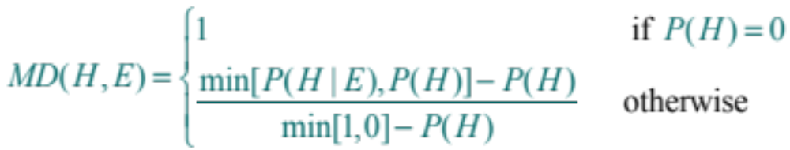
MB and MD
The measures of belief and disbelief were defined in terms of probabilities by

Slide 40
MB and MD
Belief
P(H)
Disbelief

Slide 41
Characteristics of MB, MD and CF
Characteristics | Values
Ranges | 0 ≤ MB ≤ 1 0 ≤ MD ≤ 1 –1 ≤ CF ≤ 1
Certain True Hypothesis P(H|E) = 1 | MB = 1 MD = 0 CF = 1
Certain False Hypothesis P(H'|E) = 1 | MB = 0 MD = 1 CF = –1
Lack of Evidence P(H|E) = P(H) | MB = 0 MD = 0 CF = 0

Slide 42
Combine evidence
Evidence | Antecedent Certainty
E₁ AND E₂ | min[CF(E₁, e), CF(E₂, e)]
E₁ OR E₂ | max[CF(E₁, e), CF(E₂, e)]
NOT E | – CF(E, e)
For example, given a logical expression for combining evidence such as
E = (E₁ AND E₂ AND E₃) OR (E₄ AND NOT E₅)
= max[min(E₁, E₂, E₃), min(E₄, – E₅)]

Slide 43
CF for the streptococcus rule
IF
The stain of the organism is gram positive, and
The morphology of the organism is coccus, and
The growth conformation of the organism is chains
THEN
There is suggestive evidence (0.7) that the identity of the organism is streptococcus.

Slide 44
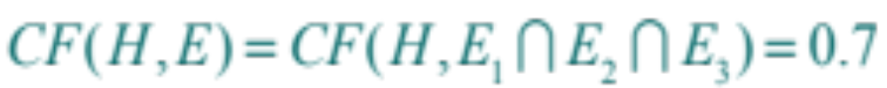
CF for the streptococcus rule
IF
The stain of the organism is gram positive, and
The morphology of the organism is coccus, and
The growth conformation of the organism is chains
THEN
There is suggestive evidence (0.7) that the identity of the organism is streptococcus.
where the certainty factor of the hypothesis under certain evidence is

Slide 45
CF for the streptococcus rule
Assuming
CF(E₁, e) = 0.5, CF(E₂, e) = 0.6, CF(E₃, e) = 0.3
then
CF(E, e) = CF(E₁ ∩ E₂ ∩ E₃, e)
= min[CF(E₁, e), CF(E₂, e), CF(E₃, e)]
= min[0.5, 0.6, 0.3]
The certainty factor of the conclusion is
CF(H, e) = CF(E, e) CF(H, E)
= 0.3 × 0.7
= 0.21

Slide 46
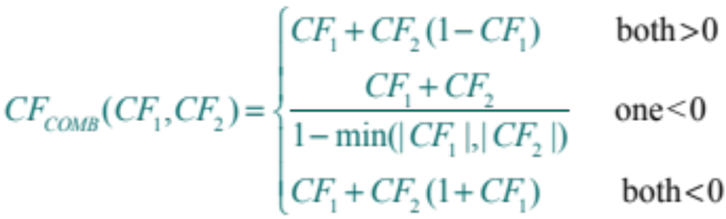
Combining function
The certainty factors of rules concluding the same hypothesis are calculated from the combining function for certainty factors defined as
Note: CF_{COMB}(X, Y) = CF_{COMB}(Y, X)

Slide 47
Computing CF of two rules
Hypothesis, H
Rule 1
Rule 2
CF₁(H, e) = CF₁(E, e) CF₁(H, E)
CF₂(H, e) = CF₂(E, e) CF₂(H, E)
AND
(min)
OR
(max)
NOT
(–)
AND
(min)
OR
(max)
NOT
(–)

Slide 48
Difficulties with certainty factors
One problem was that the CF values could be the opposite of conditional probabilities.
P(H₁) = 0.8
P(H₁|E) = 0.9
P(H₂) = 0.2
P(H₂|E) = 0.8
Then
CF(H₁, E) = 0.5, CF(H₂, E) = 0.75
Since one purpose of CF is to rank hypotheses in terms of likely diagnosis, it is a contradiction for a disease to have a higher conditional probability P(H|E) and yet have a lower certainty factor, CF(H, E)

Slide 49
Difficulties with certainty factors
Second major problem with CF is that in general
P(H|e) ≠ P(H|i) P(i|e)
where i is some intermediate hypothesis based on evidence e.
Certainty factor of two rules in an inference chain is calculated as independent probabilities by
CF(H, e) = CF(E, e) CF(H, E)

Slide 50
Temporal reasoning
• Reasoning about events that depend on time is called
temporal reasoning.
• Expert systems that reason about temporal events such
as aircraft traffic control could be very useful.
• Expert systems that reason over time have been developed
in medicine.
Notes:
只介绍最简单一个模型，有兴趣的同学可以看一下“随机过程”方面的资料

Slide 51
Stochastic process
Transition matrix
Future
Future
S₁
S₂
C₁
C₂
S₁
P₁₁
P₁₂
C₁
0.1
0.9
Present
Present
S₂
P₂₁
P₂₂
C₂
0.6
0.4
Where P_{mn} is the probability of a transition from state m to n.
C₁: buy Lenovo computer.
C₂: buy Apple computer.

Slide 52
State diagram interpretation
Future
C₁
C₂
0.1
0.4
C₁
0.1
0.9
0.9
Present
C₁
C₂
C₂
0.6
0.4
0.6
C₁: buy Lenovo computer.
State diagram
C₂: buy Apple computer.

Slide 53
State matrix
S = [ P₁, P₂, … P_{n} ]
Initially, with 80 percent of the people owning lenovo, with 20 percent owing apple
S₁ = [ 0.8, 0.2 ]
S₂ = S₁ · Transition matrix
0.1
0.9
= [ 0.8, 0.2 ]
0.6
0.4
= [ 0.2, 0.8]

Slide 54
Equilibrium
S₃ = [ 0.5, 0.5 ]
S₆ = [ 0.3875, 0.6125 ]
S₄ = [ 0.35, 0.65 ]
S₇ = [ 0.40625, 0.59375 ]
S₅ = [0.425, 0.575 ]
S₈ = [ 0.396875, 0.602125]
Notice that the states are converging on
S_{n} = [ 0.4, 0.6 ]
If transition matrix is a regular, which has some power with only positive elements, then a unique steady-state S_{n} exists.

Slide 55
Markov chain process
• A finite number of possible states.
• The process can be in one and only one state at a time.
• The process moves or steps successively from one
state to another over time.
• The probability of a move depends only on the
immediately preceding state.

Slide 56
Solve steady-state matrix
0.1
0.9
[ P₁ P₂ ]
= [ P₁ P₂ ]
0.6
0.4
We have
0.1P₁ + 0.6P₂ = P₁
0.9P₁ + 0.4P₂ = P₂
P₁ = 2/3 · P₂
P₁ = 2/3 · P₂
P₁ + P₂ = 1
P₁ = 0.4, P₂ = 0.6

Slide 57
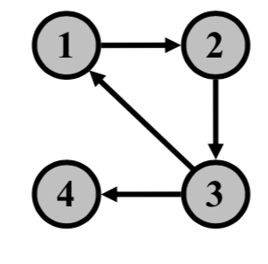
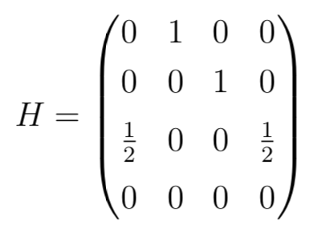
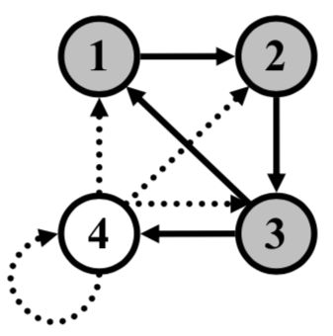
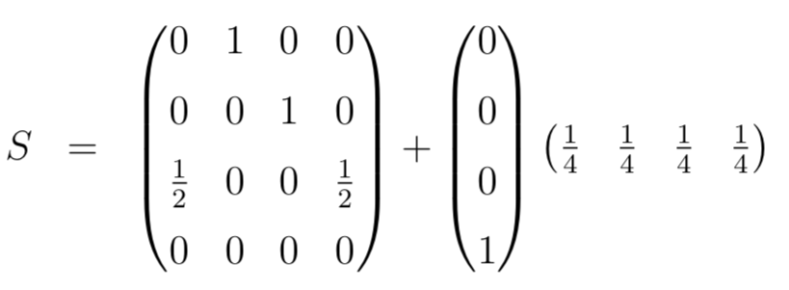

PageRank
Notes:
Damping factor
Personalization vector

Slide 58
Fuzzy set
• Fuzzy set is primarily concerned with quantifying and reasoning
using natural language in which many words have ambiguous
meanings such as tall, hot, dangerous, a little, and so on.
• Classical concept that an object is either in a set or not in a set
dates form the Aristotelian view of bivalent or two-valued logic.
• The problem with this bivalent logic is that we live in an analog,
not a digital world.
• The development of analog theories of computation such as
artificial neural systems and fuzzy theory more accurately
represents the real world.
Notes:
Zadeh的Fuzzy集合理论是UC Berkeley 1957至今在计算理论方面5项对世界主要贡献之一（并且排第一）

Slide 59
Membership function
Membership or compatibility function
1.0
μ_{A}(x): x → [0, 1]
0.9
0 ≤ μ_{A}(x) ≤ 1
0.5
Membership
function
Fuzzy set TALL
0
5
6
6.5
7
Height in feet

Slide 60
Linguistic variable and typical value
Linguistic variable | Typical Values
height | dwarf, short, average, tall, giant
number | almost, none, several, few, many
stage of life | infant, toddler, child, teenager, adult
color | red, blue, green, yellow, orange
light | dim, faint, normal, bright, intense
dessert | pie, cake, ice cream, baked alaska

Slide 61
Fuzzy rules
IF the TV is too dim THEN turn up the brightness
IF it is too hot THEN add some cold
IF the pressure is too high THEN open the relief value
IF interest rates are going up THEN buy bonds
IF interest rates are going down THEN buy stocks

Slide 62
Concentration operation
Very F = F ²
1
CON(F)
F
0.5
0
x

Slide 63
Dilation operation
More or Less F = F ^{0.5}
1
DIL(F)
F
0.5
0
x

Slide 64
Linguistic hedges and operation
Hedge | Operator definition
Very F | CON(F ) = F ²
More or Less F | DIL(F ) = F ^{0.5}
Plus F | F ^{1.25}
Not F | 1 – F
Not Very F | 1 – CON(F )
TALL
= { 0.125/5.5, 0.5/6, 0.875/6.5, 1/7 }
VERY TALL
= { 0.0156/5.5, 0.25/6, 0.7656/6.5, 1/7 }
NOT TALL
= { 0.875/5.5, 0.5/6, 0.125/6.5, 0/7 }

Slide 65
Fuzzy relation
y
x | 120 | 130 | 140 | 150 | 160
120 | 1.0 | 0.7 | 0.4 | 0.2 | 0.0
130 | 0.7 | 1.0 | 0.6 | 0.5 | 0.2
140 | 0.4 | 0.6 | 1.0 | 0.8 | 0.5
150 | 0.2 | 0.5 | 0.8 | 1.0 | 0.8
160 | 0.0 | 0.2 | 0.5 | 0.8 | 1.0
R(x, y) = APPROXIMATELY EQUAL
on the binary relation of people's weights.

Slide 66
Composition operator
R₁(x) = HEAVY = { 0.6/140, 0.8/150, 1/160 }
R₂(x, y) = APPROXIMATELY EQUAL
R₃(y) = MORE OR LESS HEAVY
= R₁(x) o R₂(x, y)
max min_{x} (R₁(x), R₂(x, y))
o
= [ 0.0 0.0 0.6 0.8 1.0 ]
1.0 0.7 0.4 0.2 0.0
0.7 1.0 0.6 0.5 0.2
0.4 0.6 1.0 0.8 0.5
0.2 0.5 0.8 1.0 0.8
0.0 0.2 0.5 0.8 1.0
= { 0.4/120, 0.6/130, 0.8/140, 0.8/150, 1/160 }

Slide 67
Membership grades for images
Membership Grade
Image | Missile | Fighter | Airliner
1 | 1.0 | 0.0 | 0.0
2 | 0.9 | 0.0 | 0.1
3 | 0.4 | 0.3 | 0.2
4 | 0.2 | 0.3 | 0.2
5 | 0.1 | 0.2 | 0.7
6 | 0.1 | 0.6 | 0.4
7 | 0.0 | 0.7 | 0.2
8 | 0.0 | 0.0 | 1.0
9 | 0.0 | 0.8 | 0.2
10 | 0.0 | 1.0 | 0.0

Slide 68
Fuzzy sets for Aircraft identification
1/M
1
.9/M + .1/A
2
.4/M + .3/F + .2/A
3
.2/M + .3/F + .5/A
4
.1/M + .2/F + .7/A
5
.1/M + .6/F + .4/A
6
.7/F + .2/A
7
.1/A
8
..8/F + .2/A
9
.1/F
10

Slide 69
Fuzzy rules
IF IMAGE4 THEN TARET4 (.2/M + .3/F + .5/A)
IF IMAGE6 THEN TARGET6 (.1/M + .6/F + .4/A)
TARGET = TARGET4 + TARGET6
= .2/M + .3/F + .5/A + .1/M + .6/F + .4/A
= .2/M + .6/F + .5/A
where only the maximum membership grades for each element are retained in the TARGET fuzzy set.

Slide 70
Fuzzy inference
In general, given n observations and rules
IF E₁ THEN H₁
IF E₂ THEN H₂
.
.
.
IF E_{n} THEN H_{n}
μ_{H} = max(μ_{H1}, μ_{H2}, ..., μ_{Hn} )
= max[ min(μ_{E1}), min(μ_{E2}), ..., min(μ_{En}) ]
where each E_{i} may be some fuzzy expression.
For example, E₁ = E_{A} AND (E_{B} OR NOT E_{C})
Then,
μ_{E1} = min(μ_{EA}, max(μ_{EB}, 1 – μ_{EC})

Slide 71
Any question?
Xiaoqing Zheng
Fudan University

