Slide 1
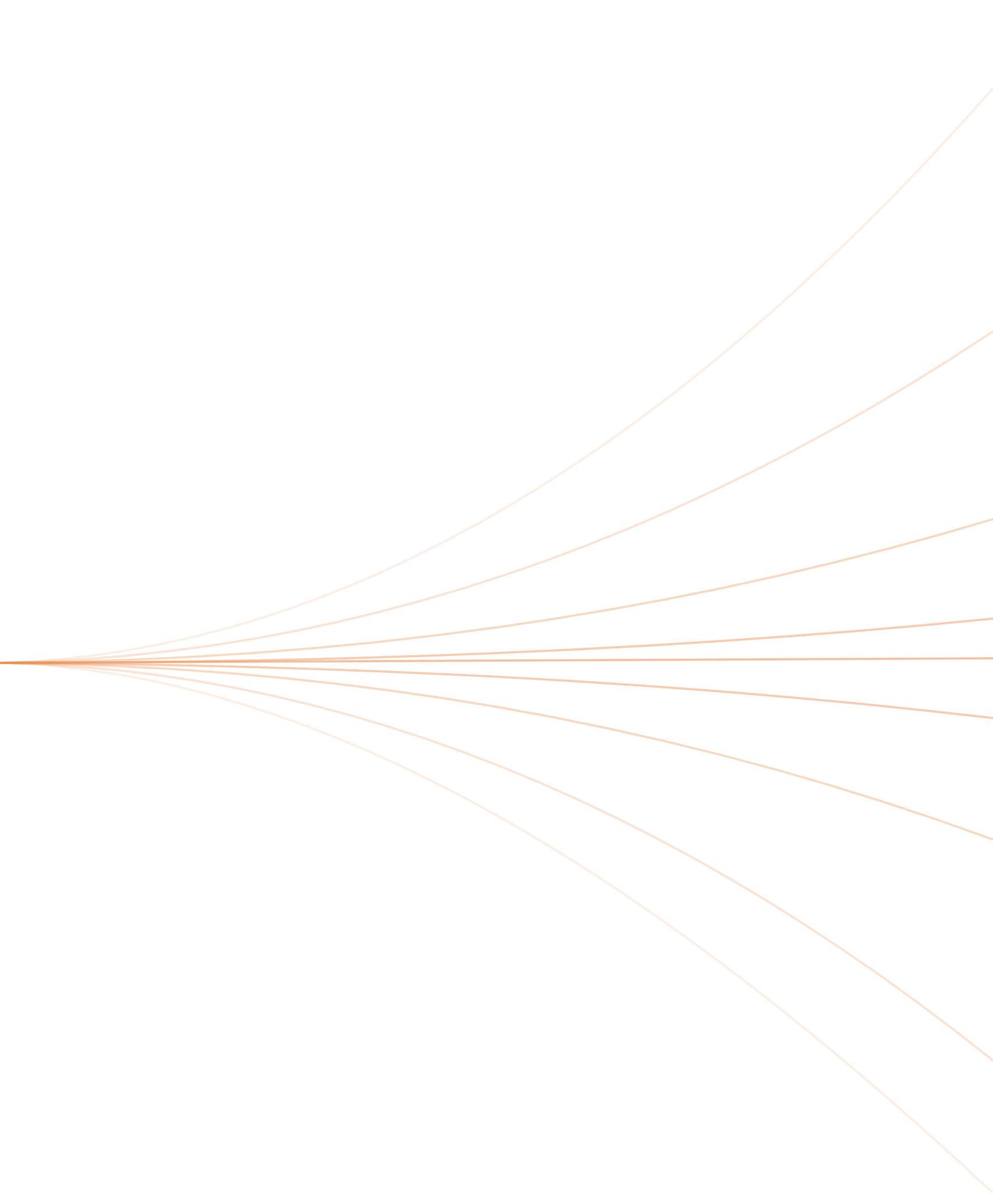
Error Propagation in AI Models
How small mistakes accumulate, spread and grow — and how to assess the risk
Roman Shyrshov
National Academy of the Security Service of Ukraine
Notes:
[0:45] Good [morning / afternoon], everyone. My name is Roman Shyrshov, and I am presenting joint work with Professor Yuriy Danyk and Professor Valery Shestakov. Our topic is error propagation in AI models. Most discussions of AI reliability ask a simple question: does the model make mistakes? We already know the answer — yes, it does. Today I want to ask a different question: what happens to a mistake after it has been made? Does it fade away? Does it stay the same size? Or does it grow and spread? The picture on this slide is the idea of the whole talk: many paths that start from almost the same point and drift further and further apart. A tiny error at the beginning can become a large error at the end. In the next thirty minutes I will explain where AI errors come from, how they feed each other, how fast they can grow, when correction helps and when it actually makes things worse — and what we observed in a small experiment.

Slide 2
AI errors are costly where AI is deployed
MOTIVATION
97 of 178
Wrong advice in high-stakes fields
Cases of inappropriate surgical recommendations have been reported [1]. In 2025 OpenAI barred using its services for personalised medical advice without a licensed professional [2].
references produced by ChatGPT in one study could not be verified: 69 pointed to DOIs that do not exist, and 28 more could not be found at all [3].
Damage beyond a single answer
The answers looked confident and well formatted. Nothing on the surface signalled that more than half of the sources were invented.
Errors raise risk in medicine, law and finance, reinforce users’ information bubbles, and weaken the security of critical information infrastructure.
02 / 22
Notes:
[1:30] Let me start with why this matters. AI is no longer a laboratory curiosity. It is used in energy, medicine, education, national security and defence — areas where a wrong answer has real consequences. And yet the problem of AI reliability is still unresolved. Here is one striking number. In a study published in 2023, researchers asked ChatGPT to provide scientific references. Out of 178 references, 69 had DOI identifiers that simply do not exist, and another 28 could not be found anywhere. That is 97 out of 178 — more than half. And the important point is that these answers looked perfectly normal: correct formatting, confident tone, plausible titles. Nothing warned the reader. On the right you see two other kinds of harm. First, wrong advice in high-stakes fields: there are reported cases of inappropriate surgical recommendations, and in 2025 OpenAI changed its usage policy to forbid personalised medical advice without a licensed professional. Second, damage that goes beyond a single answer: errors distort the personal information bubble of each user, and they reduce the security of critical information infrastructure. So the question is: are these accidental bugs that the next model version will fix — or is there something structural going on? Prior research points to the second answer.

Slide 3
Prior work: errors are structural
RELATED WORK
[9] 2024
Even a well-calibrated model must hallucinate on some kinds of facts — however good its architecture or data.
A floor that cannot be engineered away
[10] 2025
Hallucinations come from how models are trained and scored: generating an answer is far more error-prone than recognising one.
Rooted in training itself
[11–13]
Newer models with stronger reasoning sometimes make more errors than the models they replaced.
More complex is not more reliable
[14] 2024
Models trained on AI-generated text gradually lose rare knowledge and finally collapse.
Errors recycle through data
[15] 2020
Bigger models, more data and more compute raise quality — but a residual error always remains.
Scaling never reaches zero
The gap: we know that errors exist. We know much less about how they spread, multiply and grow over reasoning steps and model generations [20–25].
03 / 22
Notes:
[2:00] The research community has been looking at this problem closely, and five results stand out. Together they say that errors are built into the technology, not added by accident. First, Kalai and Vempala showed in 2024 that a well-calibrated language model must hallucinate on certain kinds of facts. This is a statistical floor — it does not depend on the architecture or on the quality of the data. You cannot engineer it away. Second, researchers from OpenAI showed in 2025 that hallucinations come from the way models are trained and evaluated. Producing a correct answer is fundamentally harder than recognising one, so generative errors are at least twice as frequent as classification errors. Third, several studies found that newer models with more sophisticated reasoning sometimes make more errors than their predecessors. Greater complexity does not guarantee greater reliability. Fourth, the well-known Nature paper on model collapse: when models are trained on text produced by other models, they gradually lose rare knowledge — the tails of the distribution disappear — and eventually degrade. And fifth, the scaling laws: adding parameters, data and compute improves quality, but there is always a residual error that does not go away. So we know that errors exist and will continue to exist. What is much less studied is their dynamics: how they spread, how they multiply, and how fast they grow. That is the gap our work addresses.

Slide 4
RESEARCH HYPOTHESIS
Errors are a built-in risk of AI models that work on probabilities — and the risk grows with poor data, long reasoning and weak checking.
It predicts, it does not know
It compresses with losses
Accuracy has a price
A language model picks the most likely continuation. Its answer depends on its data, the prompt and the context — even when it “reasons”.
Training keeps the main patterns and drops details. Faced with something new, the model has to guess.
Tuning a model to be very accurate on one kind of data makes it more fragile on others.
Our aim: a method to assess how errors appear, accumulate, spread and scale
04 / 22
Notes:
[1:00] This leads us to our research hypothesis. Errors are not a defect that will one day be fixed. They are a built-in risk of AI models that work on probabilities. And this risk becomes larger in three situations: when the data are incomplete, biased, rare or generated by other models; when the task requires a long chain of reasoning; and when there is little external checking. Why do we believe this? Three reasons. First, a language model predicts — it does not know. It chooses the most likely continuation, so its answer always depends on the training data, the prompt and the context, even when it appears to reason step by step. Second, training is compression with losses: the model keeps the main patterns and throws away details. When it meets a situation it has never seen, it has no choice but to guess. Third, accuracy has a price: if you tune a model to be extremely accurate on one kind of data, it becomes more fragile on other kinds. So the aim of our work is a methodology to assess how errors appear, how they accumulate, how they spread and how they scale — so that these risks can be detected and reduced before AI is deployed in areas that are critical for society.

Slide 5
Three interacting error types
TAXONOMY
D
Skewed training data
H
Hallucination
F
Context fading
The model learns what is common in its data, not what is true. If the data over-represent one view or miss rare cases, the model repeats that skew with confidence. More data of the same kind does not fix it.
When information is missing, the model still produces a fluent answer. Every word it writes becomes context for the next, so one invented detail pulls the rest of the answer further from reality.
In long prompts and dialogues, earlier facts and conditions lose weight. The model quietly replaces them with “typical” assumptions — and correct reasoning turns into reasoning about a different task.
Trained on Renaissance science, a model would confidently place the Earth at the centre of the universe.
A reference with a real-looking DOI that leads nowhere.
A limit stated at the start of a dialogue is ignored ten messages later.
They do not simply add up: each type can trigger and amplify the others.
05 / 22
Notes:
[2:00] We focus on three types of error. I will label them with letters — D, H and F — because I will use these letters for the rest of the talk. D stands for skewed training data. A model learns what is common in its data, not what is true. Here is an example from our paper. Imagine an AI trained on all the scientific works available in the Renaissance. Hundreds and thousands of treatises described the geocentric model, and only a handful described the heliocentric one. Such a model would state with complete confidence that the Earth is the centre of the universe. And more data from the same period would only make it more confident. When we asked ChatGPT about the ratio of geocentric to heliocentric works of that time, it answered: several hundred to several thousand, against a handful. H is hallucination. When information is missing, the model does not say "I don't know" — it produces a fluent answer anyway. And because every word it writes becomes context for the next word, one invented detail pulls the rest of the answer further away from reality. The non-existent DOI from the previous slide is a typical case. F is context fading. In long prompts and long dialogues, information stated earlier gradually loses its weight. The model quietly replaces the lost conditions with typical assumptions. The reasoning may be perfectly logical — but it is now reasoning about a slightly different task. The key point of this slide is at the bottom: these errors do not simply add up. One type can trigger and amplify another. That is what the next slide shows.

Slide 6
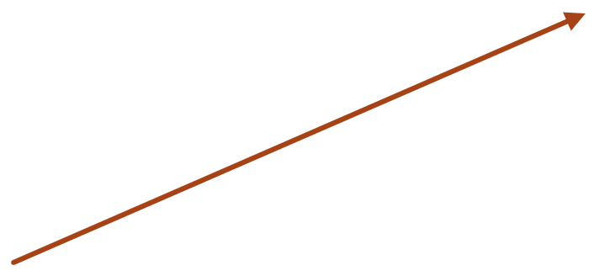
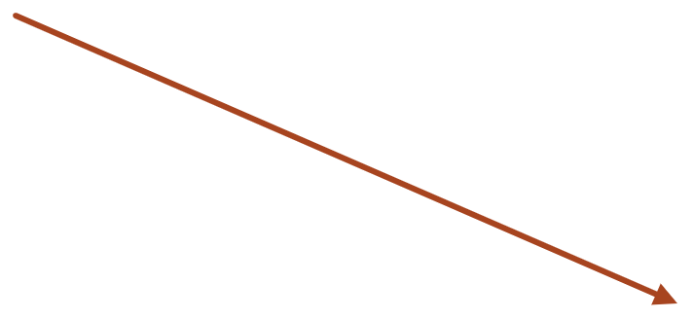
Errors form causal chains
CAUSAL STRUCTURE
F
Context fading
Chain 2 · a model poorly trained on a topic also holds on to instructions and context less firmly
Chain 3 · once a fact or condition is forgotten, the model fills the gap with plausible invention
D
Skewed data
H
Hallucination
Chain 1 · stereotyped, noisy or sparse data lead directly to more factual errors
The links are statistical: making one type of error rarer changes how often the others appear [16–18]. The practical consequence — we can check the weak links of the chain, not only the final answer.
06 / 22
Notes:
[1:30] Here is how the three types are connected. We studied three realistic chains. Chain 1 goes directly from data to hallucination. If the training corpus contains many incorrect, stereotyped or noisy patterns — or simply very few examples on a topic — the model produces factually wrong statements more often. Chain 2 goes from data to context fading. A model that was poorly trained on a topic, or trained to follow instructions only weakly, also holds on to the conditions of the task less firmly. It drops constraints more easily. Chain 3 goes from context fading to hallucination. Once the model has forgotten a fact or a condition, it does not stop. It fills the gap with something plausible — and that is exactly where invented facts appear. These links are statistical, and other studies confirm that measures aimed at reducing one type of error change the balance of the others. For practice, this has an important consequence: because errors form a chain, we do not have to wait for the final answer to check quality. We can monitor the weak links of the chain — the points where it breaks. The next two slides look at the chains in a little more detail.

Slide 7
Thin data breeds fabrication
CHAIN 1 · D → H
Skew in the data is usually hidden: nobody labels a dataset as “biased”. So we look for warning signs that can be measured:
THE IDEA
The fewer examples a topic has, the more likely the model is to invent.
terms and style that differ from the user’s domain
topics or groups with very few examples
noisy or inconsistent labels
questions far outside what the model was trained on
How we test it: split topics into thinly and richly covered ones and compare how often the model hallucinates in each group.
The simplest sign of all: a topic covered by fewer examples than a set minimum.
Fair comparison: account for query type, dialogue length, numbers in the question and generation settings — rare topics may also simply be harder.
07 / 22
Notes:
[1:30] Let's look at the first chain: from skewed data to hallucination. The difficulty is that skew in training data is almost always hidden. Nobody publishes a dataset with a label saying "this part is biased". So instead of looking for bias directly, we look for warning signs that can be measured. On the left you see four of them: vocabulary and style that differ from the user's domain; topics or groups with very few examples; noisy or inconsistent labels; and questions that lie far outside the training domain. The simplest and most practical sign is coverage: a topic is considered "thin" if it is represented by fewer examples than some minimum we set in advance. The idea itself is intuitive, and it is written on the right: the fewer examples a topic has, the more likely the model is to invent. Where knowledge is thin, the model fills the gaps. How do we test this? We split the topics into thinly covered and richly covered ones, and we compare how often the model hallucinates in each group. If hallucinations are clearly more frequent in the thin group, data scarcity is driving them. But we have to compare fairly. Rare topics may simply be harder, and other factors also matter — the type of query, the length of the dialogue, whether the question contains numbers, the generation settings. Our method accounts for these factors, so that we measure the effect of thin data and not something else.

Slide 8
Forgetting leads to inventing
CHAINS 2 AND 3 · D → F → H
CHAIN 2 · D → F
Distance to the fact
Noise and distractors
Number of conditions
Thin data weakens the grip on context
Forgetting grows the further back a fact was stated, the more irrelevant material surrounds it and the more conditions the model must keep at once. On poorly covered topics, distance hurts even more.
CHAIN 3 · F → H
After losing a condition, the model does not stop — it fills the gap with something plausible. The further away the forgotten fact, the more likely the filler is invented. This is why hallucinations cluster in long dialogues and long documents.
A lost condition is filled by invention
08 / 22
Notes:
[1:30] The second and third chains together tell one story: forgetting leads to inventing. Chain 2 — from thin data to context fading. When a model has seen few examples on a topic, it also holds on to the instructions and context less firmly. We found three factors that make forgetting worse, and you can see them on the slide. First, distance: how far back in the conversation or the document the important fact was stated. Second, noise: how much irrelevant material surrounds it. Third, load: how many conditions the model has to keep in mind at the same time. And these factors interact with data coverage — on poorly covered topics, distance hurts even more. Chain 3 — from context fading to hallucination. This is the step where the damage becomes visible. After losing a condition, the model does not stop and does not ask. It fills the gap with something plausible. And the further away the forgotten fact is, the more likely it is that the filler is simply invented. This explains a pattern that many of you have probably noticed in practice: hallucinations cluster in long dialogues and long documents. It is not random — it is the end of a chain that starts much earlier.

Slide 9
Measuring the chain in practice
ESTIMATION
1
Sample real answers
Take answers from system logs or a test set, spread across topics and across short and long dialogues.
2
Label each answer
Is the topic thinly covered? Did the answer break an earlier instruction? Does it contain an invented fact?
3
Compare the groups
How often do invented facts appear when context was lost, and when it was kept? A clear, stable gap means a real link in the chain.
4
State the uncertainty
Audit samples are small, so we report how confident we are that the gap is real — and that it is larger than an agreed threshold.
The same four steps work for every link: data → fading, data → hallucination, fading → hallucination.
09 / 22
Notes:
[1:30] How can an organisation actually measure these links? Our methodology reduces it to four practical steps. Step one: sample real answers. Take them from the system's logs or from a test set, and make sure the sample covers different topics and both short and long dialogues. Step two: label each answer with three simple questions. Is the topic thinly covered in the training data? Did the answer break a condition or instruction given earlier? Does it contain an invented fact? Step three: compare the groups. For example, how often do invented facts appear in answers where the context was lost, compared with answers where it was kept? If there is a clear and stable gap between the groups, we have found a real link in the chain. Step four: state the uncertainty honestly. Audit samples are usually small — tens or hundreds of answers, not millions. So we do not just report a number; we report how confident we are that the gap is real, and how likely it is that the gap is larger than a threshold agreed with the system owner. Technically we use a Bayesian estimate for this, but the idea is simply: how sure are we? The same four steps work for every link in the chain.

Slide 10
Three questions about total risk
ESTIMATION
How often is something wrong?
The chance that an answer contains at least one of the three errors. Useful for monitoring and quality targets. Even when we cannot measure how errors overlap, we can still give a lower and an upper limit.
How bad can it get?
The chance that all three happen together: thin data, then forgotten context, then an invented fact. We estimate it step by step along the chain — in the same order in which the failure unfolds.
What does it cost?
Errors are not equal. An invented drug dose costs more than an outdated term, so each error type gets a weight that reflects its consequences. This lets us compare operating scenarios on one scale.
Plan monitoring around the first question; plan safeguards around the second.
10 / 22
Notes:
[1:15 — can be shortened if time is tight] Once we can measure the individual links, we can talk about total risk. Our methodology answers three questions. The first question: how often is something wrong? This is the chance that an answer contains at least one of the three errors — skewed data, forgotten context or an invented fact. This number is useful for everyday monitoring and for quality targets. And even when we do not know how often the errors overlap, we can still say that the risk lies between a lower and an upper limit. The second question: how bad can it get? This is the worst case — all three errors happening together: the topic is thinly covered, the model forgets a condition, and then it invents a fact. We estimate this step by step along the chain, in exactly the order in which such a failure unfolds in reality. The third question: what does it cost? Errors are not equal. An invented dosage in a medical answer is far more serious than a slightly outdated term. So we give each type of error a weight that reflects its consequences. This allows us to compare different operating scenarios for an AI system on one common scale. A simple practical rule: build monitoring around the first question, and build safeguards around the second.

Slide 11
Small errors compound
DYNAMICS
STEP BY STEP
MODULE BY MODULE
Each step inherits the last one’s error
Pipelines multiply risk
In any step-by-step process, each step starts from the result of the previous one — including its mistakes. If a step tends to enlarge small deviations, the error grows faster and faster.
An AI system is often a chain of modules: search, reasoning, summary, translation. If the modules were independent and rarely wrong, their risks would roughly add up.
Like a navigator one degree off course: harmless after a mile, a different city after a thousand.
In reality one module’s mistake is the next module’s input — and the effect multiplies.
Adding up is the optimistic case; in real systems errors multiply.
11 / 22
Notes:
[1:15] So far we have looked at a single answer. Now let's look at time — at how errors behave over many steps. On the left: any step-by-step process. Each step starts from the result of the previous one, and that includes its mistakes. If a step tends to make small deviations a little bigger, the error does not just grow — it grows faster and faster. Think of a navigator who is one degree off course. After one mile, nobody notices. After a thousand miles, the ship arrives in a different city. On the right: modern AI systems are rarely one model. They are pipelines of modules — search, reasoning, summarising, translating. If these modules were independent and each rarely made a mistake, the total risk would be roughly the sum of the individual risks. That is the optimistic picture. In reality, the modules feed each other: the output of one module is the input of the next. So one module's mistake becomes the starting point for the next module's work, and the effect multiplies instead of adding. That is the message at the bottom: adding up is the best case; in real systems errors multiply. The next question is — how fast?

Slide 12
Three ways to picture error growth
DYNAMICS
DOUBLING LAW
EPIDEMIC
BUTTERFLY EFFECT
Like Moore’s law, in reverse
Errors spread like a virus
Does the loop heal or amplify?
Transistor counts double at regular intervals. In the same way, the number of errors can multiply by a fixed factor with every cycle — each model release, each round of retraining on the model’s own logs.
A dataset, document or model that carries an error “infects” everything built on it. If each carrier infects more than one new one, we get an error epidemic; if fewer, it dies out.
A model that learns from its own outputs is a feedback loop. If tiny distortions grow from one generation to the next, the loop drifts towards collapse; if they shrink, it heals itself.
IN PRACTICE
Track how far the model’s answers drift from reference answers, step after step. How fast that drift grows is the speed of error accumulation.
12 / 22
Notes:
[1:30] To describe how fast errors grow, we propose three pictures — three analogies that each fit a different kind of system. The first is a doubling law. Everyone here knows Moore's law: the number of transistors on a chip doubles at regular intervals. We suggest that errors can behave the same way, only in the wrong direction: with every cycle — every model release, every round of retraining on the model's own logs — the number of errors is multiplied by a fixed factor. The second picture is an epidemic. An error behaves like a virus. A dataset, a document, a knowledge base or a model that contains it "infects" everything that is trained or built on top of it. The key number is the same as in epidemiology: if each carrier infects, on average, more than one new carrier, we get an error epidemic. If fewer than one, it dies out. This picture fits best for systems that learn from synthetic data — data produced by other models. The third picture is the butterfly effect. A model that learns from its own outputs is a feedback loop, a dynamical system. The question is whether a tiny distortion grows from one generation to the next — then the loop drifts towards collapse — or shrinks, and the loop heals itself. In mathematics this is measured with the Lyapunov exponent, but the idea is simply: does the loop amplify or damp small errors? In practice, the simplest tool is at the bottom: measure how far the model's answers drift from reference answers, step after step. How fast that drift grows is the speed of error accumulation.

Slide 13
Long reasoning makes errors explode
REPRODUCTION
Think of a reasoning chain as a relay race. If each runner sometimes drops the baton, the chance of a clean finish falls with every extra runner.
How many times the error grows (illustrative) · log scale
1024
Reasoning is worse than a relay: a wrong step does not just add one error — it misleads every step after it. The longer the chain, the more chances to fail and the heavier each failure.
323
110
41
Short tasks stay reliable. Over ten steps, error can grow a thousand-fold.
17
7.6
3.8
2.2
1.1
1.44
1
2
3
4
5
6
7
8
9
10
Number of reasoning steps
13 / 22
Notes:
[1:30] Now the central idea of the dynamic part: why long reasoning is so dangerous. Accumulation means errors pile up. Reproduction means something stronger: one error gives birth to new errors. We describe this with a reproduction coefficient — how many new errors one error produces. If it is below one, errors die out and the system corrects itself. If it equals one, the error stays. If it is above one, we get a chain reaction. Let me use an analogy. Think of a reasoning chain as a relay race. If each runner occasionally drops the baton, the chance that the team finishes cleanly goes down with every additional runner. That alone is bad enough. But reasoning is worse than a relay. In a relay, a dropped baton is one mistake. In reasoning, a wrong step does not just add one error — it misleads every step that comes after it. So as the chain gets longer, two things grow at the same time: the number of chances to fail, and the weight of each failure. That is why the growth is faster than exponential. The chart shows an illustration with a modest impact factor. With two steps, the error grows by less than one and a half times. With ten steps, it grows about a thousand times. Note that the bar heights are on a logarithmic scale — on a normal scale the last bar would leave the screen. This explains something every user has seen: modern models handle short instructions very well, but become unreliable on long, multi-step reasoning.

Slide 14
Self-correction helps — up to a limit
SELF-CORRECTION
When the model checks and fixes its own steps, it pushes back against error growth — a brake on the chain reaction.
Minimum share of error removed per step (illustrative)
2 steps
17%
But the brake must get stronger as the chain gets longer. The bars show how much of the error the model must remove at every step just to keep the chain stable.
5 steps
33%
10 steps
50%
20 steps
67%
40 steps
80%
When the checker is wrong
The checker is the same model. Sometimes it “corrects” a right answer into a wrong one. If its checking is weaker than its writing, every extra round of self-correction speeds up the collapse instead of preventing it. Beyond a certain point, more checking only adds confusion.
14 / 22
Notes:
[1:30] The natural answer to this problem is self-correction: let the model check and fix its own steps. Many modern systems do exactly this. In our model, self-correction is a brake on the chain reaction — a negative feedback loop. At every step the error first grows because of complexity, and then the correction pulls it back down. The question is: how strong must the brake be? The bars on the right answer it for an illustrative case. For a two-step task, it is enough if the model removes about seventeen percent of the error at each step. For ten steps, it must remove half of the error at every single step. For forty steps — eighty percent. So the longer the reasoning, the closer self-correction must come to perfection just to keep the system stable. If the brake is weaker than that, errors keep reproducing even with correction switched on. And now the important twist, at the bottom of the slide. The checker is the same model. It can also be wrong. Sometimes it "corrects" a right answer into a wrong one. If the model's ability to check is weaker than its ability to write, then every additional round of self-correction does not prevent collapse — it accelerates it. There is a point beyond which more checking only adds confusion. So simply adding more verification steps does not guarantee quality. We need a way to find the moment when self-correction turns into self-destruction. That is what our algorithm does.

Slide 15
Spotting when “fixing” starts to hurt
ERAS · ERROR REPRODUCTION ASSESSMENT STRATEGY
1
2
3
4
5
Size the task
Record each step
Measure drift
Add it up
Find the turn
Count the reasoning steps. Measure how often the model errs on simple tasks — its baseline noise.
Save the model’s answer before and after it corrects itself, at every step.
How far did the meaning move in this step? Did the correction bring it back to the task?
Combine all steps into one number: is the error growing or shrinking overall?
Detect the step where error starts to speed up — from here, each “correction” makes things worse.
The key number: reproduction speed
At the turning point
Below one, the error contracts and the system is stable. Above one, the error reproduces and the system degrades.
Stop self-correcting and hand over to an external check.
15 / 22
Notes:
[2:00] This is our main practical contribution: the ERAS algorithm — Error Reproduction Assessment Strategy. Its purpose is to find the moment when the system moves from refinement to degradation. It has five steps. Step one: size the task. We count how many reasoning steps it requires — for example, the number of steps in a proof, or the number of queries an agent makes. And we measure the model's baseline noise: how often it is wrong on simple tasks. Step two: record each step. At every step we save two versions of the answer — before the model corrected itself and after. Step three: measure drift. For each step we ask two questions. How far did the meaning move in this step — we measure this as a semantic distance between the texts. And did the correction bring the answer back towards the original conditions of the task, or not? Step four: add it up. We combine all the steps into one number — the speed of error reproduction. The rule is simple: below one, the error contracts and the system is stable; above one, the error reproduces and the system degrades. Step five: find the turn. The algorithm looks for the step at which the error starts to accelerate. That is the point where self-correction begins to do harm — from here on, each new "correction" only increases the error. An important detail: this speed is not a constant. It changes during the task, depending on how quickly the model uses up its reserve of logical stability as the chain gets longer. And the practical recommendation on the right: at the turning point, stop self-correcting and hand the result over to an external check. That brings us to external verification.

Slide 16
The quality of the checker sets the limit
EXTERNAL VERIFICATION
Survival condition
A reasoning chain stays stable only while three forces together outweigh its complexity: the model’s own correction, how much of the output an external checker covers, and how good that checker is.
An external checker — a web search, a database, a human expert — does not share the model’s blind spots. But it can be wrong too, for example by accepting citations that look real but do not exist.
Longest stable reasoning chain (illustrative assumptions)
4
13
41
steps with no checker
steps, checker catches half
steps, checker catches 90%
Hazard: a weak checker raises confidence (“it was verified”) while errors keep multiplying.
16 / 22
Notes:
[1:30] The natural way to stop degradation is an external checker — for example a web search, a reference database or a human expert. Unlike self-correction, an external checker does not share the model's blind spots, so it is more stable. But it costs time and resources. Our model describes the survival condition, shown at the top. A reasoning chain stays stable only while three forces together outweigh its complexity: the model's own ability to correct itself, how much of the output the external checker actually covers, and how good the checker is — that is, how often it really catches and fixes an error. The quality part matters a lot. An external checker can also be wrong. A typical case: the model produces a citation with a plausible title and a plausible DOI, and the checker accepts it because it looks real. This creates a dangerous effect, marked as a hazard on the slide. The system spends resources on verification, everyone's confidence goes up — "the answer was verified" — but the actual rate of error reproduction hardly changes. The three numbers on the right are an illustration that we calculated from our model with assumed parameters; they are not measured values. Without any checker, the reasoning chain in this example stays stable for only about four steps. With a checker that catches half of the errors — about thirteen steps. With a checker that catches ninety percent — about forty-one steps. So it is not the presence of a checker that sets the limit of task complexity. It is its quality.

Slide 17
A chain of translations as a test
EXPERIMENT
«Книга вчить, як на світі жить»
→
Polish
→
Chinese
→
Arabic
→
Malay
→
Turkish
“A book teaches how to live in the world” · each translation becomes the next input · five language families
Three systems
Two modes
How each step was scored
ChatGPT (GPT-5.5)
Gemini (Gemini 3)
Duck.ai (free tier)
Plain step-by-step translation
Translation with self-correction to keep the original meaning
Gemini rated each translation against the original from 1 to 100 on three criteria, matched to our error types:
Same images and facts → hallucination
Same logical structure → context loss
Same people and terms → skew / shift
17 / 22
Notes:
[1:30] To see error propagation with our own eyes, we needed a task where each step uses the output of the previous step, and where we always have a clear reference. A chain of translations is exactly such a task. We took the Ukrainian aphorism «Книга вчить, як на світі жить» — literally, "A book teaches how to live in the world". We asked the system to translate it into Polish, then to translate that Polish text into Chinese, then into Arabic, Malay and Turkish. Each translation became the input for the next one. The languages belong to five different language families, so every step is a real transformation. We expected Chinese in particular to distort the logical structure and the meaning. We tested three systems: ChatGPT, Gemini and the free version of Duck.ai. And we used two modes: plain step-by-step translation, and translation with self-correction, where the system was asked to check that the original meaning was preserved. To score the results, we asked Gemini to compare each translation with the original aphorism on a scale from 1 to 100, using three criteria that correspond to our three error types. Does the translation keep the same images and facts? A loss here is a hallucination. Does it keep the same logical structure? A loss here is context loss. Does it keep the same people, terms and relationships? A change here is a skew or shift. The error at each step is simply how far the score falls short of 100. All final translations still carried the main idea of the aphorism — but, as you will see, not equally well.

Slide 18
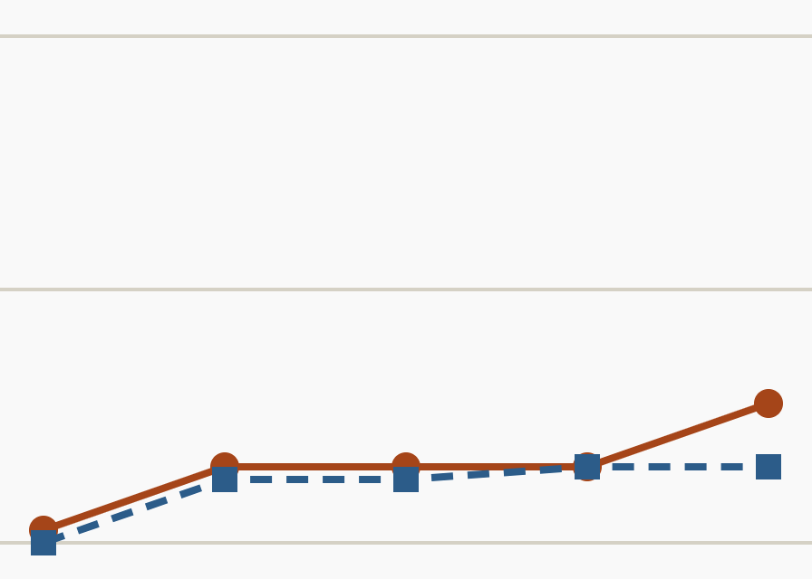
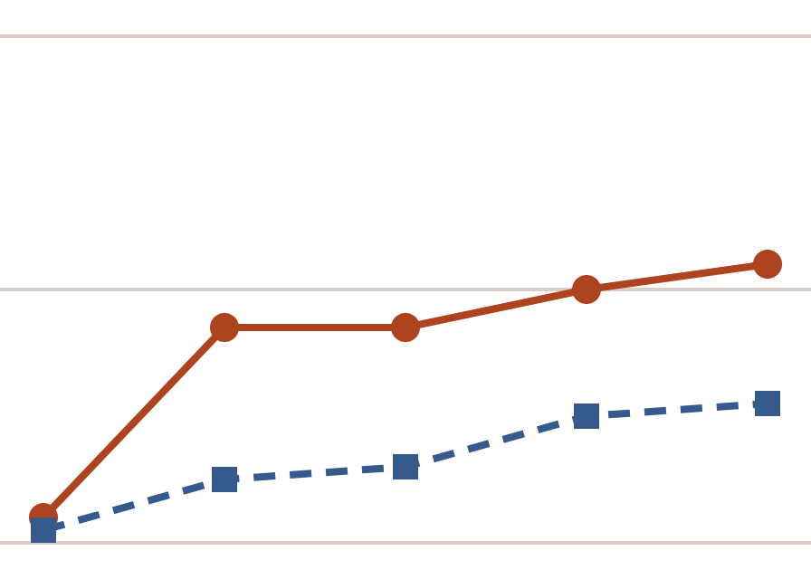
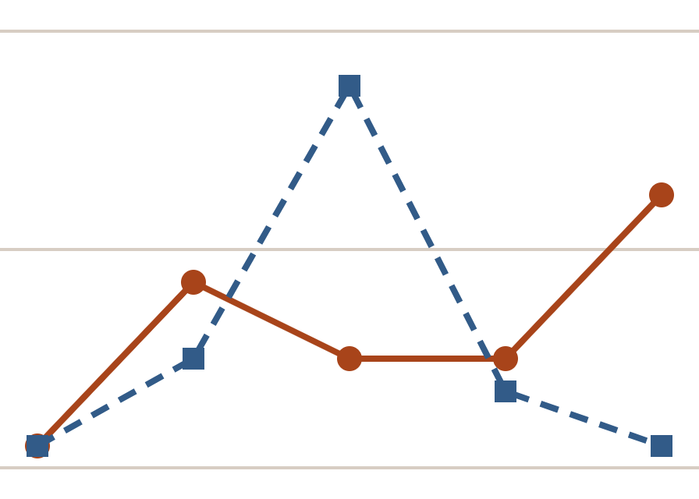
Total error along the chain
RESULTS
Sequential (solid, circles)
With self-correction (dashed, squares)
ChatGPT
Gemini
Duck.ai
0.4
0.4
0.4
0.35
0.2
0.2
0.2
0
0
0
PL
ZH
AR
MS
TR
PL
ZH
AR
MS
TR
PL
ZH
AR
MS
TR
Error = how far the similarity score falls short of 100 (0 = perfect) · PL Polish, ZH Chinese, AR Arabic, MS Malay, TR Turkish
18 / 22
Notes:
[1:30] Here are the results. Each panel is one system. The horizontal axis is the chain of languages, from Polish to Turkish. The vertical axis is the total error — zero means a perfect match with the original. The solid orange line is plain translation, the dashed blue line is translation with self-correction. Look first at the solid lines. In all three systems the error grows along the chain — exactly the accumulation we described. And the biggest jump happens at the second step, Chinese, just as we expected. By the end of the chain, plain translation reaches an error of about 0.11 for ChatGPT, 0.22 for Gemini and 0.25 for Duck.ai. Now the dashed lines. For ChatGPT and Gemini, self-correction keeps the error lower at every step. Gemini's error is roughly halved. This is the brake working as intended. The most interesting panel is the one on the right — Duck.ai. With self-correction, its error suddenly jumps at the third step, Arabic, to 0.35 — three and a half times higher than without self-correction at the same step. Then it falls again. Duck.ai explained that at every step it tried to preserve meaning, emotional depth and natural phrasing. In trying to improve the text, it moved away from the original. This is exactly the effect our model predicted: self-correction itself can introduce errors. These values come from Table 2 and Figures 1 to 3 of our paper.

Slide 19
What the experiment shows
RESULTS
Errors pile up
Checking helps…
In plain translation, every system ended the chain further from the original than it started — the biggest jump came at Chinese.
With self-correction all three systems finished lower. ChatGPT had the smallest error in both modes; Gemini’s was roughly halved.
…until it hurts
Not a simple sum
At the Arabic step, Duck.ai’s self-correction made the error 3.5 times larger. Trying to improve the style, it lost the meaning.
The total error was not the sum of its parts. Gemini’s steady curve was closest to what our model predicts.
19 / 22
Notes:
[1:00] Let me summarise what the experiment shows in four short statements. First, errors pile up. In plain translation, every system ended the chain further from the original than it started, and the largest jump came at the Chinese step. Second, checking helps. With self-correction, all three systems finished the chain with a lower error. ChatGPT showed the best results in both modes, and Gemini's final error was roughly halved. Third — and this is the most important observation — checking helps until it hurts. At the Arabic step, Duck.ai's self-correction made the error three and a half times larger. It was trying to improve the style and naturalness of the text, and in doing so it lost the meaning. This confirms experimentally our assumption that self-correction itself can contain errors. Fourth, the total error is not a simple sum of the individual error types — they interact, as our model assumes. And Gemini's smooth, steadily rising curve was the closest to the theoretical picture of accumulation.

Slide 20
Limitations and next steps
VALIDITY
What limits the experiment | What we will do next
One sentence, one run per system and mode — we cannot yet tell how much results vary | Many texts and repeated runs, with confidence ranges
Gemini scored every translation, including its own | Human experts or several different AI judges
Model versions and generation settings were not fixed | Fixed versions and settings for every run
The model’s parameters are illustrative, not yet measured on real data | Calibration on audit logs and long-reasoning tasks
The experiment shows that the predicted effects exist — errors that do not simply add up, and self-correction that can do harm. It does not yet tell us how large they are in general.
20 / 22
Notes:
[1:00] Before the conclusions, I want to be honest about the limits of our experiment. First, it is small: one sentence, and one run for each system and mode. So we cannot yet say how much the results would vary if we repeated them. The next step is many texts and repeated runs, with confidence ranges. Second, Gemini acted as the judge — and it also judged its own translations. That may favour Gemini. In future work we plan to use human experts or several different AI judges and compare their scores. Third, we used public interfaces, where the model version and the generation settings are not fixed. Next time every run will use fixed versions and settings. And fourth, the parameters of our model — for example, how strongly one wrong step affects the next — are illustrative for now. They need to be calibrated on real data, such as audit logs and long reasoning tasks. So the correct way to read the experiment is this: it shows that the effects our model predicts really exist — errors that do not simply add up, and self-correction that can do harm. It does not yet tell us how large these effects are in general. Expanding the empirical base is the main direction of our future work.

Slide 21
Measure the speed, not just the error
CONCLUSIONS
1
We can estimate both how often an AI answer goes wrong and how bad the worst case can be.
2
Errors form a chain — thin data, forgotten context, invented facts — so we can check its weak links.
3
Errors can spread like an epidemic; a self-training loop can either amplify or heal them.
4
Long reasoning makes errors grow very fast; self-correction and external checks slow it — up to a limit.
5
ERAS finds the moment when “fixing” starts to hurt — and our experiment saw exactly that.
For critical infrastructure: build these ideas into audits, monitoring, warning thresholds and regular cycles of data cleaning and validation.
21 / 22
Notes:
[1:15] Let me conclude. The main message of our work is in the title of this slide: for the safe use of AI, especially in critical infrastructure, it is not enough to detect errors. We must also measure how fast they accumulate and spread. Our contributions are five. One: a framework to estimate both how often an AI answer goes wrong and how bad the worst case can be, taking into account that errors depend on each other and have different costs. Two: we showed that errors form a chain — thin data leads to forgotten context, and forgotten context leads to invented facts. This means we can check the weak links of the chain, not only the final answer. Three: errors can spread like an epidemic across datasets and models, and a self-training loop can either amplify them or heal them. We proposed ways to tell which is happening. Four: long reasoning makes errors grow very fast. Self-correction and external checks slow this growth — but only up to a limit, and the quality of the checker determines that limit. Five: the ERAS algorithm finds the moment when "fixing" starts to hurt — and in our experiment we observed exactly that moment. In practice, these results can be built into the safe operation of AI systems: audits, monitoring, warning thresholds and regular cycles of data cleaning and validation.

Slide 22
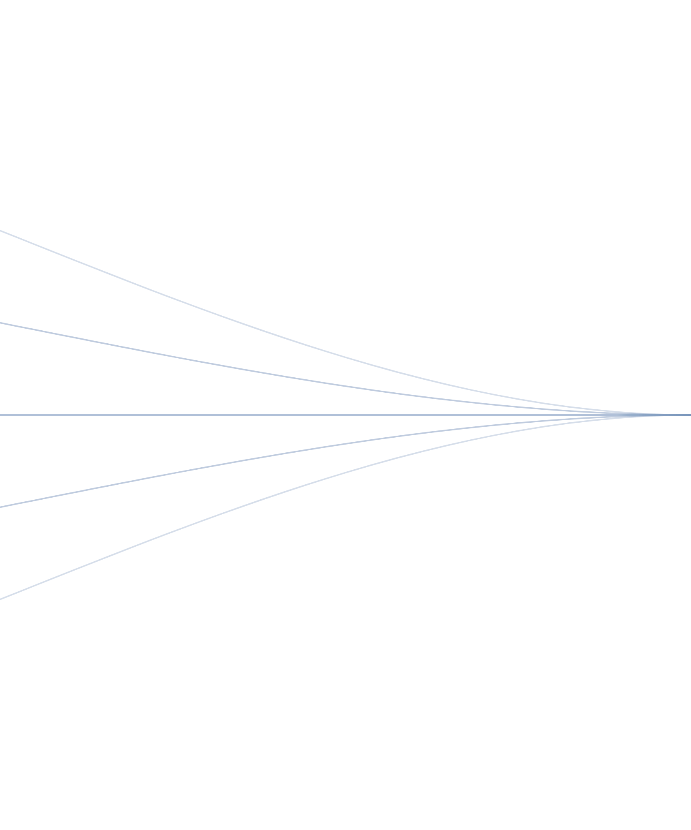
Thank you
ERROR PROPAGATION IN AI MODELS
Questions and discussion
Yuriy Danyk¹ · Valery Shestakov² · Roman Shyrshov²
¹ Igor Sikorsky Kyiv Polytechnic Institute
² National Academy of the Security Service of Ukraine
Yuriy Danyk · zhvinau@ukr.net
Valery Shestakov · shvi_zt@ukr.net
Roman Shyrshov · signorum@gmail.com
Notes:
[0:15] Thank you for your attention. The lines on this slide come back together — with good checking, errors can be brought back to the reference. I will be glad to answer your questions. Possible questions and short answers: — How do you estimate how strongly one wrong step affects the next? From the observed rate at which results degrade as the number of steps grows. Calibrating this on real data is our next step. — Why translation? It gives a clear reference, a controllable number of steps, and each step's output is the next step's input — a clean model of a reasoning chain. — Isn't Gemini a biased judge? Yes, and we say so on the limitations slide; we plan to use human experts and several AI judges. — How does ERAS measure drift? As the semantic distance between the text after the previous correction and the new raw text at the current step. — What should practitioners take away? Keep reasoning chains short where possible, monitor the weak links, invest in the quality of external checks, and stop self-correction at the turning point.

