Slide 1

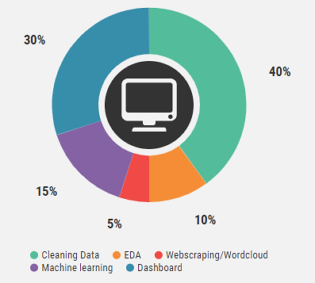
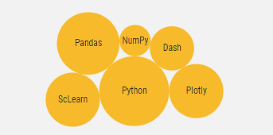
Data Science Portfolio at a glance
An investigation of processes in Environmental Economics such as the relationship between CO2 emissions per capita and various world development indicators
Data collection: the World Bank
Environmental Economics hypothesis: Kuznets Curve
Predictive Modelling: Machine learning pipeline for CO2 prediction
GitHub link: https://github.com/aparinatali/Python_Project_2020

