Slide 1
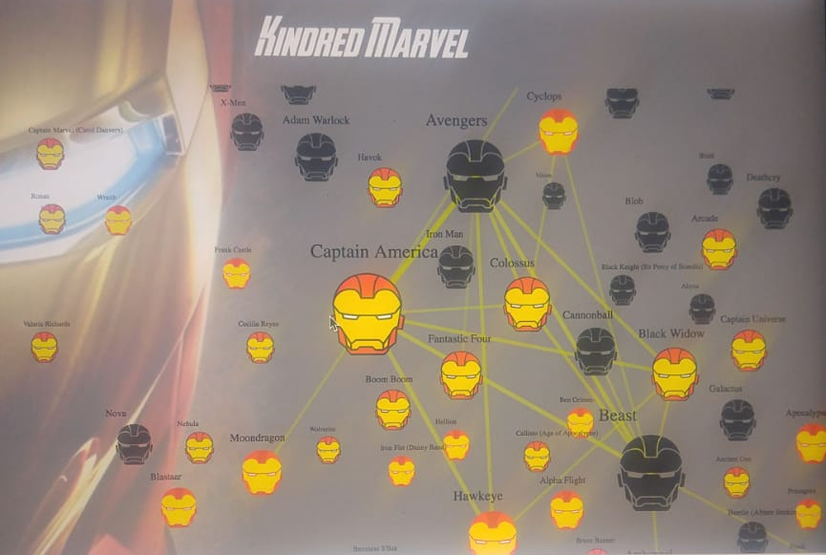
Kindred Marvel

Slide 2
The Research Question
What properties of Marvel Comics characters affect the number of their comics appearances?
This question is subject to interpretation as many variables need to be accounted for. We will focus on the following factors: the number of events characters participate in, their affiliations and their alignment (good/evil).
Rather than answering the question above directly, we aim to create a platform that will allow us to research this question in a dynamic fashion.

Slide 3
Our Goal
We expect that by the end of this project, we will have created a platform that enables users to intuitively gain insights about the nature of the connections between Marvel Comics characters.
The platform will be a searchable graphical user interface of the Marvel Comics characters and the connections between them.
Searchable by character names or substrings or via search box
The GUI enables browsing the most prominent characters
Easy and convenient way to analyze information about character from the Marvel Comics Universe.

Slide 4
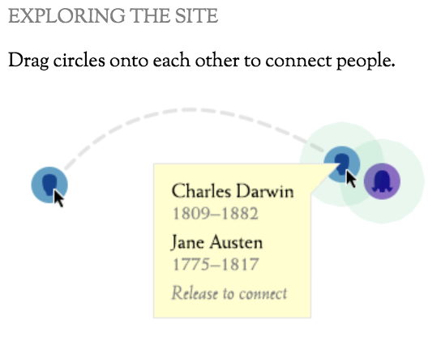
Inspiration
Kindred Britain
Kindred Britain is a network of nearly 30,000 individuals — many of them iconic figures in British culture — connected through family relationships of blood, marriage, or affiliation. It is a vision of the nation’s history as a giant family affair.

Slide 5
The Data
Most of the data is provided in a fully-structured JSON format by querying the Marvel API and SuperHero API, by manipulating it/ extracting from it
The basic information about events and characters such as name, image and comics that it appears in are fully structured.
The free text fields, e.g. title, description and affiliations provide helpful data that is NOT structured and needs to be parsed or processed otherwise, e.g. by an NLP engine.
Other sources may be used in the future to fill the details that Marvel’s database doesn’t provide.
Data is partially analyzed as some of it yields little information of interest to the project

Slide 6
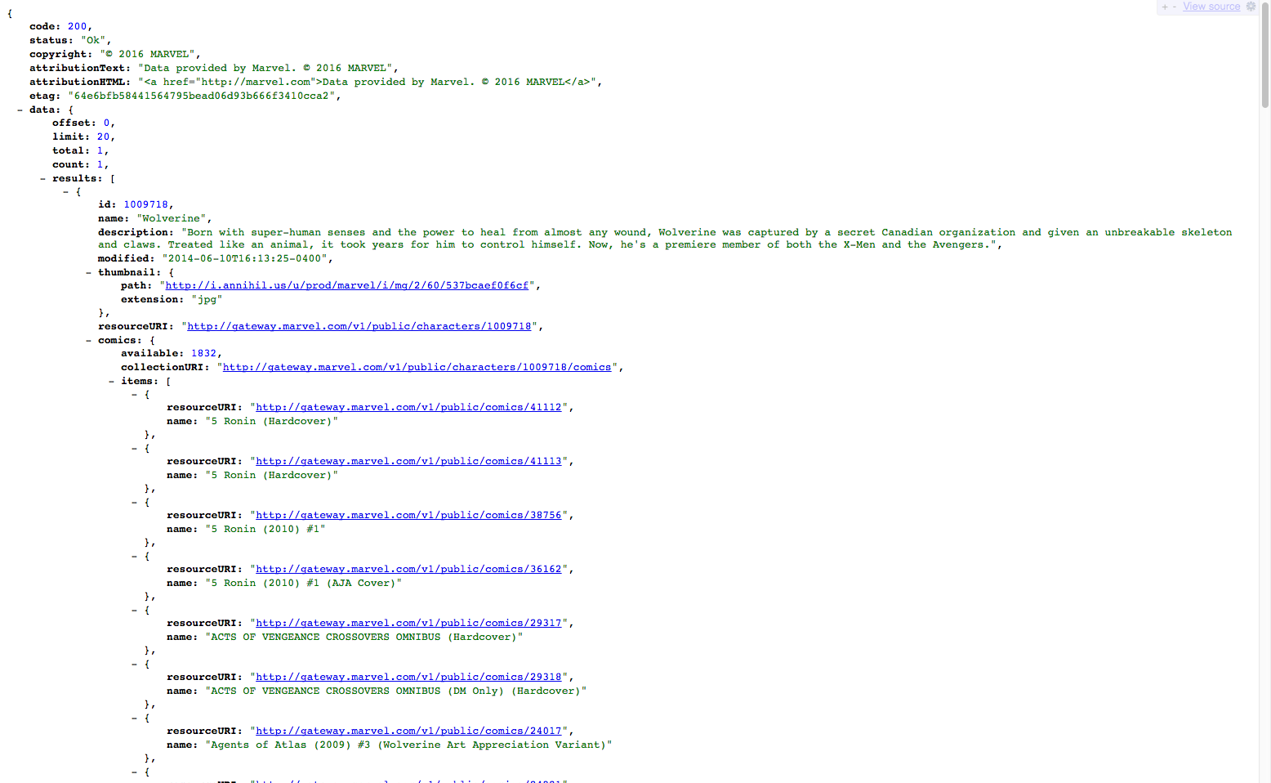
Not structured
Fully structured

Slide 7
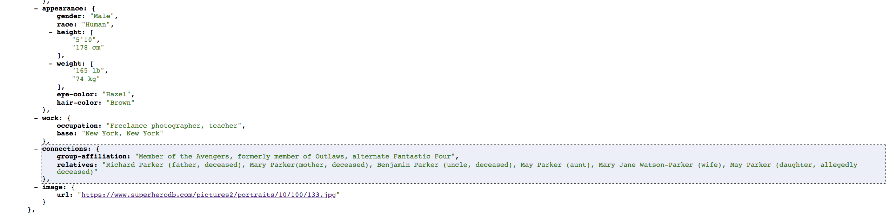
Semi-structured

Slide 8
Tools and Technologies
Data : the Marvel API and SuperHero API. possibly other sources in the future.
Display (web development framework): Angular 6
NLP engine: TBD. Maybe Textrazor, GPT2, or some Python library

