Slide 1
Reinforcement Learning Q-Learning and DQN
Pankratov Vasilii
Smirnova Natalia
Group 301

Slide 2
Reinforcement Learning
2018 - "Reinforcement Learning doesn't work yet"
2020 - the state-action table replaced with a neural network to cope with large-scale tasks

Slide 3
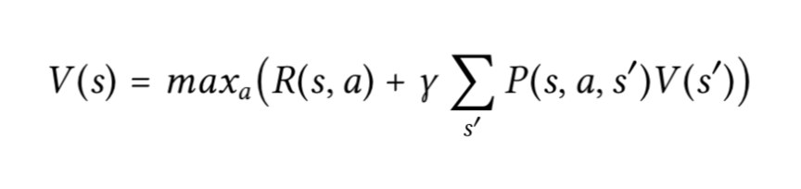
Bellman equation
Bellman equation is not an exact algorithm,
it is a general approach to solving problems

Slide 4
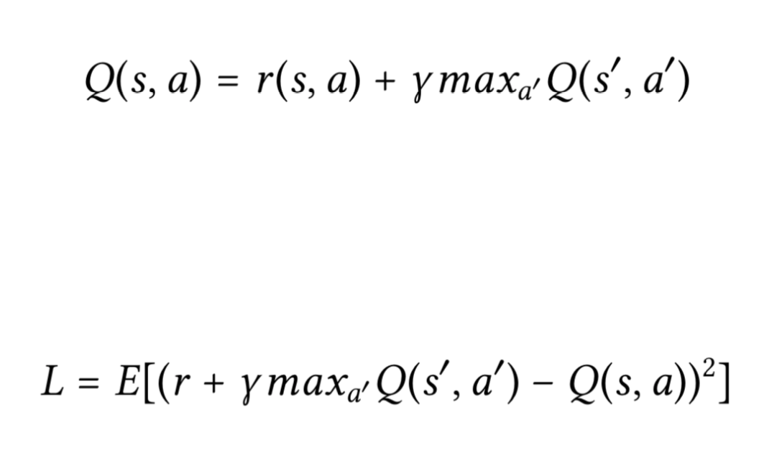
Deep Q-Network
Loss function (squares error):

Slide 5
Cart-pole balancing
The agent has to decide between
two actions - moving the cart
left or right
Basic Principle: encourage actions that lead to rewards and avoid actions that lead to failure

Slide 6
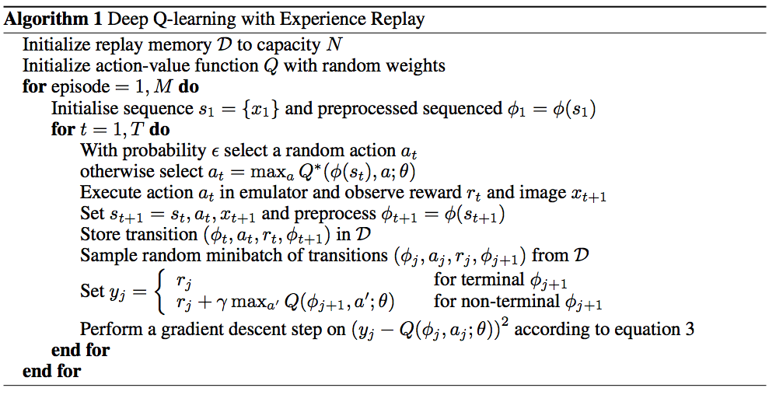

Slide 7
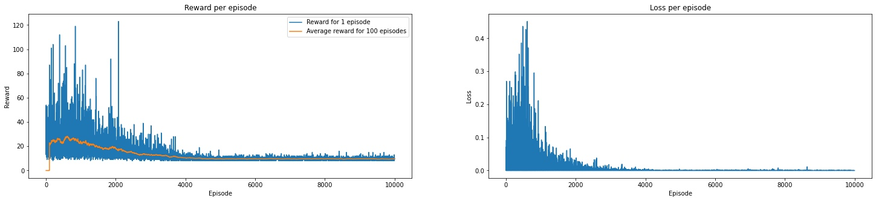

Slide 8
https://github.com/Natangens/Reinforcement-Learning-and-DQN

