Slide 1
Hypothesis Testing Exercise
A F&B manager wants to determine whether there is any significant difference in the diameter of the cutlet between two units. A randomly selected sample of cutlets was collected from both units and measured? Analyze the data and draw inferences at 5% significance level. Please state the assumptions and tests that you carried out to check validity of the assumptions.
Minitab File : Cutlets.mtw
Ans:
Objective of business problem : We need to determine is their any significant difference in the diameter of the cutlet between two ubits.
Framing of the Hypothesis : Let Mu1 is the mean diameter of cutlet of unit 1 and Mu2 is the mean diameter of cutlet of unit 2
Null Hypothesis(H0) : Mu1 - Mu2 = 0 (There is no significant difference in the diameter of the cutlet between two units)
Alternative Hypothesis(Ha) : Mu1-Mu2 != 0 (There is difference in the diameter of cutlet between two units)
Test statistics : We will do two sample two tail test
Significance level(α) : 0.05 or 5%

Slide 2
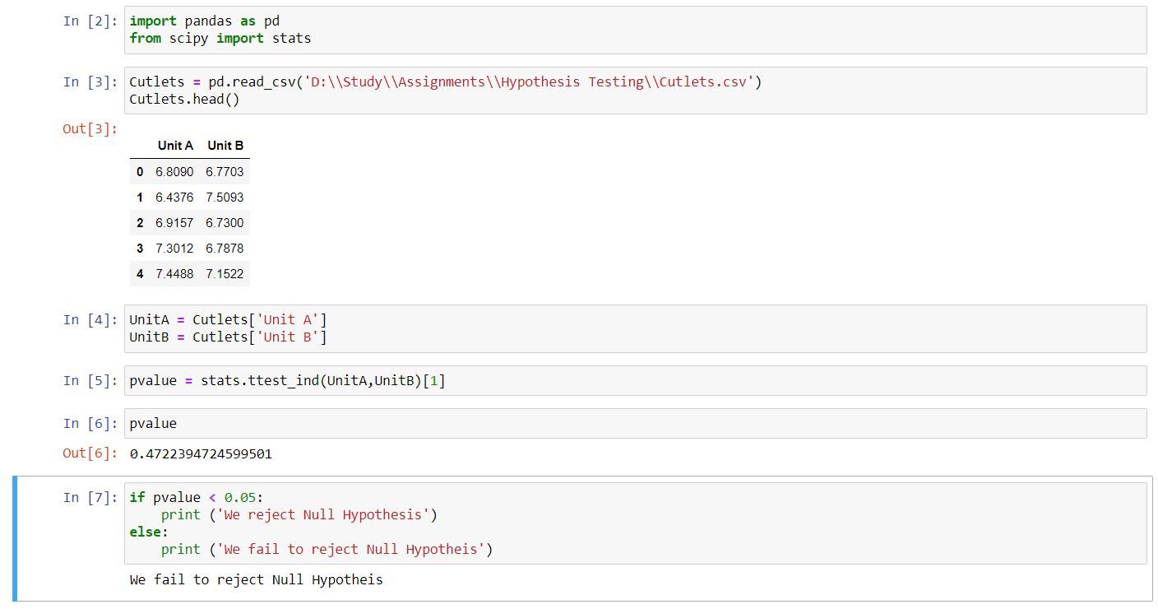
As here pvalue > 0.05 , so we cannot reject Null Hypothesis.
There is no significance difference in the diameter of the cutlet between two units

Slide 3
Hypothesis Testing Exercise
A hospital wants to determine whether there is any difference in the average Turn Around Time (TAT) of reports of the laboratories on their preferred list. They collected a random sample and recorded TAT for reports of 4 laboratories. TAT is defined as sample collected to report dispatch.
Analyze the data and determine whether there is any difference in average TAT among the different laboratories at 5% significance level.
Minitab File: LabTAT.mtw

Slide 4
Objective : We need to determine whether there is any difference in the average Turn Around Time (TAT) of reports of the 4 laboratories.
Framing of the Hypothesis : Let µ1, µ2, µ3 and µ4 are the mean TAT of lab1, lab2, lab3 and lab4 respectively.
Null Hypothesis(H0) : µ1=µ2=µ3=µ4 (There is no significant difference in the average Turn Around Time (TAT) of reports of the 4 laboratories)
Alternative Hypothesis(Ha) : µ1≠µ2≠µ3≠µ4 (There is significant difference in the average Turn Around Time (TAT) of reports of the 4 laboratories)
Test statistics : We will do ANOVA test as the data is based upon 4 samples
Significance level(α) : 0.05 or 5%
Pvalue = 2.115670894992414e-57
As here pvalue < 0.05 , so we reject Null Hypothesis.
There is significance difference in the average Turn Around Time (TAT) of reports of the 4 laboratories

Slide 5
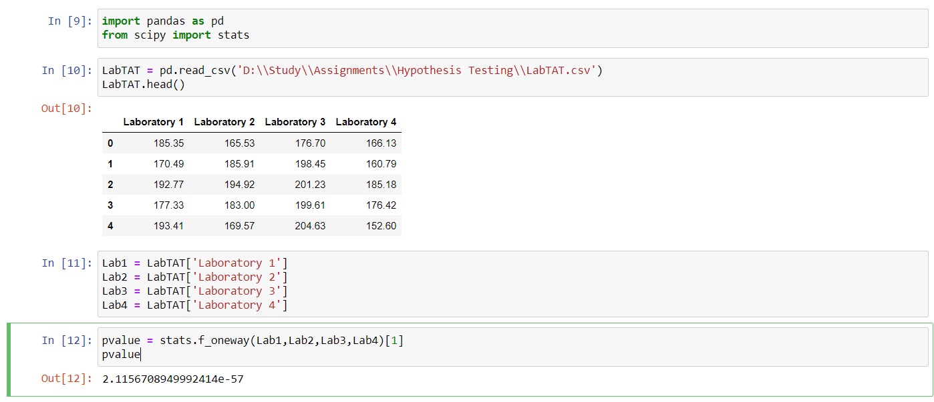

Slide 6
Hypothesis Testing Exercise
Sales of products in four different regions is tabulated for males and females. Find if male-female buyer rations are similar across regions.
 | East | West | North | South
Males | 50 | 142 | 131 | 70
Females | 550 | 351 | 480 | 350
Check p-value
If p-Value < alpha, we reject Null Hypothesis
H0
All proportions are equal
Ha
Not all Proportions are equal
Buyer Ratio.mtw

Slide 7
Objective: We need to determine whether there is significant similarity between sales in different regions for male-female buyer.
Framing of Hypothesis:
Null Hypothesis(H0) : Male - female buyer rations are similar across all regions
Alternative Hypothesis(Ha) : Male - female buyer rations are not similar across all regions
Test Statistics : Chi Square Test
Significance Level : 0.05
Here p-value is 0.66039, which is greater than significance level so we cannot reject null hypothesis.
Inference : Male- Female buyer rations are similar across all regions.

Slide 8
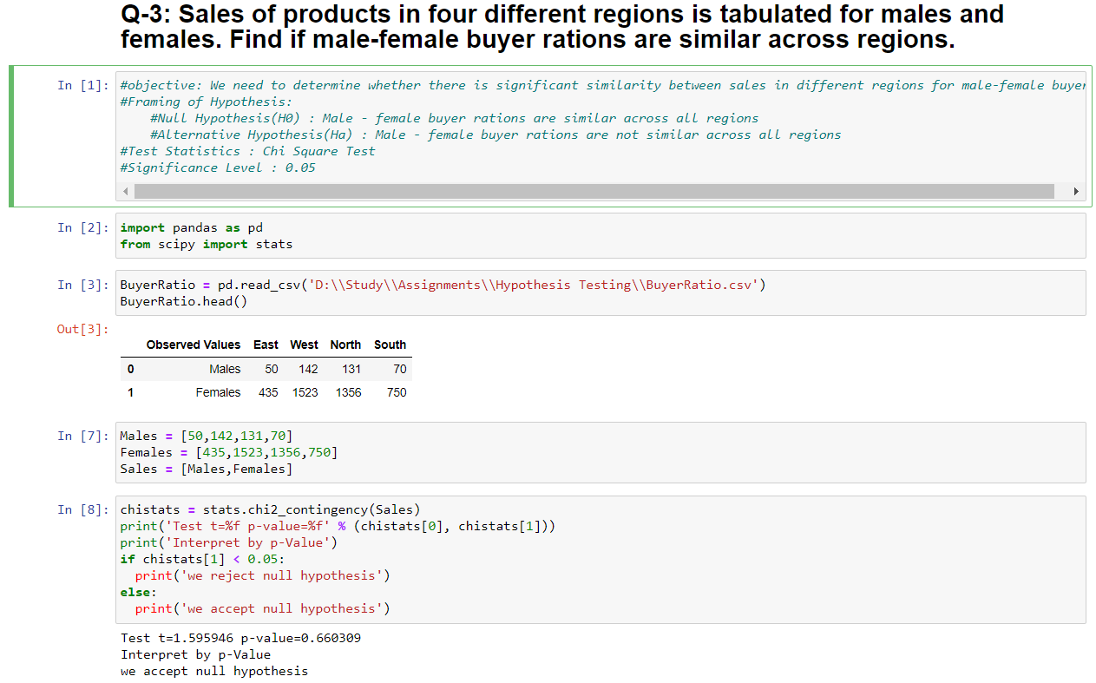

Slide 9
Hypothesis Testing Exercise
TeleCall uses 4 centers around the globe to process customer order forms. They audit a certain % of the customer order forms. Any error in order form renders it defective and has to be reworked before processing. The manager wants to check whether the defective % varies by centre. Please analyze the data at 5% significance level and help the manager draw appropriate inferences
Minitab File: CustomerOrderForm.mtw
Objective: We need to determine whether the defective % varies by centre.
Framing of Hypothesis:
Null Hypothesis(H0) : Defective % does not vary by centres
Alternative Hypothesis(Ha) : Defective % varies by centres
Test Statistics : Chi Square Test
Significance Level : 0.05
Here pvalue is 0.939938, which is greater than significance level ,hence we fail to reject null hypothesis.
Inference: Defective % does not vary by centres

Slide 10
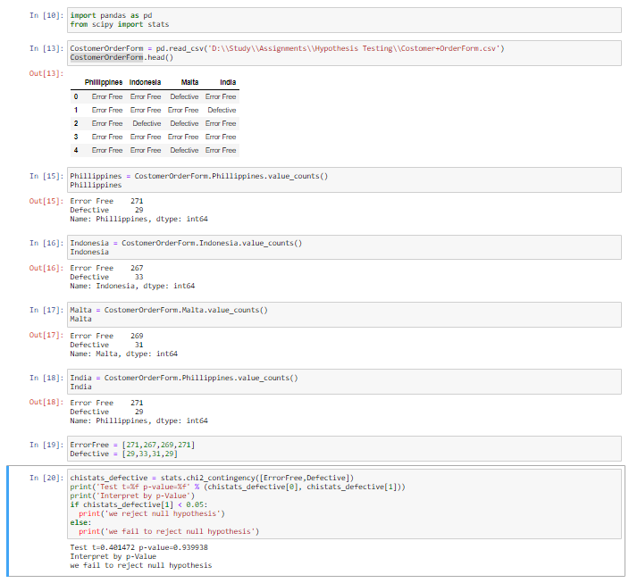

Slide 11
Fantaloons Sales managers commented that % of males versus females walking in to the store differ based on day of the week. Analyze the data and determine whether there is evidence at 5 % significance level to support this hypothesis.
Minitab File: Fantaloons.mtw
Ans:
Objective: We need to determine whether the % of males versus females walking into the stores based on day of the week.
Framing of Hypothesis:
Null Hypothesis(H0) :Proportion % of males versus females walking into the store do not differ based on day of the week
Alternative Hypothesis(Ha) : Proportion % of males versus females walking into the store differ based on day of the week
Test Statistics : Proportion test
Significance Level : 0.05
Here pvalue is lesser than significance level ,hence we reject null hypothesis.
Inference: Proportion % of males versus females walking into the store differ based on day of the week

Slide 12
