Slide 1
Deep Learning Approach to Diabetic Retinopathy Detection
SUBJECT: COMPUTER VISION(IT813)
Presented By:
Natasha Jain(222IT023)
Deepak Gaur(222IT010)

Slide 2
INTRODUCTION
Diabetic retinopathy is a diabetes complication that affects eyes. It's caused by damage to the blood vessels of the light-sensitive tissue at the back of the eye (retina).
It becomes the leading cause of vision impairment and blindness for working-age adults in the world today
According to Data from the National Health Interview Survey,2019
Among adults aged 45 and over with diagnosed diabetes, 8.6% had diabetic retinopathy. 4.1% had vision loss due to diabetic retinopathy.

Slide 3
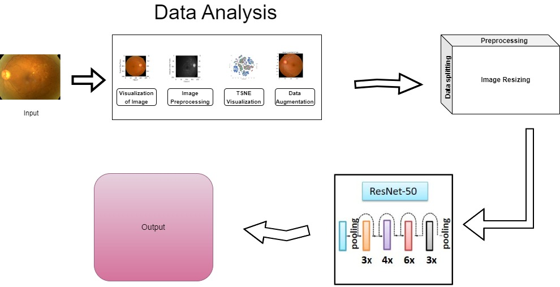
Components of Our Model

Slide 4
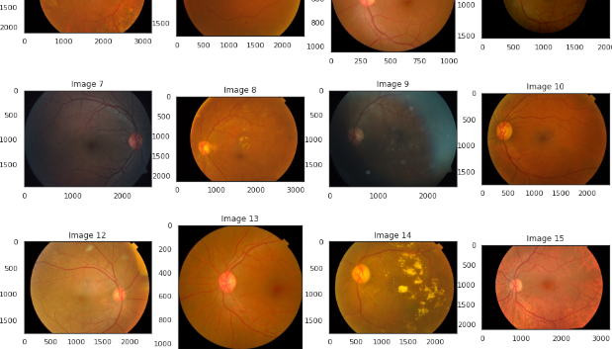
DATA USED
The dataset which we are using is a large set of retina images taken using Fundus Photography under a variety of imaging conditions.
The dataset is provided by Asia Pacific Tele-Ophthalmology Society (APTOS)
The full dataset consists of 18590 fundus photographs, which are divided into 3662 training, 1928 validation, and 13000 testing images
Captions

Slide 5
LIBRARY USED
LIBRARY USED
Matplotlib
Sys
Os
Numpy
Pandas
Sklearn
Sklearn
keras

Slide 6
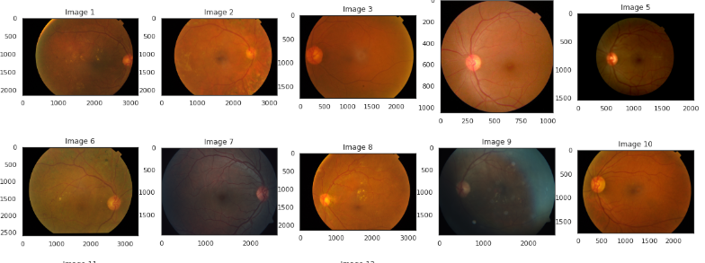
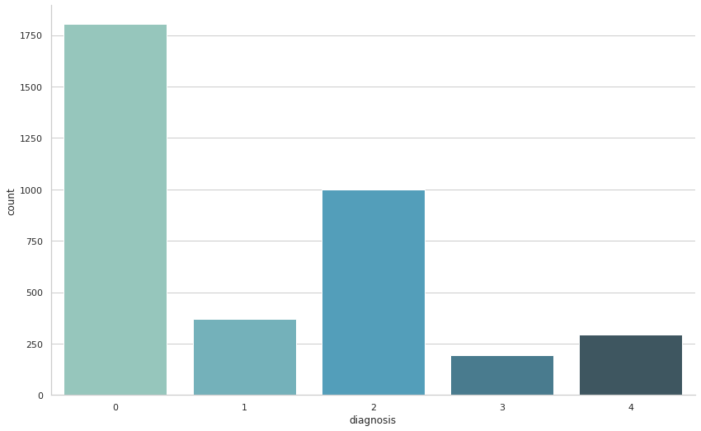
METHODOLOGY
Pre-processing Images
0 - No DR
1 - Mild
2 - Moderate
3 - Severe
4 - Proliferative DR
The images have different sizes, they may need resizing or some padding.

Slide 7
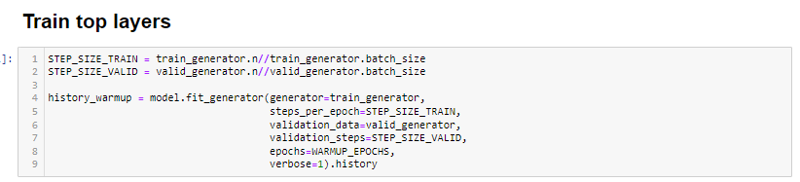
METHODOLOGY
Training Process
Model used: ResNet 50
Top Layer Training with Epoch 2
.

Slide 8
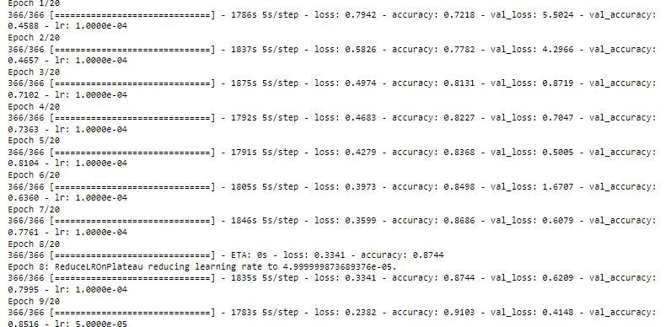
METHODOLOGY
Fine tuning Model with 20 EPOCHS
Even Though while training we used 20 epochs , The model early stopped at epoch 14 because loss and accuracy becomes constant

Slide 9
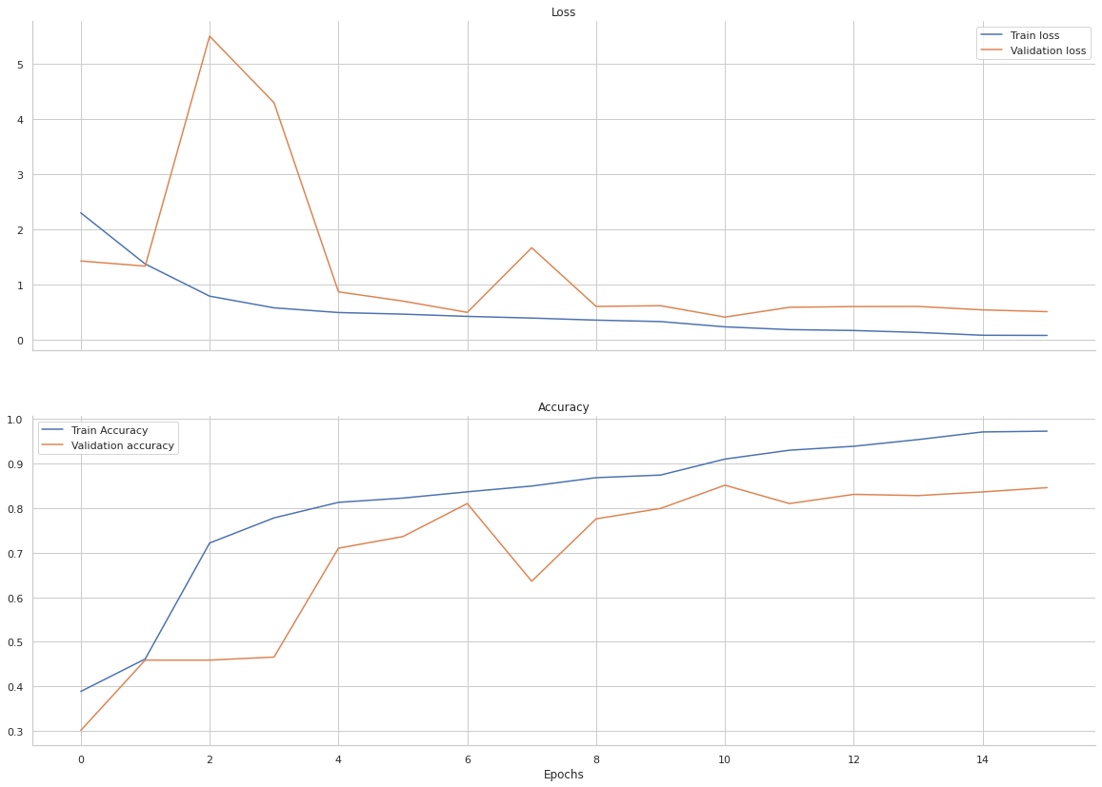
TRAINING OF MODEL

Slide 10
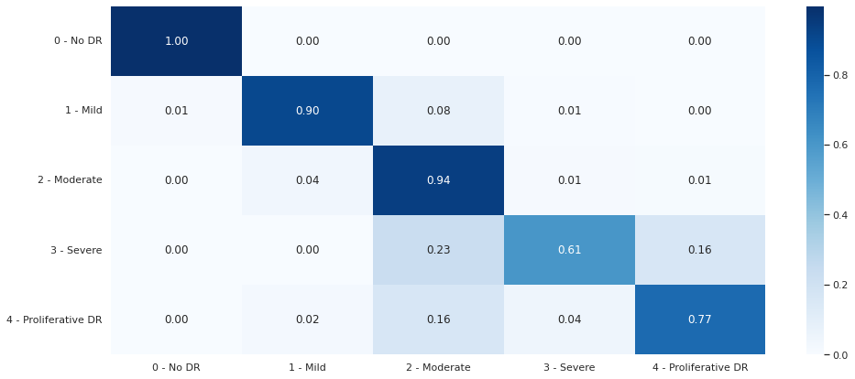
Result
precision recall f1-score support
0 1.00 1.00 1.00 1805
1 0.87 0.90 0.89 370
2 0.88 0.94 0.91 999
3 0.81 0.61 0.69 193
4 0.84 0.77 0.81 295
accuracy 0.93 3662
macro avg 0.88 0.84 0.86 3662
weighted avg 0.93 0.93 0.93 3662
Train Cohen Kappa score: 0.959

Slide 11
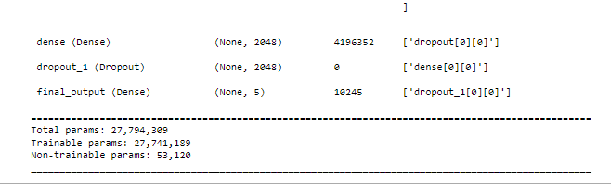
Result
Summary of model:

Slide 12
THANK YOU

