Slide 1

AMBULANCE VICTORIA RESPONSE TIMES 2018 & 2019
Amrit
Soheil
Natasha
Iaroslav
MONASH UNIVERSITY: DATA ANALYTICS BOOT CAMP – GROUP PROJECT 1

Slide 2

INTRODUCTION
Our motivation was to research Ambulance Victoria’s performance over the years 2018 and 2019. We aimed to investigate whether Ambulance Victoria is meeting their self-stated goals regarding response times and if they aren't, what factors may be contributing to this.
Ambulance Victoria data includes:
Code 1 incidents: “urgent, requiring a lights and sirens response”
Code 2 incidents: “not time critical and do not require a lights and sirens response”
Local Government Area (LGA)
Urban Centres and Localities (UCL)
Notes:
The data from Ambulance Victoria includes both Code 1 incidents, which are defined as “urgent, requiring a lights and sirens response” and Code 2 incidents, which are “not time critical and do not require a lights and sirens response”. The data is divided up into both Local Government Area (LGA) and Urban Centres and Localities (UCL). We have chosen to focus on UCLs because it allowed us to line up the Ambulance data from Ambulance Victoria, Census data from the Australian Bureau of Statistics, and traffic data from VicRoads.

Slide 3
We have raised the following questions regarding these datasets:
What is the difference in the average response time of the Ambulance teams for Code 1 and Code 2 emergencies?
Does population density of a UCL affect Ambulance response time?
Which UCLs consistently meet or fail to meet the 85% or 90% response time targets for Code 1 incidents?
Does traffic density affect the response time?

Slide 4
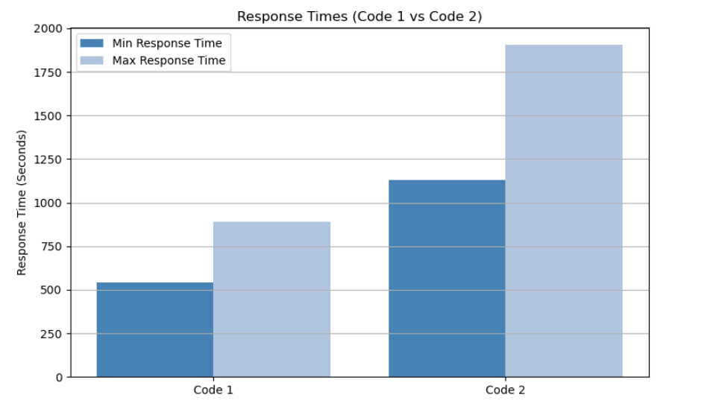
What is the difference in the average response time of the Ambulance teams for Code 1 and Code 2 emergencies?
Code 1- Less response time (Faster service)
Code 2- More response time (Slower service)
potential service capacity issues
impacting the speed of lower-priority responses.

Slide 5
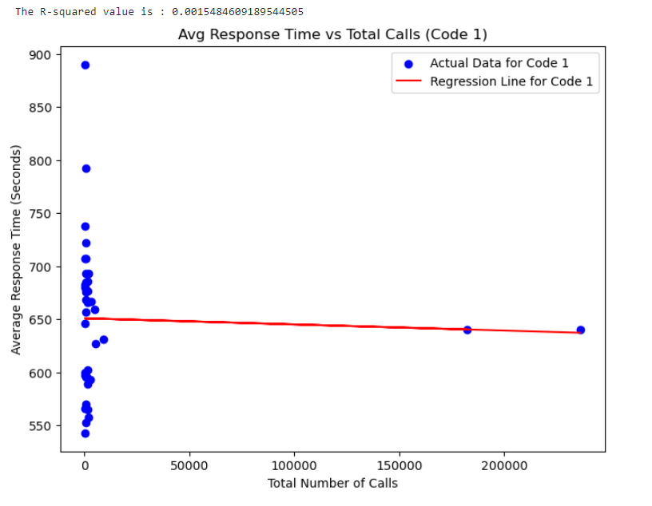
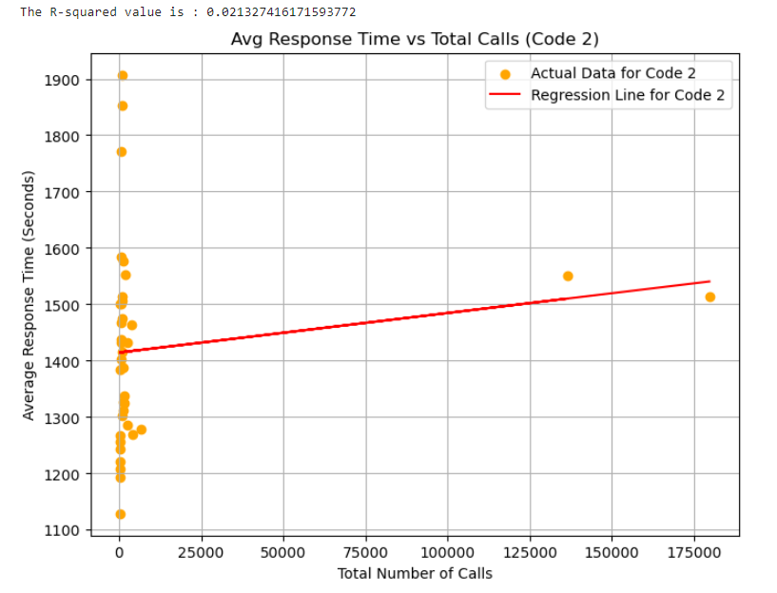
What is the difference in the average response time of the Ambulance teams for Code 1 and Code 2 emergencies?
Code 1- Weak correlation (Increased Call number != Delayed Response)
Code 2 -Moderate Correlation(Increased Call number = Delayed Response)

Slide 6
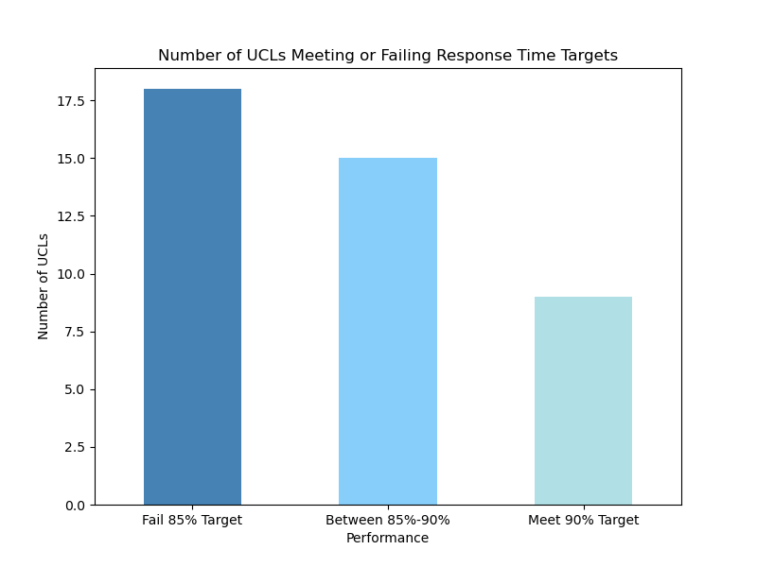
Which UCLs consistently meet or fail to meet the 85% or 90% response time targets for Code 1 incidents?
Performance Categories: UCLs were classified into 'High' (≥90%), 'Mid' (85%-90%), and 'Low' (<85%) performance, based on average response times.
Close to Target: Many UCLs fall in the 85%-90% range, indicating they are near the 90% target but need further improvement.
Challenges in Low-Performing Areas: UCLs below 85% face issues like infrastructure limitations, resource shortages, or long travel distances, affecting emergency response.

Slide 7
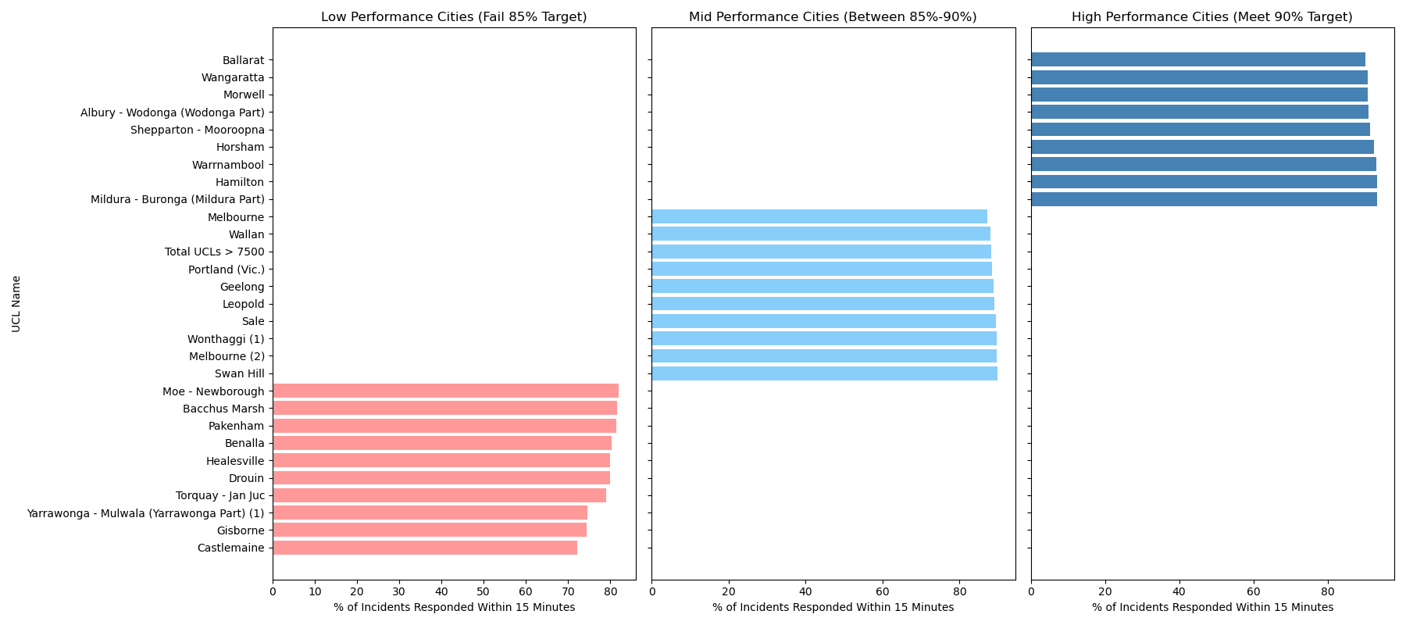
Which UCLs consistently meet or fail to meet the 85% or 90% response time targets for Code 1 incidents?
Cities with Low, Mid and High Performance

Slide 8
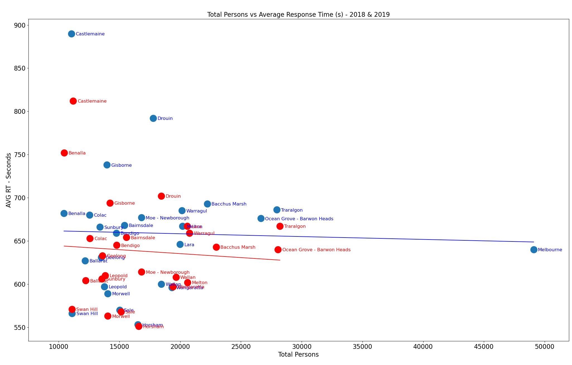
Does population density of a UCL affect Ambulance response time? One of the factors we think could affect the response time of any given area is the population of that area. Our assumption is that with a higher population density there will be an increase in ambulance response times.
This figure compares the total population “Total Persons” and the average ambulance response time in seconds “AVG RT – Seconds” for both 2018 and 2019.
Notes:
The linear regression shows a slight negative correlation. This indicates that contrary to the assumption, an increase in population does not exactly impact the response time in any particular area. The statistical analysis may in fact indicate that response times increase in areas with a lower population.

Slide 9
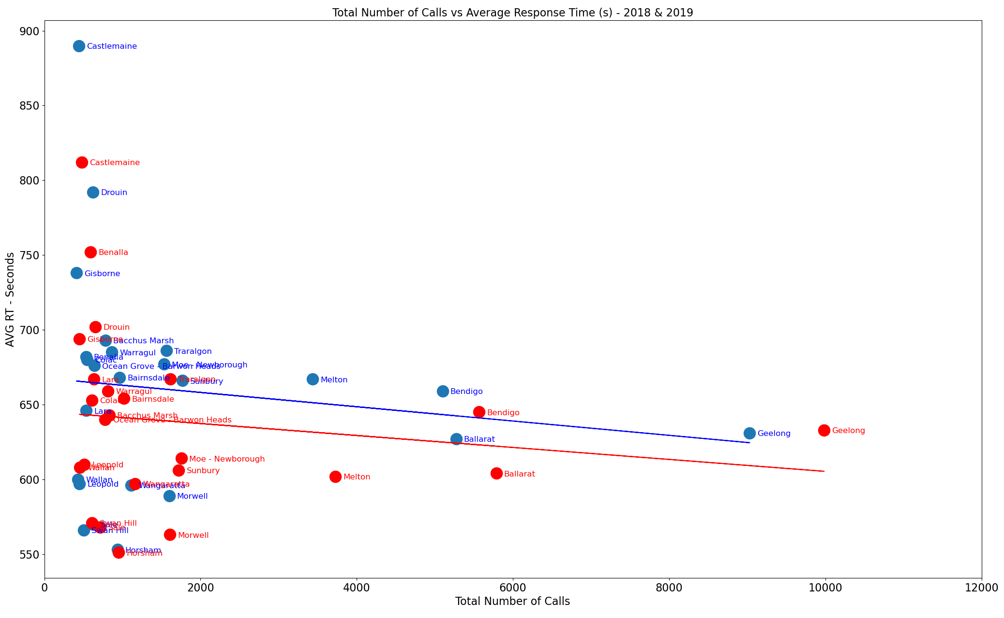
Does population density of a UCL affect Ambulance response time?
In addition to higher population in a densely populated area, we can assume that this will cause an increase in the number of calls to Ambulance Victoria services. This figure compares the total number of calls and the average ambulance response for both 2018 and 2019.
Notes:
The linear regression still shows a slight negative correlation, however it is a stronger correlation than the previous plot. This could indicate that a greater number of calls will have a strong chance of decreasing the average response time.

Slide 10
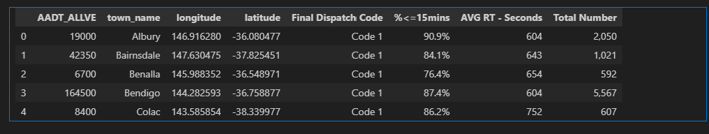
Does traffic density affect the response time?
I compared the average traffic against ambulance records for 2019 and plotted scatter charts.
Based on the scatter plots, in my opinion there is no strong dependency between the traffic count and the wait reaction to calls. It could be because those topics are totally unrelated or because the service quality is spread rather equally based on the potential request density

Slide 11
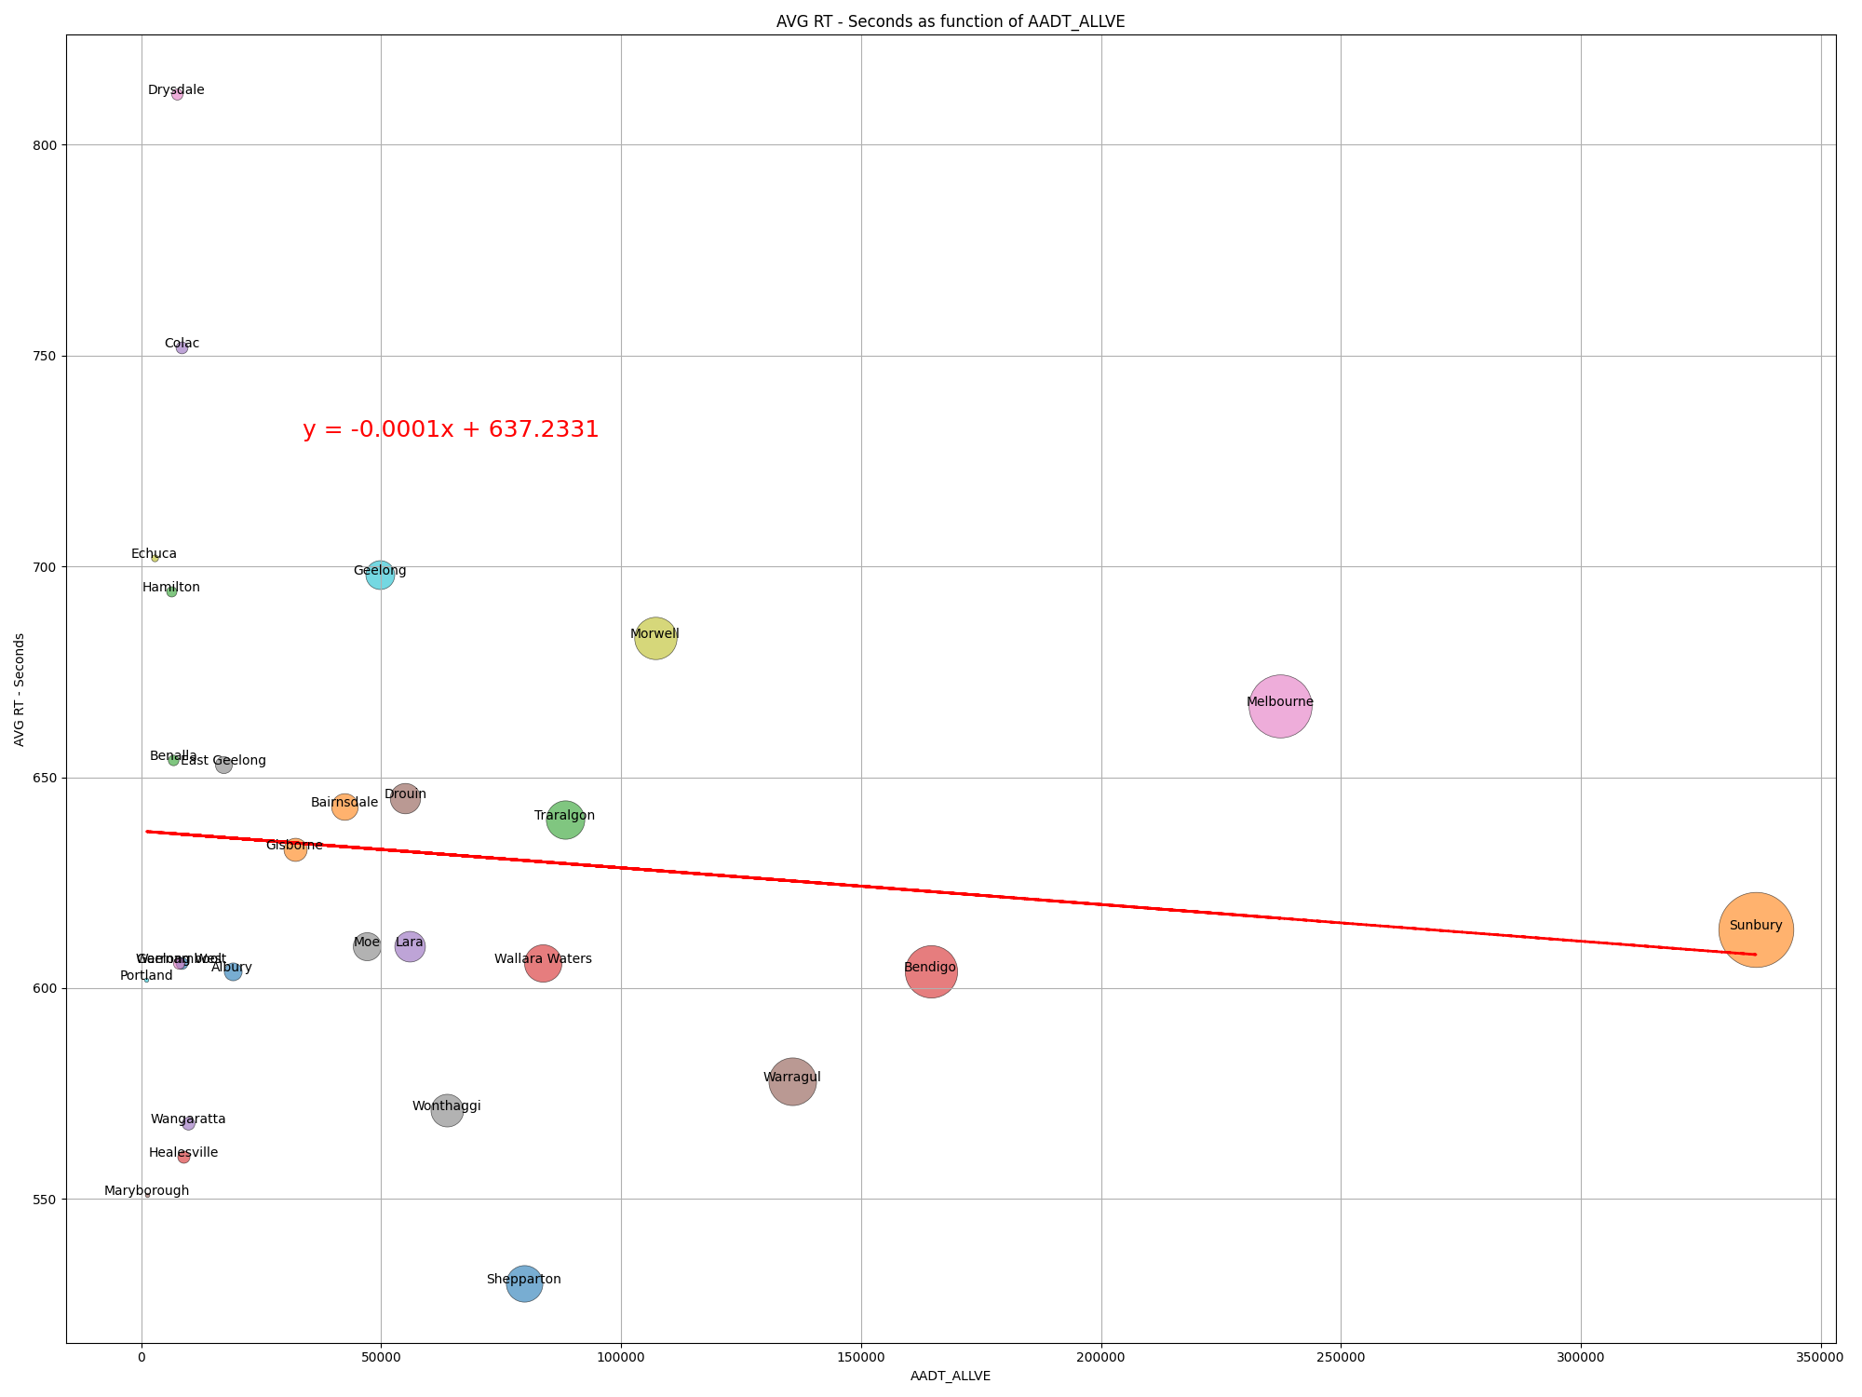
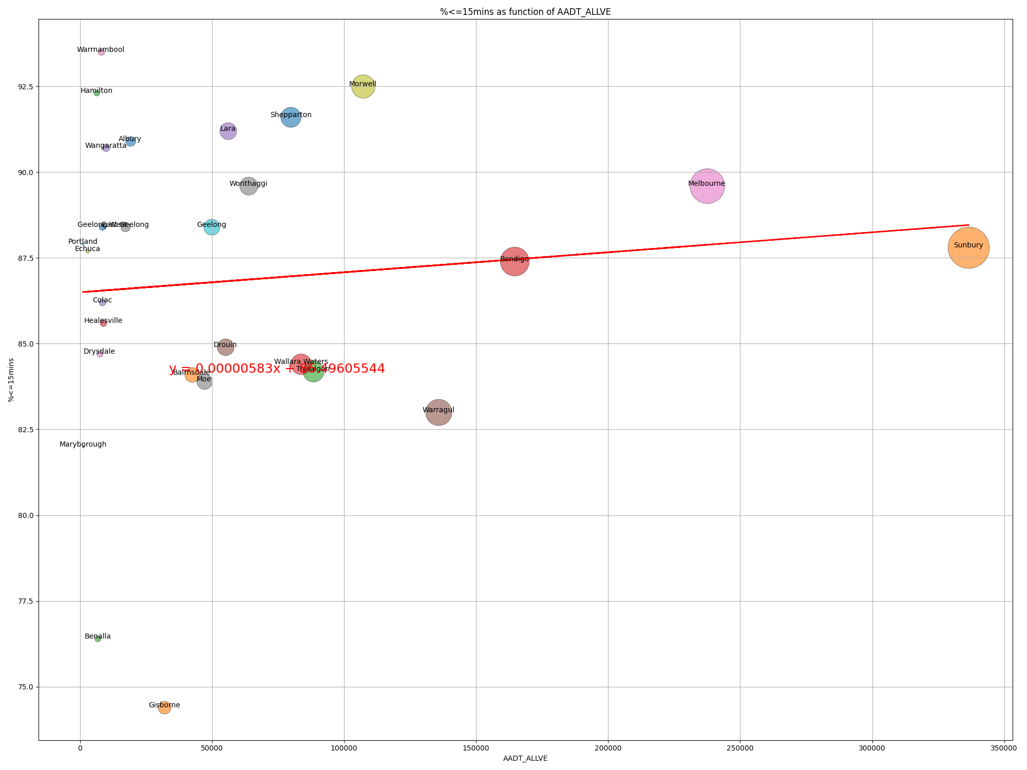

Slide 12
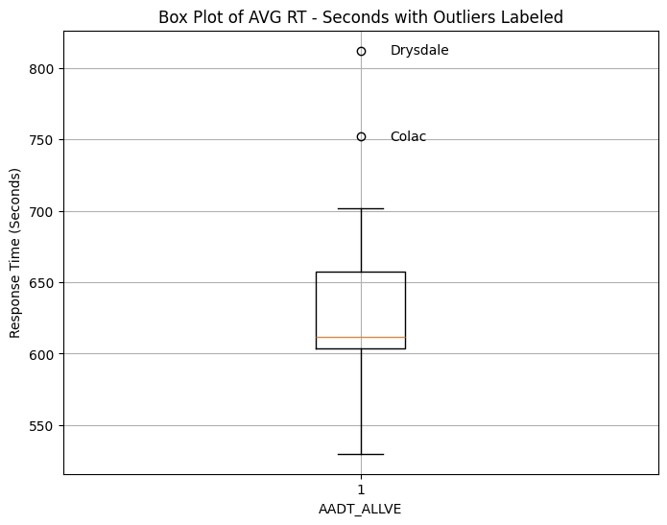
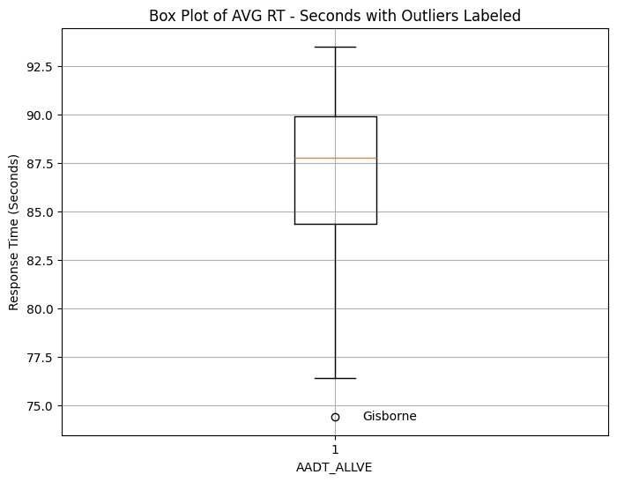
There are outliers though. For the average response time, Colac & Drysdale performed the worst. I suppose it needs to be closer verified before making conclusion. Gisborne happened to be as another outlier with the best time for quick response.

Slide 13
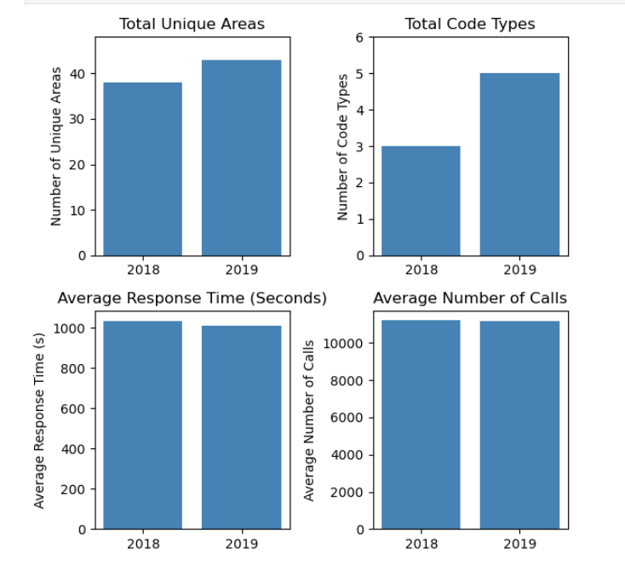
CONCLUSION
This analysis of ambulance response times reveals that the data leads to a weak relationship between traffic volume/population density and response times. This may suggest that other variables play a more significant role in shaping efficiencies in Ambulance Victoria meeting their time targets. While many UCLs are close to meeting the 90% response time for Code 1 incidents, there’s evident room for improvement.
The analysis of emergency service metrics reveals several important trends and implications:
Increase in Unique Areas
Decrease in Average Number of Calls
Increase in Code Types
Consistency in Average Response Time
Overall, these trends suggest that emergency services are adapting well to changing community needs, with a focus on improving accessibility, efficiency, and quality of service. Continued monitoring and evaluation will be essential to sustain these positive developments and ensure that the system remains responsive to the demands of the population.

