Slide 1
pager rotation duties
WEB 430
Natasha W

Slide 2
Outline
What is an On-Call Schedule?
DevOps On-Call
How DevOps On-Call is Setup
Setting Up On-Call
‘PagerDuty’ Graphic
Escalation
The DevOps Movement and it’s Crucial Use

Slide 3
What is an on-call schedule?
On-call schedules are used to determine who is on-call at a given time
The tools used for on-call scheduling need to be flexible enough to support:
Sophisticated scheduling scenarios
The amount of what-ifs that can happen due to geographically distributed teams, schedule changes, personnel changes, and more are important factors to consider when developing your on-call schedule

Slide 4
DevOps On-Call
In one of the sources listed, it is brought up that developers and designers should be exposed to the production issues together
Most people would thing this would be counterproductive as writing code and responding to production alerts are completely different
The key to this would be to have your engineers that are focusing on certain tasks would not focus on the alerts, and the engineers focused on the alerts wouldn’t work on tasks
With this mindset your engineers can see both sides of the development and production and go back and forth to prevent more alerts

Slide 5
How DevOps On-Call is Setup
One way to setup a On-Call process would be to have two different tiers:
The first tier would be setup to have all alerts go to the operations engineer during work hours, so that your production team could have time to do their stuff. Then on off hours the alerts could go to everyone
The second tier would have an escalated issues involving production circumstances unrelated to the ops team. This way the second tier could rotate through ops engineers that know more about the product and provide better assistance.

Slide 6
Setting up On-Call
Another Key thing for having an on call system is to have a schedule set up for your team members and having a secondary schedule to account for escalations and members not being able to keep up with the schedule
An example for having a secondary situation would be if you have an engineer that doesn’t respond within a time limit (such as 15 minutes) there would be someone else available to take the call
Another example could be dealing with someone that might be traveling or ill and you would need to rearrange the on-call slots.

Slide 7
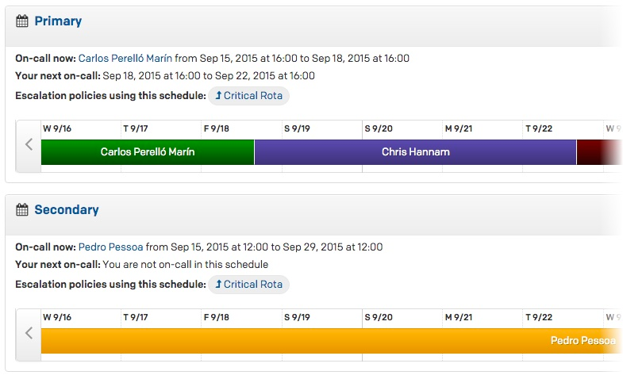
PagerDuty Graphic!

Slide 8
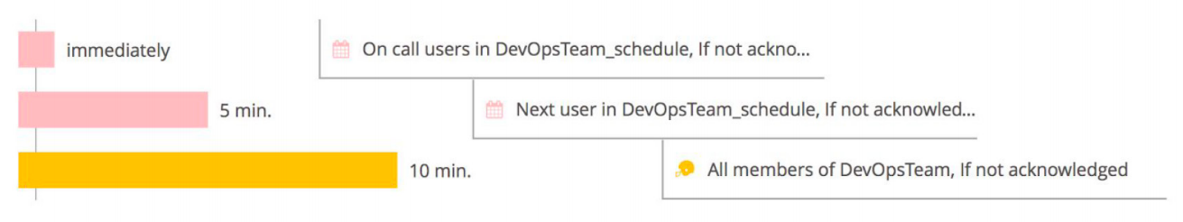
Escalation
Escalations determine who is the one to be notified when an alert happens
Escalations also determine what happens when no one responds to the alert and what should happen next.
This is key as alerts may happen in the middle of the night when individuals don’t see the alert and it is pressing to get the alert taken care of

Slide 9
DevOps Movement and it’s Crucial Use of On-Call Scheduling
Within the last decade responding to IT incidents was the primary job of the Ops team
Typically there was a tiered structure included levels one through three
Adding the ‘always on’ services, customer expectations have risen causing urgency between outages and impacting company’s reputation through social media
With the factors, having a structure to respond to incidients in a timely manner is mission critical
With the on-call system including all faces of development and ops, helps to prevent customers from not being included on what is happening as well as give an accurate ETA on outages

Slide 10
Sources
https://blog.serverdensity.com/how-we-handle-on-call-schedules/
https://www.opsgenie.com/blog/how-to-manage-on-call

