Slide 1
Weather Forecasting

Slide 2
Weather Forecasting:
Weather forecasting predicts atmospheric conditions, including temperature, humidity, and precipitation.
Temperature and humidity often show a negative correlation.
Time series analysis forecasts future values based on past patterns.
Techniques include Numerical Weather Prediction and ensemble forecasting.
Applications include agriculture, aviation, energy, and emergency management.

Slide 3
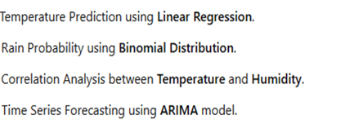
Topic distribution:

Slide 4
Correlations analysis between temperature and humidity

Slide 5

Correlation analysis
Correlation analysis is a statistical technique used to investigate the relationship between two continuous variables.

Slide 6
Interpretation of Correlation Coefficient
Correlation measures the strength and direction of the linear relationship between two variables. It ranges from -1 (perfect negative correlation) to 1 (perfect positive correlation), with 0 indicating no correlation.

Slide 7

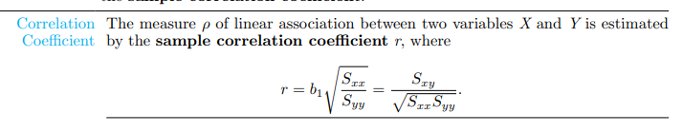

Pearson's Correlation Coefficient (r): Measures linear relationship between temperature and humidity.
2. Spearman's Rank Correlation Coefficient (ρ): Measures monotonic relationship between temperature and humidity.

Slide 8
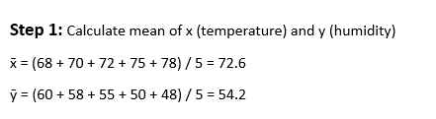
A meteorologist collected data on temperature (°F) and relative humidity (%) for 5 consecutive days:
Day | Temperature (x) | Humidity (y)
1 | 68 | 60
2 | 70 | 58
3 | 72 | 55
4 | 75 | 50
5 | 78 | 48
Calculate the correlation coefficient between temperature and humidity

Slide 9

Day | x - x̄ | y - ȳ
1 | -4.6 | 5.8
2 | -2.6 | 3.8
3 | -0.6 | 0.8
4 | 2.4 | -4.2
5 | 5.4 | -6.2

Slide 10
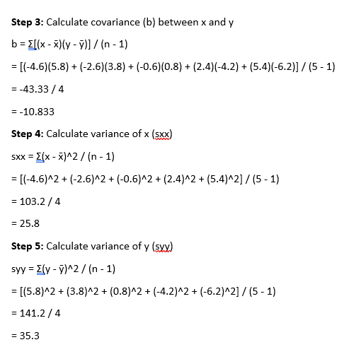

Slide 11
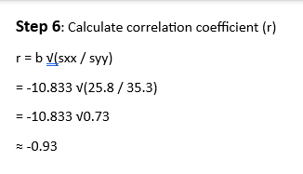

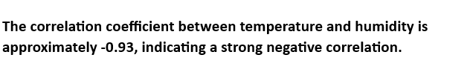
b = covariance between x and y
sxx = variance of x
syy = variance of y

Slide 12
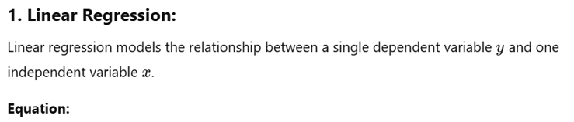

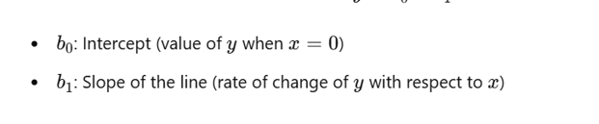
TEMPERATURE PREDICTION USING LINEAR REGRESSION MODEL

Slide 13
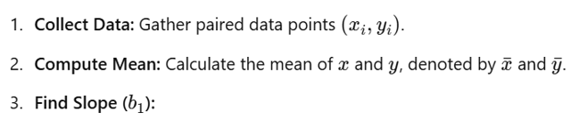
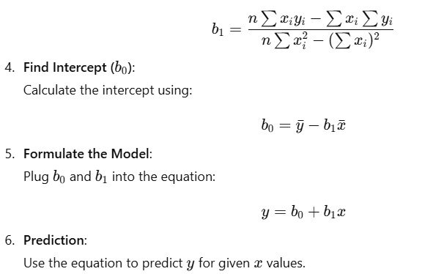
Steps to calculate Linear Regression:

Slide 14
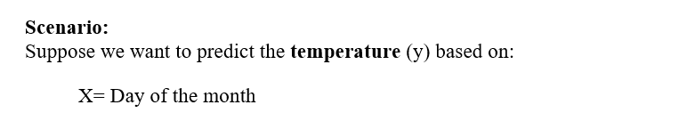

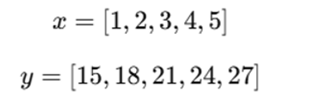
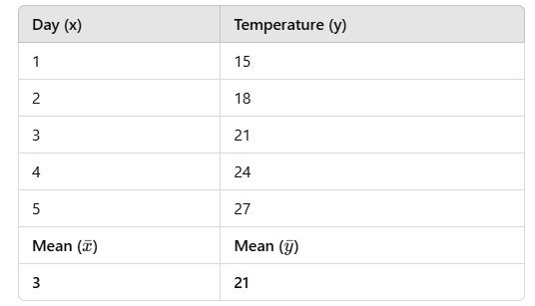

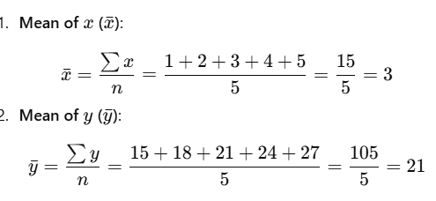

Slide 15
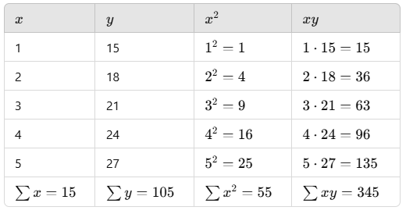

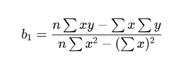
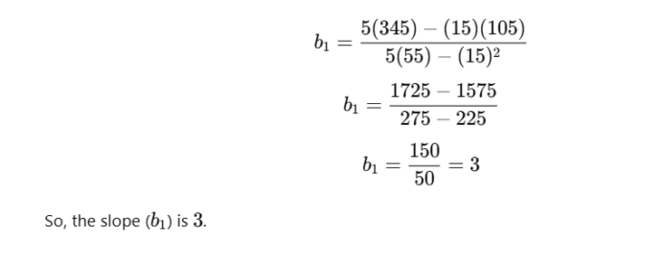
.
Step 3: Compute slope
The formula for the slope is:

Slide 16
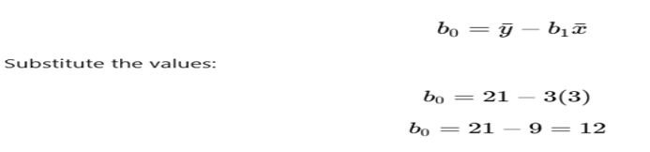
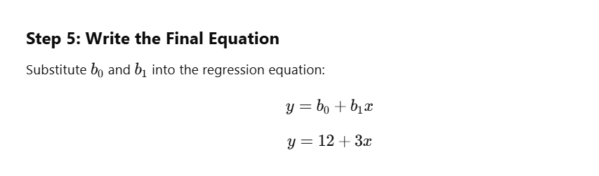
.
The formula for the intercept is
So, the intercept is 12.

Slide 17

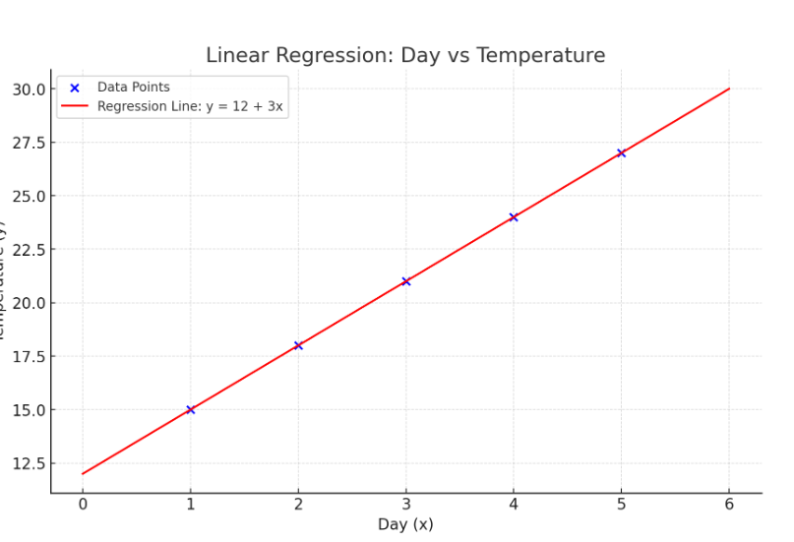
.
Step 6: Predictions Using the model y= 12+3x, we can predict the temperature (y) for any data (x).
Example:
For x=6 (Day ):
y = 12 + 3(6) = 12 + 18 =
The blue line represents the actual data(Day vs Temperature).
The red line represents the regression line y=12+3x, which models the relationship between day and temperature.

Slide 18

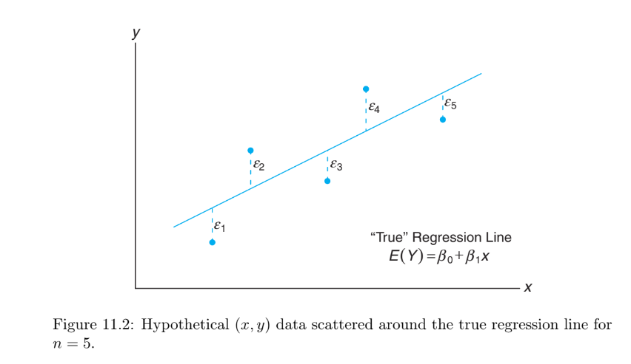
Adjust the linear regression equation:
For this example;
Where e represents deviaions from from regression line.
The presence of error does not change the equation’s form but the observed values now contains residuals;

Slide 19
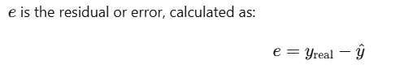
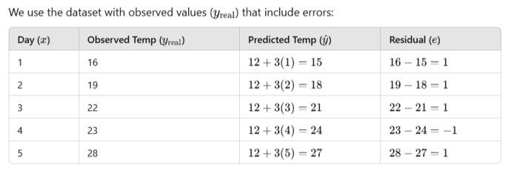
Error calculation:

Slide 20
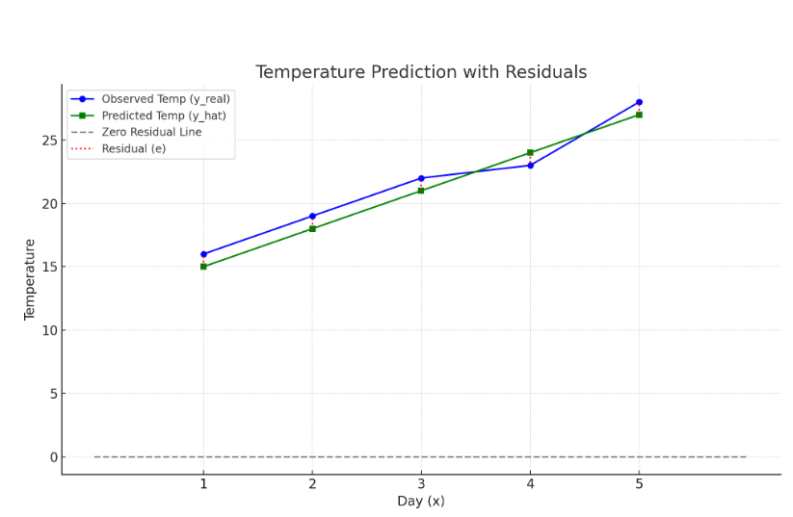


Error calculation:
Blue line: represents the observed temperatures
Green line: represents the predicted temperatures
Red dotted line: highlights the residuals (e) as the difference between observed and predicted values.

Slide 21
Rainfall analysis using bionomial distribution

Slide 22
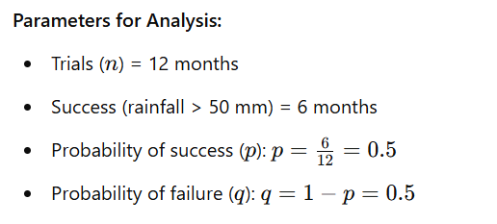
Rainfall analysis refers to the process of studying and evaluating rainfall patterns and trends over a specific period of time. This analysis is crucial for understanding how rainfall behaves in a certain region, and it helps in planning and managing various sectors such as agriculture, water resources, and disaster preparedness.

Slide 23
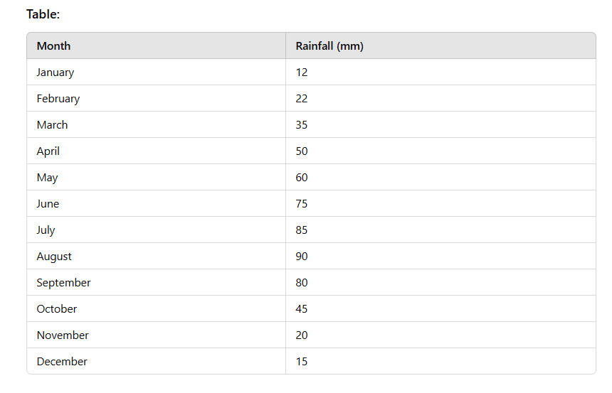
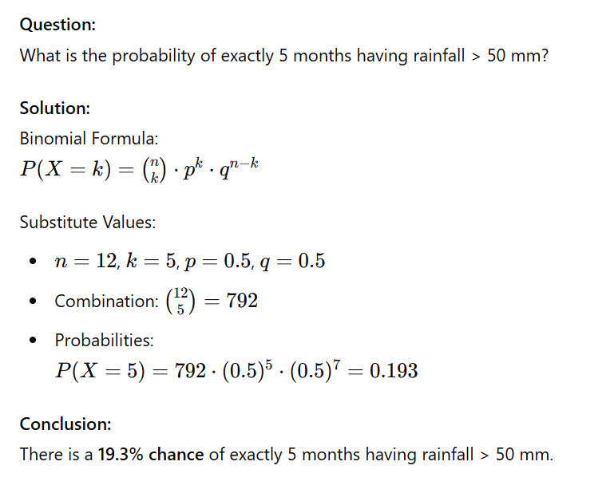

Slide 24
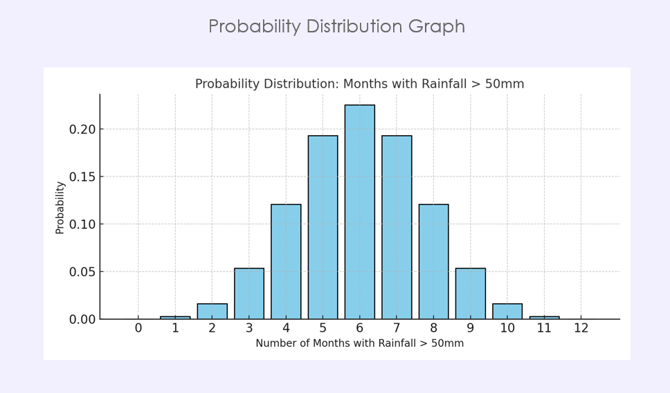


Slide 25
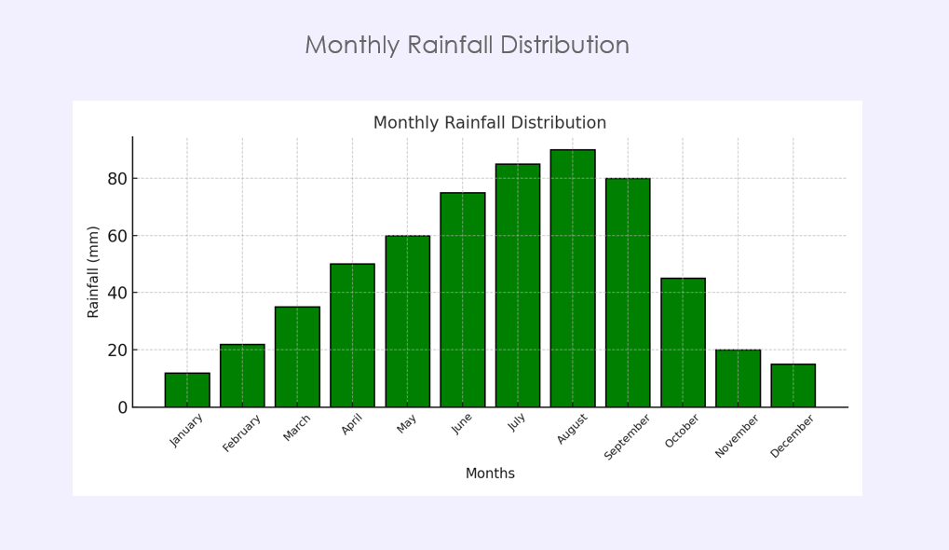
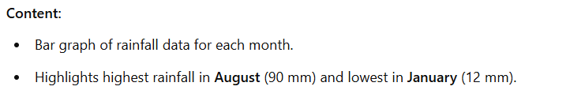

Slide 26
Thank you

