Slide 1
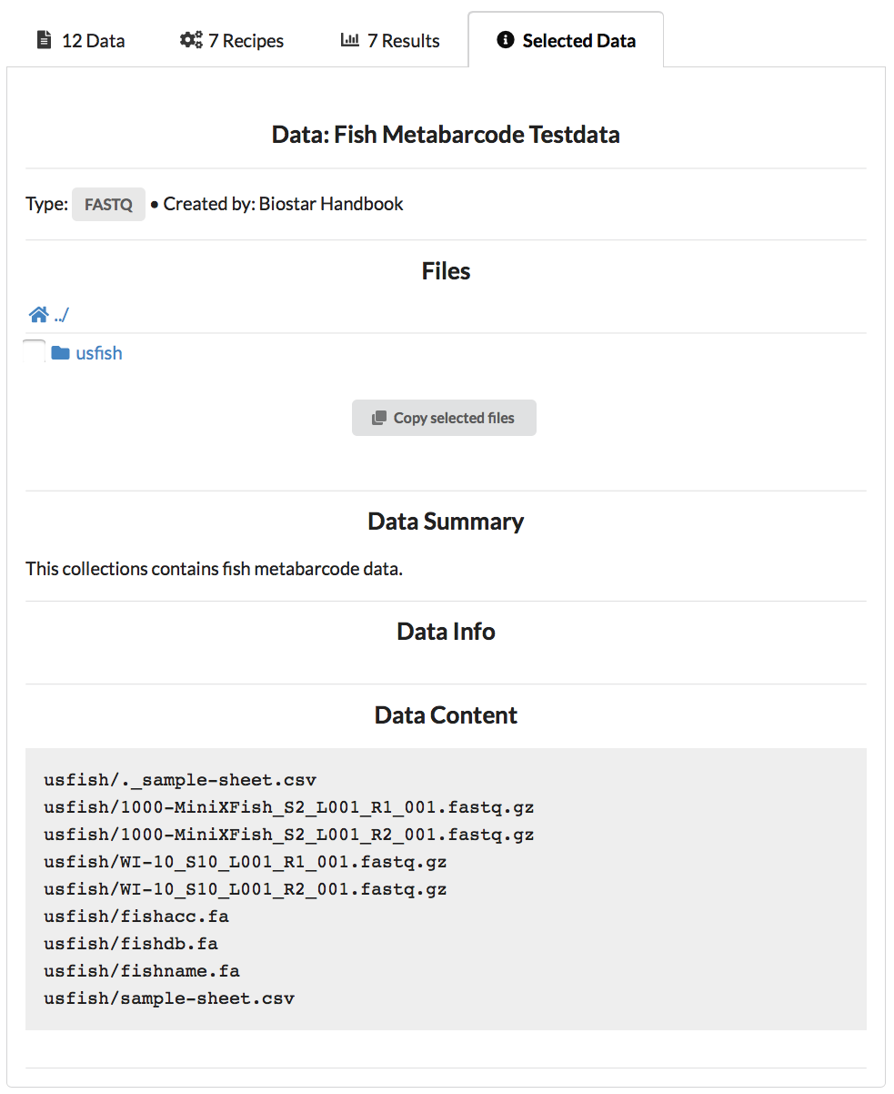
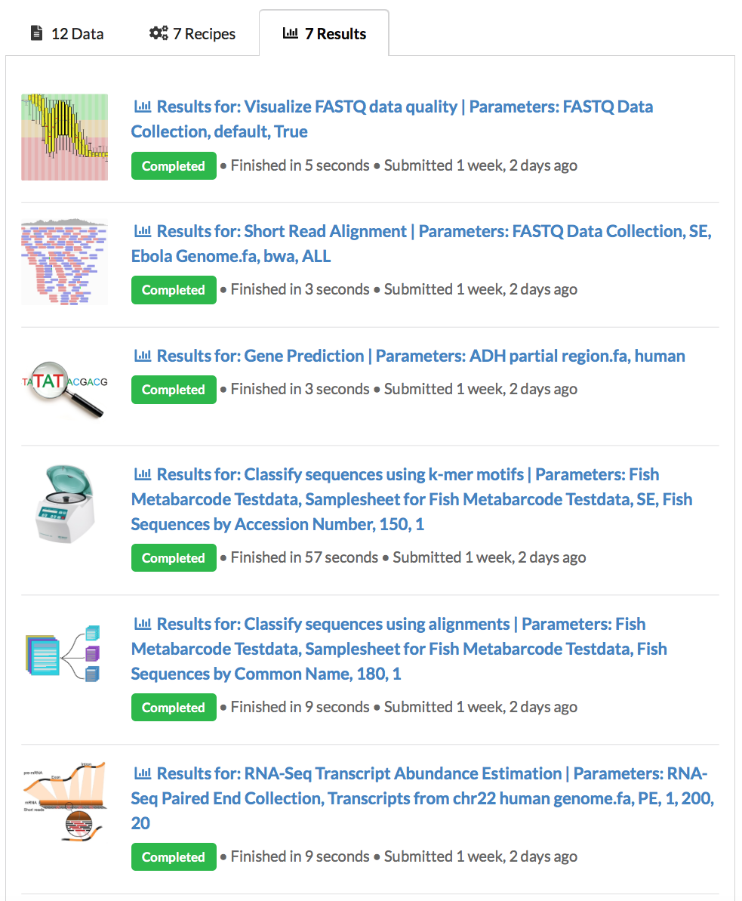
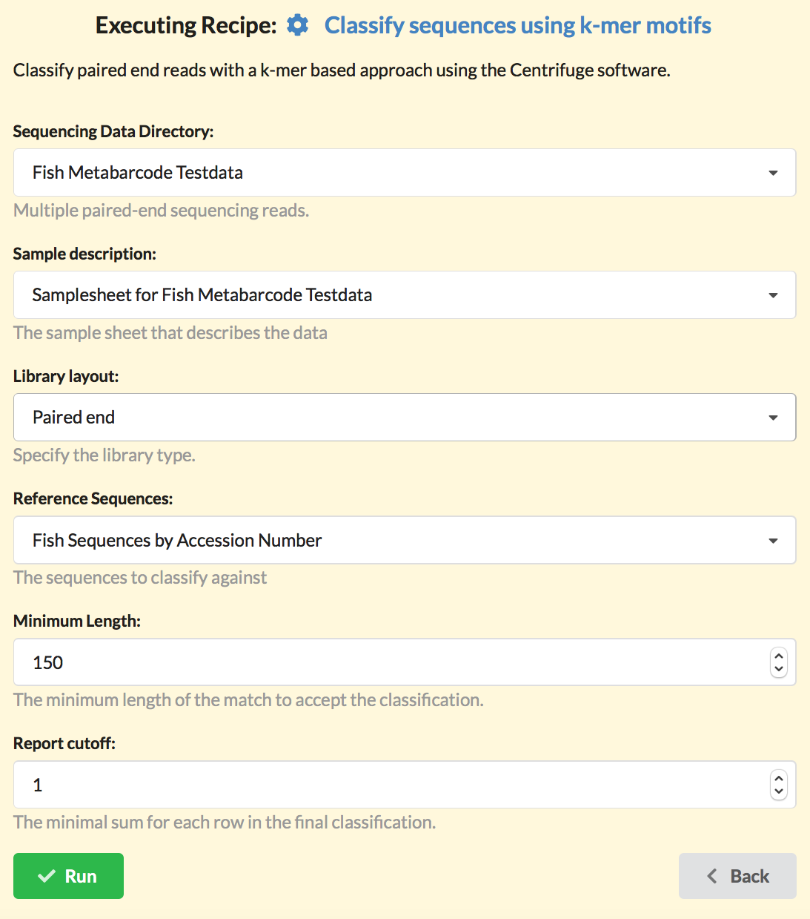
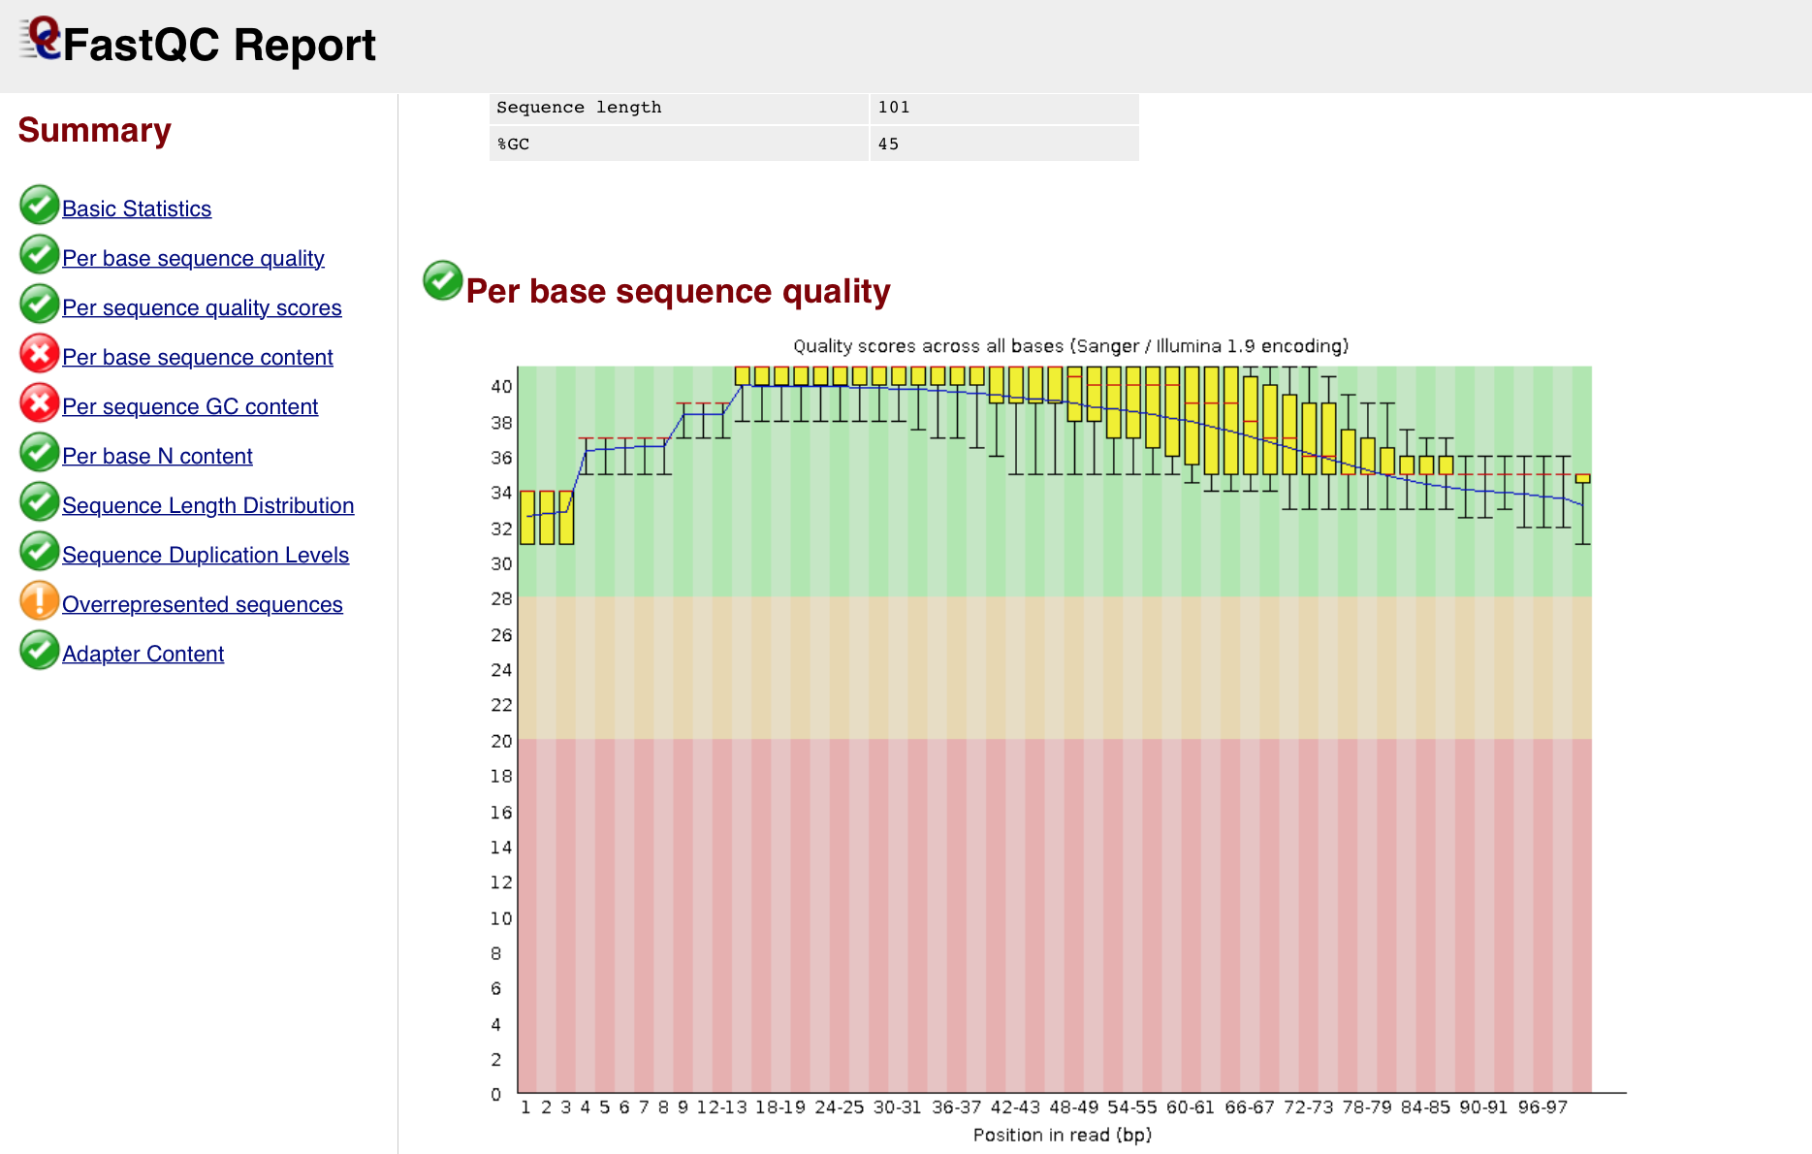
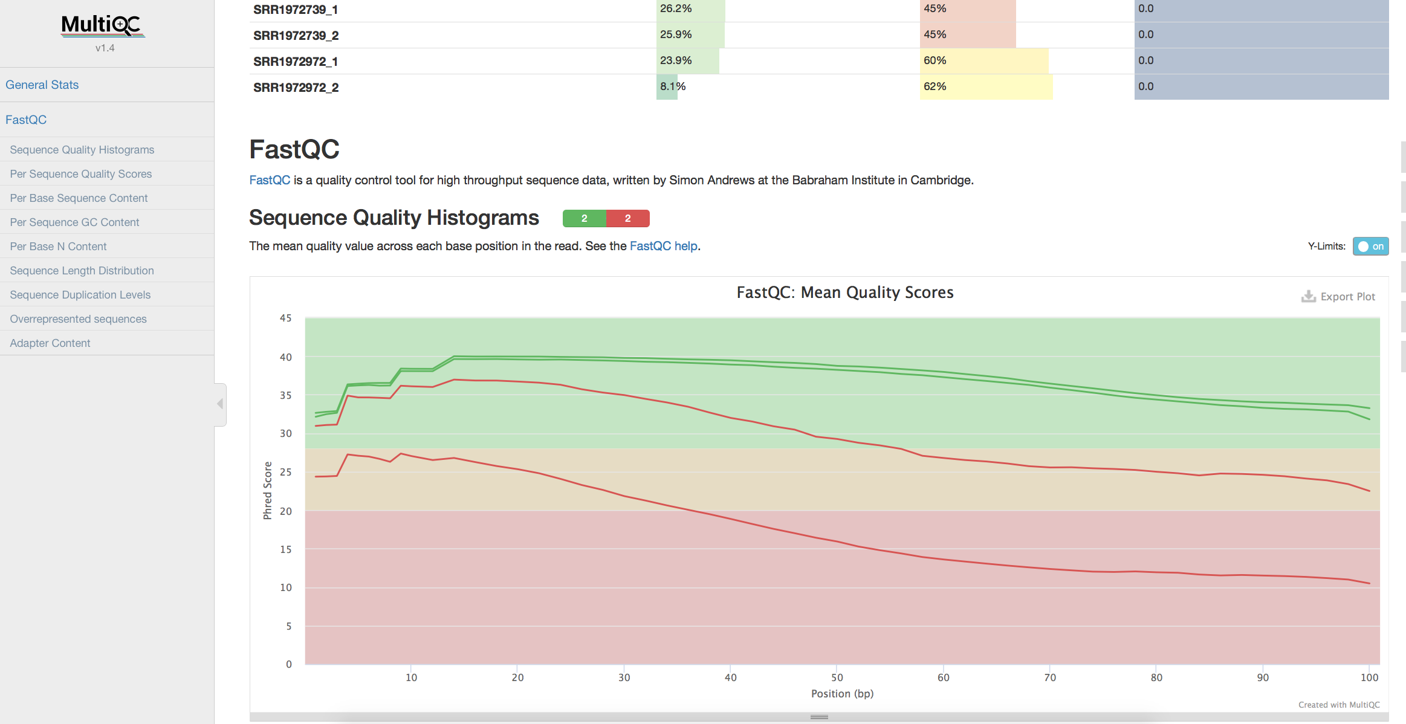
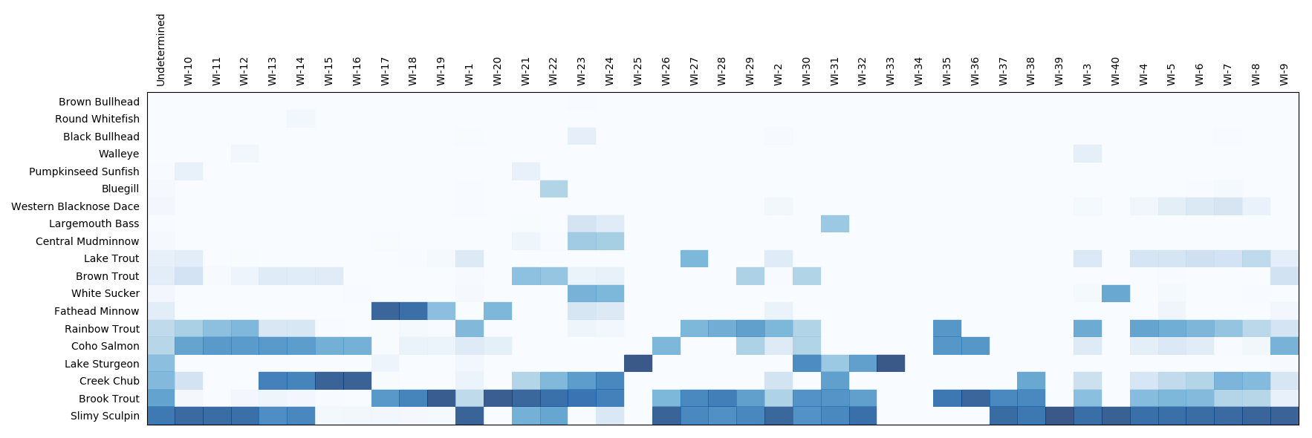
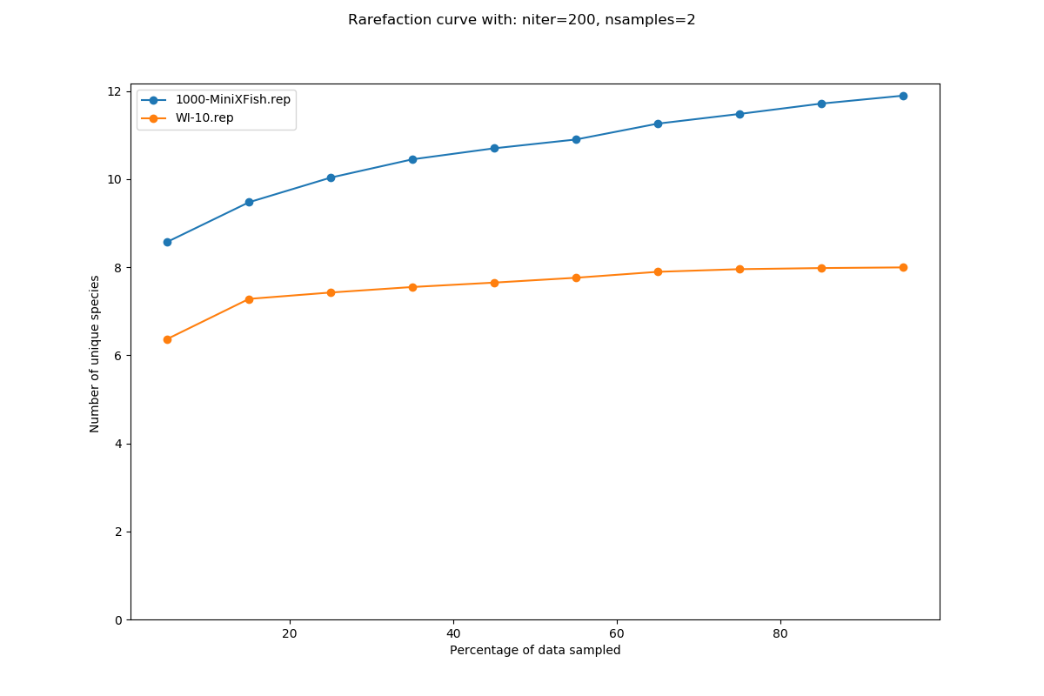
Bioinformatics Recipes:
A novel approach to sharing and disseminating bioinformatics protocols
Problem : Bioinformatics is experiencing a reproducibility crisis. Solution : A web application allowing users to document, execute and share data analysis scripts.
What is a recipe?
Data analysis scripts + graphical user interface.
What is the purpose of a recipe?
Recipes allow other people to run scripts that a bioinformatician has written.
Can it run QIIME ?
Can it run MOTHUR ?
It can run any list of commands that can be executed in an environment.
Results
Sample plots

