Slide 1
EFFICIENT TRAFFIC CONGESTION CONTROL MODEL USING IOT

Slide 2
System design and development
This section discusses the proposed system model, different software and hardware components required, and algorithms to implement the proposed system. The proposed system communication model is presented below, which has components installed at the roadside and a cloud-based central server. The roadside setup includes sensors and message boards. The sensors and boards will be installed between two road segment intersections. The central server includes data storage, cloud services, and interfaces. The components can communicate with each other using WiFi.

Slide 3
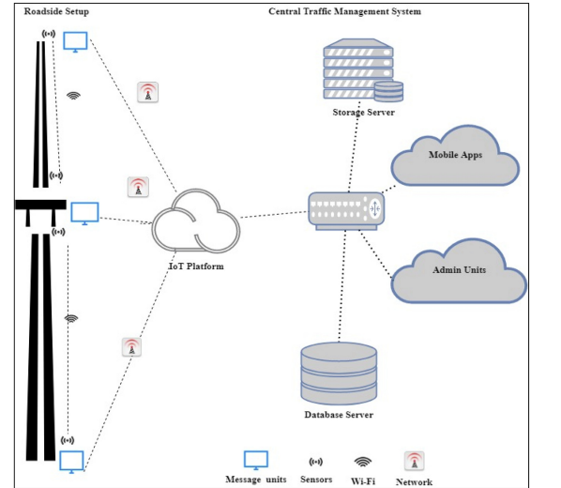

Slide 4
System architechture:
An IoT based system architecture mostly contains a sensing layer, network layer, service layer, and an application layer [54]. The sensing layer acquires data from the things, the network layer transfers the collected data from devices to the service layer, the service layer controls the devices and analyzes the collected data, and finally, the application layer which indicates the user interface. The layered architecture is presented in Fig. 4. The four main system development activities are: (i) populate geographical map details for a given location, (ii) detect vehicle and estimate vehicle length, (iii) determine growing queue, and (iv) display traffic updates. The system components include (i) geographical map, (ii) Sensors, (iii) Microcontroller, (iv) IoT platform, (v) Database, and (vi) Electronic display units. The activities, the software, and hardware components associated with each activity.

Slide 5
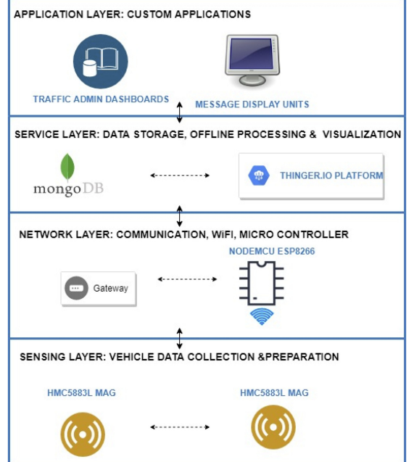

Slide 6
Hardware and software components:
An extensive literature review has been conducted to select various system components and technologies [58]. The hardware and software components used for the system development are given below.
OpenStreetMap: The OpenStreetMap (OSM) is one of the practical projects that provide map data. The map data provided by OSM is free to use (wiki.openstreetmap.org). The individual users are contributed to the development of OSM, and the geographical information contributed by them is the core part of OSM. OSM provides editing, exporting, and uploading functionalities. The export functionality can be used to generate row map data or map images. The raw data can be processed by other systems that use geographical information. The OSM also provides a java interface to edit and work with maps, i.e., Java OpenStreetMap (JOSM) editor, similar to traditional geographic information system packages.
MongoDB: MongoDB (www.mongodb.com) is a document database, and it stores the data from JSON like documents. MongoDB provides flexible access to data and supports nested objects as values. MongoDB has both community and enterprise

Slide 7
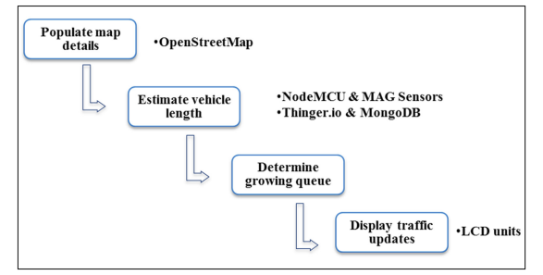

Slide 8
Magnetic Sensors: The magnetic sensor has the following advantages: (i) it can be easily installed on roadsides, (ii) reduces detection error, (iii) there is no climate influence. Honeywell HMC5883L is a tri-axial magnetic sensor used in many traffic monitoring research due to its high sensitivity. and cost-effectiveness
NodeMCU: NodeMCU is a firmware developed for ESP8266 WiFi system on chip (SoC). It is also an open-source platform. NodeMCU helps to prototype IoT products. ESP8266 has a general-purpose input/output interface, hence the sensors/ devices can be integrated easily. NodeMCU board has WiFi capability, digital pins (D0-D8), analog pin (A0), and supports serial communication protocols (I2C, UART, etc.).

Slide 9
Thinger. io: Thinger. io is an open-source IoT platform that supports sensor data collection, management, analysis, and visualization. Thinger. io (www.thinger.io) supports the deployment of data fusion applications with the integration of cloud, IoT technologies, and big data. It supports the remote sensing and actuation of any sensor, and provide readymade services to connect devices.
LCD Unit: The message board unit can be a WiFi-enabled character type LCD unit. However, to experiment, a 16 x 02 LCD unit was used that can display only 32 characters.

Slide 10
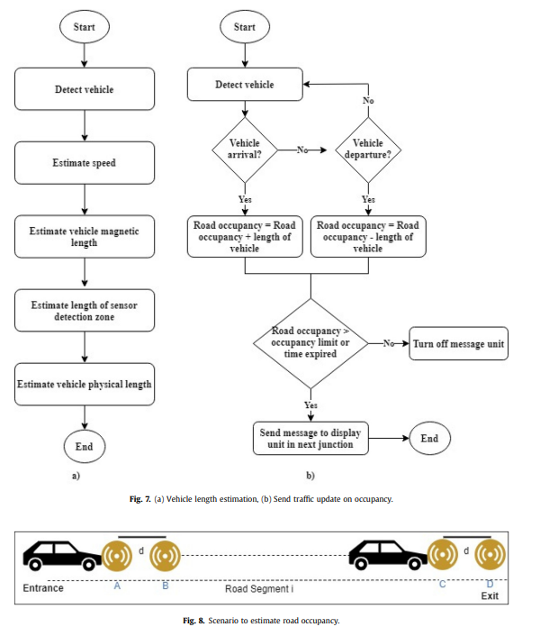

Slide 11
Conclusion:
This research proposed an IoT based system model to collect, process, and store real-time traffic data. This research provided real-time traffic monitoring for traffic updates through roadside message units. The traffic authorities can also broadcast messages on VIP visits, medical emergencies, accidents, etc. to corresponding message units, which will assist the public in decision making and save their time on roads. The proposed system uses magnetic sensor nodes to collect real-time vehicle information. The real-time data is processed by WiFi-enabled microcontrollers and sends to an IoT platform for further actions.

