Slide 1

Patient Readmission Prediction using H2O AutoML
Natasha Shereen Benita
Guide: Prof. Dr. Ireneusz Jablonski

Slide 2
Introduction
Problem Statement:
Hospital readmission prediction is critical for resource allocation, patient care, and cost reduction.
Objective:
Use H2O AutoML to automate model selection and improve prediction accuracy.
Key Result:
Best-performing model (GBM) achieved 99% accuracy, AUC = 1.0.

Slide 3

Literature Review
Traditional Approaches:
Logistic Regression, Decision Trees – struggled with complex medical data.
Advancements:
ML models like XGBoost, Random Forests, GBM improve predictions.
Why AutoML?
Automates model selection & tuning, making healthcare predictions more accessible.

Slide 4
Dataset & Preprocessing
Dataset: eICU Collaborative Research Database (PhysioNet).
Key Tables Used: Patient, AdmissionDX, Diagnosis, Lab, Treatment.
Preprocessing Steps:
Removed duplicates, optimized data types, merged tables.
Dropped medication table due to high memory usage.
Final dataset: 1000 rows, 14 columns.

Slide 5
Feature Engineering & EDA
New Features Created:
Age Groups, Diagnosis Length, Gender Encoding, Critical Discharge Indicator.
Target variable
Research has also shown that discharge outcomes are strong indicators of readmission risk
Binary feature
Early identification of high-risk patients to enhance post-discharge care and reduce readmission rates.
Imbalanced distribution (78.3% non-critical, 21.7% critical)

Slide 6
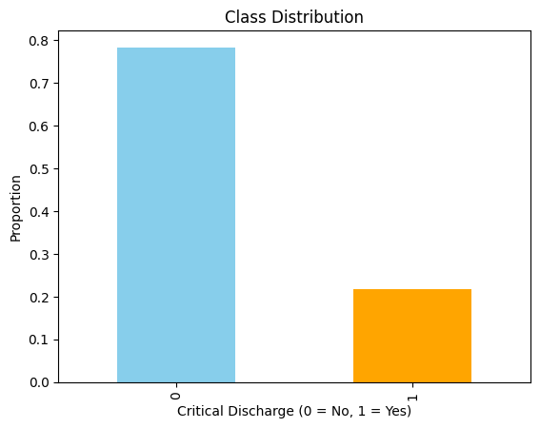
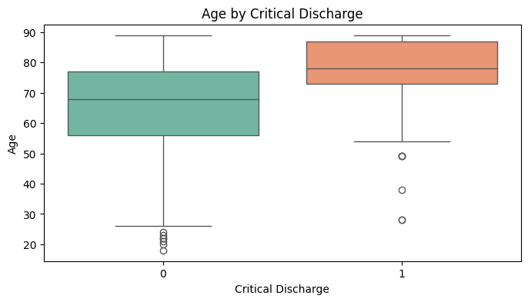
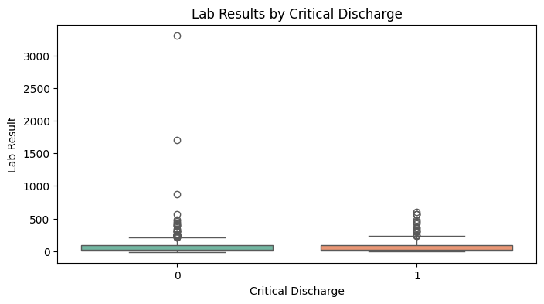
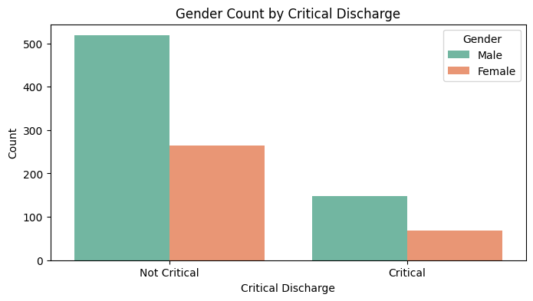

Slide 7
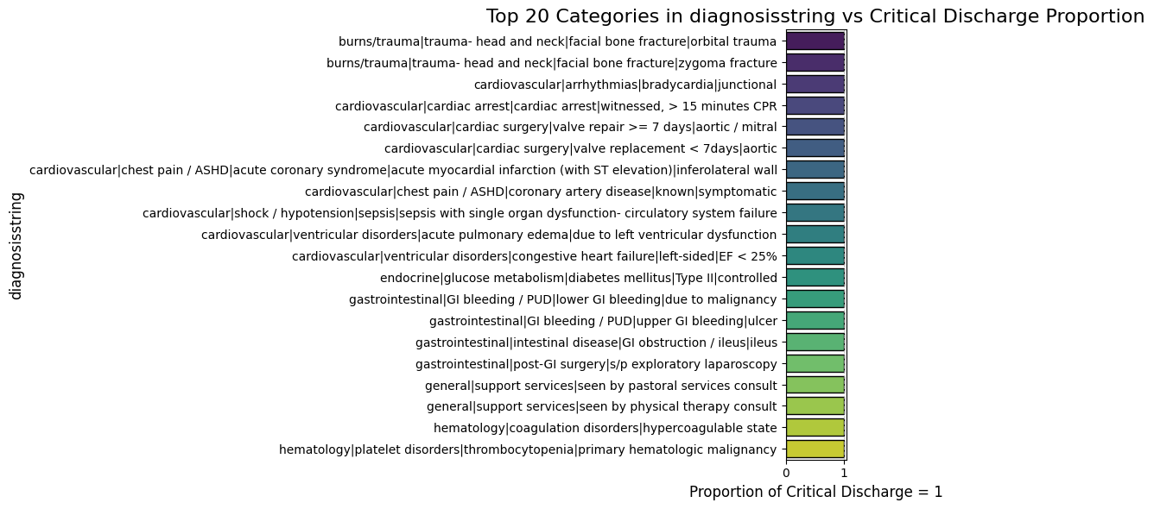
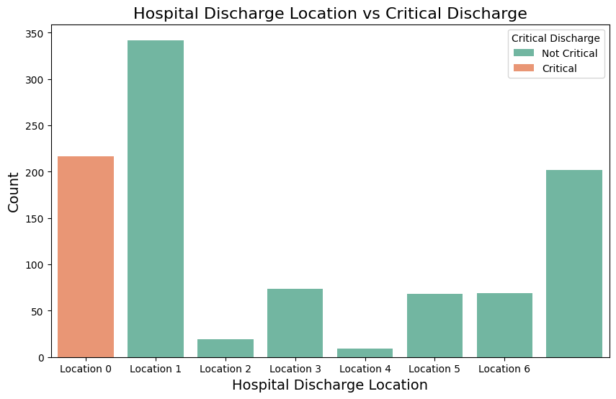
burns/trauma-related diagnoses) have the highest association with readmission

Slide 8
Model Training & Results
Best Model: Gradient Boosting Machine (GBM).
Performance Metrics:
AUC: 1.0
Log Loss: 3.459
Optimal Threshold: 0.993 (for best F1-score).

Slide 9
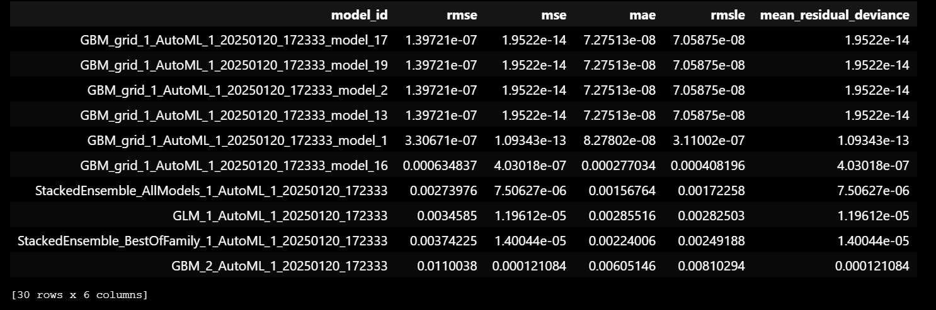
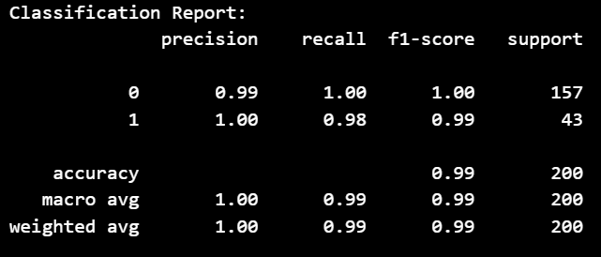
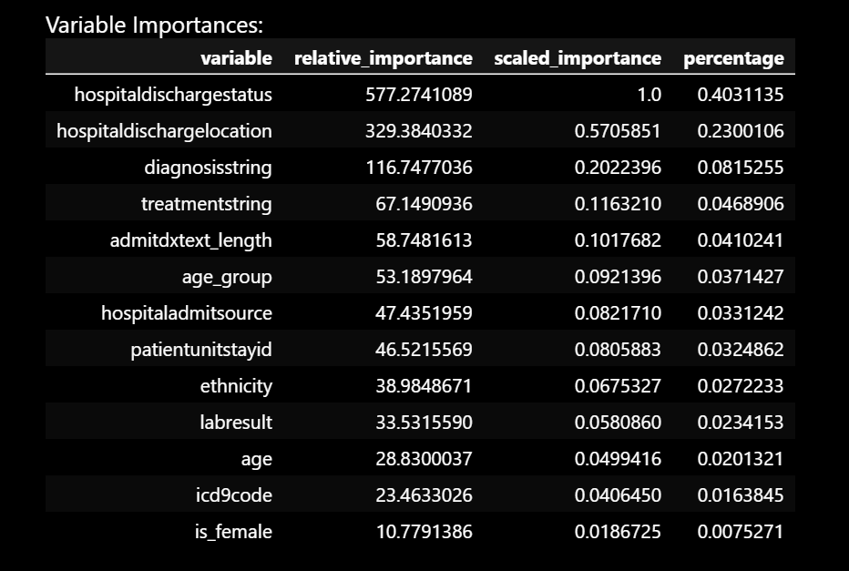
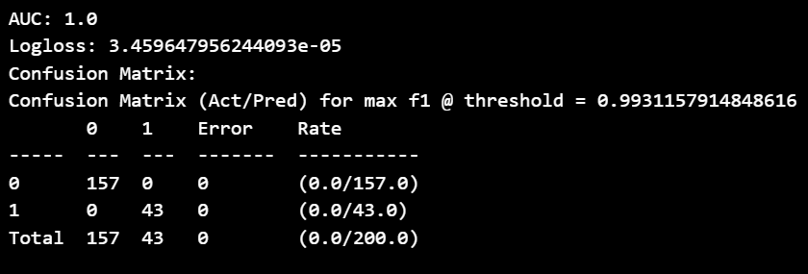

Slide 10
Why GBM is the best?
Boosting Reduces Errors Iteratively:
GBM builds trees sequentially, correcting mistakes from previous iterations, making it more robust for structured medical data.
The dataset has 78.3% non-critical vs. 21.7% critical discharges.
GBM can handle imbalance effectively by assigning higher weights to minority-class samples.
Performs Well with Mixed Data Types:
H2O AutoML tunes hyperparameters automatically, finding the best GBM settings for your data.

Slide 11
Future Work
XGBoost can be included: XGBoost requires more memory than H2O’s native GBM. If AutoML detects potential memory issues, it disables XGBoost automatically.
Check for overfitting
Data related to expired people can be removed when working with the whole dataset as it will form a significant group. However, for this study it was not excluded since the data suggests otherwise.
( From the data we can see that some patients are alive and are not critically discharged even though they are categorized under deadly diseases while some others die from minor infections. If removed from this subset valuable information related to other variables and features will be lost. Overall, the numbers correspond to the class imbalance in the target column.)

