Slide 1
Color Sensor
Nathan Price

Slide 2
Sensor Info
Color sensors are sensors that are meant to find the color of objects and surfaces
Color sensors work by having the LED’s on the sensor itself produce a white light onto a nearby surface
From there following the principle that white light is made up by equal parts of the primary colors, red, blue, and yellow
Any given object’s color is perceived as such due to the rest of the colors in light being absorbed by the object, only reflecting the color we see on the object
Once the white light is shined on the object the color of the object will be reflected back onto the sensor, where it can break down how much of the primary colors its receiving which could allow it to determine what color it is being presented with

Slide 3
Important characteristics
The main static characteristics that are of note for this sensor are:
Repeatability: deviation between measurements in a sequence where the same object is under the same test multiple times
Accuracy: difference between indication of the sensor and the real value
Drift: deviation of a reading as time passes measuring the same object
Range: the extremes a sensor can measure
Precision: standard deviation or variance of a set of readings for the same input

Slide 4
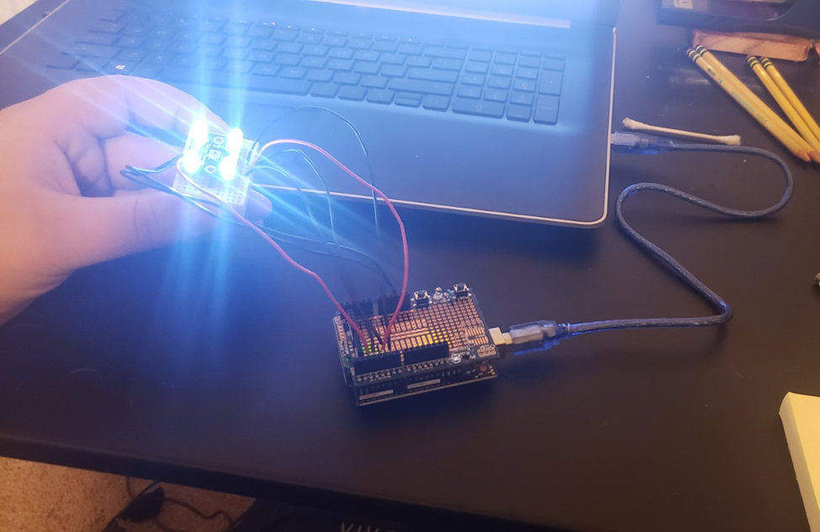
Sensor setup

Slide 5
Repeatability
To test repeatability I took a paint sample from a store and had the sensor gauge its color and repeated this process a few times to note any differences in the readings
R Value | G Value | B Value
36 | 43 | 42
35 | 40 | 33
32 | 40 | 43
36 | 45 | 42
36 | 46 | 42

Slide 6
accuracy
I tested Accuracy by taking 5 different paint samples and having the sensor gauge their color.
I then took the measured RGB values of the paint samples and compared them against the RGB values of the paint samples I had found using other means
 | R Value | G Value | B Value
Measured | 39 | 47 | 45
Actual | 248 | 209 | 117
Measured | 25 | 36 | 40
Actual | 135 | 173 | 190
Measured | 26 | 36 | 40
Actual | 0 | 103 | 138
Measured | 31 | 34 | 37
Actual | 220 | 125 | 106
Measured | 34 | 39 | 39
Actual | 232 | 154 | 93
R Accuracy | (155/835)/5 * 100% = | 3.71%
G Accuracy | (192/764)/5 *100% = | 5.03%
B Accuracy | (201/644)/5 * 100% = | 6.24%
Total Accuracy | (3.71+5.03+6.24)/3 = | 4.99%

Slide 7
drift
To calculate Drift I set the sensor up in a way that it was measuring the same spot in the same conditions for several data collection cycles and then used these data points to see how much the values have changed
R Value | G Value | B Value
51 | 54 | 59
52 | 71 | 75
63 | 78 | 80
69 | 82 | 86
75 | 90 | 91
Delta R | Delta G | Delta B | Avg. Delta
14 | 36 | 32 | 27.33

Slide 8
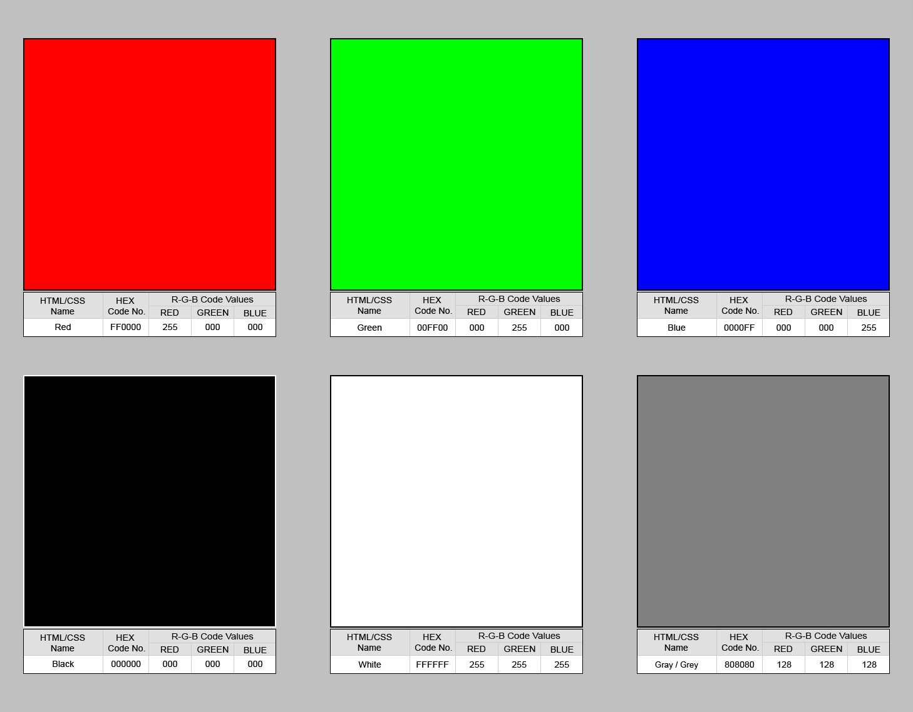
range
To find Range I use the concept of color theory that the sensor works on and can inherently know that the Range should be the extremes of the RGB values, specifically, Red Green, Blue, Black and White
I then had the sensor measure these values on objects as close as I could replicate them to such to check the values of these extremes
 | R RGB Value | G RGB Value | B RGB Value
Measured | 45 44 25 | 35 58 24 | 31 49 31
Actual | 255 000 000 | 000 255 000 | 000 000 255

Slide 9
precision
I actually did not need to run any further tests to gauge precision, I was able to use previously gathered data from repeatability and accuracy to calculate it.
R Std Dev | G Std Dev | B Std Dev
1.55 | 2.48 | 3.72
R Acc. | G Acc. | B Acc.
3.71% | 5.03% | 6.24%

Slide 10
Summary
Overall this sensor is a very inaccurate and imprecise sensor
But once it gets going it stays consistent
Which means that with enough work and effective work arounds for the sensor’s shortcomings it could be a viable usable sensor

