Slide 1
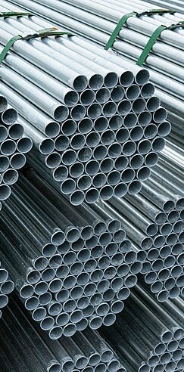
Mild Steel Tempering
Nathan Sheibley
@ UCB Data Analytics Bootcamp
Wikimedia commons

Slide 2
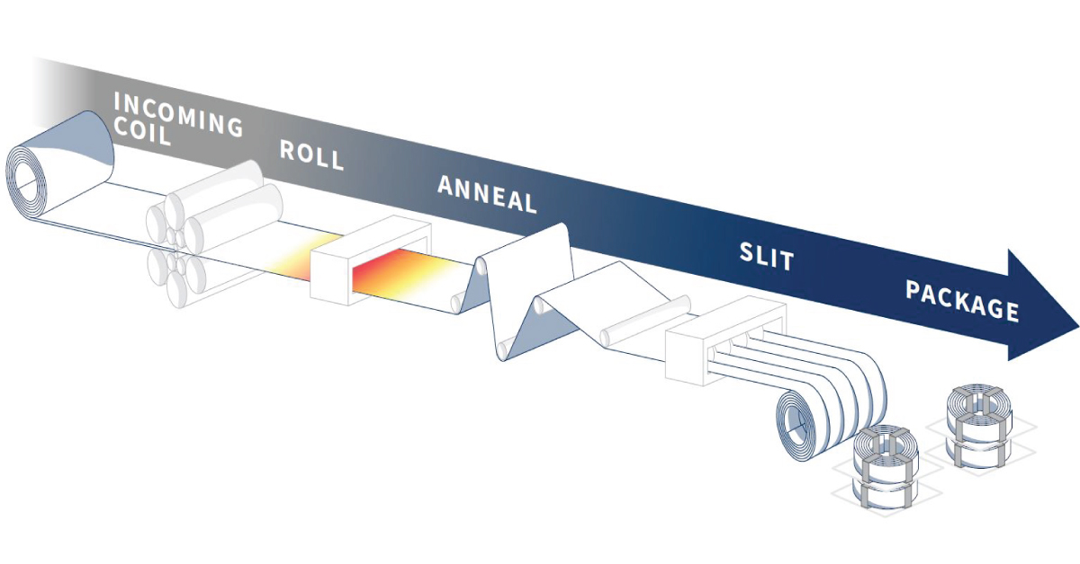
Significance of Tempering
ulbrich.com - Rolling, Annealing and Slitting Stainless Steel & Special Metals: A General Overview

Slide 3
Dataset and Sources
Raiipa Dataset
Usable columns
1487 rows
34 Steels
16 Tempering Durations
21 Tempering Temperatures
Elemental (alloy) composition
Post Tempering Hardness (HRC)
Steel Names
Unusable columns
Paper Source per row
Initial Hardness
many null values
Raiipa Technologies - AI Applications for Metallurgical Engineering
Provided public access to a mild steel tempering dataset on Kaggle
AZOM.com - AZO Materials
Free online resource with physical, mechanical, and thermal properties of many AISI grade steels
MakeItFrom.com - database of engineering material properties
Online resource with physical, mechanical, and thermal properties of many metals and ceramics, that also segregate the material listing on processing technique

Slide 4
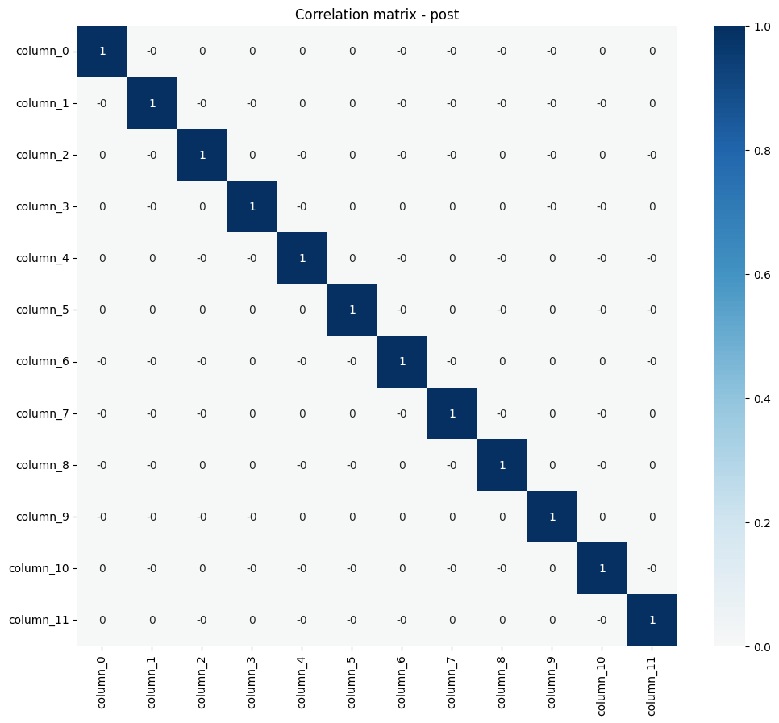
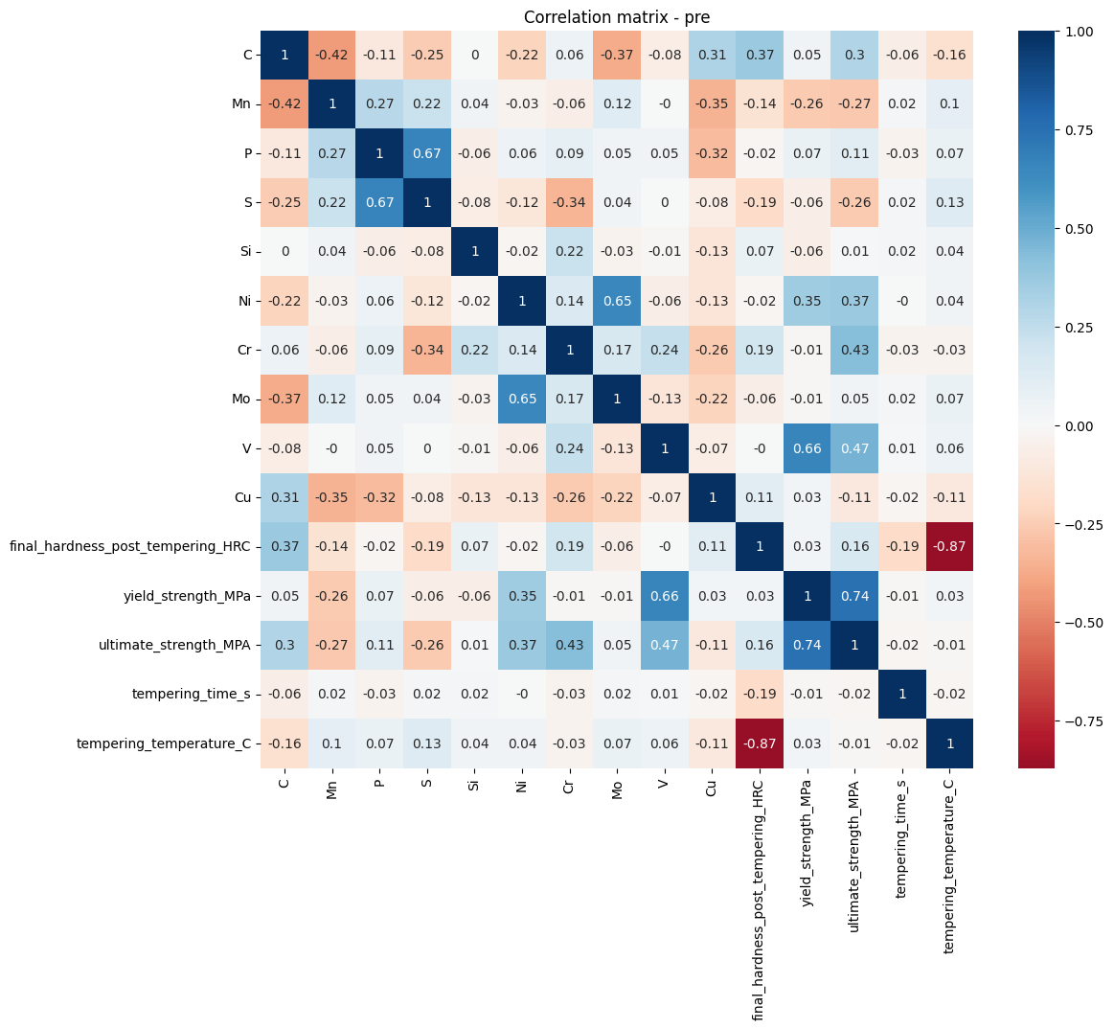
Data Processing
Searchable steels reduced rows to 1300
Scaling and One Hot Encoding was done as a pre-treatment
PCA analysis done to reduce multicollinearity

Slide 5
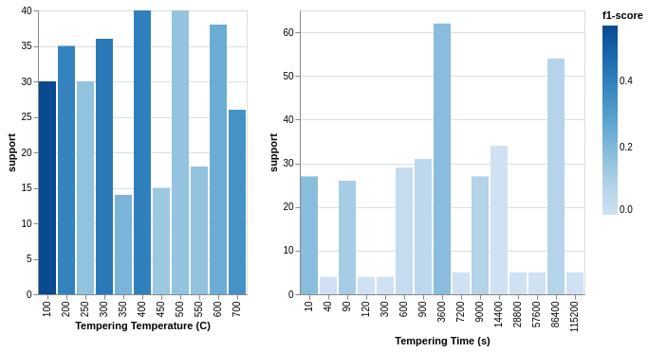
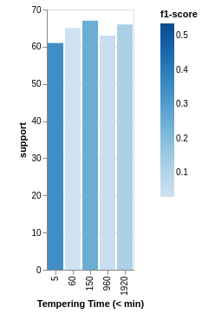
Label Balancing
Binned Temperature (55 C)
Before Binning Time
After Binning Time

Slide 6
NN model structures
Model Accuricies
Deep
Shallow
Input (12)
Classifier | Training Set | Testing Set
 | Combined Accuracy (%) | Combined Accuracy (%)
Extra Trees | 93.5 | 26.7
DNN | 47.1 | 32.5
SNN | 35.1 | 29.3
Dense (487)
Dense (172)
Dense (143)
Dense (84)
Dense (246)
Dense (51)
Dense (29)
Output (5)
Output (11)

Slide 7
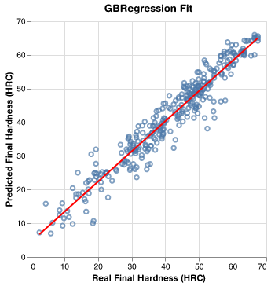
Changing Target Regression Model
Model | R-squared
Gradient Boosting Regression (GBR) | 0.928
Shallow Neural Network (16,16) | 0.937

Slide 8
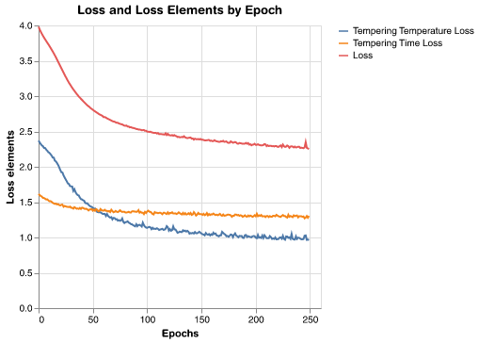
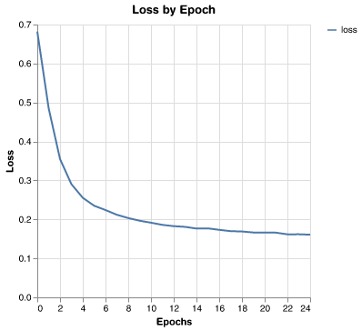
Why did the multi-output prediction fail?

Slide 9
Building the promised engineering tool
Multi-class Multi-label Problem
Data is insufficient
Features in the dataset indicate time tempered
Attempt paired prediction?
11 and 5 classes is 55 combinations
Only 1300 rows implies average of 23 support for each classification pair.
Regression Solution
Work in reverse
Build a simple fast model that predicts hardness
Build a search tool around that model to find tempering conditions that result in the desired hardness

Slide 10
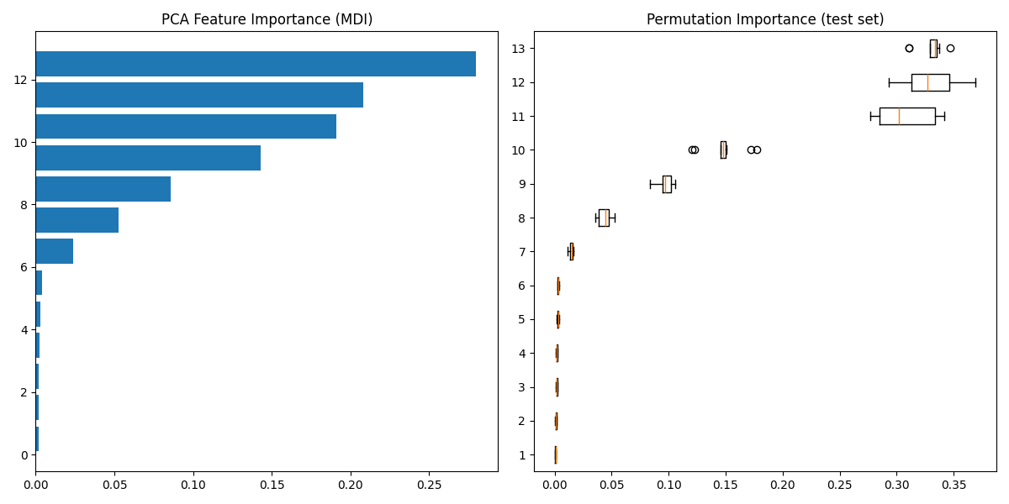
Next Steps: Develop an Explainable model
PCA confounds the explainability of the regression model
7 PCA features dominate
10 alloying elements were used initially
Consult a subject matter expert - Does this model correlate to known properties?
Alloying elements: C, Mn, Ni, Mo, Cr, V, Cu, Si, S, P

Slide 11
Thank you!
Questions?

Slide 12
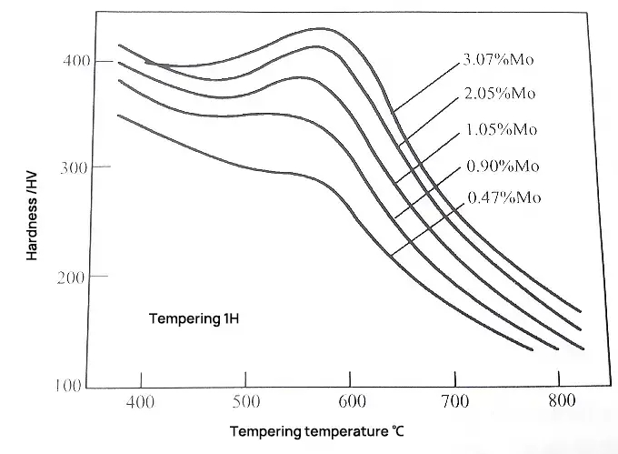
Hardness by tempering temperature, Molybdenum
Maalekian, Mehran. “Christian Doppler Laboratory for Early Stages of Precipitation The Effects of Alloying Elements on Steels (I).” (2007).
This hardness is a different measure/scale than used in my dataset.

Slide 13
Accuracies for Multi-output multi-class Classifier
Classifier | Training Set |  |  | Testing Set
 | Temp. Acc. (%) | Time Acc. (%) | Comb. Acc. (%) | Temp. Acc. (%) | Time Acc. (%) | Comb. Acc. (%)
Extra Trees | 93.7 | 93.4 | 93.5 | 36.3 | 17.1 | 26.7
Deep NN | 51.2 | 42.9 | 47.1 | 37.9 | 32.5 | 32.5
Shallow NN | 34.9 | 35.3 | 35.1 | 29.8 | 28.9 | 29.3

