Slide 1
Sentiment Analysis on Twitter Videos using Facial Emotion Recognition
By: Travis Baylor, Nathan Schaper, Hiep Duong
Mentor: Athina Bikaki

Slide 2
Our goal for Sentiment Analysis
The goal of sentiment analysis is to filter through text, audio, and/or visual content and extract the emotion of the content.
Our case: focus on detecting emotions from faces in videos
Through this analysis, we try and identify not only a generic positive, negative, or neutral tone, but more specific feelings such as anger, fear, disgust, and more.

Slide 3
What real world applications are we going for?
Many real world applications exist for a project like this because so many people and companies are looking for ways to extract useful information quickly and easily from complex data such as videos.
In this project, we have created a Python script to extract Twitter videos based on an input key phrase such as “#COVIDBooster” to get a general one word output regarding a specific emotion the person in the video is expressing.

Slide 4
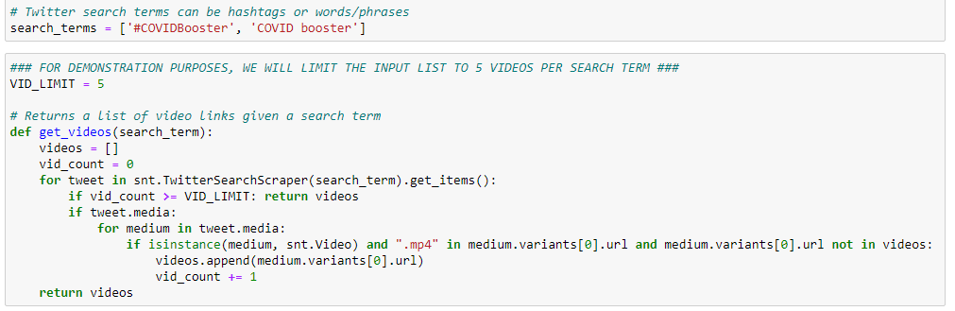
Code

Slide 5
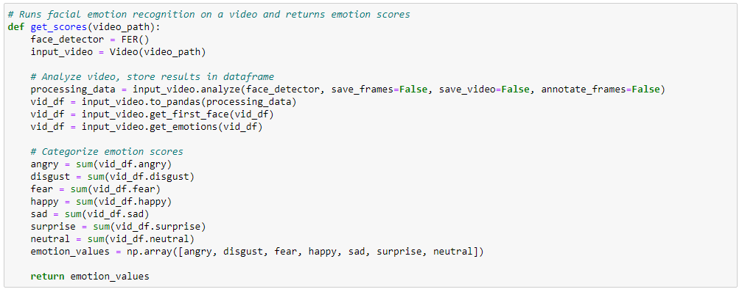
Code

Slide 6
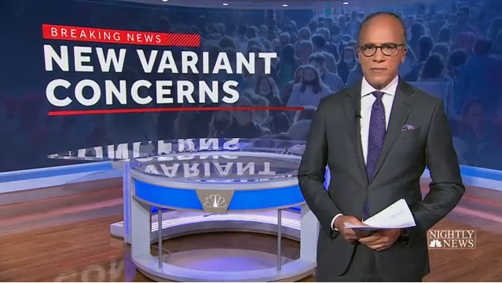
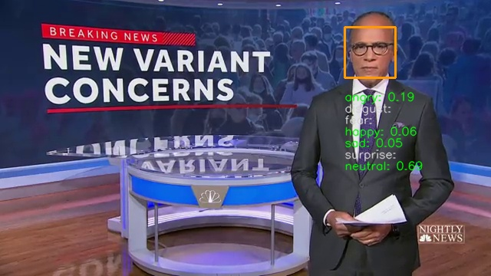
Behind the Scenes
Input frame
Output frame with face detection and emotion scores
Source: https://twitter.com/NBCNightlyNews/status/1465480697620090885

Slide 7
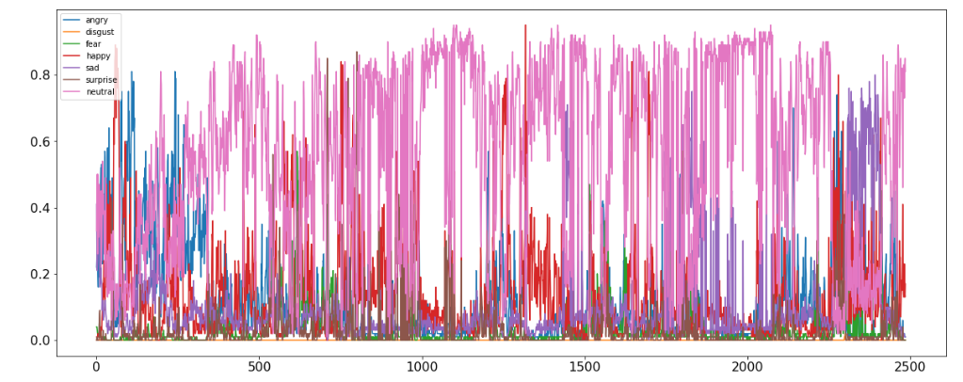
Behind the Scenes
Emotions plotted against each video frame

Slide 8
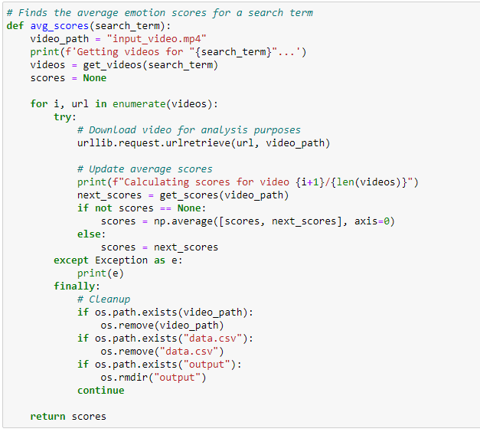
Code

Slide 9
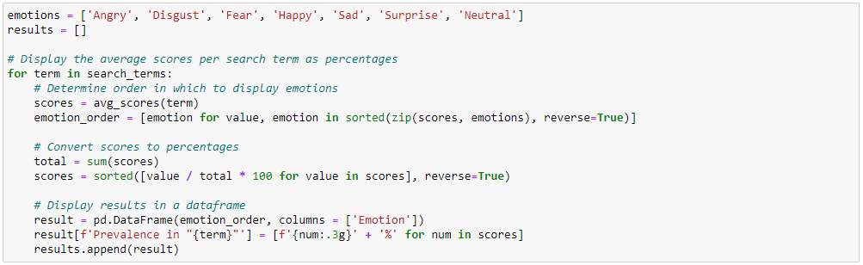
Code

Slide 10
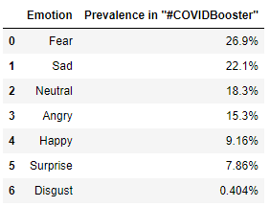
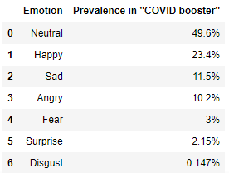
Results

Slide 11
Key technologies used
Twitter videos were obtained using the snscrape library, which can fetch a variety of data from a Tweet without limiting the number of requests a user can make.
The core of our project is the FER or “Facial Expression Recognition” library developed by Justin Shenk. Using this Python library, we are able to break down videos frame-by-frame and extract a predicted expressed emotion.
Faces by default are recognized using OpenCV’s Haar Cascade classifier. There is an option to use a more accurate MTCNN network, but for a sample larger than say 100, the time taken would be far too long.

Slide 12
Future Improvements
A gpu powered solution powered by a tensorflow-gpu library would significantly increase the video processing speed.
If speed increase is significant enough, swapping to the MTCNN Neural Network for increased accuracy may be a feasible option.

