Slide 1


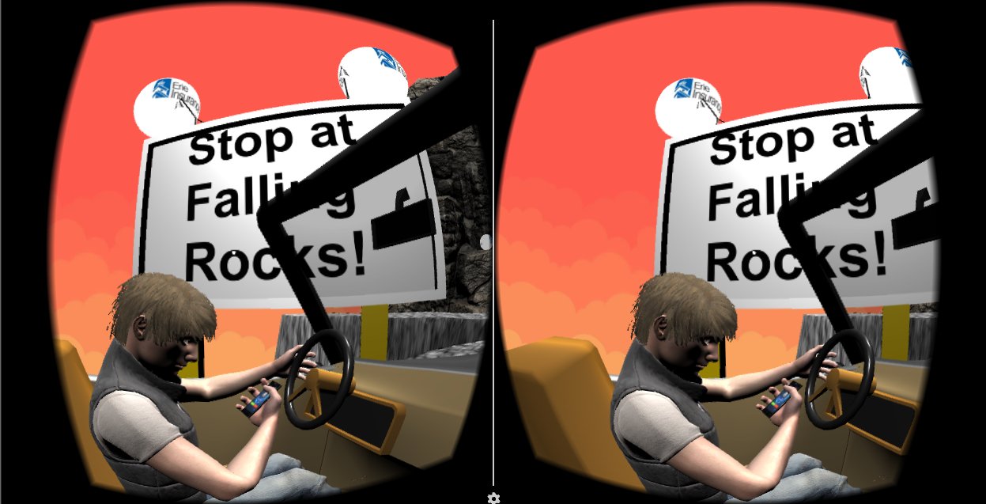


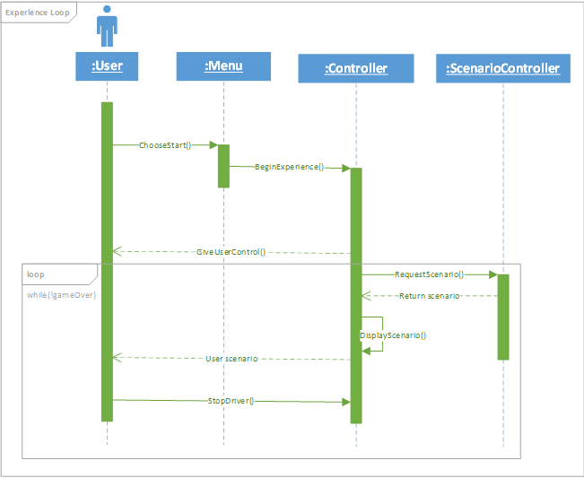


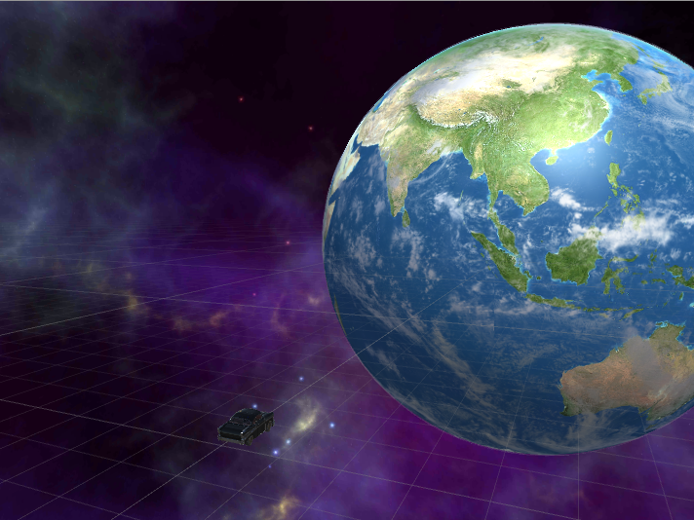
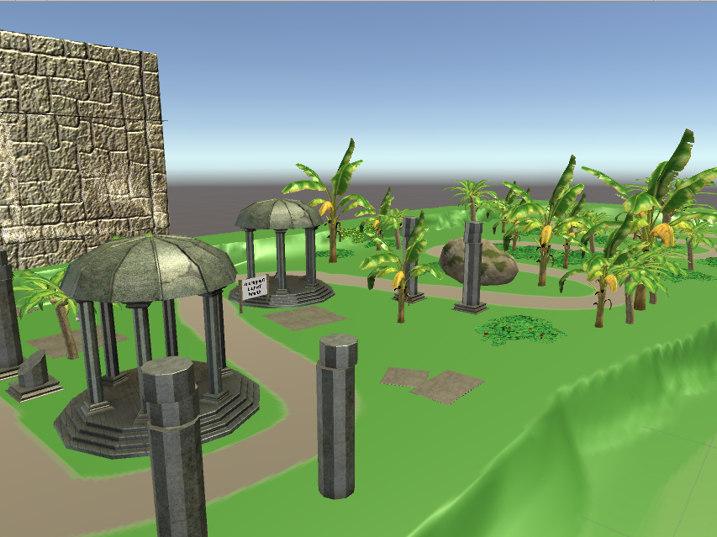
Virtual Reality – Texting While Driving
2017 Richard J. Fasenmyer Engineering Design Conference
Introduction
Author & Abstract
Practical Application
With the rise of technology, distracted driving has become more of a risk than ever before. As Erie Insurance invests in protecting people, they are taking the initiative in informing families about the dangers of driving while distracted. In order to make these talks with families memorable for the customers, Erie is interested in presenting these dangers in a fun, unforgettable fashion using a relatively new technology, virtual reality.
In the present day, virtual reality technology may seem expensive, and an unattractive paradigm for widespread, distributed use within a company as large as Erie Insurance. The Google Cardboard is the perfect solution. Cardboards are a cheap alternative to the expensive headsets that occupy the rest of the market, costing only $15 for one headset.
To accomplish this goal, our application puts the user in the passenger seat of a vehicle, being controlled by a driver engaging in distracted driving. Using a reticule located in the middle of the screen, the player must obtain points scattered throughout the game environment, while also paying enough attention to the road to alert the driver when there is an obstruction ahead. The overall goal is to amass as many points as possible while guiding the driver through pre-programmed scenarios.
Student Team: Jacob Wheeler, Nathan Christiansen, and Nick Kapty
Faculty Adviser: Mr. George Dudas
Industry Mentor: Matthew Panetta
Sponsored By: Erie Insurance
Currently, it is very difficult to display the dangers of distracted driving to a younger generation in a way that engages them. Erie Insurance is seeking an innovative solution in order to solve this problem. The business sponsors of this project are interested in a product that allows for an open discussion on the dangers of texting and driving. While this project is not aimed at teaching policyholders to refrain from texting and driving, it will be used to help the agent share something fun while having that discussion with the young driver.
This project aims to utilize virtual reality technology to create an immersive experience that engages users of all ages. The application will be distributed to agents around Erie's footprint and will effectively capture the younger audience. The business sponsors of the project need to ensure that young drivers remember the dangers of distracted driving that have been explained to them by their Erie Insurance agent, which is a gap that this project aims to fill.
Our team is constructing a memorable, fun game that achieves this goal by placing the player inside a vehicle driven through crazy, unforgettable environments such as a lava world or outer space, and equips them with objectives to make the game engaging and fun.
Abstract
Erie Insurance currently works with its agents to help them display the dangers of distracted driving to their policyholders. This can often be very difficult for agents to do since the user is not able to experience the consequences of distracted driving for themselves in a safe way. In order to help solve this problem for the agents, we are creating a virtual reality experience to allow for better engagement between agents and the teen drivers they work with. This virtual reality experience will utilize the Unity 3D engine and the Google Cardboard SDK to give the policyholder different scenarios in which they will have to make decisions in which they will have to prevent the driver from texting. This virtual reality experience will help the policyholder to understand how they can influence dangerous driving activities as well as to help stop them. The overall goal of this virtual reality experience is to give young drivers a fun, memorable experience with their agent and to help encourage them not to distract themselves by any means while driving.
Resulting Application
The application, implemented in C# and Unity, gives the player control over the passenger of a vehicle being controlled by an AI driver, that follows a pre-generated path in each level. The player’s job is to gather all of the points scattered around each level and to also make sure that the AI driver notices and avoids various situations on the road.
The overall goal is to gather as many points and avoid as many situations as possible, aiming for a perfect score across all three levels of the game.
Objectives
Third-Party Software
Create a virtual reality game, using C# and the Unity engine that places the player in an immersive and interactive environment
Make the game fun and memorable for drivers so that they can more easily recall their discussion with their agent concerning distracted driving
Unity
Visual Studio
Google Cardboard
Android
Figure 2: Distracted Driver, Points, and a Warning Sign
Top: A split-view used with the cardboard showing an example of 3 point objects, the reticule, the distracted driver, and a scenario warning sign.
Right and Left: Sample images of two of our three levels, Outer Space and the Lost Temple.
References
[1] MSDN, C# Programmer’s Reference,
https://msdn.microsoft.com/en-us/library/618ayhy6(v=vs.71).aspx
[2] Unity, Unity Scripting Reference,
https://docs.unity3d.com/ScriptReference/
[3] Unity, Unity Test Tools,
https://unity3d.com/learn/tutorials/topics/production/unity-test-tools
[4] Google, Google VR SDK for Unity,
https://developers.google.com/vr/unity/
Figure 1: Sequence Diagram of Basic Game Flow
Figure 3: Snapshot of Outer Space Environment
Figure 4: Snapshot of Temple Environment

