Slide 1
Team 1 – VR Texting & Driving
Nate Christiansen
Jake Wheeler
Nick Kapty

Slide 2
Project Overview
Android app designed for agents to demonstrate the dangers of distracted driving to policy holders
Utilizes Google Cardboard VR to create an immersive experience to engage younger audiences

Slide 3
Business Problem
Project Background: Distracted driving is becoming more prevalent with the rise of technology. Erie Insurance is invested in increasing awareness about this issue.
Project Needs: Erie Insurance is looking for an innovative solution to engage younger audiences in learning about the dangers of distracted driving.
Project Objective: This project aims to utilize virtual reality technology to create an immersive experience that involves users of all ages.

Slide 4
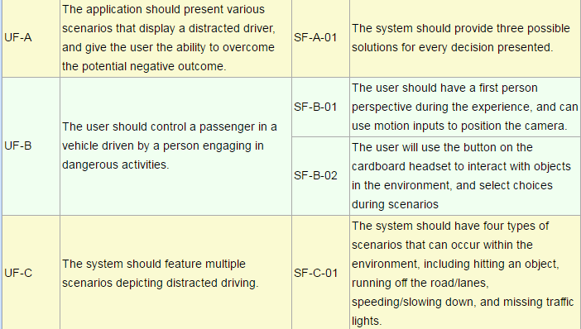
Requirements

Slide 5
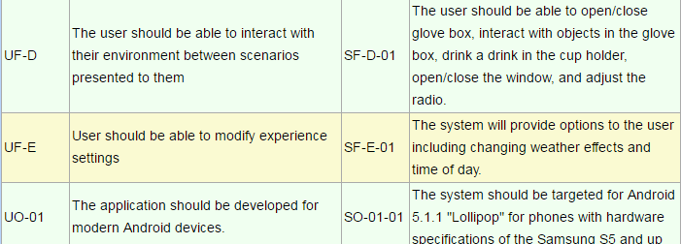
Requirements – Cont.

Slide 6
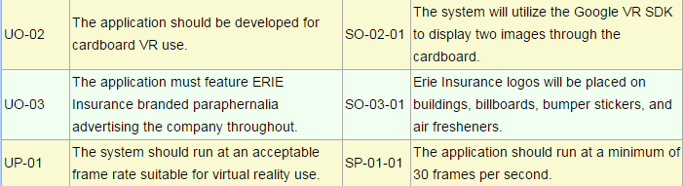
Requirements – Cont.

Slide 7
Use Case Diagram

Slide 8
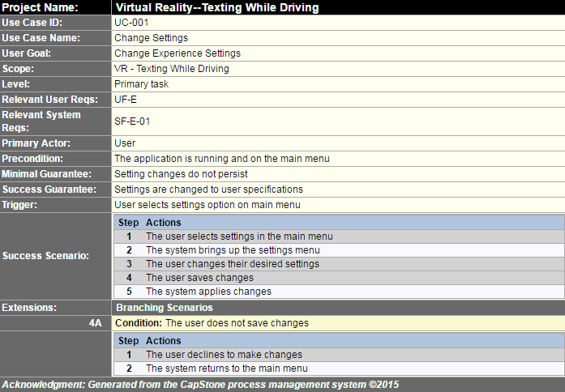
Use Cases

Slide 9
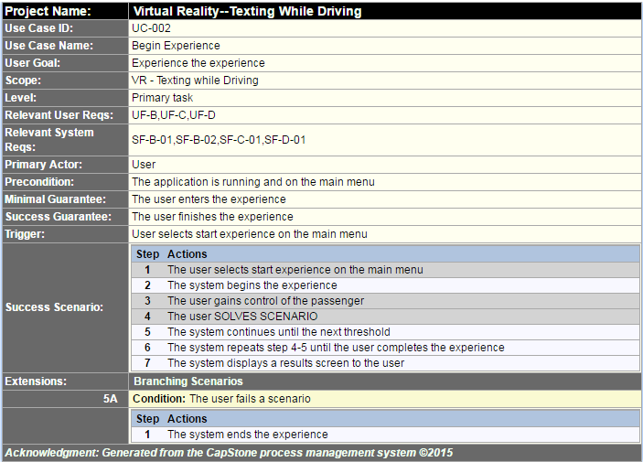
Use Cases – Cont.

Slide 10
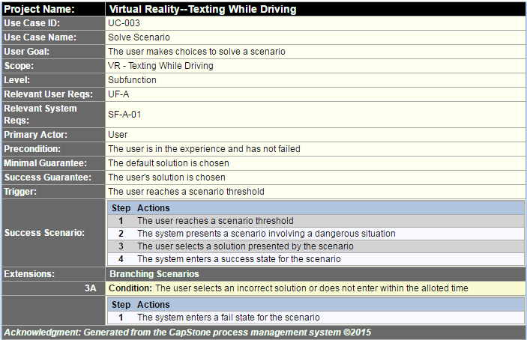
Use Cases – Cont.

Slide 11
Sequence Diagrams

Slide 12
Sequence Diagrams – Cont.

Slide 13





Development Environment

