Slide 1
Team 1 – VR Texting & Driving
Nate Christiansen
Jake Wheeler
Nick Kapty

Slide 2
Project Overview
Sponsored by Erie Insurance
Android app to show dangers of texting while driving
Google Cardboard VR
Immersive experience

Slide 3
Project background
Distracted driving is becoming more prevalent with the rise of technology. Erie Insurance is invested in increasing awareness about this issue.
In 2014, 3,179 people were killed, and 431,000 were injured in motor vehicle crashes involving distracted drivers.
One-third of drivers admitted to texting while driving, and three-quarters saying they’ve seen others do it.
Information from: http://www.distraction.gov/stats-research-laws/facts-and-statistics.html

Slide 4
Business Problem
Project Needs
Erie Insurance is looking for an innovative solution to engage younger audiences in learning about the dangers of distracted driving
Project Objective
Foster engagement between agents, parents, and young drivers
Allow the agent a helpful way to start the conversation about distracted driving
Demonstrate the dangers of distracted driving to young drivers
Broader Impacts
App will be easily distributable if ERIE desires
Potential to protect young drivers and those around them

Slide 5
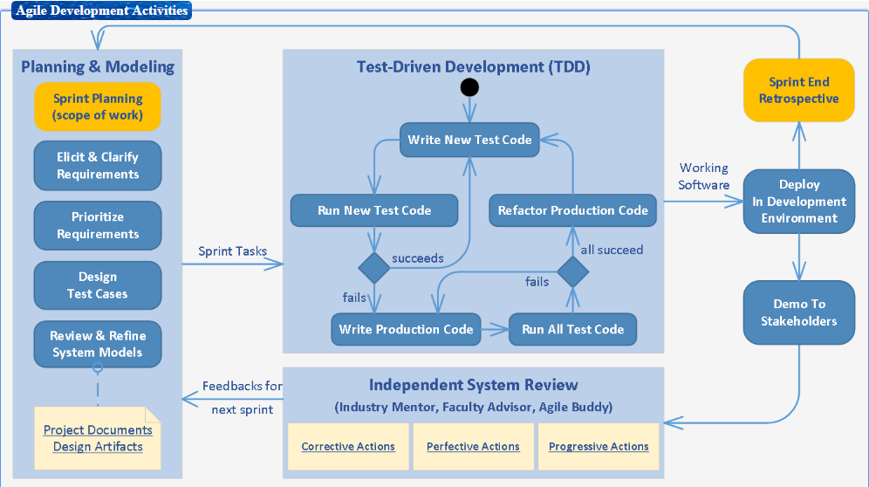
Development Process

Slide 6
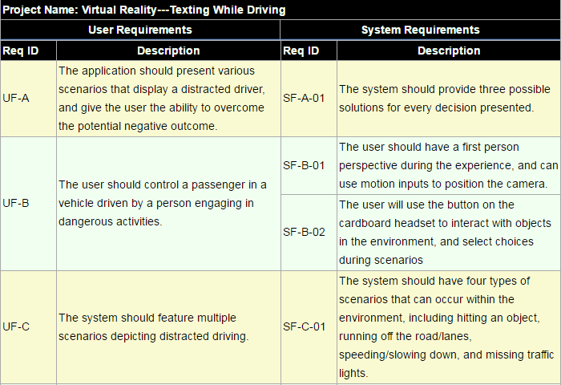
Initial user requirements & engineered system Requirements
Note: These are our initial set of requirements. We may add new requirements as we progress and current requirements may change in the future.

Slide 7
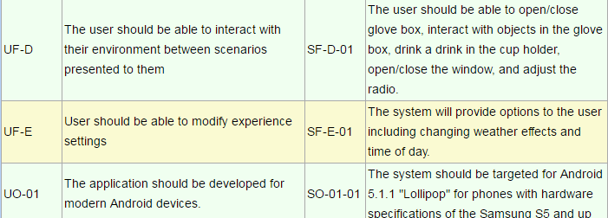
Requirements – Cont.
Note: These are our initial set of requirements. We may add new requirements as we progress and current requirements may change in the future.

Slide 8
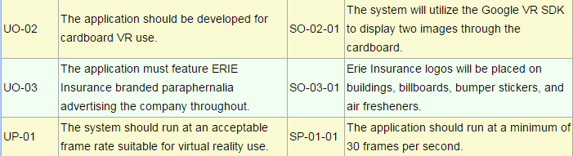
Requirements – Cont.
Note: These are our initial set of requirements. We may add new requirements as we progress and current requirements may change in the future.

Slide 9
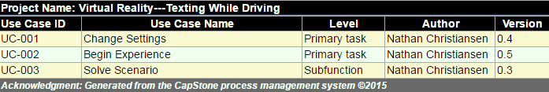
Use Case Diagram
This is our current use case diagram to meet our industry partner’s needs. These use cases may change in the future.

Slide 10
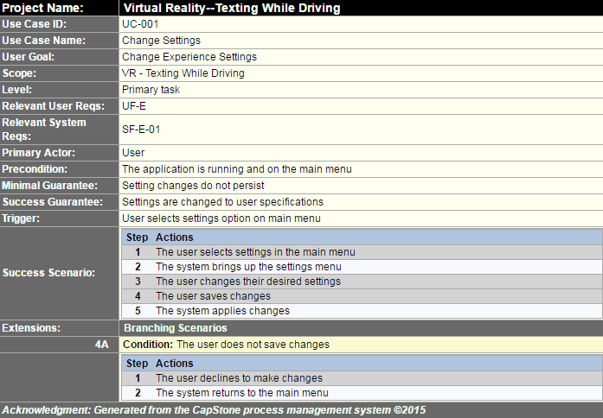
Use Cases – cont.
Note: These are our initial set of use cases. We may add new use cases as we progress and current use cases may change in the future.

Slide 11
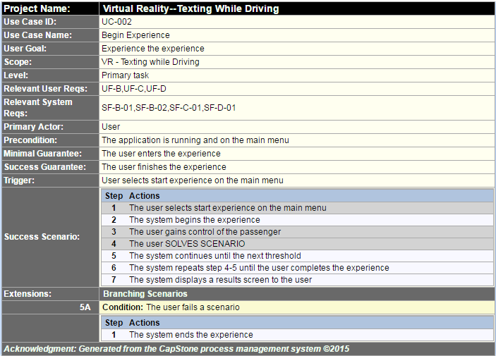
Use Cases – Cont.
Note: These are our initial set of use cases. We may add new use cases as we progress and current use cases may change in the future.

Slide 12
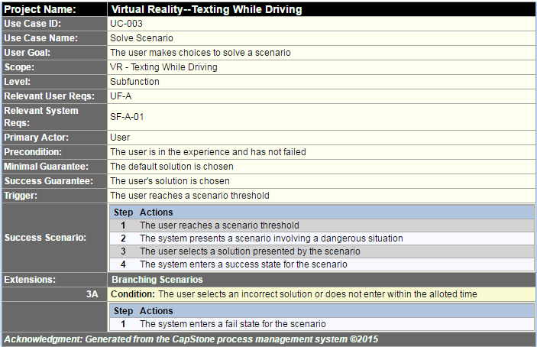
Use Cases – Cont.
Note: These are our initial set of use cases. We may add new use cases as we progress and current use cases may change in the future.

Slide 13
Sequence diagrams

Slide 14
Sequence diagrams – cont.

Slide 15
Exploratory studies
Relevant Techniques
Unity Engine – Component based design
Relevant packages/products
Unity Asset Store
Models
Scripts
Animations
Broader Impacts
Erie Insurance
Young drivers and their families
Other drivers

Slide 16
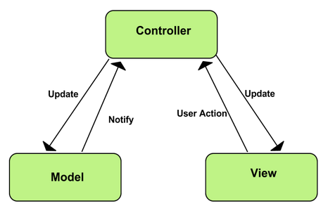
Initial consideration of system architecture
We are currently considering the MVC architecture
As we progress with a prototype, we will reassess our architecture
We may adapt to another architecture if it makes sense to do so
Image from: https://developer.chrome.com/apps/app_frameworks

Slide 17




Development Environment
Hardware:
Personal laptops
Lab computers
Home desktops
Software tools:
C# in Visual Studio
Versioning with Git
Unity Test Tools package for testing

Slide 18
Wrap up
Questions?

