Slide 1


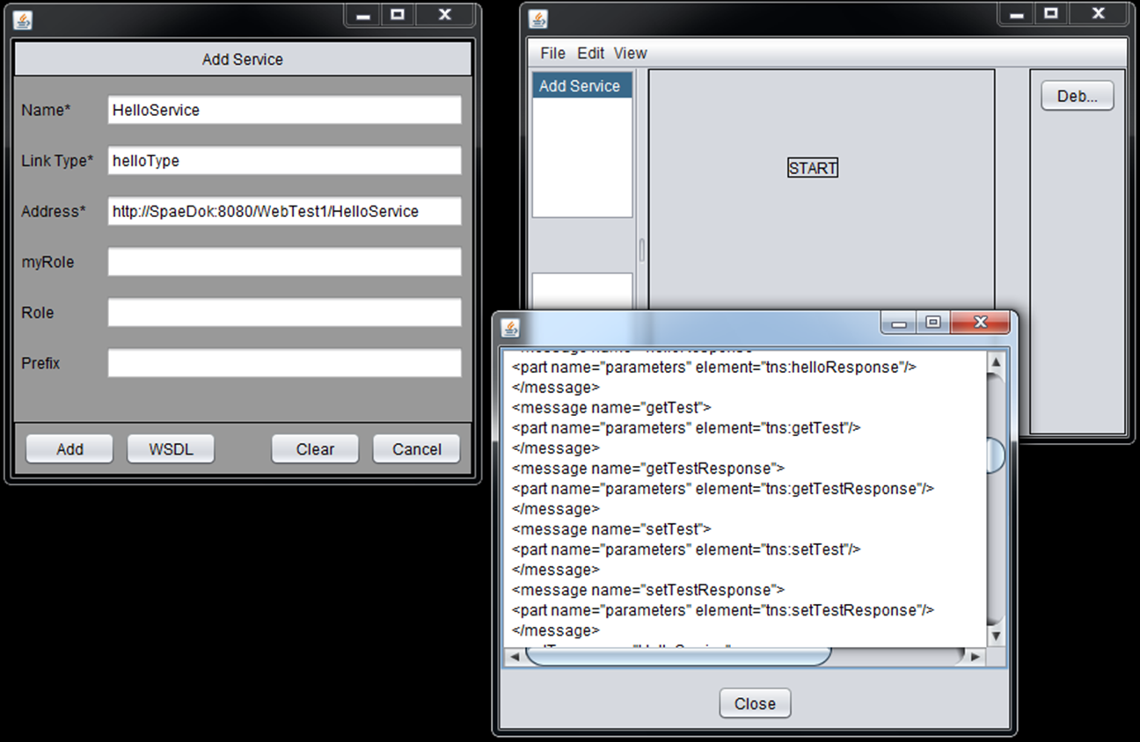





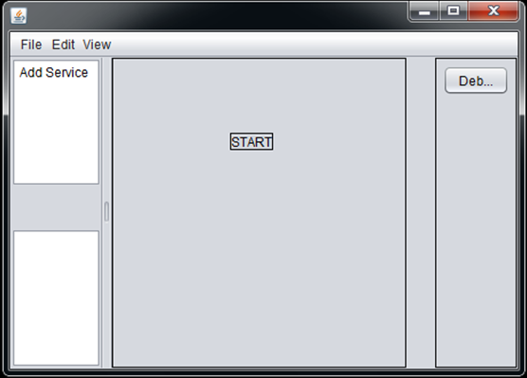
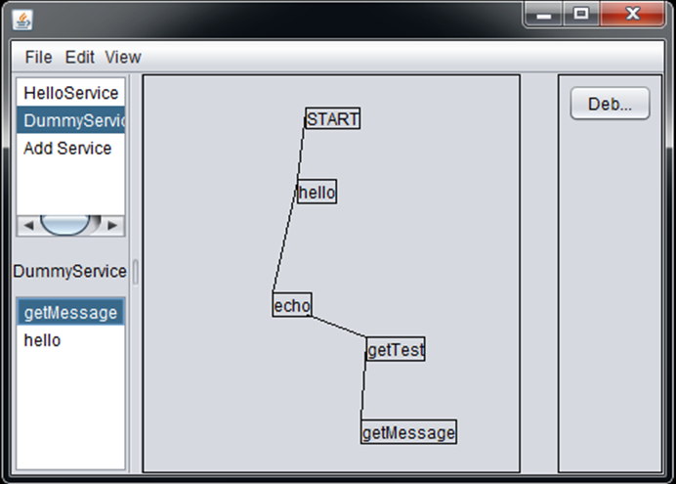
Virtual Reality – Texting While Driving
2017 Richard J. Fasenmyer Engineering Design Conference
Introduction
Author & Abstract
Practical Application
The IT world is experiencing a fast movement toward cloud computing, and it is predicted that we could see the ‘personal cloud’ replacing the PCs in a few years. There is thus a need for investigating methodologies suitable for developing cloud-based systems.
Cloud computing has many benefits. By offloading heavy tasks onto unseen machines, client machines no longer need to be large and powerful. The same can be said of storage. By using various web techniques, computing devices can be utilized to offer new services in a collective manner.
Toward this goal, our research focuses on using web techniques to coordinate the behavior of distributed intelligent agents, each having its own knowledge base. Through a coordinator agent, the distributed agents can be orchestrated to form a team; with the collective intelligence, the team can handle tasks (e.g. real-time decision making) formidable to any individuals.
Student Team: Jacob Wheeler, Nathan Christiansen, and Nick Kapty
Faculty Adviser: Mr. George Dudas
Industry Mentor: Matthew Panetta
Sponsored By: Erie Insurance
With the rise of technology, distracted driving has become more of a risk than ever before. As Erie Insurance invests in protecting people, they are taking the initiative in informing families about the dangers of driving while distracted.
Currently, it is very difficult to display the dangers of distracted driving to a younger generation in a way that engages them. Erie Insurance is seeking an innovative solution in order to solve this problem. The business sponsors of this project are interested in a product that allows for an open discussion on the dangers of texting and driving. While this project is not aimed at teaching policyholders to refrain from texting and driving, it will be used to help the agent share something fun while having that discussion with the young driver.
This project aims to utilize virtual reality technology to create an immersive experience that engages users of all ages. The application will be distributed to agents around Erie's footprint and will effectively capture the younger audience. The business sponsors of the project need a way to help young drivers remember the dangers of distracted driving that have been explained to them by their Erie Insurance agent, which is a gap that this project aims to fill.
Abstract
Erie Insurance currently works with its agents to help them display the dangers of distracted driving to their policyholders. This can often be very difficult for agents to do since the user is not able to experience the consequences of distracted driving for themselves in a safe way. In order to help solve this problem for the agents, we are creating a virtual reality experience to allow for better engagement between agents and the teen drivers they work with. This virtual reality experience will utilize the Unity 3D engine and the Google Cardboard SDK to give the policyholder different scenarios in which they will have to make decisions in which they will have to prevent the driver from texting. This virtual reality experience will help the policyholder to understand how they can influence dangerous driving activities as well as to help stop them. The overall goal of this virtual reality experience is to give young drivers a fun, memorable experience with their agent and to help encourage them not to drive while distracted.
Objectives
Results
The tool implemented in JAVA allows a user to enter the URL of a web service, and attempts to connect to the service. If successful, the program will populate a list with the various operations that the web service offers. These operations may be dragged into an editor window, allowing the user to visually build BPEL processes.
Below: Screenshot of client when first started up.
Third-Party Software
Figure 1: User Interaction with System
Build a diffusion toolkit for supporting real-life decisions where each decision maker is aided by an intelligent agent.
Unity
Visual Studio
Google Cardboard
Android
Figure 3: Depiction of agent-based operation
Top: Screenshot of adding and connecting to a web service.
Right: Screenshot of visual composition. The boxes shown can be dragged around, and connected. Each box represents a web service operation. They are added by selecting operations from the operation list.
References
Barton, Mike. "'Personal Cloud' to Replace PC by 2014, Says Gartner." http://www.wired.com/cloudline/2012/03/personal-cloud-2014/, Mar. 12, 2012 [Mar. 20, 2012].
X. Fan, et. al. Collaborative RPD-Enabled Agents Assisting the Three-Block Challenge in C2CUT. In Proceedings of the 2005 Conference on Behavior Representation in Modeling and Simulation (BRIMS), pages 113—123. May 16-19, Universal City, CA, 2005.
Figure 2: Agent-Based Architecture Diagram
Figure 4: Depiction of agent-based operation
Figure 5: Visual Composition of Operations

