Slide 1
Team 1 – VR Texting & Driving
Nate Christiansen
Jake Wheeler
Nick Kapty

Slide 2
Project Overview
Sponsored by Erie Insurance
Android app designed for agents to demonstrate the dangers of distracted driving to policy holders
Utilizes Google Cardboard VR to create an immersive experience to engage younger audiences

Slide 3
Business Problem
Project Background: Distracted driving is becoming more prevalent with the rise of technology. Erie Insurance is invested in increasing awareness about this issue.
Project Needs: Erie Insurance is looking for an innovative solution to engage younger audiences in learning about the dangers of distracted driving.
Project Objective: This project aims to utilize virtual reality technology to create an immersive experience that involves users of all ages.
Broader Impacts: This virtual reality experience has the potential to help minimize distracted driving. Since the application runs on the Android operating system, which is used by millions of people every day, this application has the potential to reach a large number of drivers and passengers.

Slide 4
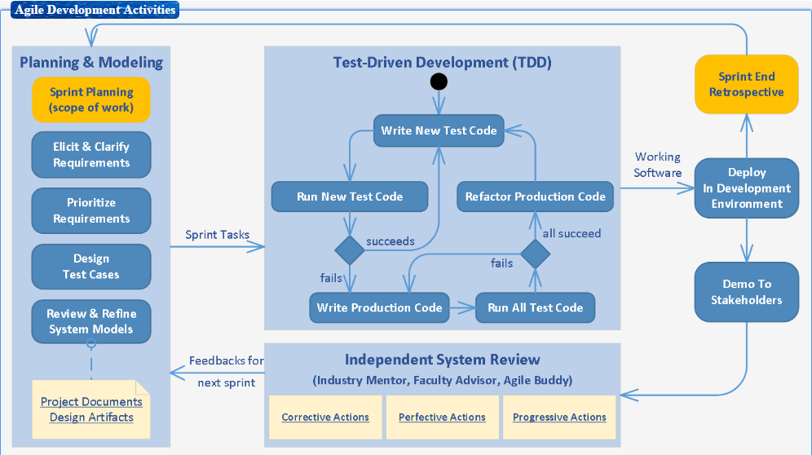
Development Process

Slide 5
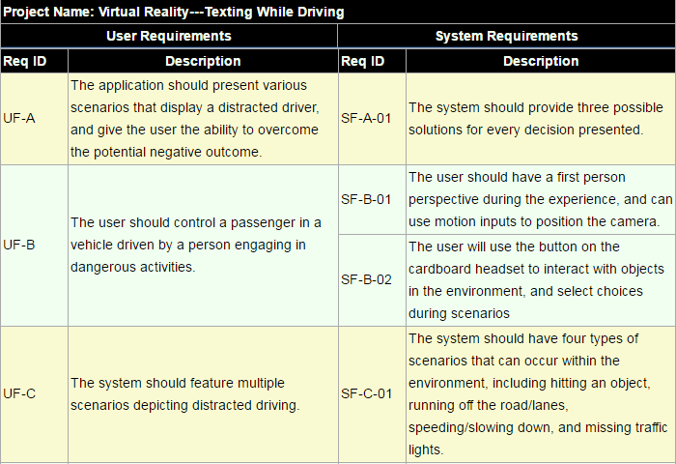
Initial user requirements & engineered system Requirements
Note: These are our initial set of requirements. We may add new requirements as we progress and current requirements may change in the future.

Slide 6
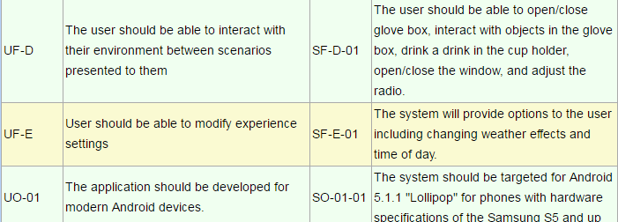
Requirements – Cont.
Note: These are our initial set of requirements. We may add new requirements as we progress and current requirements may change in the future.

Slide 7
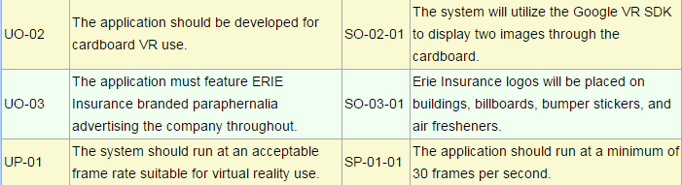
Requirements – Cont.
Note: These are our initial set of requirements. We may add new requirements as we progress and current requirements may change in the future.

Slide 8
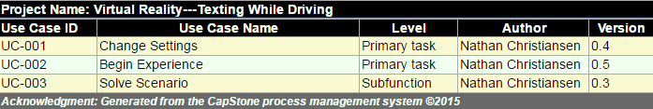
Use Case Diagram
This is our current use case diagram to meet our industry partner’s needs. These use cases may change in the future.

Slide 9
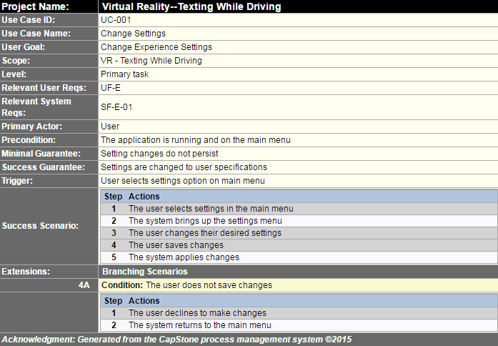
Use Cases – cont.
Note: These are our initial set of use cases. We may add new use cases as we progress and current use cases may change in the future.

Slide 10
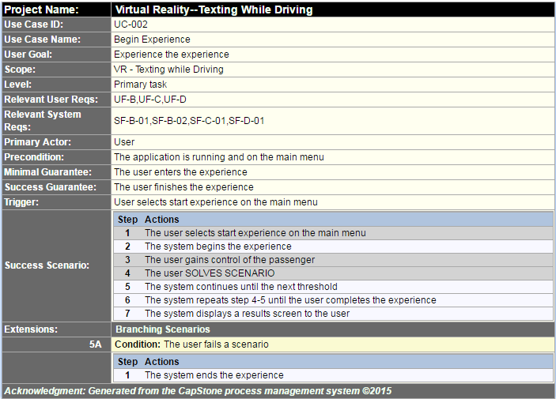
Use Cases – Cont.
Note: These are our initial set of use cases. We may add new use cases as we progress and current use cases may change in the future.

Slide 11
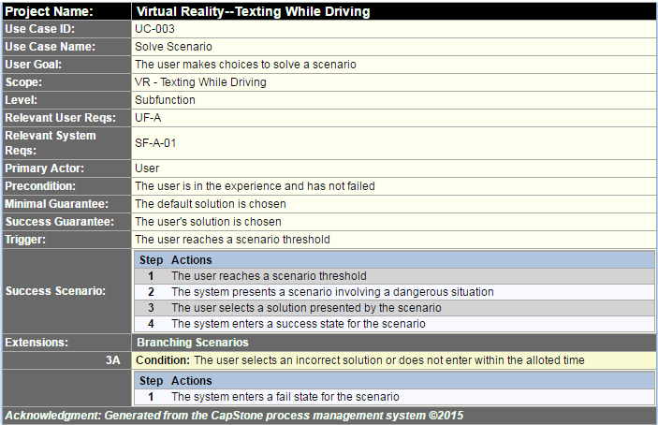
Use Cases – Cont.
Note: These are our initial set of use cases. We may add new use cases as we progress and current use cases may change in the future.

Slide 12
Sequence diagrams

Slide 13
Sequence diagrams – cont.

Slide 14
Exploratory studies
Relevant Techniques: Due to the nature of Unity Engine being component based, we plan to adopt a component based design.
Relevant packages/products: The Unity asset store contains models, scripts, animations, and other assets we can use. We are experimenting with some currently to discover what we want to use in our prototype.
Broader Impacts: Aside from Erie Insurance benefitting from our project, drivers and their families will benefit since they will give a second thought to distracted driving after using the application.

Slide 15
Initial consideration of system architecture
We are currently considering the MVC architecture
As we progress with a prototype, we will reassess our architecture
We may adapt to another architecture if it makes sense to do so

Slide 16




Development Environment
Hardware:
Personal laptops
Lab computers
Home desktops
Software tools:
C# in Visual Studio
Versioning with Git
Unity Test Tools package for testing

Slide 17
Wrap up
Questions?

