Slide 1
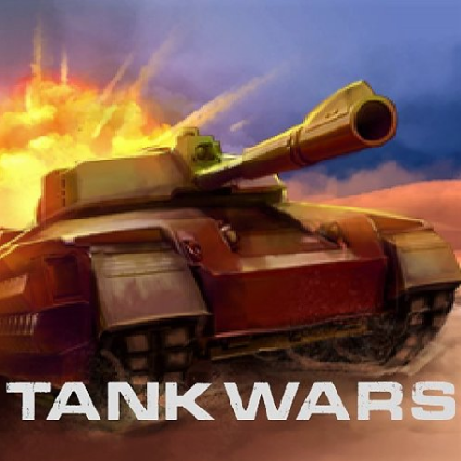

TankWars!!
By: Nate Claussen
Original Idea By: Paul Soderquist

Slide 2
What is TankWars?
Tank Wars is a game where YOU get to create your own tank AI and dominate in the arena. Given various player variables, you can choose what your tank does given the circumstance it is in.

Slide 3
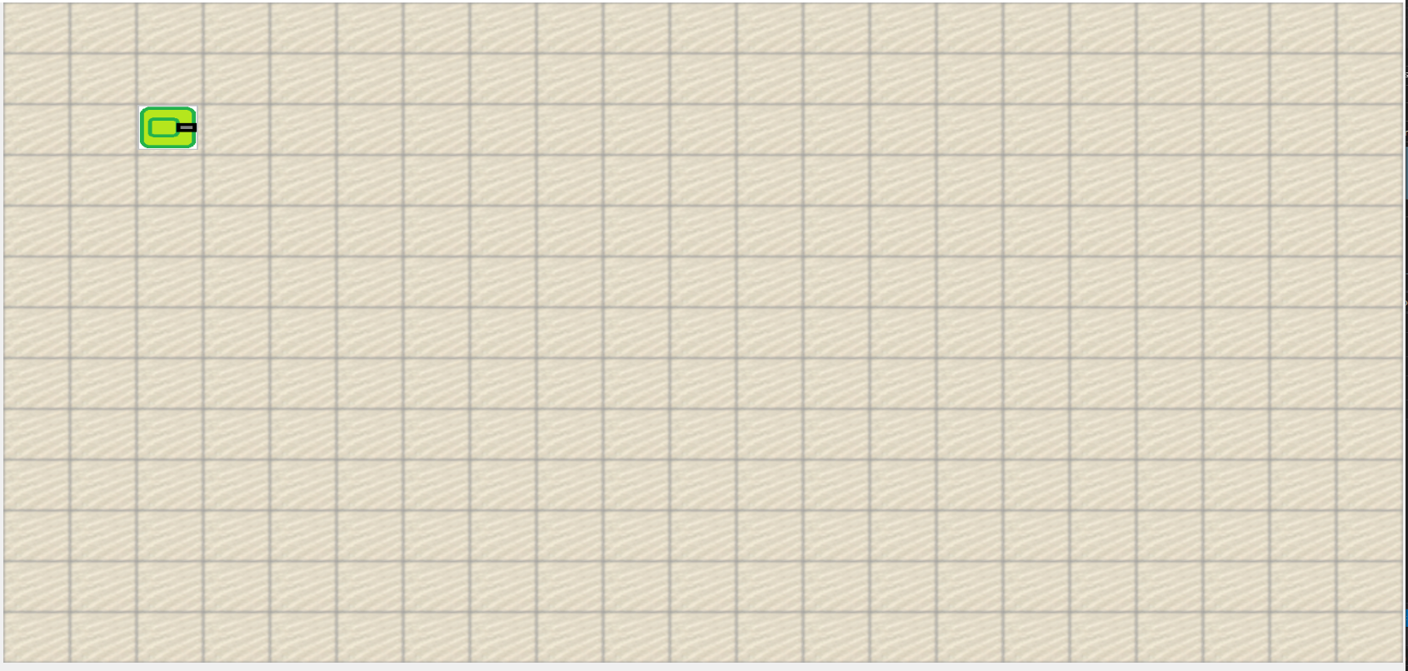
Game Board Coordinate System
(0,0)
(1,0)
(2,0)
(3,0)
(4,0)
(5,0)
(6,0)
(7,0)
(8,0)
(9,0)
(10,0)
(11,0)
(12,0)
(13,0)
(14,0)
(15,0)
(16,0)
(17,0)
(18,0)
(19,0)
(20,0)
(0,1)
(1,1)
(2,1)
(3,1)
(4,1)
(5,1)
(6,1)
(7,1)
(8,1)
(9,1)
(10,1)
(11,1)
(12,1)
(13,1)
(14,1)
(15,1)
(16,1)
(17,1)
(18,1)
(19,1)
(20,1)
(0,2)
(1,2)
(2,2)
(3,2)
(4,2)
(5,2)
(6,2)
(7,2)
(8,2)
(9,2)
(10,2)
(11,2)
(12,2)
(13,2)
(14,2)
(15,2)
(16,2)
(17,2)
(18,2)
(19,2)
(20,2)
(0,3)
(1,3)
(2,3)
(3,3)
(4,3)
(5,3)
(6,3)
(7,3)
(8,3)
(9,3)
(10,3)
(11,3)
(12,3)
(13,3)
(14,3)
(15,3)
(16,3)
(17,3)
(18,3)
(19,3)
(20,3)
(0,4)
(1,4)
(2,4)
(3,4)
(4,4)
(5,4)
(6,4)
(7,4)
(8,4)
(9,4)
(10,4)
(11,4)
(12,4)
(13,4)
(14,4)
(15,4)
(16,4)
(17,4)
(18,4)
(19,4)
(20,4)
(0,5)
(1,5)
(2,5)
(3,5)
(4,5)
(5,5)
(6,5)
(7,5)
(8,5)
(9,5)
(10,5)
(11,5)
(12,5)
(13,5)
(14,5)
(15,5)
(16,5)
(17,5)
(18,5)
(19,5)
(20,5)
(0,6)
(1,6)
(2,6)
(3,6)
(4,6)
(5,6)
(6,6)
(7,6)
(8,6)
(9,6)
(10,6)
(11,6)
(12,6)
(13,6)
(14,6)
(15,6)
(16,6)
(17,6)
(18,6)
(19,6)
(20,6)
(0,7)
(1,7)
(2,7)
(3,7)
(4,7)
(5,7)
(6,7)
(7,7)
(8,7)
(9,7)
(10,7)
(11,7)
(12,7)
(13,7)
(14,7)
(15,7)
(16,7)
(17,7)
(18,7)
(19,7)
(20,7)
(0,8)
(1,8)
(2,8)
(3,8)
(4,8)
(5,8)
(6,8)
(7,8)
(8,8)
(9,8)
(10,8)
(11,8)
(12,8)
(13,8)
(14,8)
(15,8)
(16,8)
(17,8)
(18,8)
(19,8)
(20,8)
(0,9)
(1,9)
(2,9)
(3,9)
(4,9)
(5,9)
(6,9)
(7,9)
(8,9)
(9,9)
(10,9)
(11,9)
(12,9)
(13,9)
(14,9)
(15,9)
(16,9)
(17,9)
(18,9)
(19,9)
(20,9)
(0,10)
(1,10)
(2,10)
(3,10)
(4,10)
(5,10)
(6,10)
(7,10)
(8,10)
(9,10)
(10,10)
(11,10)
(12,10)
(13,10)
(14,10)
(15,10)
(16,10)
(17,10)
(18,10)
(19,10)
(20,10)
(0,11)
(1,11)
(2,11)
(3,11)
(4,11)
(5,11)
(6,11)
(7,11)
(8,11)
(9,11)
(10,11)
(11,11)
(12,11)
(13,11)
(14,11)
(15,11)
(16,11)
(17,11)
(18,11)
(19,11)
(20,11)
(0,12)
(1,12)
(2,12)
(3,12)
(4,12)
(5,12)
(6,12)
(7,12)
(8,12)
(9,12)
(10,12)
(11,12)
(12,12)
(13,12)
(14,12)
(15,12)
(16,12)
(17,12)
(18,12)
(19,12)
(20,12)

Slide 4
Starting Positions
(0,0)
(1,0)
(2,0)
(3,0)
(4,0)
(5,0)
(6,0)
(7,0)
(8,0)
(9,0)
(10,0)
(11,0)
(12,0)
(13,0)
(14,0)
(15,0)
(16,0)
(17,0)
(18,0)
(19,0)
(20,0)
5
7
(0,1)
(1,1)
(2,1)
(3,1)
(4,1)
(5,1)
(6,1)
(7,1)
(8,1)
(9,1)
(10,1)
(11,1)
(12,1)
(13,1)
(14,1)
(15,1)
(16,1)
(17,1)
(18,1)
(19,1)
(20,1)
15
17
16
(0,2)
(1,2)
(2,2)
(3,2)
(4,2)
(5,2)
(6,2)
(7,2)
(8,2)
(9,2)
(10,2)
(11,2)
(12,2)
(13,2)
(14,2)
(15,2)
(16,2)
(17,2)
(18,2)
(19,2)
(20,2)
3
4
(0,3)
(1,3)
(2,3)
(3,3)
(4,3)
(5,3)
(6,3)
(7,3)
(8,3)
(9,3)
(10,3)
(11,3)
(12,3)
(13,3)
(14,3)
(15,3)
(16,3)
(17,3)
(18,3)
(19,3)
(20,3)
20
(0,4)
(1,4)
(2,4)
(3,4)
(4,4)
(5,4)
(6,4)
(7,4)
(8,4)
(9,4)
(10,4)
(11,4)
(12,4)
(13,4)
(14,4)
(15,4)
(16,4)
(17,4)
(18,4)
(19,4)
(20,4)
21
9
11
(0,5)
(1,5)
(2,5)
(3,5)
(4,5)
(5,5)
(6,5)
(7,5)
(8,5)
(9,5)
(10,5)
(11,5)
(12,5)
(13,5)
(14,5)
(15,5)
(16,5)
(17,5)
(18,5)
(19,5)
(20,5)
23
(0,6)
(1,6)
(2,6)
(3,6)
(4,6)
(5,6)
(6,6)
(7,6)
(8,6)
(9,6)
(10,6)
(11,6)
(12,6)
(13,6)
(14,6)
(15,6)
(16,6)
(17,6)
(18,6)
(19,6)
(20,6)
1
2
(0,7)
(1,7)
(2,7)
(3,7)
(4,7)
(5,7)
(6,7)
(7,7)
(8,7)
(9,7)
(10,7)
(11,7)
(12,7)
(13,7)
(14,7)
(15,7)
(16,7)
(17,7)
(18,7)
(19,7)
(20,7)
13
24
14
(0,8)
(1,8)
(2,8)
(3,8)
(4,8)
(5,8)
(6,8)
(7,8)
(8,8)
(9,8)
(10,8)
(11,8)
(12,8)
(13,8)
(14,8)
(15,8)
(16,8)
(17,8)
(18,8)
(19,8)
(20,8)
10
12
(0,9)
(1,9)
(2,9)
(3,9)
(4,9)
(5,9)
(6,9)
(7,9)
(8,9)
(9,9)
(10,9)
(11,9)
(12,9)
(13,9)
(14,9)
(15,9)
(16,9)
(17,9)
(18,9)
(19,9)
(20,9)
19
(0,10)
(1,10)
(2,10)
(3,10)
(4,10)
(5,10)
(6,10)
(7,10)
(8,10)
(9,10)
(10,10)
(11,10)
(12,10)
(13,10)
(14,10)
(15,10)
(16,10)
(17,10)
(18,10)
(19,10)
(20,10)
22
(0,11)
(1,11)
(2,11)
(3,11)
(4,11)
(5,11)
(6,11)
(7,11)
(8,11)
(9,11)
(10,11)
(11,11)
(12,11)
(13,11)
(14,11)
(15,11)
(16,11)
(17,11)
(18,11)
(19,11)
(20,11)
18
(0,12)
(1,12)
(2,12)
(3,12)
(4,12)
(5,12)
(6,12)
(7,12)
(8,12)
(9,12)
(10,12)
(11,12)
(12,12)
(13,12)
(14,12)
(15,12)
(16,12)
(17,12)
(18,12)
(19,12)
(20,12)
6
8

Slide 5
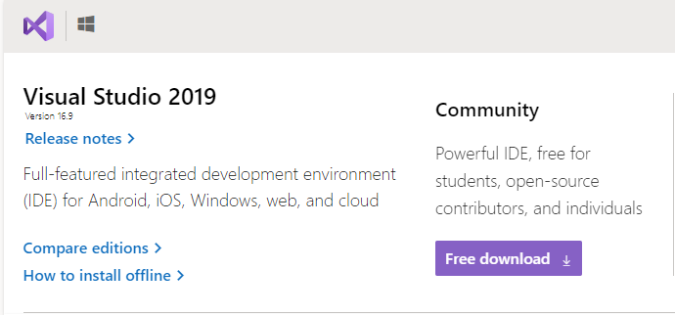
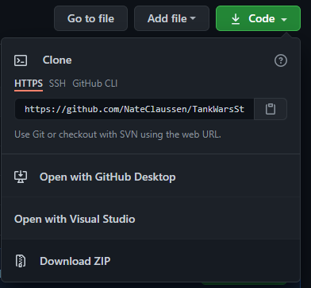
How to start?
1
2
Install the latest version of Visual Studio and make sure that you have .NET 5 installed!
Next, go to my GitHub and download a zip of the project and unzip to a local folder.

Slide 6
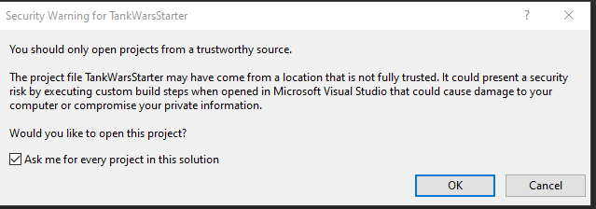
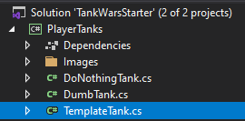
After It is Installed and Unzipped
Open the Solution File( )
Click OK to the Security Warnings and wait for it to load
In the Solution Explorer, Expand The PlayerTanks Project, and open the TemplateTank.cs file

Slide 7
Congrats! You are set-up and ready to create your own tank!

Slide 8
What’s inside the PlayerTank Class?

Slide 9
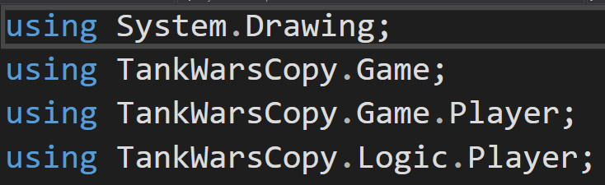
Using Statements
Using statements bring in all the libraries that you use in your Tank. This list might grow as you make changes later

Slide 10
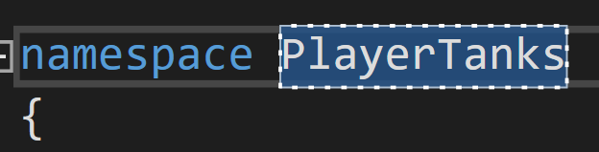
Namespace declaration
This adds your tank to the correct namespace which we don’t really need to worry about right now.

Slide 11

Class Declaration
The class declaration declares a new class. In this case it is the TemplateTank
Do notice that your tank derives from the base class PlayerTank

Slide 12

Name and Image Overrides
These overrides allow you to easily change the name and image of your tank (more on that later)

Slide 13
And Finally… your TankAction method!
This is where the bulk of your code will go. This method is run every 500 milliseconds and is the logic behind your tank.
It is this method that you can ‘return’ an ActionType to determine what your tank does

Slide 14
Customization!

Slide 15


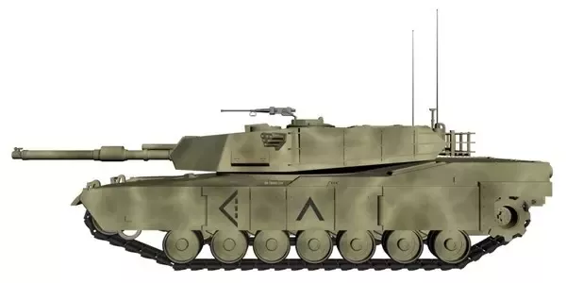
Tank Image
To change the Tank Image, find a picture you like and put it in the images folder.
For example, If I wanted to have my tank image be TankOne.jpg, I would do so like this…
Take note that each tank starts facing right, so choose your picture accordingly!

Slide 16
Tank Name
Changing the name is even easier! You just change what’s inside the arrow brackets (<>)!

Slide 17
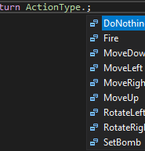
Tank Action!
To Change what your tank does, you change what that method returns. You can use itellisense to help you with this ☺
Tank Action Choices
Do Nothing -> does nothing
Fire -> fires a bullet
Move Down -> moves down one square
Move Left -> moves left one square
Move Right -> moves right one square
Move Up -> moves up one square
Move Down -> moves down one square
Set Bomb -> sets a bomb (takes away one of your lives)

Slide 18
Bombs will take away one of your lives for setting it, but all tanks who get caught in the explosion will lose 2 lives!

Slide 19
If a bullet hits a bomb, it will immediately explode!

Slide 20
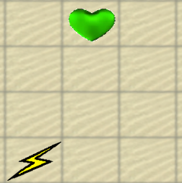
Powerups
Hearts will give your tank a life. You cannot have more than max lives
(set in startup)
Lightning jolts your tank and makes its bullets shoot significantly faster for the rest of the game
Powerups will spawn in the arena and can be the difference between victory and defeat!

Slide 21
Lets create a tank that will dodge a bullet!
It is very important to have a tank that can dodge a bullet!
What are we going to do?
Check all around us to determine if there is a bullet coming at us from the left side.
If there is a bullet, check its direction to see if it will hit us
Finally, if it will hit us, move!

Slide 22

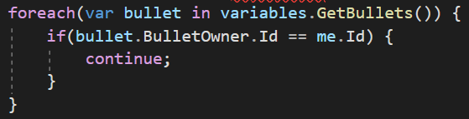
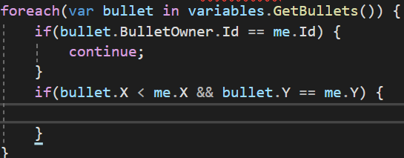
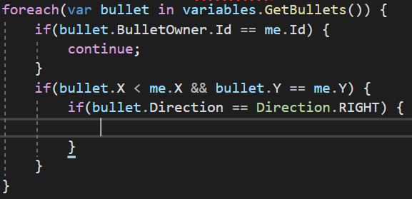
Step 1: Check around us for bullets
1. Go through all the bullets in the arena
2. If the bullet came from us, continue to the next bullet
3. If the bullet is to the left of us (X < us) and its on the same height (Y value)
4. If the bullet is facing us

Slide 23

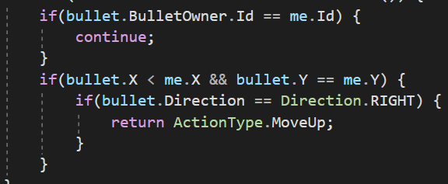




5. Move!!!
Your code could look like this (or be completely different!!) You can now test your tank out (maybe with the control tank) and see if it will move out of the way if you shoot from the left!

Slide 24
Add More
You can have as many different Tank classes as you’d like. Just make sure that they are part of the PlayerTanks project and derive from the PlayerTank base class. You can make as many as you’d like so you can test various strategies out.
So have fun! Make your reigning champion and win the war!!

Slide 25
What next?
Obviously your tank won’t last very long if all it can do is move up when a bullet is coming to your left. What if the bullet is on the opposite side of the arena? Would you still want to move?
What about bombs? Is it worth the risk to lay bombs down? How about making them explode early?
How do you determine when to rotate your tank to look at your opponent?
What is going to be your strategy to win?

Slide 26

Questions

