Slide 1
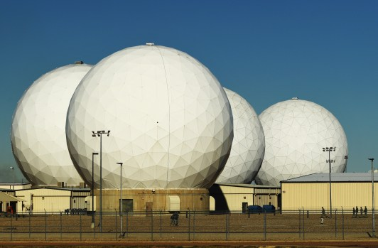
Analyzing Methods of DOA Array Processing in the Presence of Colored Noise Fields
Nate Golding
Buckley Space Force Base

Slide 2
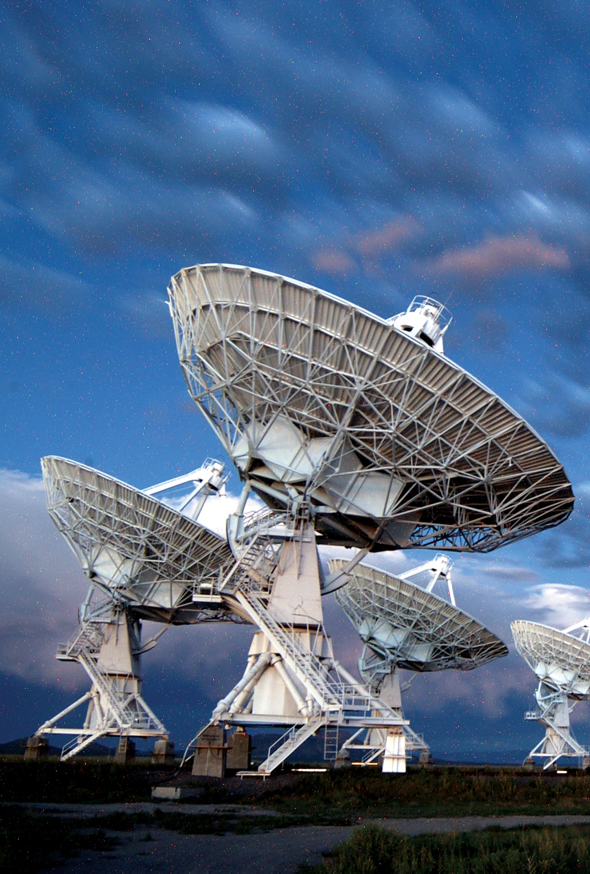
DOA Motivations
Radar/Sonar signal tracking (military, civilian aircraft)
Radio astronomy
Beamforming-based coexistence (6G, 802.11be)
Spacecraft-to-ground communications optimization
Navigation
Medical imaging
Acoustic localization in robotics
The Very Large Array at the National Radio Astronomy Observatory (NRAO) New Mexico

Slide 3
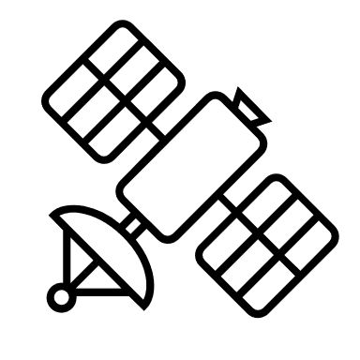

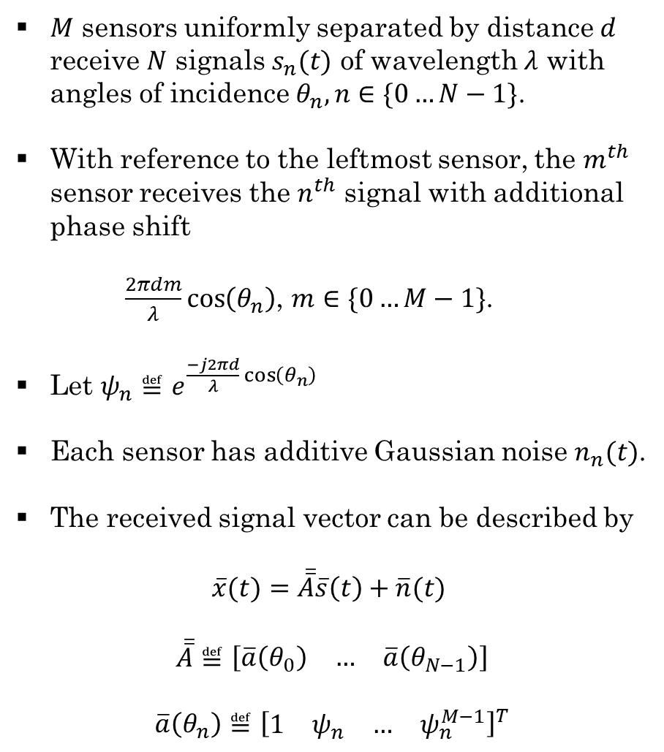







MUltiple SIgnal Classification (MUSIC) for DOA
$M$ sensors uniformly separated by distance $d$ receive $N$ signals $s_{n}(t)$ of wavelength $λ$ with angles of incidence $θ_{n}, n∈\{0…N−1\}$.
With reference to the leftmost sensor, the $m^{th}$ sensor receives the $n^{th}$ signal with additional phase shift
$\frac{2πdm}{λ}\cos\left(θ_{n}\right)$, $m∈\{0…M−1\}$.
Let $ψ_{n}≝e^{\frac{−j2πd}{λ}\cos\left(θ_{n}\right)}$
Each sensor has additive Gaussian noise $n_{n}(t)$.
The received signal vector can be described by
$$\overline{x}(t)=\overline{\overline{A}}\overline{s}\left(t\right)+\overline{n}(t)$$
$$\overline{\overline{A}}≝\left[\begin{matrix}\overline{a}\left(θ_{0}\right) & … & \overline{a}\left(θ_{N−1}\right)\end{matrix}\right]$$
$$\overline{a}\left(θ_{n}\right)≝{\left[\begin{matrix}1 & ψ_{n} & … & ψ_{n}^{M−1}\end{matrix}\right]}^{T}$$
$$N$$
$$…$$
$$…$$
$$d$$
$$M$$
$$0^{∘}$$
$${−90}^{∘}$$
$${90}^{∘}$$

Slide 4
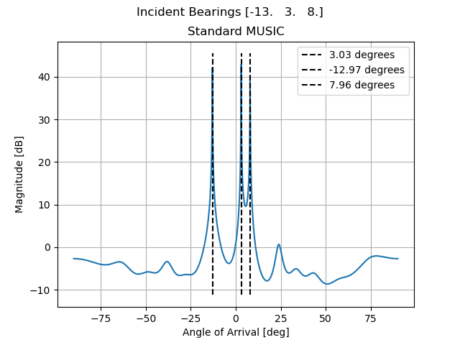
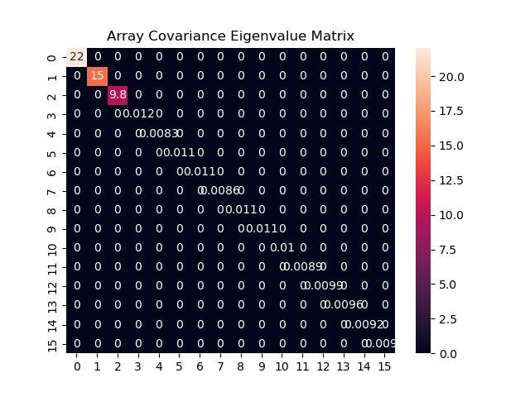
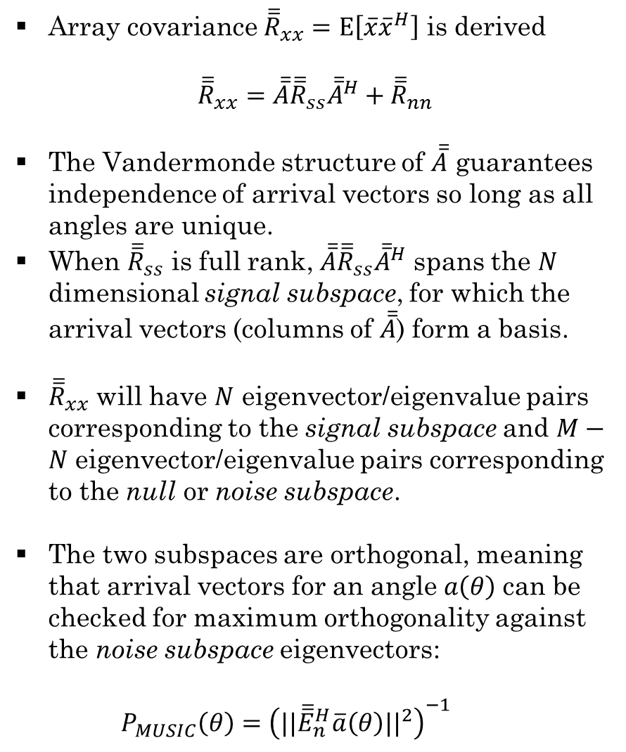
Array covariance ${\overline{\overline{R}}}_{xx}=Ε\left[\overline{x}{\overline{x}}^{H}\right]$ is derived
$${\overline{\overline{R}}}_{xx}=\overline{\overline{A}}{\overline{\overline{R}}}_{ss}{\overline{\overline{A}}}^{H}+{\overline{\overline{R}}}_{nn}$$
The Vandermonde structure of $\overline{\overline{A}}$ guarantees independence of arrival vectors so long as all angles are unique.
When ${\overline{\overline{R}}}_{ss}$ is full rank, $\overline{\overline{A}}{\overline{\overline{R}}}_{ss}{\overline{\overline{A}}}^{H}$ spans the $N$ dimensional signal subspace, for which the arrival vectors (columns of $\overline{\overline{A}}$) form a basis.
${\overline{\overline{R}}}_{xx}$ will have $N$ eigenvector/eigenvalue pairs corresponding to the signal subspace and $M−N$ eigenvector/eigenvalue pairs corresponding to the null or noise subspace.
The two subspaces are orthogonal, meaning that arrival vectors for an angle$a\left(θ\right)$ can be checked for maximum orthogonality against the noise subspace eigenvectors:
$P_{MUSIC}\left(θ\right)={\left({||\overline{\overline{E}}}_{n}^{H}\overline{a}\left(θ\right){||}^{2}\right)}^{−1}$

Slide 5
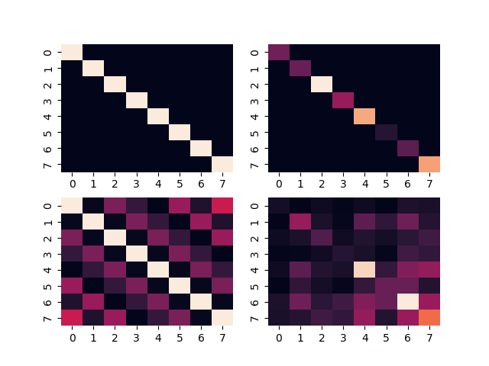
Colored Noise Fields
Uniform Diagonal: ideal case of uncorrelated noise of equal power across all sensors
Non-Uniform Diagonal: uncorrelated noise of unequal power across sensors
Block Diagonal: correlated noise between nearby sensors, e.g. coupling in the receiver
Symmetric Toeplitz: correlated noise of equal power across sensors, e.g. low noise figure receivers, noise off-platform
Symmetric, Non-Toeplitz: correlated noise of unequal power across sensors, e.g. a mix of the above situations are equally relevant.

Slide 6
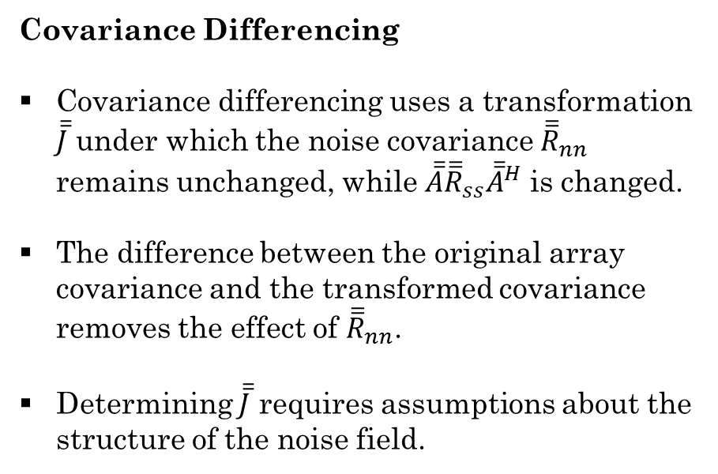
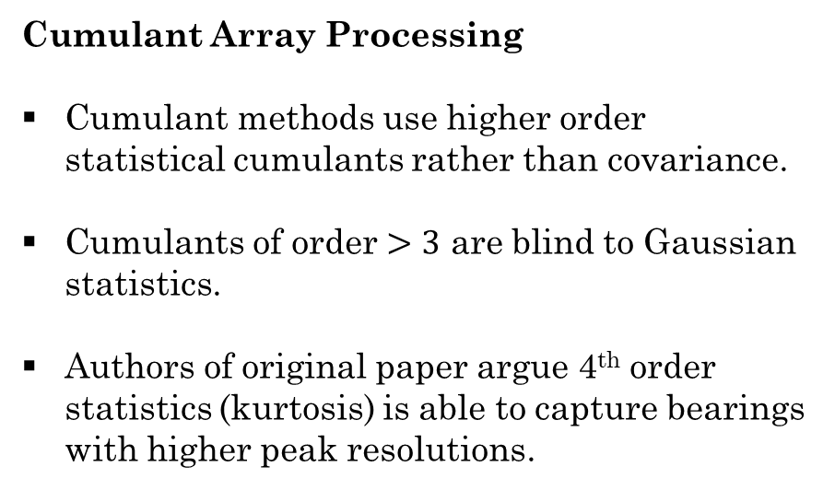
Mitigation: Covariance Differencing and Cumulant Methods
Covariance Differencing
Covariance differencing uses a transformation $\overline{\overline{J}}$ under which the noise covariance ${\overline{\overline{R}}}_{nn}$ remains unchanged, while $\overline{\overline{A}}{\overline{\overline{R}}}_{ss}{\overline{\overline{A}}}^{H}$ is changed.
The difference between the original array covariance and the transformed covariance removes the effect of ${\overline{\overline{R}}}_{nn}$.
Determining $\overline{\overline{J}}$ requires assumptions about the structure of the noise field.
Cumulant Array Processing
Cumulant methods use higher order statistical cumulants rather than covariance.
Cumulants of order $>3$ are blind to Gaussian statistics.
Authors of original paper argue 4th order statistics (kurtosis) is able to capture bearings with higher peak resolutions.

Slide 7
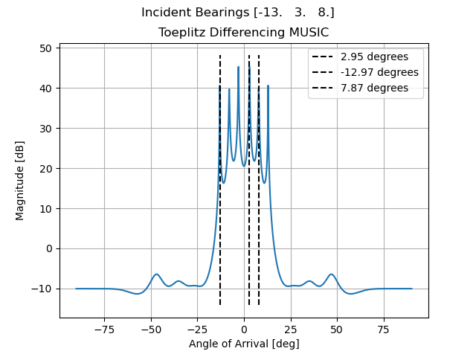
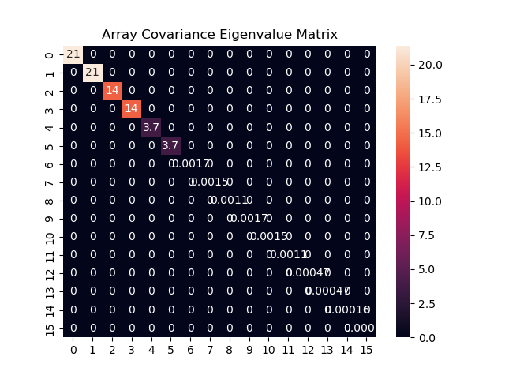
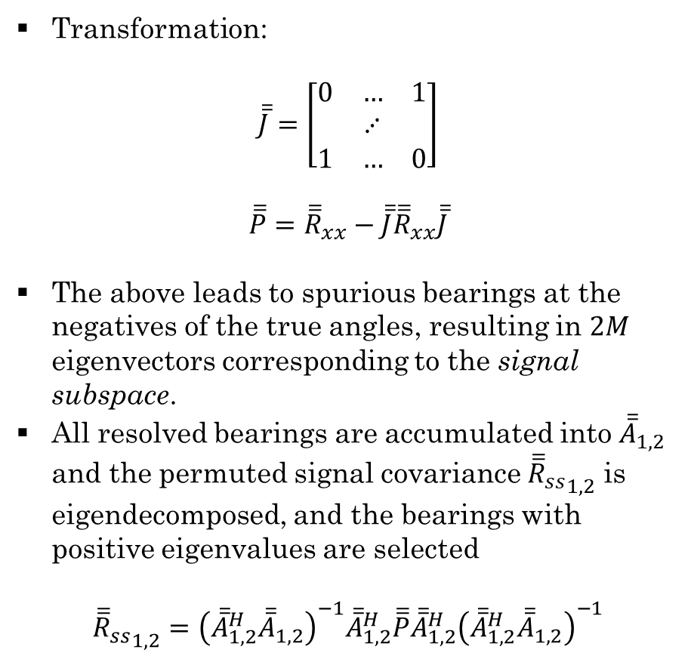
Covariance Differencing Toeplitz Assumption
Transformation:
$$\overline{\overline{J}}=\left[\begin{matrix}0 & … & 1 \\ & ⋰ & \\ 1 & … & 0\end{matrix}\right]$$
$$\overline{\overline{P}}={\overline{\overline{R}}}_{xx}−\overline{\overline{J}}{\overline{\overline{R}}}_{xx}\overline{\overline{J}}$$
The above leads to spurious bearings at the negatives of the true angles, resulting in $2M$ eigenvectors corresponding to the signal subspace.
All resolved bearings are accumulated into ${\overline{\overline{A}}}_{1,2}$ and the permuted signal covariance ${{\overline{\overline{R}}}_{ss}}_{1,2}$ is eigendecomposed, and the bearings with positive eigenvalues are selected
$${{\overline{\overline{R}}}_{ss}}_{1,2}={\left({\overline{\overline{A}}}_{1,2}^{H}{\overline{\overline{A}}}_{1,2}\right)}^{−1}{\overline{\overline{A}}}_{1,2}^{H}\overline{\overline{P}}{\overline{\overline{A}}}_{1,2}^{H}{\left({\overline{\overline{A}}}_{1,2}^{H}{\overline{\overline{A}}}_{1,2}\right)}^{−1}$$

Slide 8
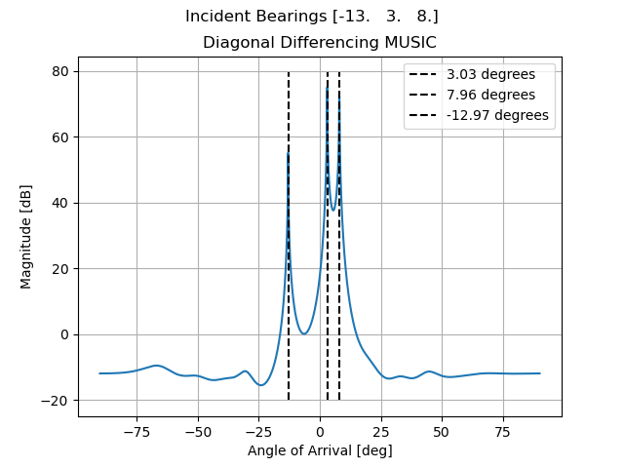

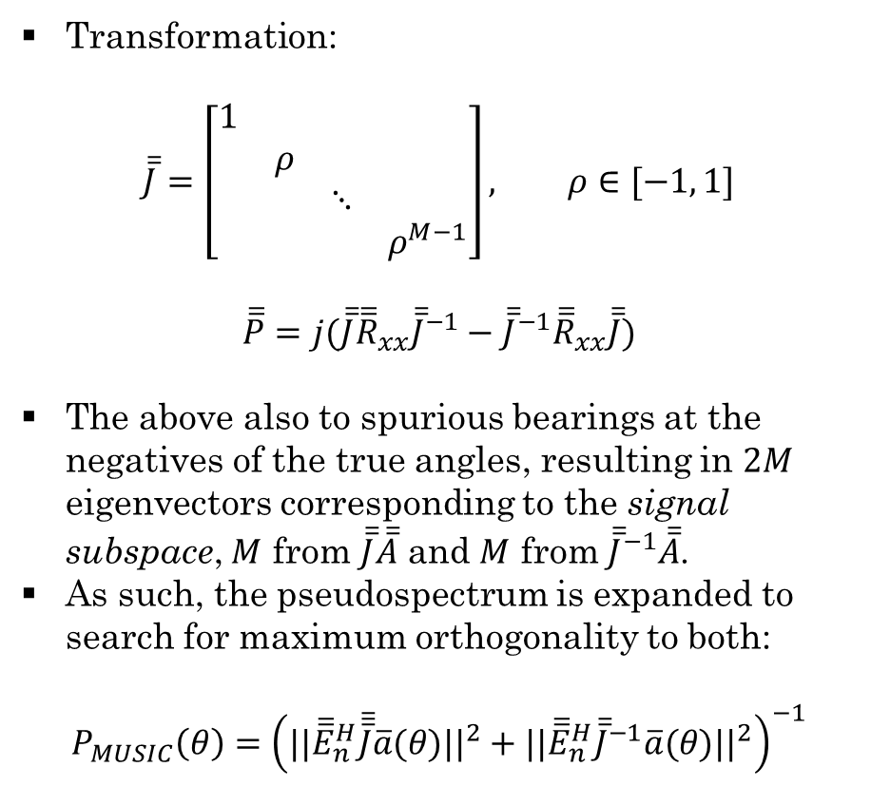
Covariance Differencing Diagonal Assumption
Transformation:
$$\overline{\overline{J}}=\left[\begin{matrix}1 & & & \\ & ρ & & \\ & & ⋱ & \\ & & & ρ^{M−1}\end{matrix}\right], ρ∈[−1, 1]$$
$$\overline{\overline{P}}=j(\overline{\overline{J}}{\overline{\overline{R}}}_{xx}{\overline{\overline{J}}}^{−1}−{\overline{\overline{J}}}^{−1}{\overline{\overline{R}}}_{xx}\overline{\overline{J}})$$
The above also to spurious bearings at the negatives of the true angles, resulting in $2M$ eigenvectors corresponding to the signal subspace, $M$ from $\overline{\overline{J}}\overline{\overline{A}}$ and $M$ from ${\overline{\overline{J}}}^{−1}\overline{\overline{A}}$.
As such, the pseudospectrum is expanded to search for maximum orthogonality to both:
$$P_{MUSIC}\left(θ\right)={\left(||{\overline{\overline{E}}}_{n}^{H}\overline{\overline{\overline{J}}}\overline{a}(θ)||^{2}+||{\overline{\overline{E}}}_{n}^{H}{\overline{\overline{J}}}^{−1}\overline{a}(θ)||^{2}\right)}^{−1}$$

Slide 9
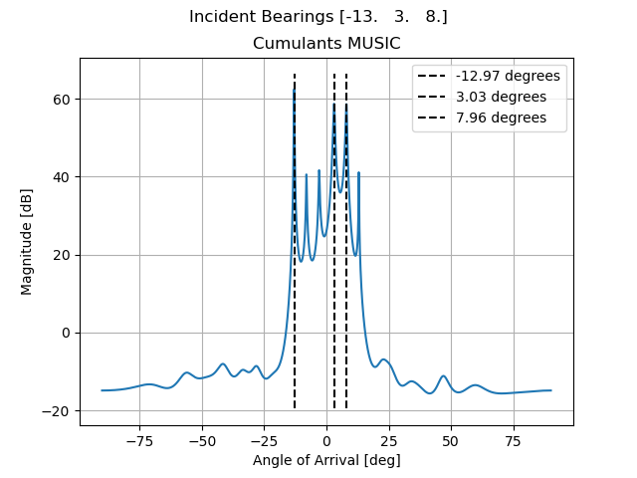
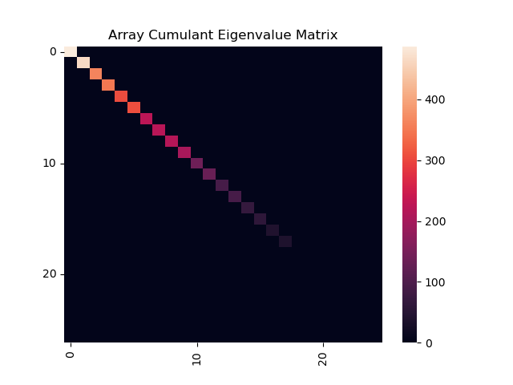
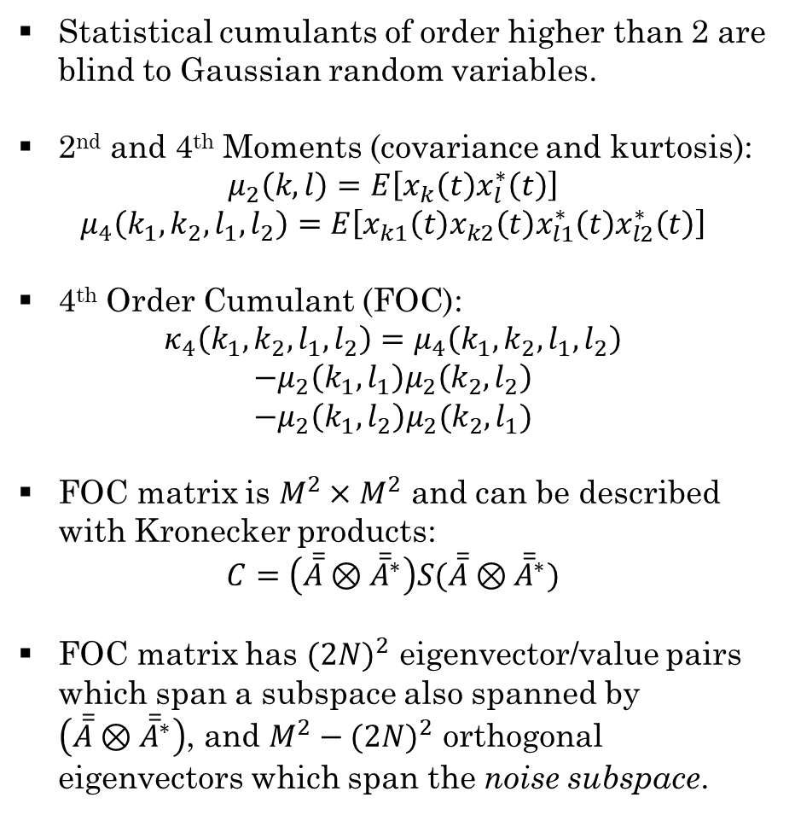
4th Order Cumulants
Statistical cumulants of order higher than 2 are blind to Gaussian random variables.
2nd and 4th Moments (covariance and kurtosis):
$$μ_{2}\left(k,l\right)=E\left[x_{k}\left(t\right)x_{l}^{∗}\left(t\right)\right]$$
$$μ_{4}\left(k_{1},k_{2},l_{1},l_{2}\right)=E\left[x_{k1}\left(t\right)x_{k2}\left(t\right)x_{l1}^{∗}\left(t\right)x_{l2}^{∗}\left(t\right)\right]$$
4th Order Cumulant (FOC):
$$κ_{4}\left(k_{1},k_{2},l_{1},l_{2}\right)=μ_{4}\left(k_{1},k_{2},l_{1},l_{2}\right)$$
$$−μ_{2}\left(k_{1},l_{1}\right)μ_{2}\left(k_{2},l_{2}\right)$$
$$−μ_{2}\left(k_{1},l_{2}\right)μ_{2}(k_{2},l_{1})$$
FOC matrix is $M^{2}×M^{2}$ and can be described with Kronecker products:
$$C=\left(\overline{\overline{A}}⊗{\overline{\overline{A}}}^{∗}\right)S(\overline{\overline{A}}⊗{\overline{\overline{A}}}^{∗})$$
FOC matrix has ${(2N)}^{2}$ eigenvector/value pairs which span a subspace also spanned by $\left(\overline{\overline{A}}⊗{\overline{\overline{A}}}^{∗}\right)$, and $M^{2}−{(2N)}^{2}$ orthogonal eigenvectors which span the noise subspace.

Slide 10
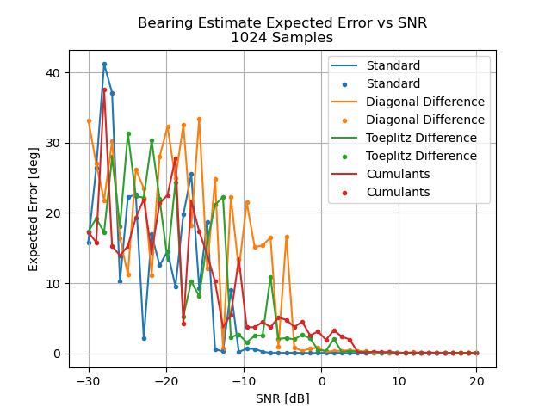


Uniform Diagonal ${\overline{\overline{R}}}_{nn}$ Performance
16-element Array, $λ/2$ separation
1024 samples used in covariance estimation
Bearings at $\left[−{13}^{∘}, 3^{∘}, 8^{∘}\right]$

Slide 11
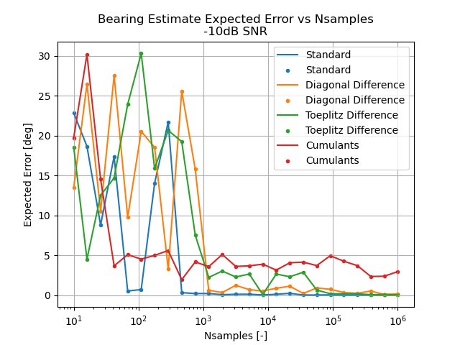

Uniform Diagonal ${\overline{\overline{R}}}_{nn}$ Performance
16-element Array, $λ/2$ separation
$−10dB$ SNR
Bearings at $\left[−{13}^{∘}, 3^{∘}, 8^{∘}\right]$

Slide 12
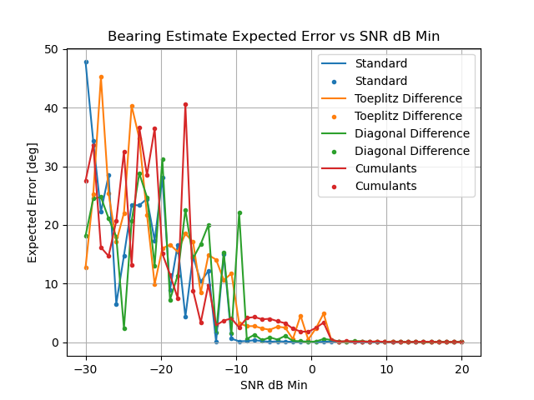
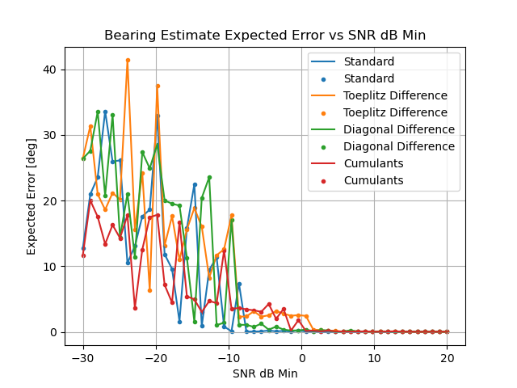
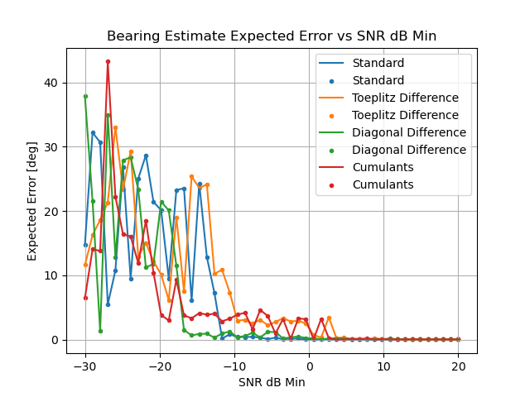




Non-Uniform Diagonal ${\overline{\overline{R}}}_{nn}$ Performance
$5dB$ SNR spread
$10dB$ SNR spread
$40dB$ SNR spread

Slide 13
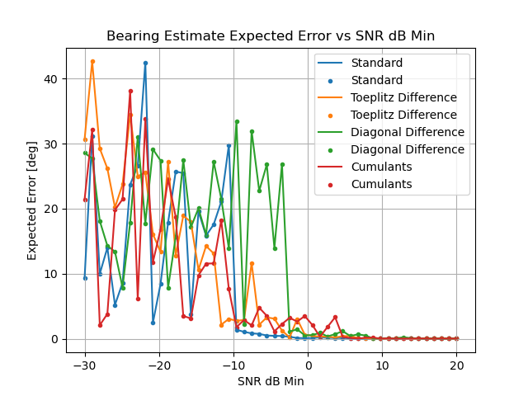
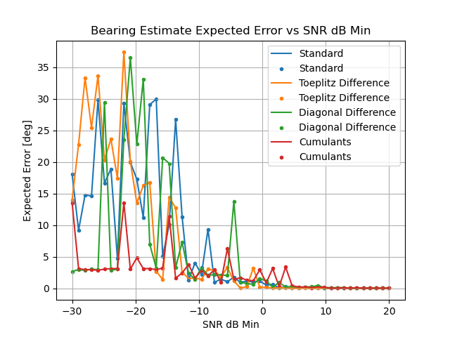



Symmetric Toeplitz ${\overline{\overline{R}}}_{nn}$ Performance
$5dB$ SNR spread
$$ρ∈[0.0, 0.25]$$
$$ρ∈[0.5, 0.75]$$

Slide 14
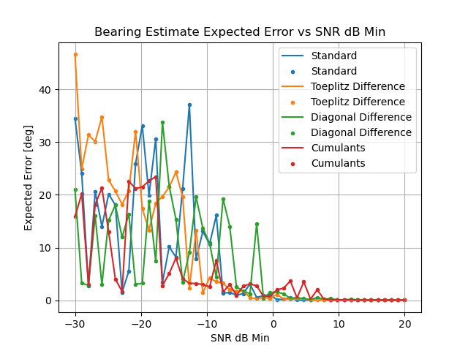
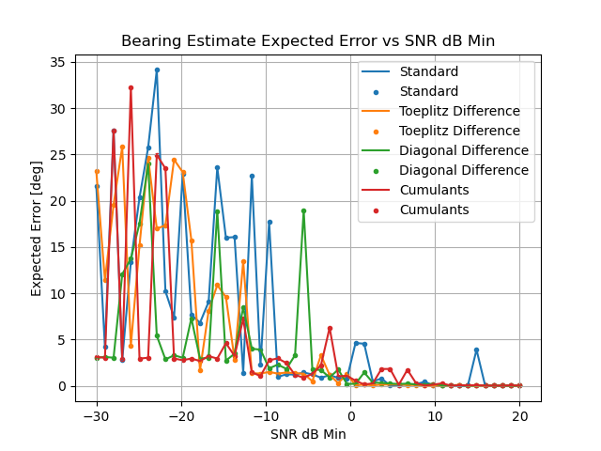

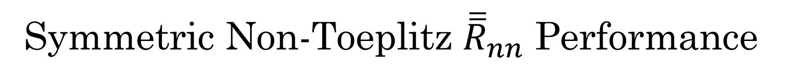

Symmetric Non-Toeplitz ${\overline{\overline{R}}}_{nn}$ Performance
$$ρ∈[0.0, 0.25]$$
$10dB$ SNR Spread
$$ρ∈[0.5, 0.75]$$
$10dB$ SNR Spread

Slide 15
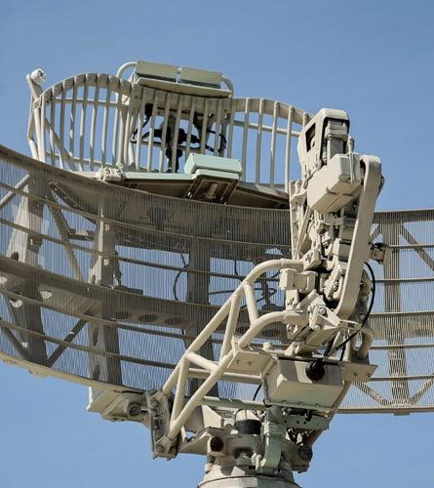
Conclusions
Colored noise fields degrade standard algorithm performance vs SNR by up to 10dB, and vs integration time by up to 1000 samples.
Toeplitz Differencing and Diagonal Differencing methods match and exceed the standard algorithm’s performance under colored noise fields, but only in arguably unrealistic extenuating circumstances.
Cumulant method performs identically across noise fields, but does not perform well, and is more computationally intensive. May be missing something in implementation.

Slide 16
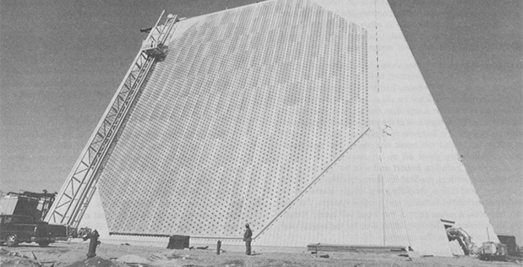
Thank You! Questions?
FPS-85 Ballistic Missile Defense System from the Electronically Steered Array Radar (ESAR) Program ca. 1959

