Slide 1
Advanced Concepts

Slide 2
Some Topics for Consideration
From scripts to functions to a package
How do you run it all?
Controller scripts
Rmd files with knitr
MAKE files
Branches in git
Pull requests
Tags

Slide 3
Package to Support a Paper
To build an R package to store:
(Raw) data
Data prep
Data analysis
Figure production for
Web
Print
Vignettes (long form documentation) to explain it all
For me
For NEAq collaborators
For scientific audience

Slide 4
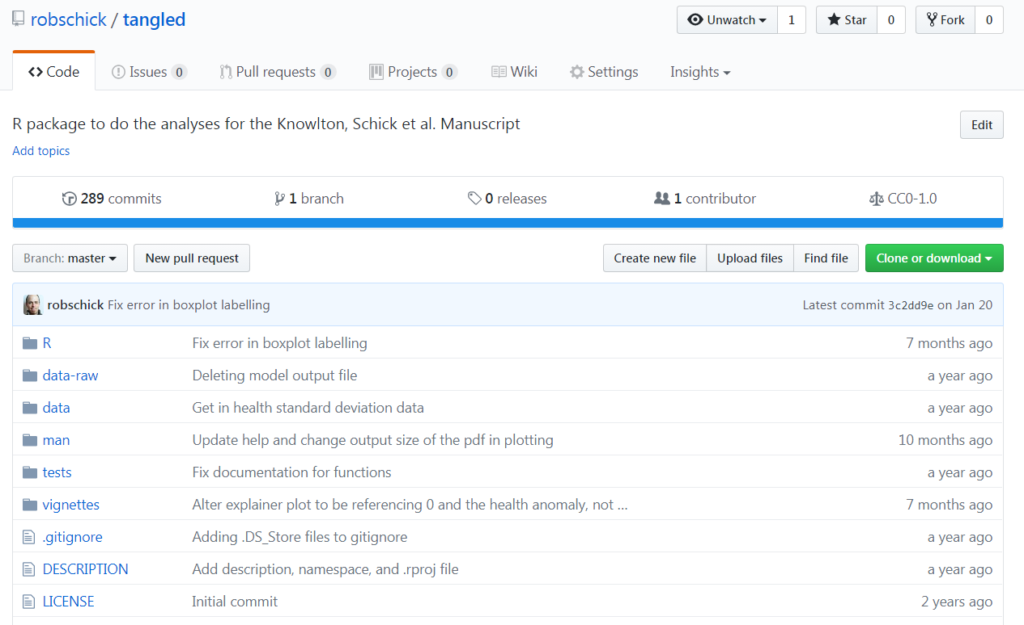
tangled

Slide 5
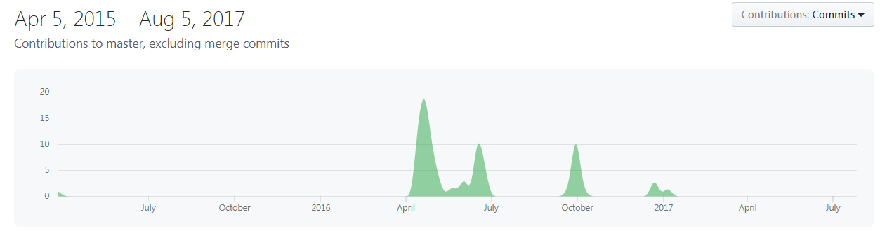
tangled
View an example commit

Slide 6
Vignettes
Function documentation is great if you know the name of the function you need, but it’s useless otherwise
A vignette is like a book chapter or an academic paper: it can describe the problem that your package is designed to solve, and then show the reader how to solve it

Slide 7
ANALYSIS 1 – Change in health scores
Notes:
As this slope graph shows, there is dramatic decline in health as injury severity increases

Slide 8
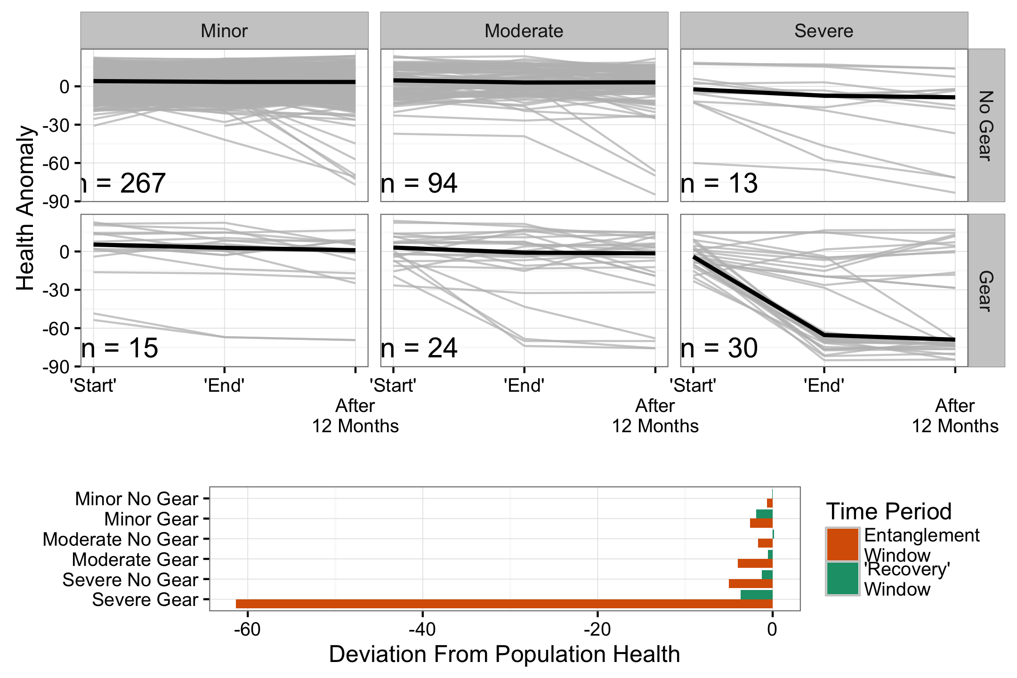
Slope Graph

Slide 9
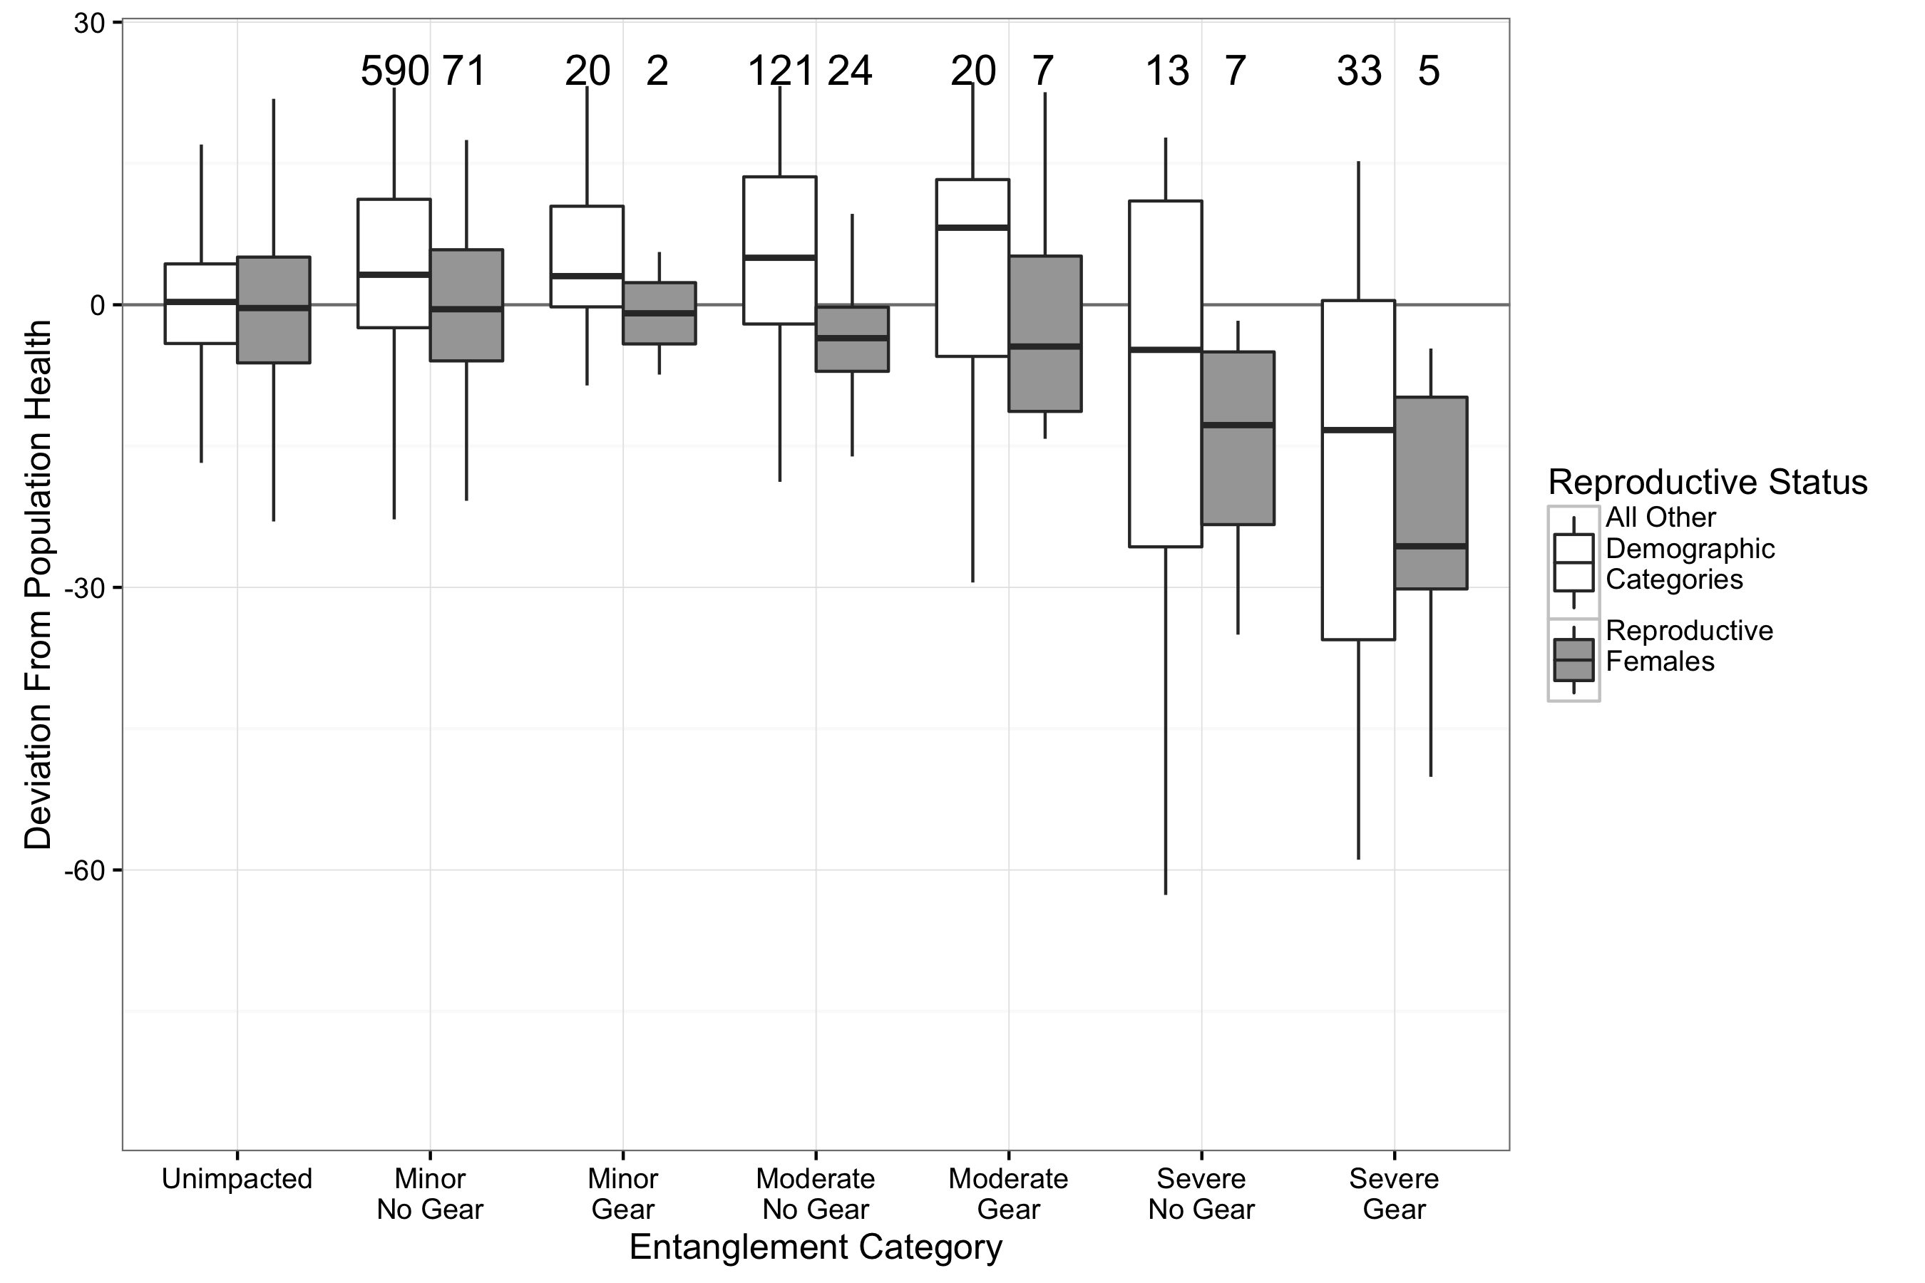
git and Branching
Notes:
Idea with this section is to highlight the use of branches within git. To do that, I’ll:
Open up Rstudio to the tangled package on master
Take a second to highlight:
some code in cleanMerge()
The existing of the branch dropdown
Use git log to show the existing of the branch
Go to the command line and checkout a new branch
Switch to Rstudio and note how it has already changed to the new branch
Make some changes to the code
Save it
Commit it and highlight how Rstudio catches and assigns the flag to the right branch
Switch back to the master branch and see the old code
Go back to command line to delete the branch with -D

Slide 10
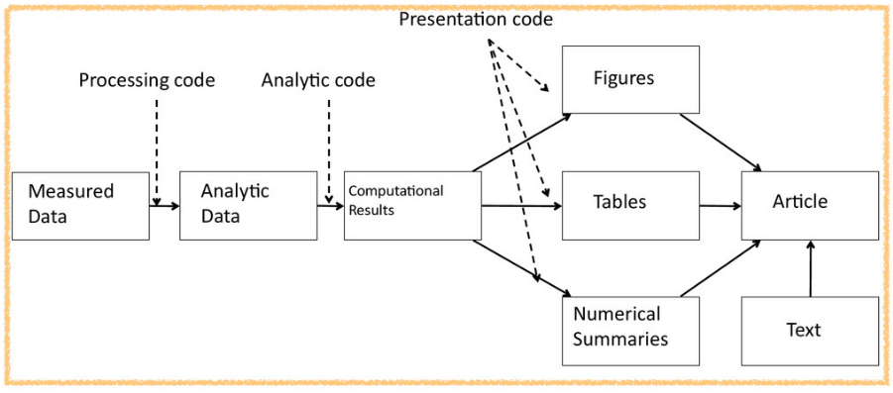
Rep Research Workflow (once analysis was mature)
tangled

Slide 11

(When) Should My Analysis Become a Package?
is flexible….
EDA → Analysis → Modelling → Visualisation
Package
tension
Read-eval-print loop
Programming
Software Engineering
Notes:
Computer programming isn’t necessarily software engineering

Slide 12
(When) Should My Analysis Become a Package?
Package development* gives you:
Version control
Documentation
Set of conventions:
Data go in data/
Raw data go in data-raw/
Code goes in R/
Scaffolding around the project
Open Question: how & when to transform an EDA into a formal/mature analysis?

Slide 13
See RStudio

Slide 14
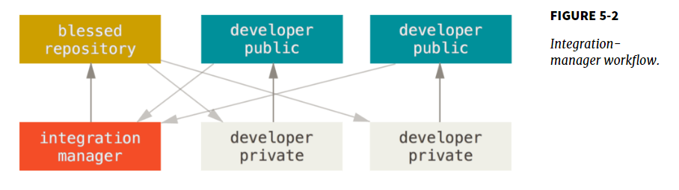
Working With Collaborators
Only one person can push to the production repo
Use Pull requests: https://help.github.com/articles/about-pull-requests/

Slide 15
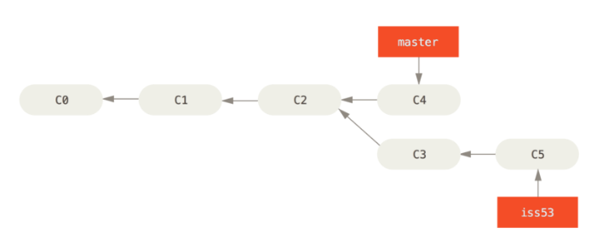
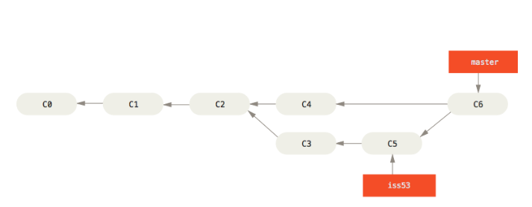
Branches
One of git’s killer features

Slide 16
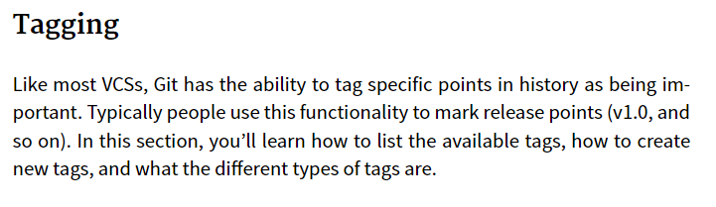
tags

