Slide 1
Final Thoughts
We made it!

Slide 2
What have we learned?
Basics of a good enough workflow & directory structure
Basics of git
What it is, why should we use it
That it’s kind of a pain in the keister
How to navigate a repository
How to work across multiple repositories
Working locally
Working with Github
Working locally, github, node, and additional collaborators
How to collaborate with git
Present good practices – even if painstaking – make for better future work

Slide 3
What Will I Follow-up With?
All slide-decks
Some relevant PDFs
Screencasts of all the lessons – including the advanced topics (within a month)
If there’s interest, a google hangout to review some questions & new issues
A post-workshop survey to gather feedback

Slide 4
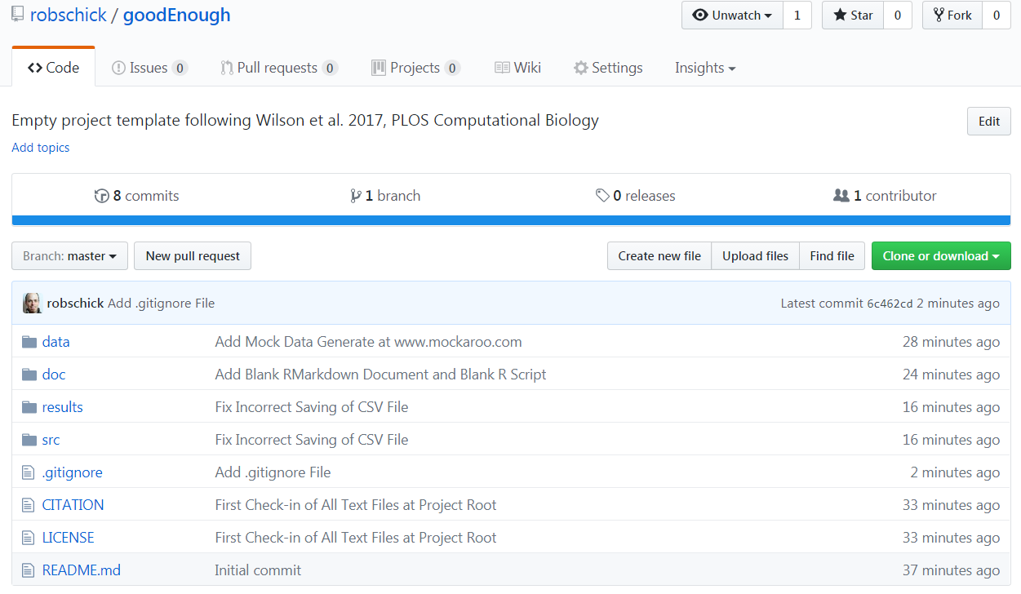
Template at My GitHub Page
git clone https://github.com/robschick/goodEnough.git myProject

Slide 5
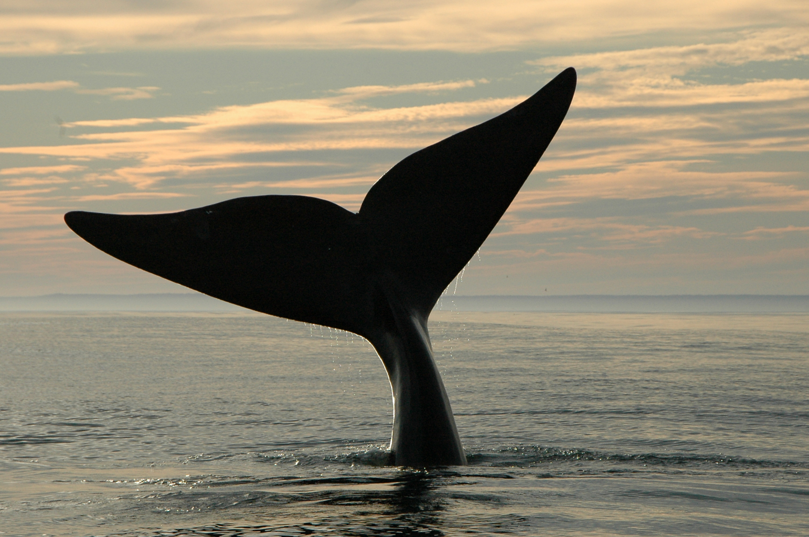
Thanks

