Slide 1
Lesson #1
Elements of a Good Enough Workflow

Slide 2
Brainstorm with Your Neighbor
What are critical elements needed?
What has been a problem?
What do you consider a need?

Slide 3
Selected Survey Results
Responses
Managing multiple contributors, interface between git and r, unwilling collaborators, version control for scripts where original + repo live on computer … but [have] active version on a cluster, when to version control a script if tweaking constantly to try new things, what to version control (scripts to generate figs, but do I add the figs themselves? sometimes would be useful to see an old version I've over-written)
merge conflicts, loss of functionality between OS
Using R often enough to remember how to get things done efficiently
overcoming habits; investing time in new software & methods; working with collaborators not on board; effective and consistent annotation
Despite working through a plethora of tutorials, I still can't wrap my head around how git/github works from the command line or how it interfaces with R/RStudio.
I often do not feel like I know what is happening or how to interpret the little icons in the GitHub tab of RStudio. I am concerned that my future self will not be able to look back at the work we do in the workshop and be able to clearly identify what steps are necessary to recreate it.

Slide 4
Consistent Themes
Working with collaborators
Consistent uncluttered file structure
Ability to re-enter the project and quickly reorient
Knowing what to version control
Knowing version control
Testing new code without breaking original
Re-running things efficiently

Slide 5
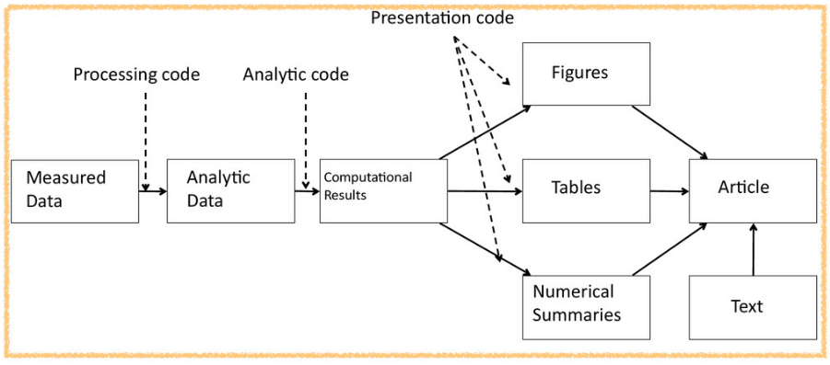
Rep Research Workflow

Slide 6
A Good Enough Starting Point
“Computing workflows need to follow the same practices as lab projects and notebooks, with organized data, documented steps, and the project structured for reproducibility, but researchers new to computing often don’t know where to start.”

Slide 7
Six Core Tenets of a Good Enough Practice
Best Practices
Data Management
Software
Collaboration
Project Organization
Keeping Track of Changes
Manuscripts

Slide 8
Six Core Tenets of a Good Enough Practice
Data Management
Save the raw data
Back them up in >1 location
Create the data you wish to see in the world
Create analysis-friendly data
Record all the steps used to process data (use version controlled code for this)
Anticipate needing multiple tables; so use unique IDs
Submit data to a reputable DOI-issuing repository so others can access and cite

Slide 9
Six Core Tenets of a Good Enough Practice
Software
Place a brief explanatory comment at the start of every program
Decompose programs into functions
Be ruthless about eliminating duplication
Search for libraries that do what you want to do
Test them before relying on them
Give functions and variables meaningful names
Make dependencies and requirements explicit
Do not comment and uncomment sections of code to control a program’s behavior (we’ll come back to this)
Provide a simple example or test data set
Submit code to a reputable DOI-issuing repository

Slide 10
Six Core Tenets of a Good Enough Practice
Collaboration
Create an overview of your project
Create a shared “to-do” list for the project
Decide on communication strategies
Make the license explicit
Make the project citable

Slide 11
Six Core Tenets of a Good Enough Practice
Project Organization
Put each project in its own directory, which is named after the project
Put text documents associated with the project in the doc directory
Put raw data and metadata in a data directory and files generated during cleanup and analysis in a results directory
Put project source code in the src directory
Put external scripts or compiled programs in the bin directory
Name all files to reflect their content or function

Slide 12
Six Core Tenets of a Good Enough Practice
Keeping Track of Changes
Back up almost everything created by a human being as soon as it is created
Keep changes small
Share changes frequently
Create, maintain, and use a checklist for saving and sharing changes to a project
Add a file called CHANGELOG.txt to the project’s doc subfolder
Use a version control system

Slide 13
Six Core Tenets of a Good Enough Practice
Manuscripts
Don’t use MS-Word, Pages, Libre Office, etc.
Write manuscripts using online tools with rich formatting, change tracking, and reference management
Use a version control system

Slide 14
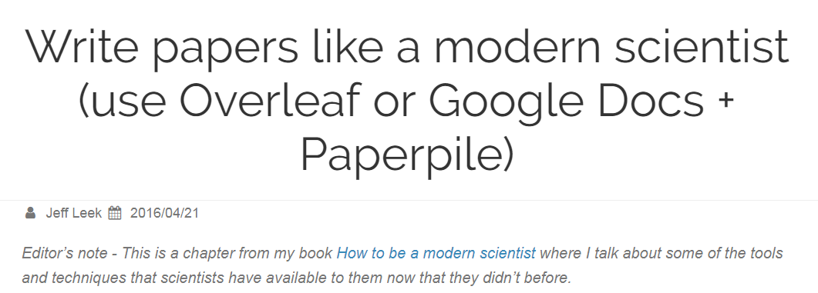
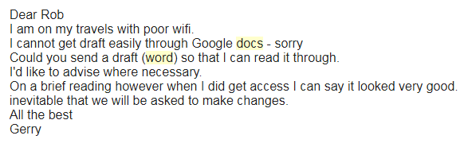
Getting Collaborators on Board - ymmv
https://simplystatistics.org/2016/04/21/writing/

Slide 15
An R Package for the Analysis
We’ll talk about this briefly in the last section
Good option, but with positives/negatives
Great resource: http://r-pkgs.had.co.nz/
Plays nicely with GitHub

Slide 16
Six Core Tenets of a Good Enough Practice
Best Practices
Data Management
Software
Collaboration
Project Organization
Keeping Track of Changes
Manuscripts

Slide 17
Let’s Build and Populate a Project
Navigate to a directory
Make a folder for your project named whatever you want
cd into the project folder
Start making folders with mkdir
Create 4 files using a text editor, or the touch command
CITATION
README
LICENSE
requirements.txt

Slide 18
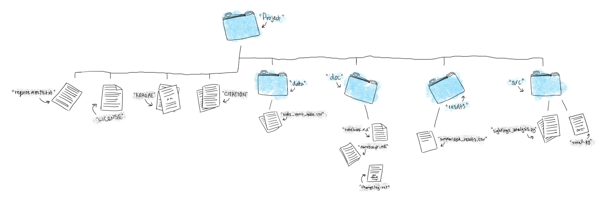

Slide 19
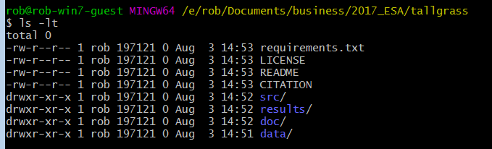
What it Looks Like

Slide 20
What Goes in Each? – Data Folder
Raw data
Consider locking the file, or making read-only
Never hand edit the file!
Metadata
I have one .csv file from BBMRO

Slide 21
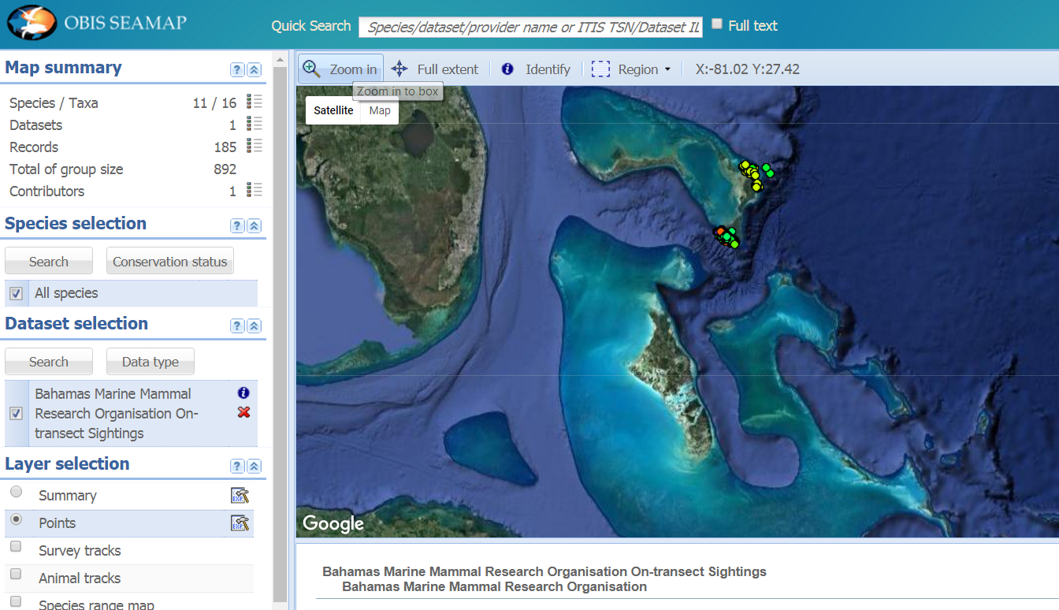
BMMRO Data

Slide 22
What Goes in Each? – src Folder
Two types of scripts
Individual analytical blocks
reshapeData.R
runRegression.R
Controller file, e.g. runAll.R (we’ll come back to this in the last section)
runAll.R may contain:
source(reshapeData.R)
source(runRegression.R)
source(plotAnalysis.R)
And can be called from a command prompt with:
R CMD BATCH –vanilla runAll.R runAll.rout &

Slide 23
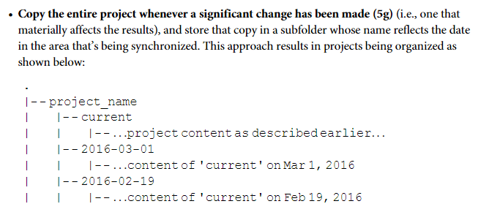
What Goes in Each? – results Folder
Any “generated” result:
Intermediate results
Cleaned data
Simulated data
Final Results
Figures
Tables
For most projects, you’ll likely have sub-directories:
Results
CleanedData
Figures
Tables
Should I keep old Figures?*

Slide 24
What Goes in Each? – doc Folder
Any text based documents:
If manually versioning, a changelog.txt file
projectNotebook.md (I use evernote…)
Manuscript (if using a version control, otherwise Google Docs)

Slide 25
What Goes in Each File?
The README file provides an overview of the project as a whole
Project’s title
Brief description
Up-to-date contact information
An example of how to run the code
How people can engage with the project
If you are looking for contributors

Slide 26
What Goes in Each File?
CITATION
Explains how to reference the project
DOIs for code and data
DOI for project if using OSF
Manuscript
Example here (https://github.com/dib-lab/khmer/blob/master/CITATION)
LICENSE
Explains the licensing, e.g. CC-BY, CC-ND, etc.

Slide 27
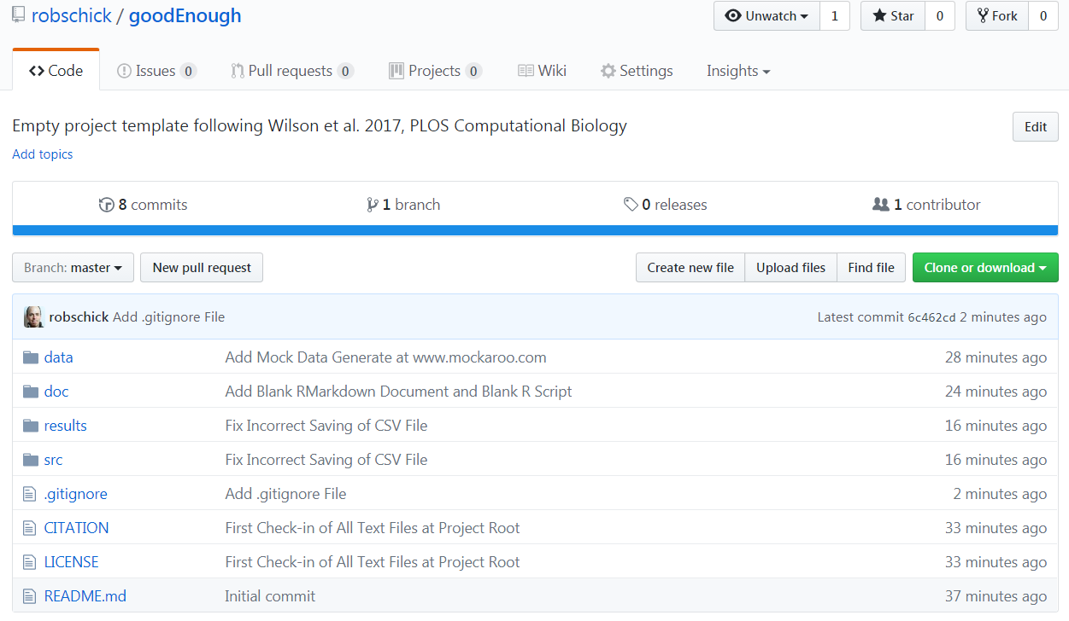
Template at My GitHub Page
git clone https://github.com/robschick/goodEnough.git myProject

