Slide 1
How Does the Repo Change?
Lesson 3

Slide 2
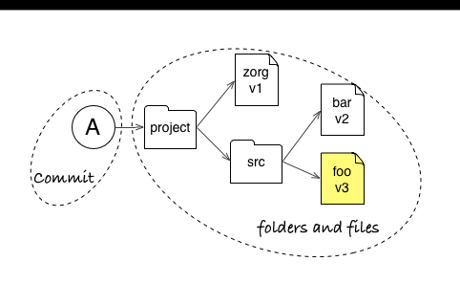
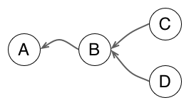
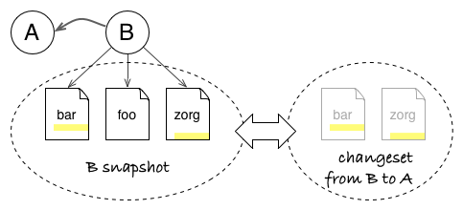
3 Core Concepts
Snapshot
Graph
Changeset

Slide 3
With These Concepts, We Can
Use the sha-1 unique identifier to view a snapshot
Compare the differences from one snapshot to a next
Compare two different snapshots/commits
Revert to the project at specific points (commits) in time

Slide 4
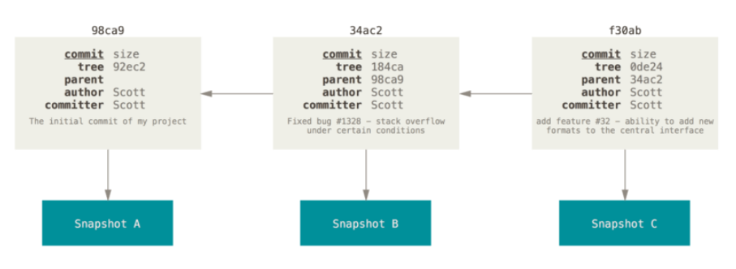
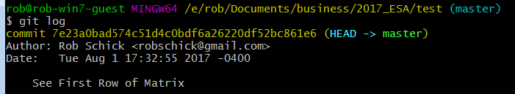
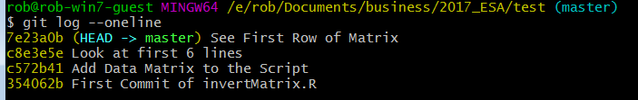
sha-1 Identifier – These Are Crucial
These are the nodes along the graph
We use them to view and/or navigate

Slide 5
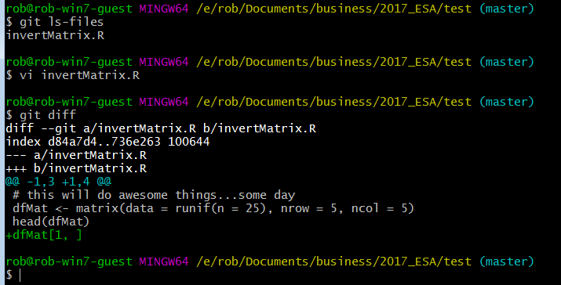
Seeing Changes Before a Commit
Visualize Changes
before a commit

Slide 6
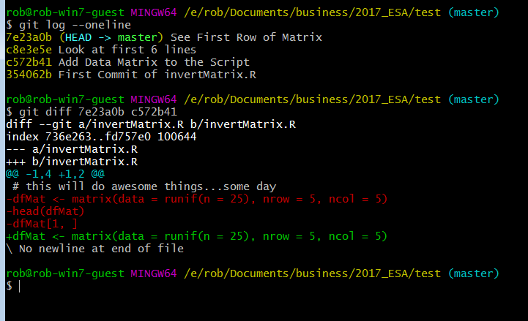
Seeing Changes Between Two Diffs
sha-1 commit IDs
Visualize differences
between 2 commits

Slide 7
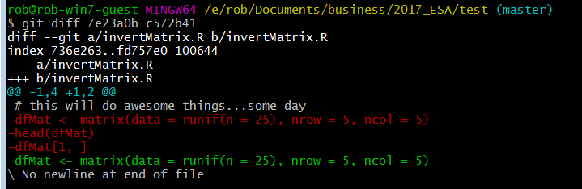
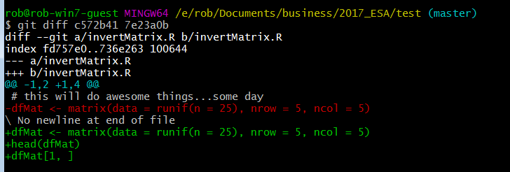
Order Matters Between Two Diffs

Slide 8
Seeing Changes Between Two Diffs
git diff master~1 master
git diff <sha-1> <sha-1>
git diff (this just shows changes made but not added)
Why all the hassle?
Diffs tell you what changed
Commit messages tell you why
With both, you can easily navigate through the history of a repo

Slide 9
Going to a Particular Commit
git checkout <sha-1>

Slide 10
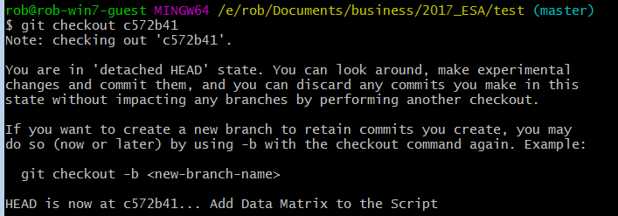
Going to a Particular Commit
git checkout c572b41

Slide 11
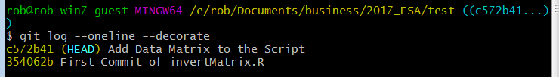
Detached Head???
git log --oneline --decorate
Has to do with where the branch is pointing – now it’s to a previous commit
Explore your script and you’ll see it from that state:

Slide 12
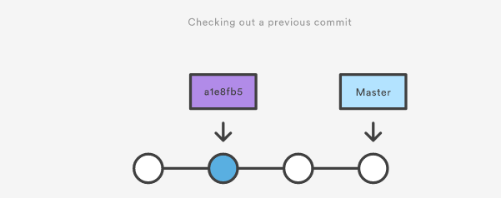
Where are we?

Slide 13
Detached Head???
git log --oneline --decorate
Where did the other commits go?

Slide 14
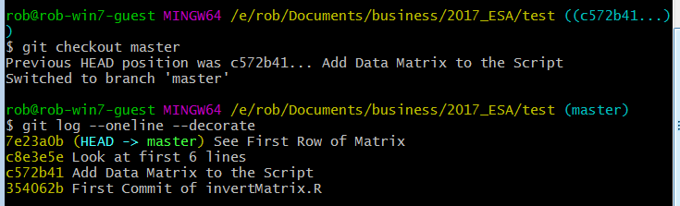
The Commits Are Still There - Phew!
git checkout master

Slide 15

Why Would You Want to Do This?
Allows you to work with the file as it was at that time:
And then bring those changes into the current commit
I’ll argue for using a branch to do this in the last section

Slide 16
Backing Out Changes
This can get complicated!
Three main commands:
git reset (hard, soft, mixed)
git rebase
git revert
git cherry-pick
This diagram helps:

Slide 17
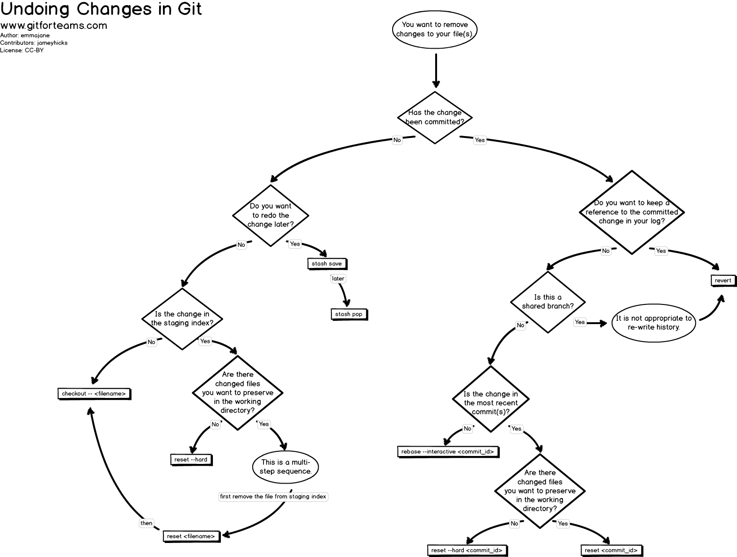

Slide 18
More Resources
https://git-scm.com/book/en/v2/Git-Basics-Undoing-Things
https://www.atlassian.com/git/tutorials/undoing-changes
https://www.atlassian.com/git/tutorials/rewriting-history

