Slide 1
Connecting a Local Repo to a Remote Repo
Lesson 4

Slide 2
Git is a Distributed Version Control System
Peer-to-peer as opposed to server-client
Common operations (commits, viewing history, etc.) are fast since there is no need to communicate with a central server
Communication is only necessary with sharing changes among peers
Each working copy effectively functions as a remote backup of a codebase and its change history – protecting against data loss

Slide 3
How Does My Local Repo Sync with GitHub*
Several ways to do this:
Clone an existing repository from GitHub to a local folder
Your own, or
Another coder’s
Initialize a repository locally and push to GitHub
Start a new project in RStudio with version control

Slide 4
Local First
We’ve started this with git init in a local repo
How connect to GitHub?
Make an empty repo on GitHub, i.e. no README
Copy the url of this repo from GitHub
Navigate to your current folder
Add the remote
Push the repo

Slide 5
GitHub First
You did a version of this when you worked through the Happy Git with R install tutorial
How connect to GitHub?
Make a repo on GitHub (I typically add both a README and a .gitignore file)
Copy the url of this repo from GitHub
Navigate to your current folder
Clone the repo

Slide 6
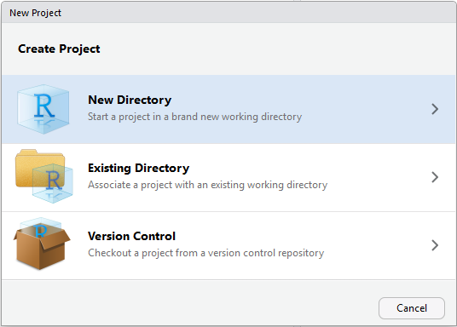
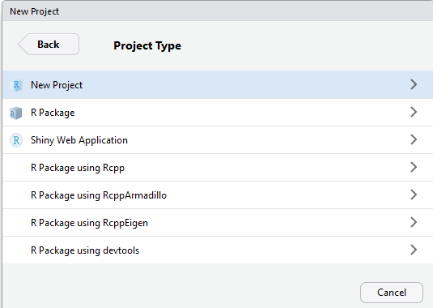
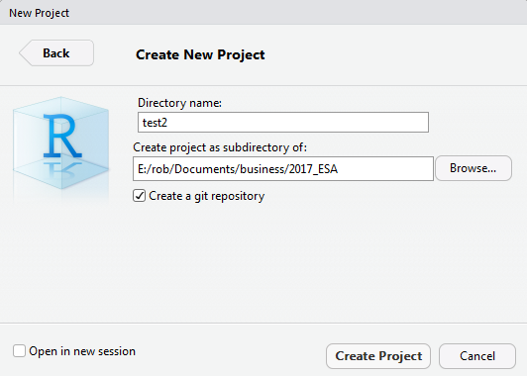
From RStudio*
Make a new project
Project type
Choose name & git

Slide 7
My Preferred Way
Start on GitHub
Create an empty repo
Include a README file
Include a .gitignore file
Clone it locally on the command line
Set up a new project in RStudio in the existing directory

Slide 8
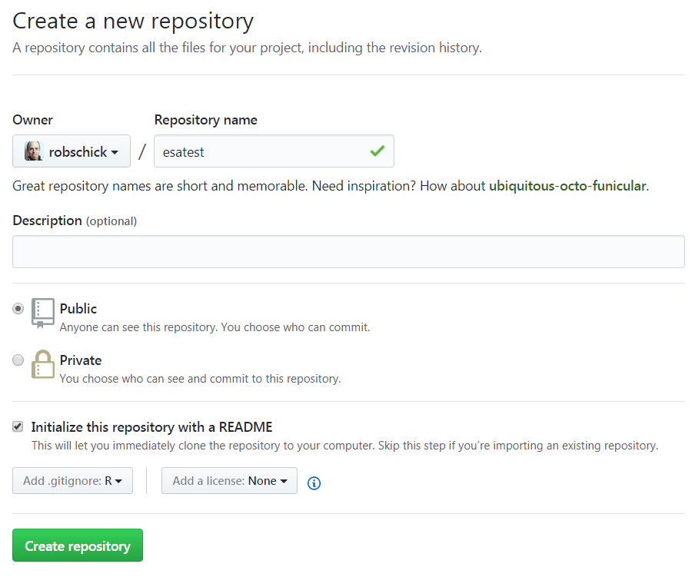
Let’s Practice

Slide 9
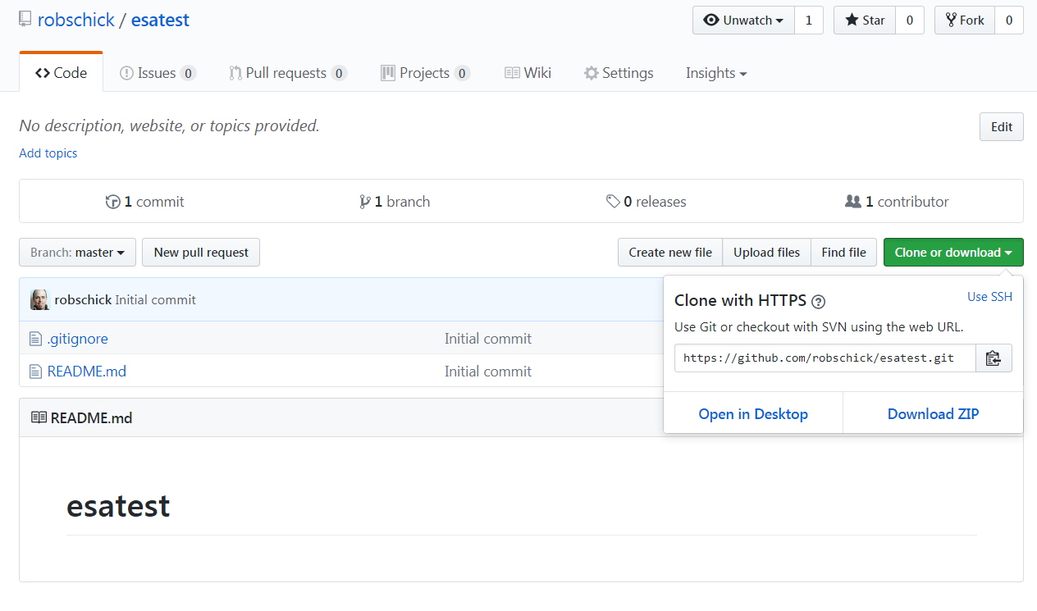
Let’s Practice

Slide 10

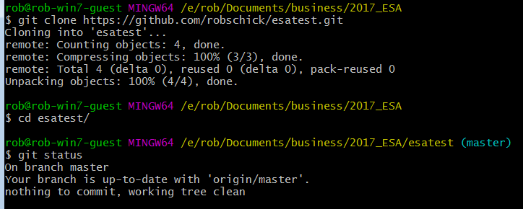
Let’s Practice

Slide 11
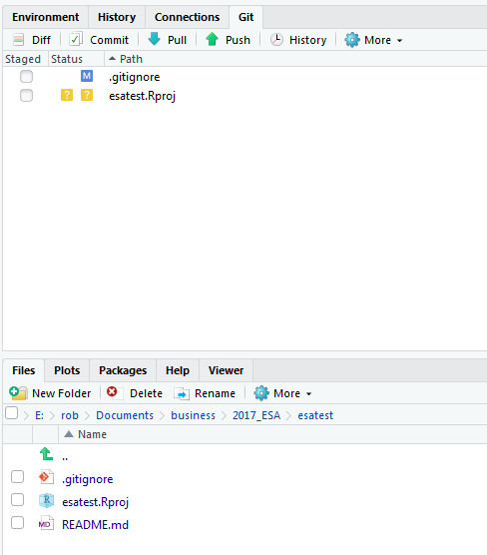
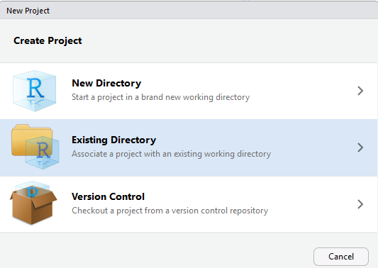
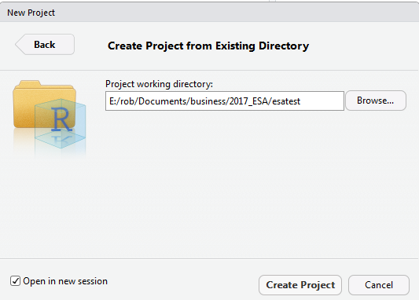
Let’s Practice

Slide 12
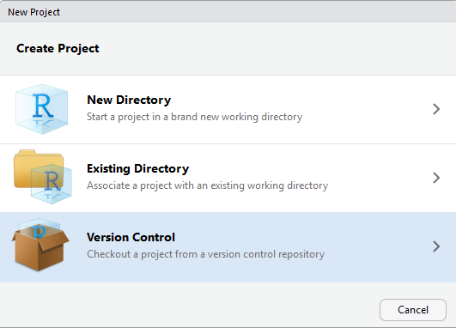
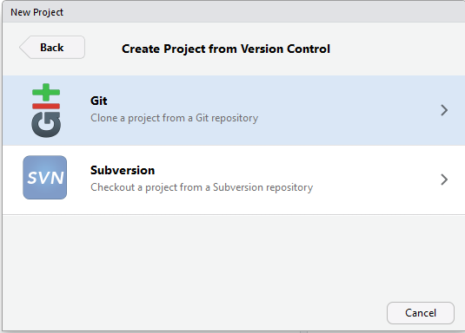
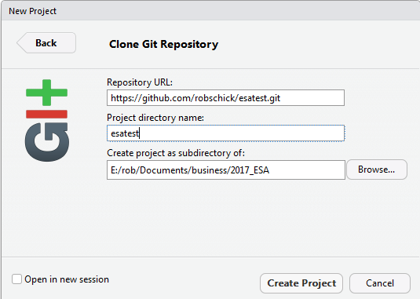
Bypass the Command Line

Slide 13
Pushing to GitHub – How Often?
Several schools of thought on how often to push
A prominent one (Hadley Wickham) is to push considerably less often than you commit*
“Pushing code means publishing code”
“Strive to push code that works”
I tend to push more often than this, because I code on small teams, and I like the back up

Slide 14
Pushing to GitHub – Good Commit Messages*
Be concise, yet evocative. At a glance, you should be able to see what a commit does. But there should be enough detail so you can remember (and understand) what was done
Describe the why, not the what. Since you can always retrieve the diff associated with the commit, the message doesn’t need to say exactly what changed. Instead it should provide a high-level summary that focuses on the reasons for the change

Slide 15
Practice a Cycle in Local Repo

Slide 16
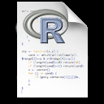
Three Local States with Remote
Working Directory
Staging Area
Repository (.git folder)
Remote (GitHub)
git push

Slide 17
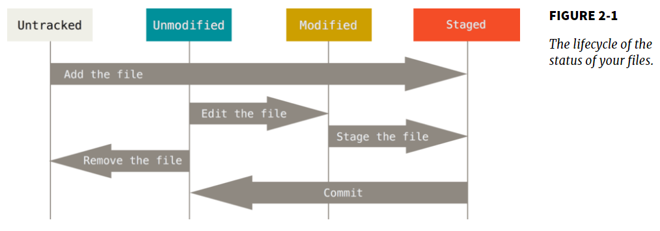
Adding GitHub to the Workflow – git push

Slide 18
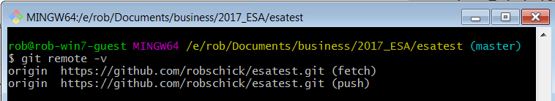
Knowing Your Remotes

Slide 19
What is a Merge Conflict?
A merge operation in git is when you try to blend changes made:
To the same file
On two different branches
Wait, but we haven’t talked (much) about branches?
For now, know that we’ve been working with one branch – MASTER
So we can work with the same branch – MASTER – in two (or more repos):
Local
GitHub
Node
And these can come into conflict – let’s try!

Slide 20
Merge Conflicts
Make sure your working directory shows a clean status
Do a git pull
Do a git push
Modify the file locally
Commit it, but don’t push it yet
Navigate to the repo on GitHub
Modify the same file on GitHub
Commit it
Go back to local repo and attempt a push

Slide 21
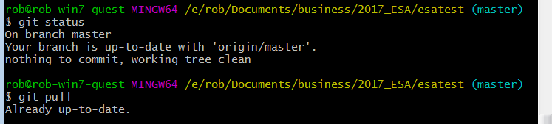
Check Status of Your Local Repo
Best practice to pull before you push (n.b. if it’s just you and GitHub, this isn’t as big a concern)

Slide 22
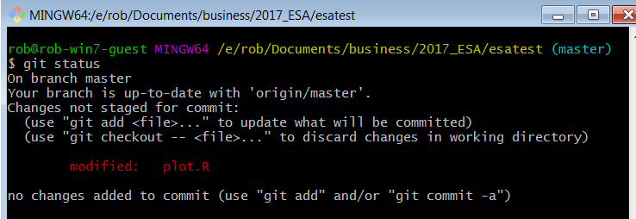
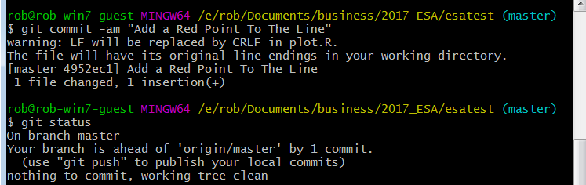
Make Local Changes

Slide 23
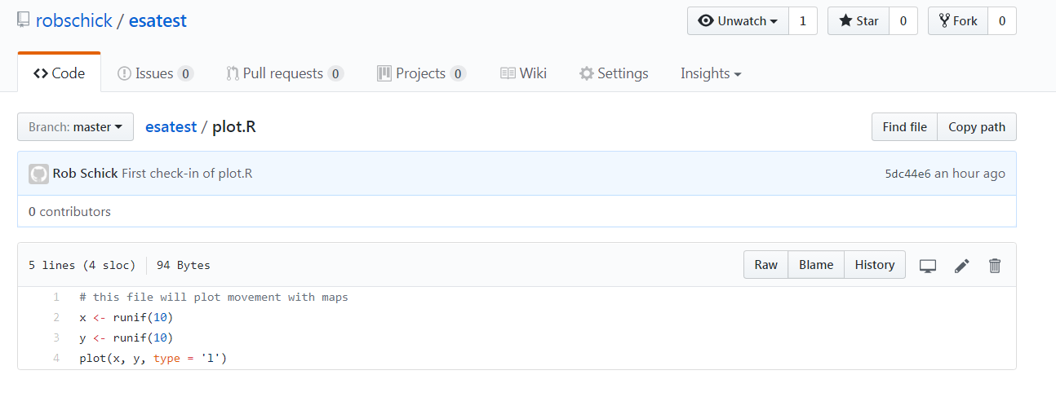
Make Remote Changes
Edit on GitHub

Slide 24
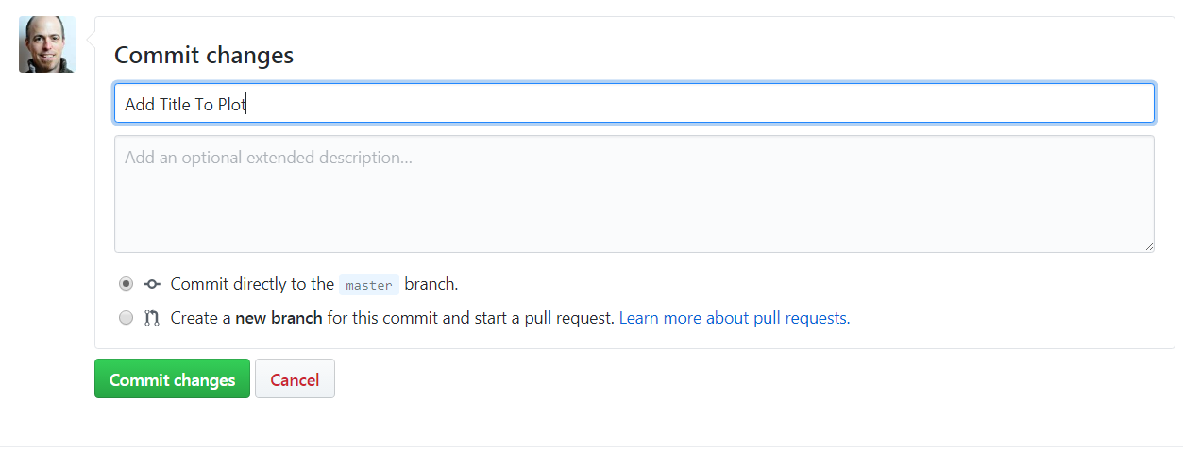
Commit the Changes

Slide 25
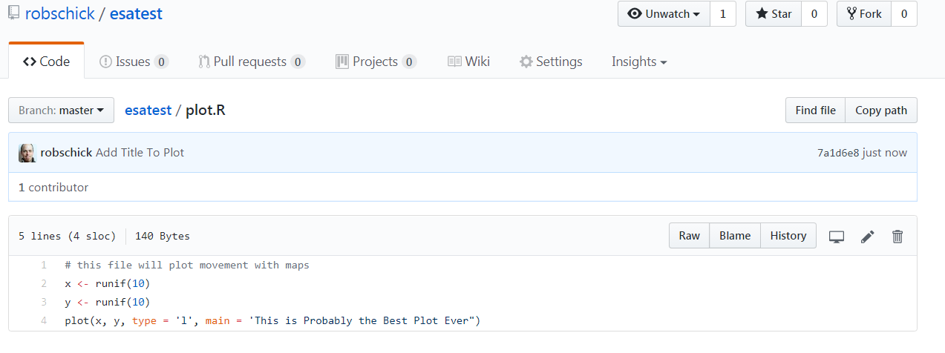
View Status on GitHub

Slide 26
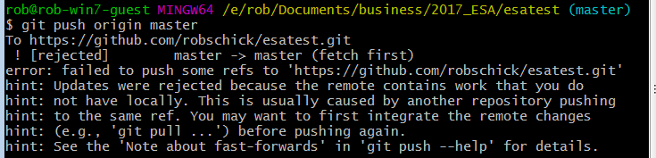

What’s Happened
We have one repo – esatest (or whatever you’ve named it)
We’ve made and committed changes in two different places
Now let’s try to sync the repos by pushing our local to GitHub

Slide 27
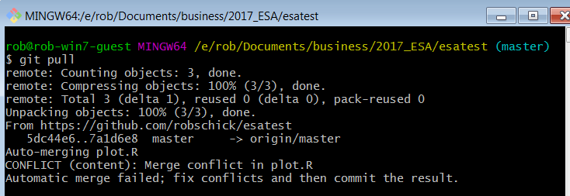
Pull the Changes

Slide 28
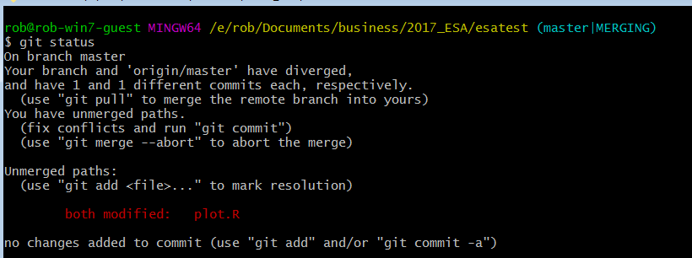
Check Status

Slide 29
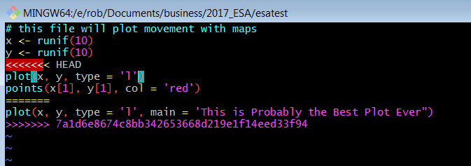
View the Conflict
Unchanged lines
Incoming marker
Branch Separator
Current marker
sha-1 from GitHub

Slide 30
Manually Resolve the Conflict
Choose this Block
Or this Block

Slide 31
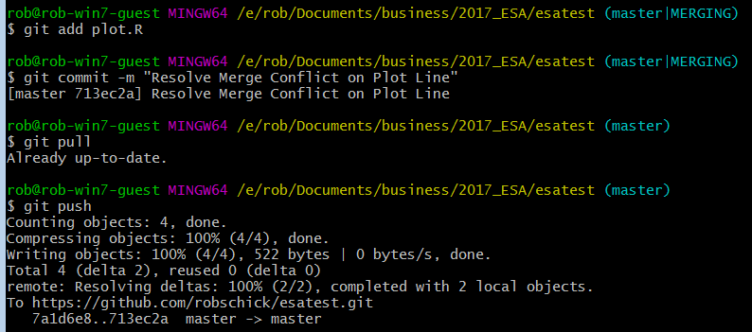
Add it, Commit it, Push it
Note status
Merge Resolved

Slide 32
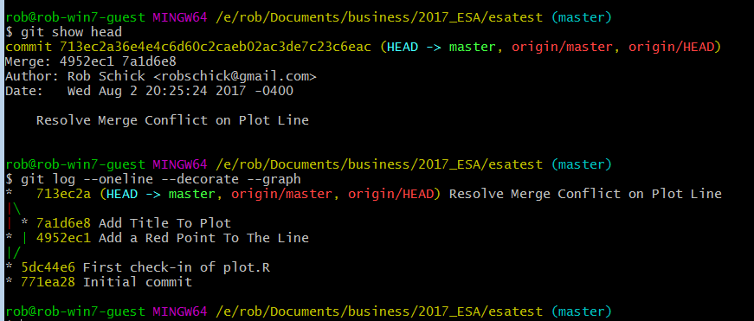
Merge Commits Look a Bit Different

Slide 33
Just Another Repo!
Well, yes, but…
I’ll try a live demo to show what happens
If it fails, following is an example of the normal bs that you need to put up with
(But it’s worth it!)

Slide 34
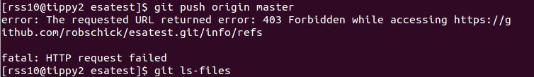
SSH to a Linux Box
Cloned my repo from GitHub
Created a new file
Added it
Pushed it:
??? Stackoverflow to the rescue

Slide 35
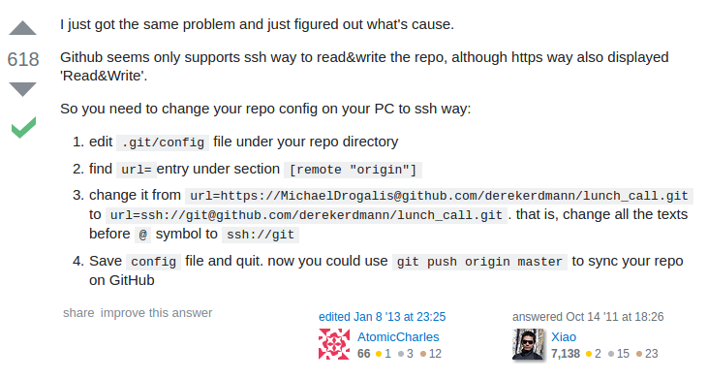
Need to Use SSH not HTTP

Slide 36
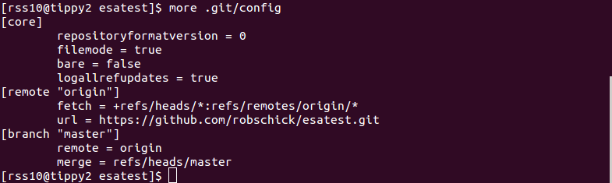
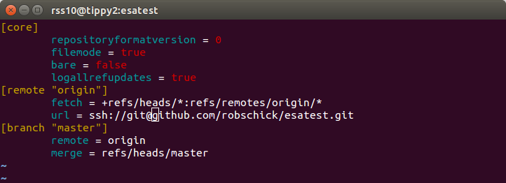
Need to change this

Slide 37
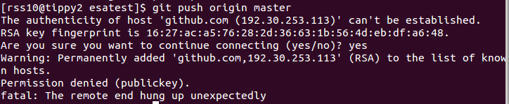
No LUCK!
Need to pair the SSH keys…. http://happygitwithr.com/ssh-keys.html

Slide 38
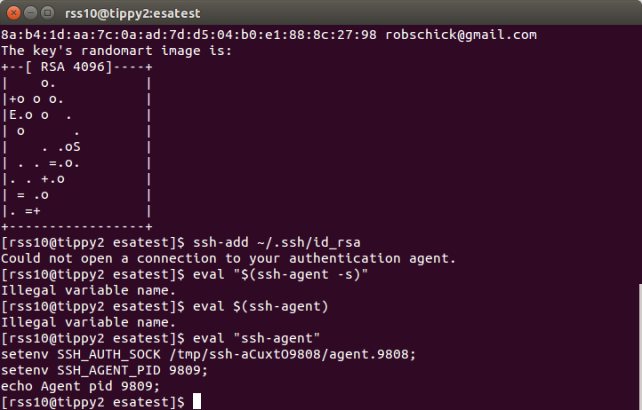

Slide 39
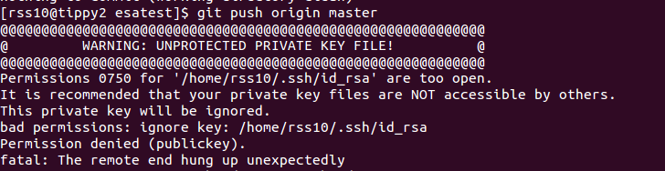

Slide 40
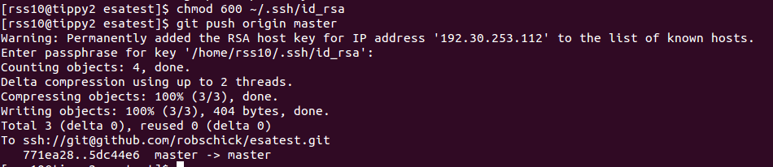

Slide 41
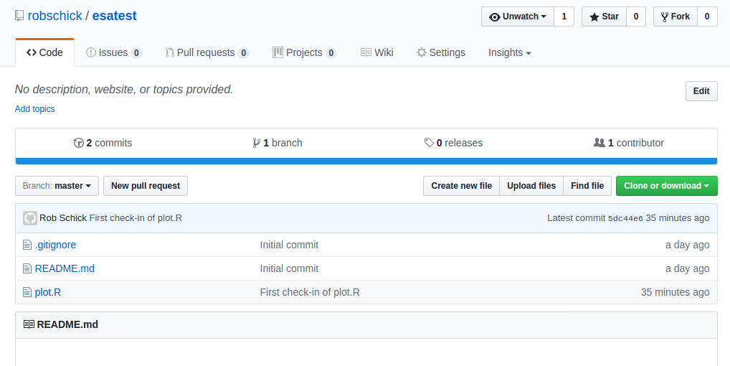

Slide 42
